Slide 1
Link to Work
https://docs.google.com/presentation/d/1OYg9UQdvHicxkrfCSB2-pUarBWaJD-pyBebTx8CLaQk/edit?ts=5fcd6b90#slide=id.p

Slide 2


Transactional
Systems
Structured Flat File Ingestion
Staging
Extract Load Entities
Final Data Layout

Slide 3

Transactional
Systems
Document Ingestion
Staging
Extract Load Entities
Final Data Layout

Slide 4





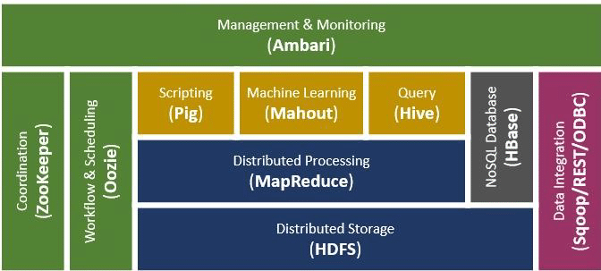
Transactional
Systems
Big data Hadoop Ingestion
Staging
Extract Load Entities
Final Data Layout

Slide 5



Transactional
Systems
Spark Ingestion
Staging
Extract Load Entities
Final Data Layout

Slide 6
Data Source Layer
Data Processing and Storage Layer
Analytics Layer
Consumption Layer
Cloud Applications
Storage
Analytics Engine
Self-Service Analytics
Structured
Statistical Analytics
On Prem Applications
Operational Reporting
Un- & Semi-
Structured
Semantic Analytics
External Data
Predictive Modeling
Processing
Visualization
Text Analytics
CRM Applications
SaaS Applications
Real-Time/Batch
Data Query
Real-time Analytics
Social Media
DWH Staging
ML Data Preparation
Spark SQL
Ingestion
Application Integration
IoT Devices Data
HIVE
Real-Time
Amazon RedShift
System Log
Event Data
Artificial Intelligence
Batch
Snowflake

Slide 7
Data Files
Data Files
Data Files
put
put
put
Snowflake Storage
Snowflake Compute
Table Stage
Internal Name Stage
User Stage
External Stage
Data Lake (Amazon, GCP, Azure)

Slide 8
2017 - Files
PUT
Stage Files
$1, $2, $3 … $n
$1, $1. $1 … $1
Tables
OD
Dimensions
Facts
Summary
2018 - Files
ELT
2019 - Files

Slide 9
Stage Table
(Institution Id, Institution Name … Row Number)
MERGE
Stage table and dimension table are joined by business key (Institution Id)
Dimension Table
(AcademicInstitutionUniqueDWSID,
Institution Id, Institution Name …)
Dimension Table
(AcademicInstitutionUniqueDWSID,
Institution Id, Institution Name …)

