Slide 1

Adhvika
Ai conversational bot using NLP
Made by Versatiledvkr

Slide 2
Introduction
Adhvika is a conversational ai bot made using Natural language processing (NLP).
It was developed by versatiledvkr in the year 2021 . it's very easy to use and handle .

Slide 3
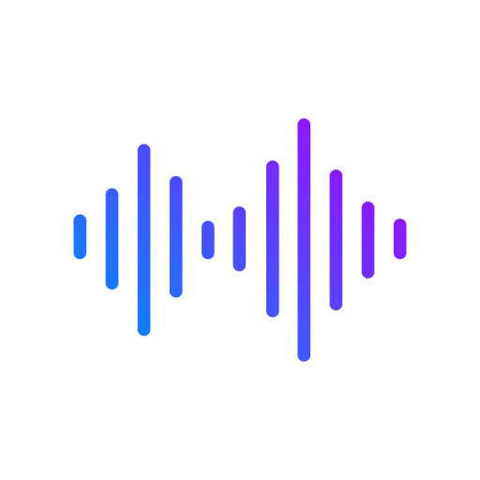
How it's made
Adhvika is made using Natural language processing in deep learning .Pytorch & nltk(natural language toolkit) these are the frameworks used in making Adhvika . neural network acts as brain and word tokenizer using nltk will teach adhvika to understand each and every word from the intent which is given by user. For example:
It will respond based on it's trained data .
Adhvika: hi there how can i help with?
If user said : Hello
Adhvika learns like this
[h,e,l,l,o]

Slide 4
Skills
*Adhvika is trained to make better conversations with the users.
*It can also able to sense human emotions .
*It is capable to answer as many questions as possible.
*It is friendly to use and handle.

Slide 5
Automations

Slide 6
Adhvika can help you in many tasks using the apps which are automated to it

Slide 7

Google search
Google search is now automated to the Adhvika.You can now
search anything in google using Adhvika with your voice.

Slide 8

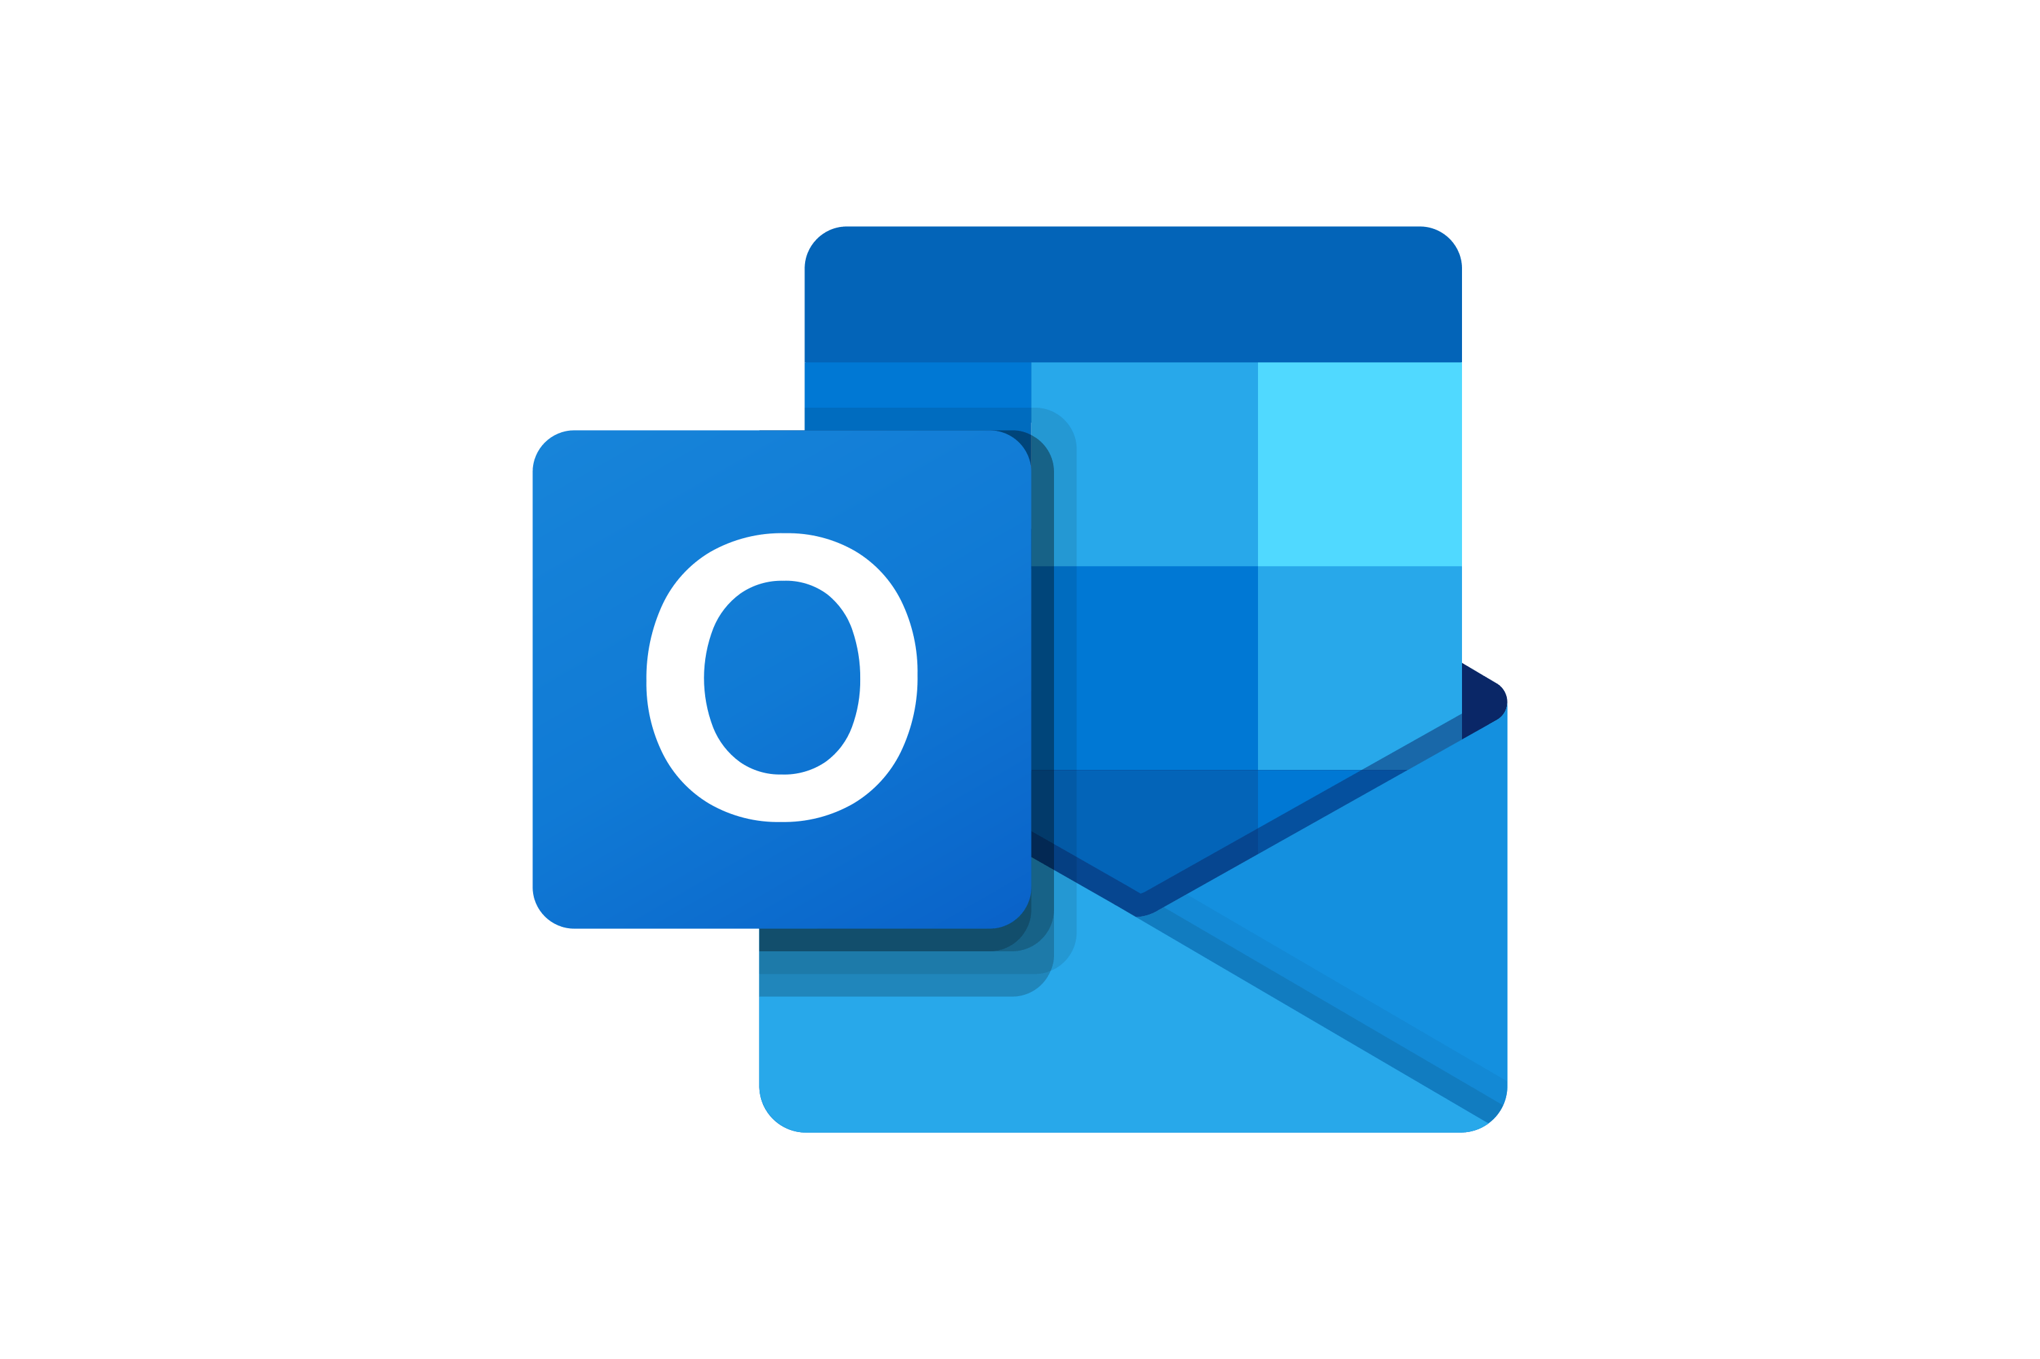
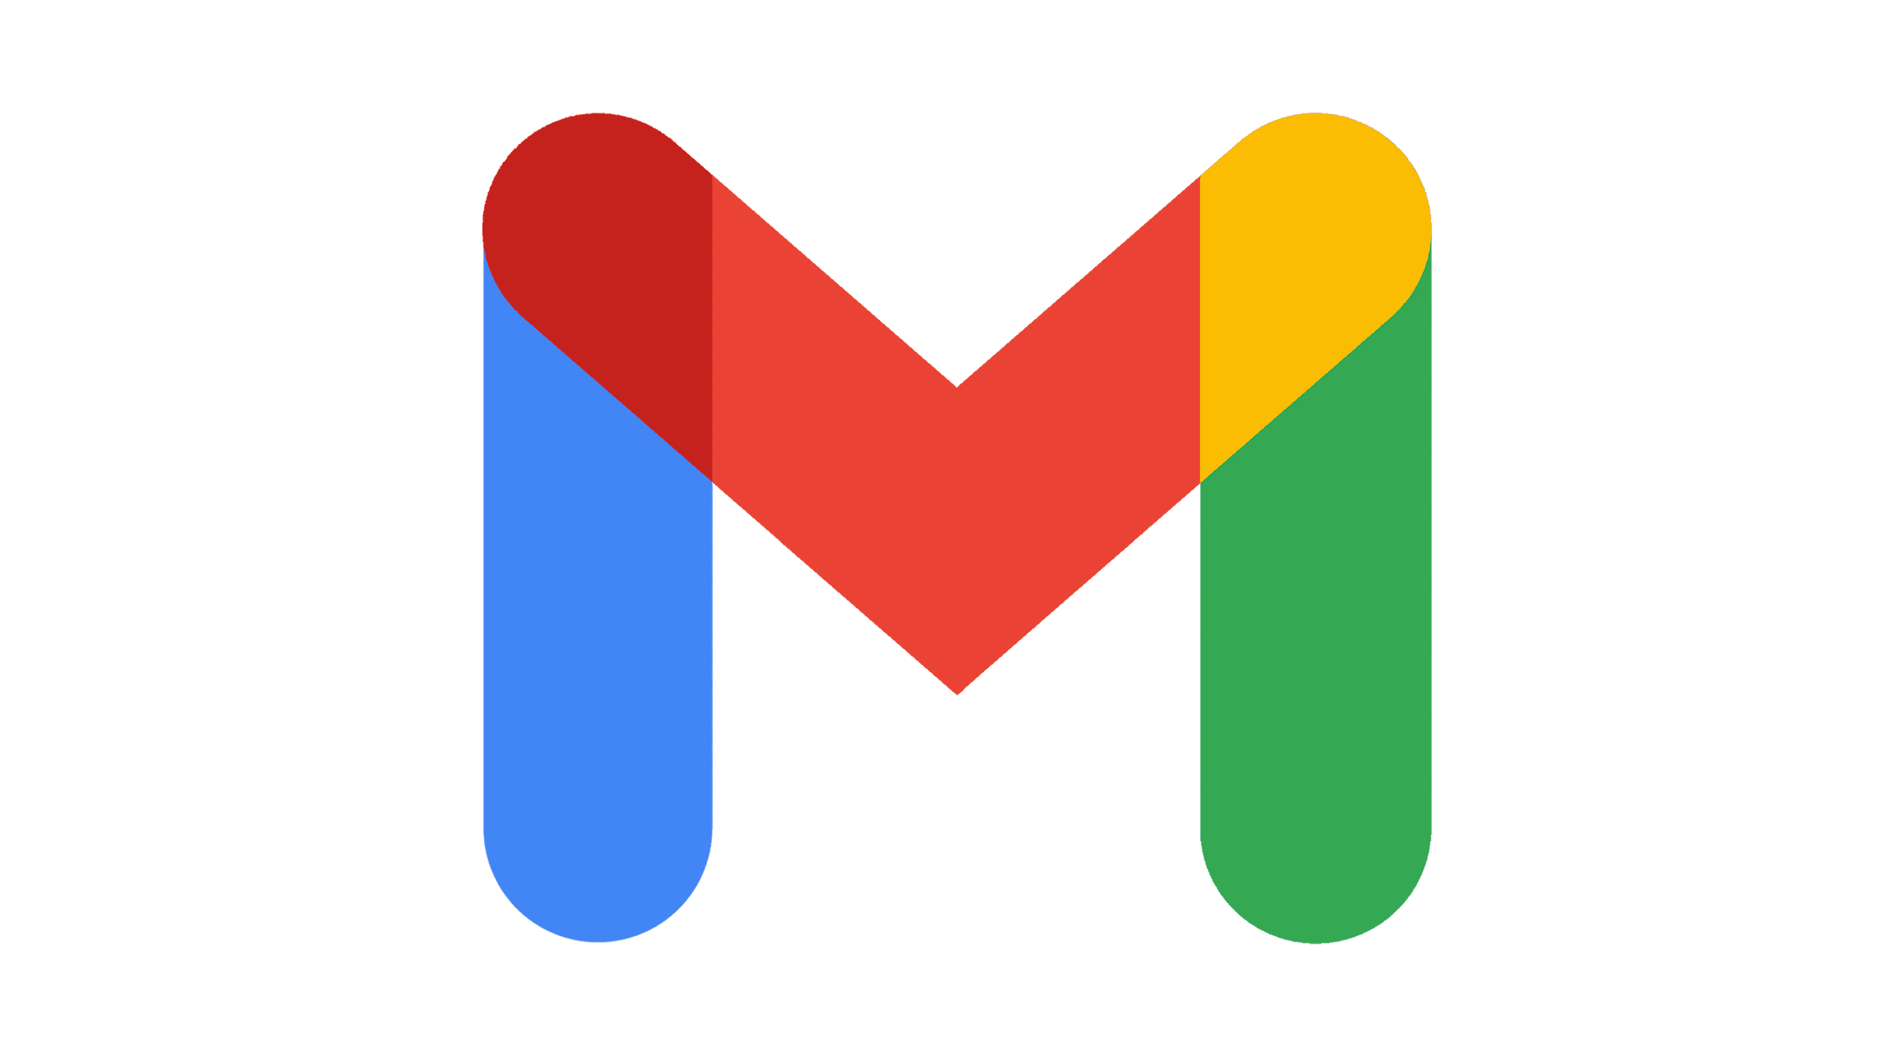

Email
Adhvika can send mails using any mailbox like
Gmail,Outlook,yahoo mail,etc.

Slide 9

Whatsapp
Whatsapp is now automated to Adhvika. You can now send
whatsapp Text messages to your friends using Adhvika with your voice.

Slide 10

Youtube
Youtube is now automated to Adhvika .Adhvika plays videos and
songs which are in youtube using your voice.

Slide 11
Devices supported
Microphone & speaker along with your computer
Bluetooth headset or speaker with built-in microphone .

Slide 12
contact
rajuvamsikrishna403@gmail.com
rajuvamsikrishna403@icloud.com
Email =

Slide 13
Thank you

