Slide 1

ALERTLENS
ALERT TRIAGE
By: Ethan Le,
10.12.26
AIC × CROWDSTRIKE
HACKATHON
TRACK 2 · DETECT
AI-POWERED BLUE TEAM

Slide 2
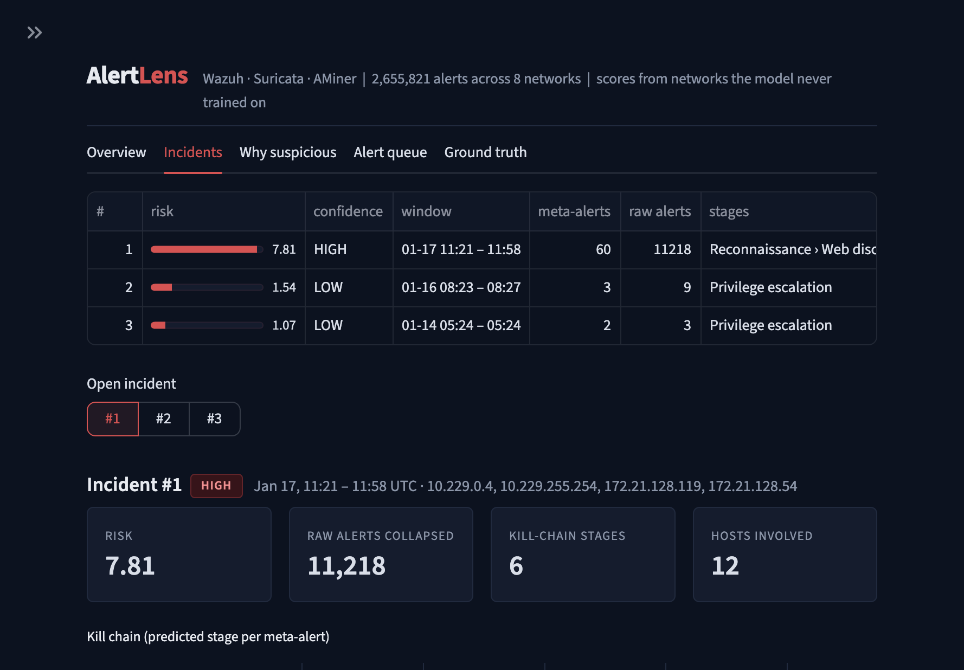

About Our Project
Track 2 · Detect: an AI blue-team assistant that turns millions of security alerts into a few explained incidents.
ALERTLENS · AIC × CROWDSTRIKE · TRACK 2
• Input: 2.66M alerts from Wazuh, Suricata and AMiner (AIT-ADS, 8 networks)
• Output: ranked incidents with reasons, MITRE stages and an analyst report
• Runs locally: no telemetry leaves the SOC
Notes:
Track 2 · Detect: an AI blue-team assistant that turns millions of security alerts into a few explained incidents.
Input: 2.66M alerts from Wazuh, Suricata and AMiner (AIT-ADS, 8 networks)
Output: ranked incidents with reasons, MITRE stages and an analyst report
Runs locally: no telemetry leaves the SOC

Slide 3
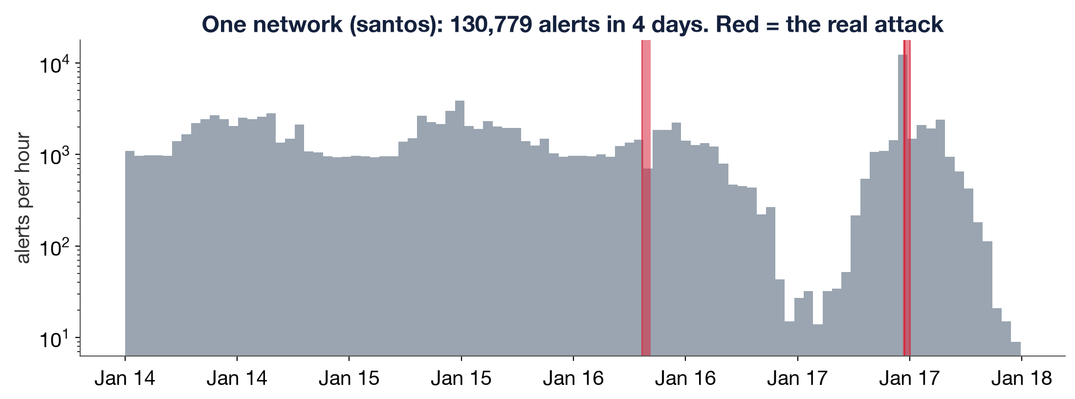
The Problem
Security teams drown in alerts. The real attack is a tiny fraction of the noise.
ALERTLENS · AIC × CROWDSTRIKE · TRACK 2
• 2.66M alerts; only 450 of 99K alert groups are the attack
• Analysts cannot read them all, so real attacks get missed (alert fatigue)
• Hackers hide inside this noise
Notes:
Security teams drown in alerts. The real attack is a tiny fraction of the noise.
2.66M alerts; only 450 of 99K alert groups are the attack
Analysts cannot read them all, so real attacks get missed (alert fatigue)
Hackers hide inside this noise

Slide 4
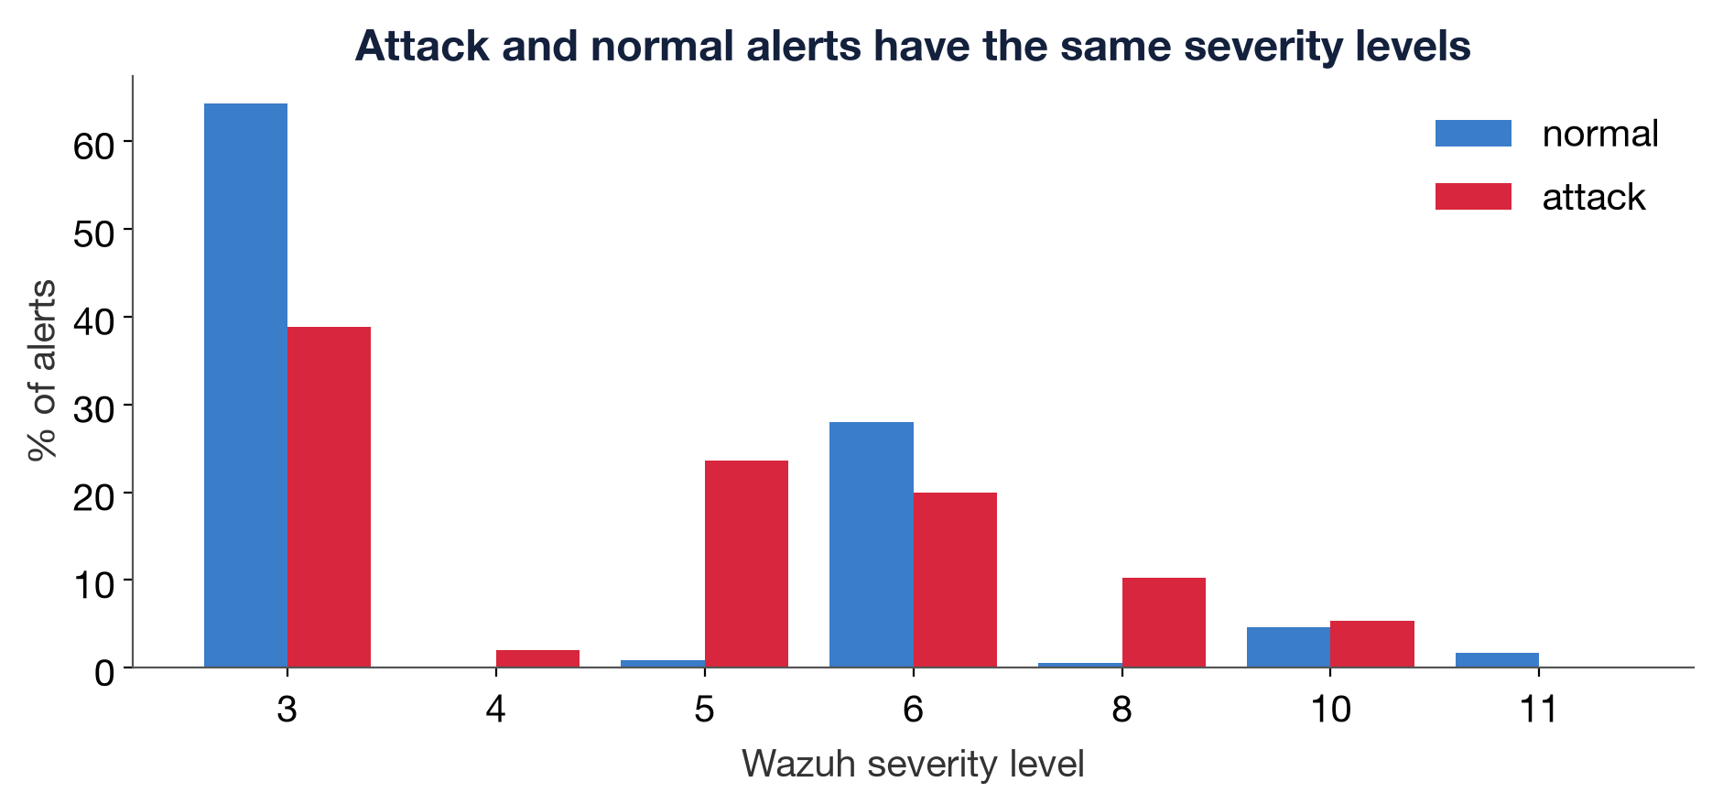
Severity Is Not Enough
Attack alerts and normal alerts get the same severity levels, so sorting by severity does not find the attack.
ALERTLENS · AIC × CROWDSTRIKE · TRACK 2
• Wazuh severity ranks the attack worse than random (ROC-AUC 0.41)
• By severity: about 12,017 items to review to catch 90% of the attack
• We need context: what is normal for this network?
Notes:
Attack alerts and normal alerts get the same severity levels, so sorting by severity does not find the attack.
Wazuh severity ranks the attack worse than random (ROC-AUC 0.41)
By severity: about 12,017 items to review to catch 90% of the attack
We need context: what is normal for this network?

Slide 5
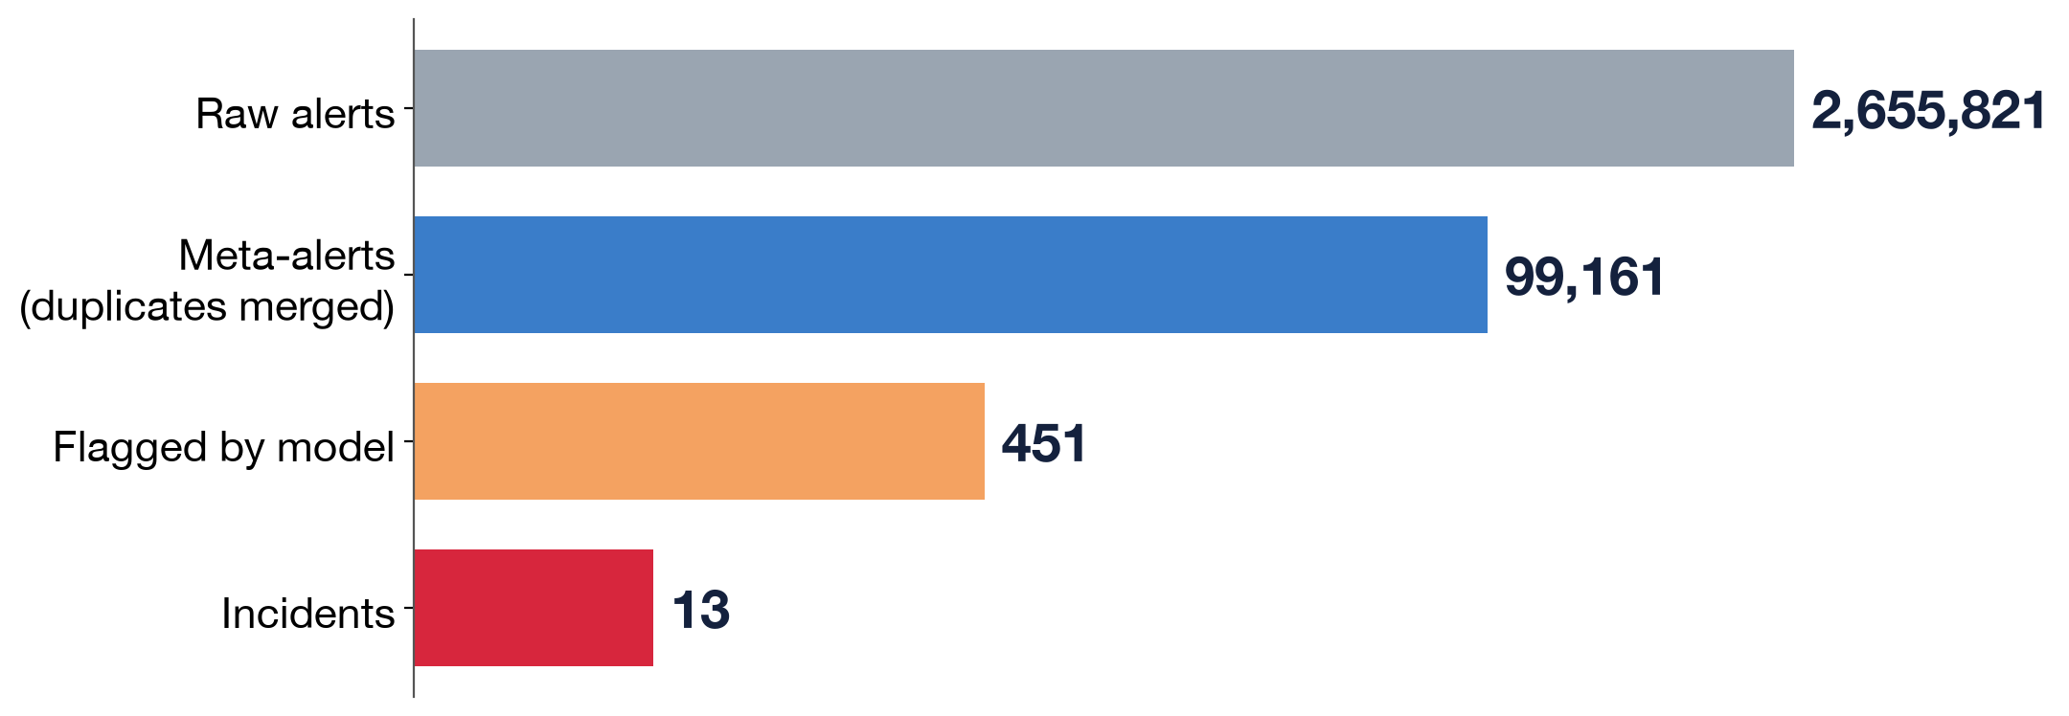
Our Solution
AlertLens shrinks 2.66M alerts to 13 ranked incidents and explains each one.
ALERTLENS · AIC × CROWDSTRIKE · TRACK 2
• Merge duplicates into 99K meta-alerts
• Machine learning flags 451; 91% of them are the real attack
• Chain them into 13 incidents: #1 is the real attack in 8 of 8 networks
• Threat hunt: unsupervised hunting over raw logs
Notes:
AlertLens shrinks 2.66M alerts to 13 ranked incidents and explains each one.
Merge duplicates into 99K meta-alerts
Machine learning flags 451; 91% of them are the real attack
Chain them into 13 incidents: #1 is the real attack in 8 of 8 networks
Threat hunt: unsupervised hunting over raw logs

Slide 6
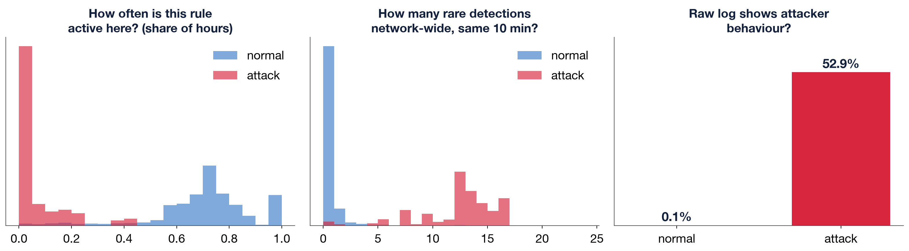
How It Works
The model learns what attacker behaviour looks like from context features, computed from past alerts only.
ALERTLENS · AIC × CROWDSTRIKE · TRACK 2
• Rarity and novelty: first time a rule, IP or account is seen
• Bursts and several sensors firing within 10 minutes
• Attacker vs. admin hints in raw logs (www-data, /etc/shadow, scanners)
• LightGBM, 5-seed ensemble
Notes:
The model learns what attacker behaviour looks like from context features, computed from past alerts only.
Rarity and novelty: first time a rule, IP or account is seen
Bursts and several sensors firing within 10 minutes
Attacker vs. admin hints in raw logs (www-data, /etc/shadow, scanners)
LightGBM, 5-seed ensemble

Slide 7
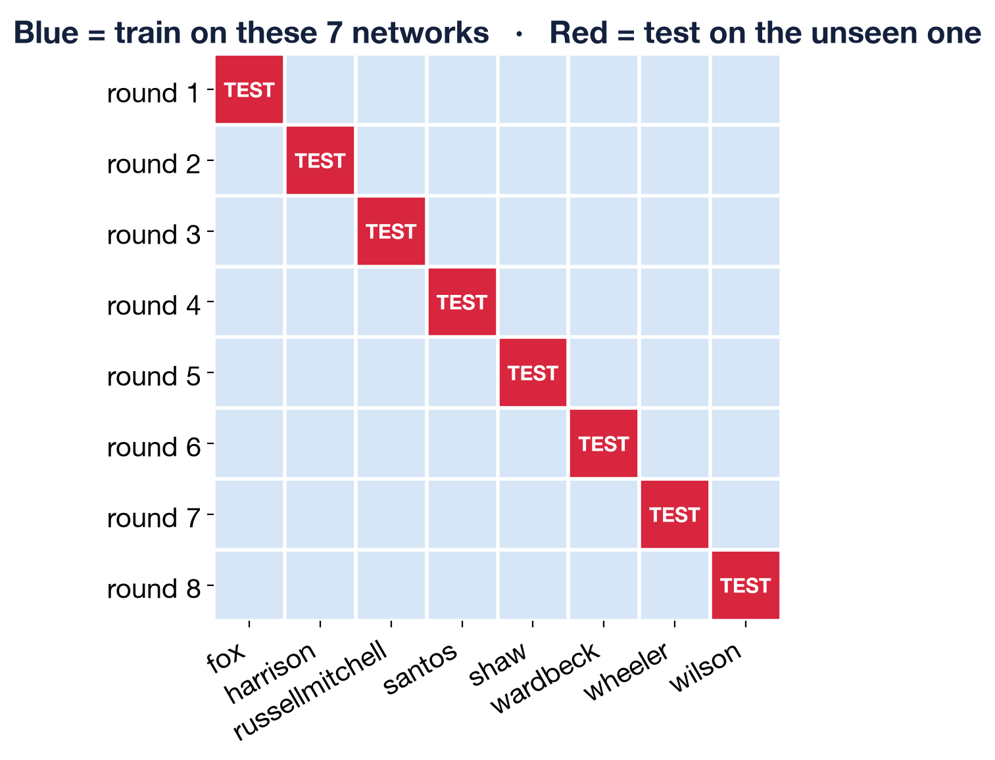
Tested On Unseen Networks
We train on 7 networks and test on the 8th, rotating through all 8 (leave-one-network-out).
ALERTLENS · AIC × CROWDSTRIKE · TRACK 2
• Every score comes from a model that never saw that network
• Like deploying to a brand-new customer
• No peeking at the future: features use only earlier alerts
Notes:
We train on 7 networks and test on the 8th, rotating through all 8 (leave-one-network-out).
Every score comes from a model that never saw that network
Like deploying to a brand-new customer
No peeking at the future: features use only earlier alerts

Slide 8
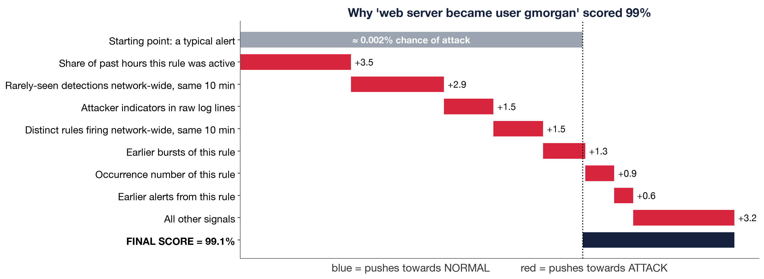
Explainable Scores
Every alert gets plain-English reasons (SHAP): which signals pushed its score up or down.
ALERTLENS · AIC × CROWDSTRIKE · TRACK 2
• Example: www-data switching to user gmorgan, a first-time event, is scored as attack
• Analysts see why, not just a number
• Mark a false positive once and it is suppressed on that host
Notes:
Every alert gets plain-English reasons (SHAP): which signals pushed its score up or down.
Example: www-data switching to user gmorgan, a first-time event, is scored as attack
Analysts see why, not just a number
Mark a false positive once and it is suppressed on that host

Slide 9
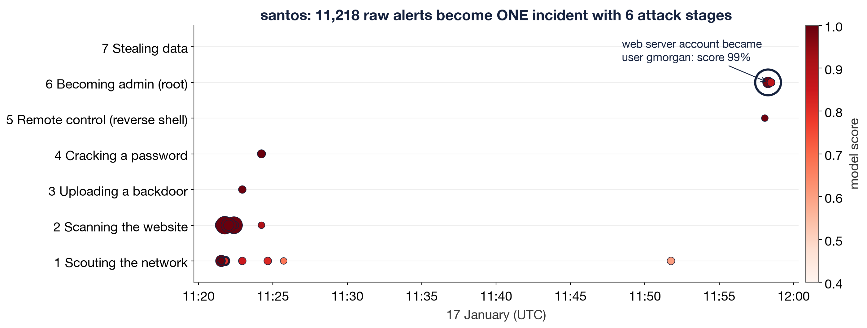
The Attack Story
Flagged alerts are chained into an incident timeline with kill-chain stages and MITRE ATT&CK techniques.
ALERTLENS · AIC × CROWDSTRIKE · TRACK 2
• From reconnaissance to webshell upload to privilege escalation
• A local LLM (qwen3:14b via Ollama) writes the report and answers questions
• Confidence HIGH only with high risk and 2+ attack stages
Notes:
Flagged alerts are chained into an incident timeline with kill-chain stages and MITRE ATT&CK techniques.
From reconnaissance to webshell upload to privilege escalation
A local LLM (qwen3:14b via Ollama) writes the report and answers questions
Confidence HIGH only with high risk and 2+ attack stages

Slide 10
Our Video:
ALERTLENS · AIC × CROWDSTRIKE · TRACK 2

Slide 11
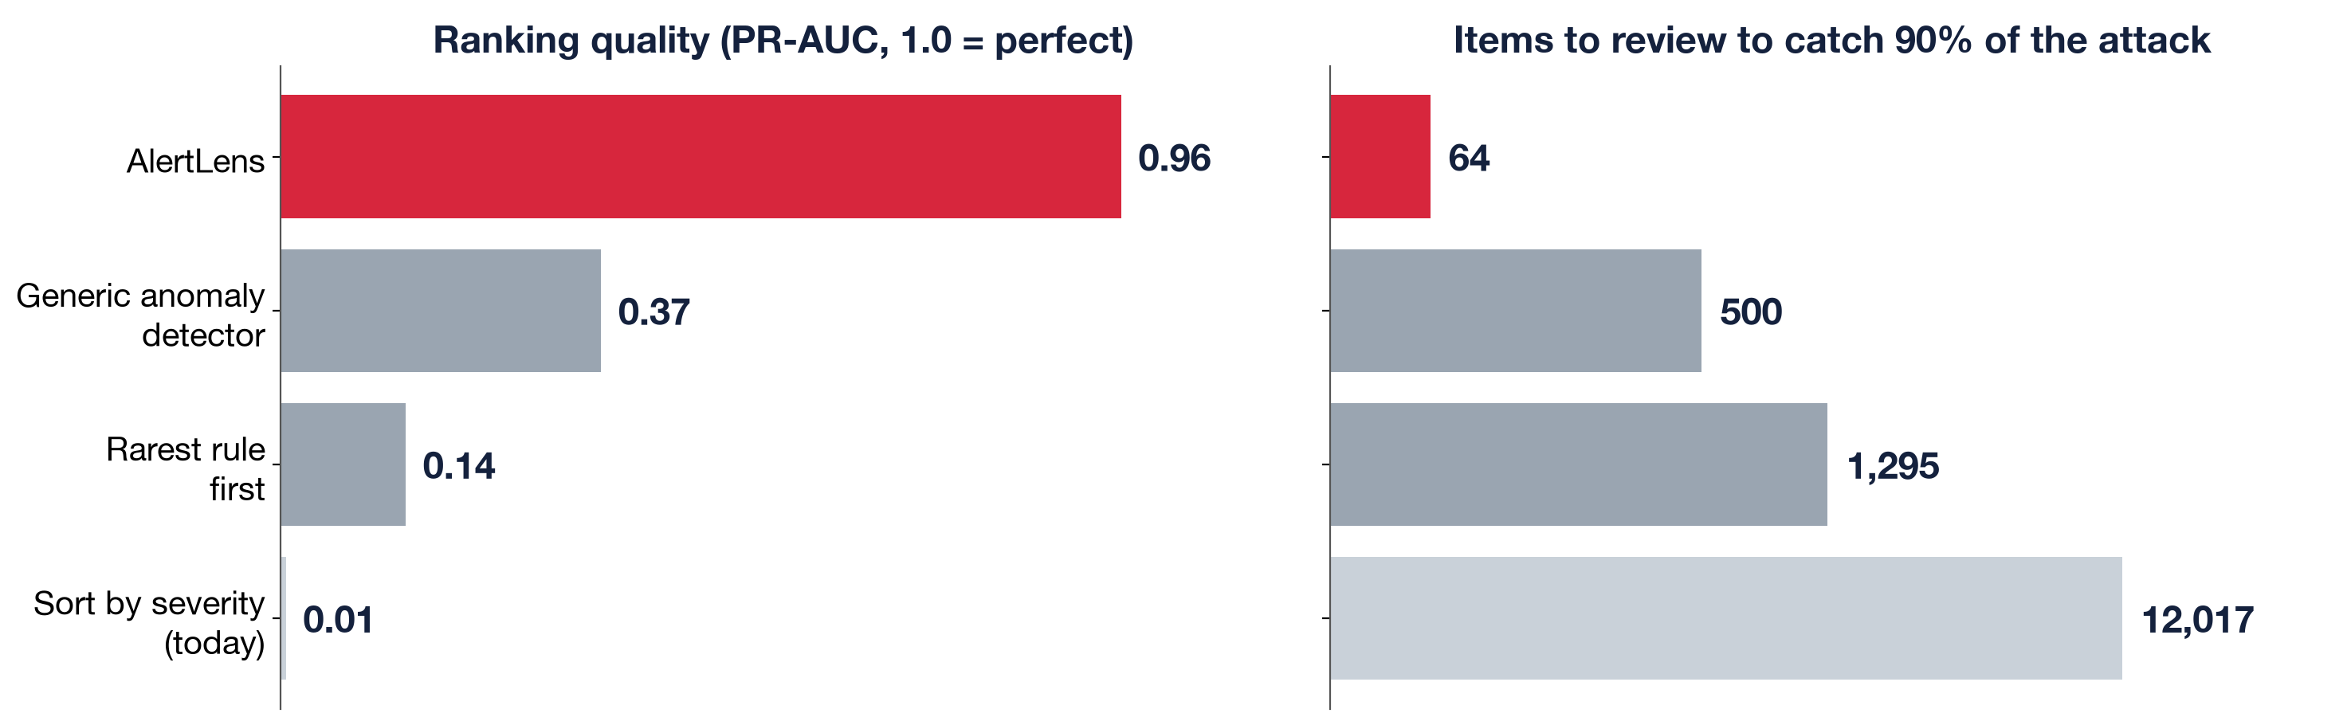
Results and Evaluation
Averaged over 8 unseen networks, AlertLens beats common approaches by a wide margin.
ALERTLENS · AIC × CROWDSTRIKE · TRACK 2
• PR-AUC 0.96 vs. 0.37 Isolation Forest, 0.14 rarity, 0.01 Wazuh severity
• Top 20 alerts: 100% are real attack
• Catch 90% of the attack: 64 items to review instead of 12,017
• Attack stage predicted correctly 90% of the time
Notes:
Averaged over 8 unseen networks, AlertLens beats common approaches by a wide margin.
PR-AUC 0.96 vs. 0.37 Isolation Forest, 0.14 rarity, 0.01 Wazuh severity
Top 20 alerts: 100% are real attack
Catch 90% of the attack: 64 items to review instead of 12,017
Attack stage predicted correctly 90% of the time

Slide 12
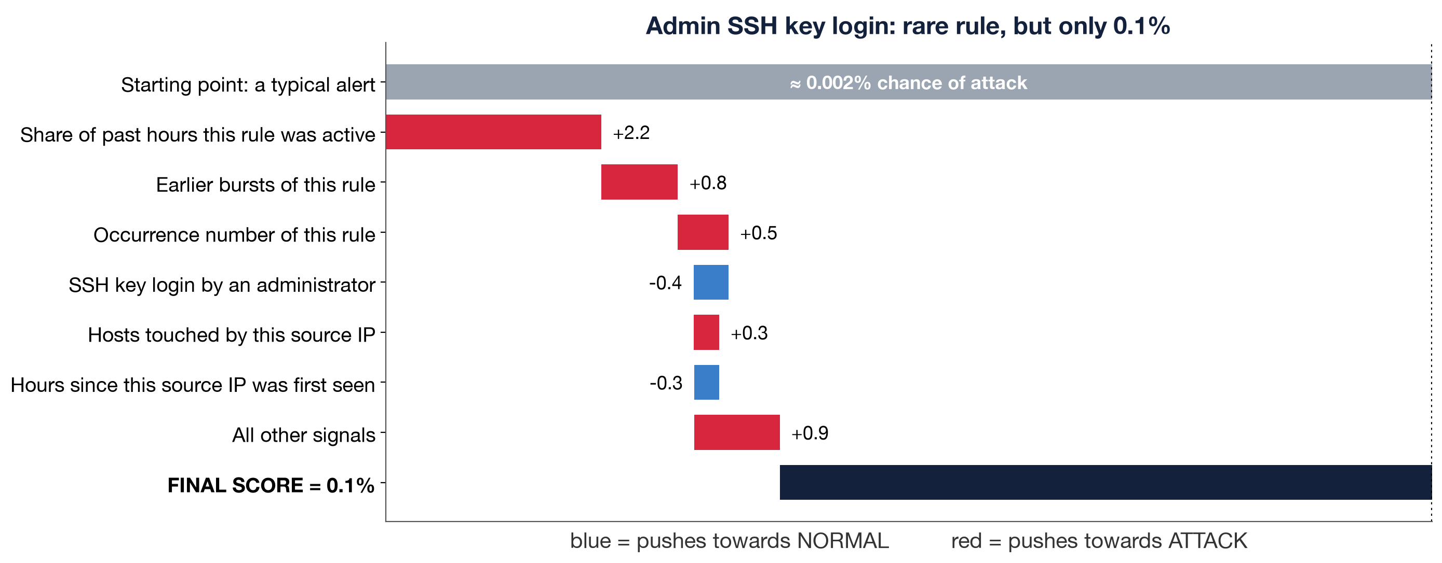
Real World Impact
Analysts review about 64 items instead of 12,000 and still catch 90% of the attack.
ALERTLENS · AIC × CROWDSTRIKE · TRACK 2
• Hides 99.91% of benign meta-alerts at 90% attack recall
• Normal admin work is explained as benign, not escalated
• Private: model and LLM run on-premises, no data leaves the SOC
Notes:
Analysts review about 64 items instead of 12,000 and still catch 90% of the attack.
Hides 99.91% of benign meta-alerts at 90% attack recall
Normal admin work is explained as benign, not escalated
Private: model and LLM run on-premises, no data leaves the SOC

Slide 13
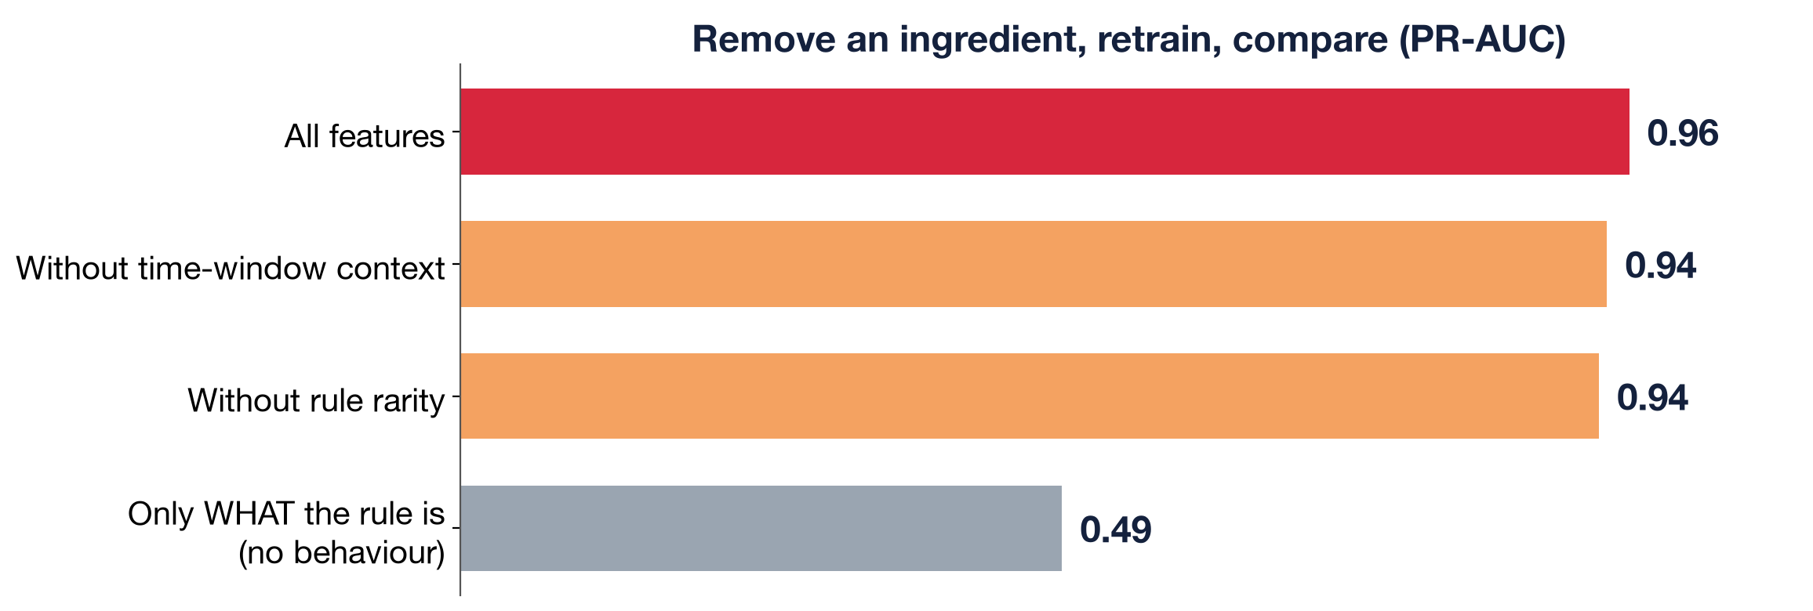
Why Our Product Wins
Accurate, explainable, tested on unseen networks, and private.
ALERTLENS · AIC × CROWDSTRIKE · TRACK 2
• Behaviour matters: PR-AUC 0.49 from rule meaning alone, 0.96 with context
• Every score has reasons, every incident has a story
• End to end: raw logs to analyst report in one dashboard
Notes:
Accurate, explainable, tested on unseen networks, and private.
Behaviour matters: PR-AUC 0.49 from rule meaning alone, 0.96 with context
Every score has reasons, every incident has a story
End to end: raw logs to analyst report in one dashboard

Slide 14
THANKS
FOR
LISTENING!

