Slide 1
THE TRAVEL APPROVAL & EXPENSE REIMBURSMENT DATABASE AT STARK SEALING SOLUTIONS Phase III Presentation – Team Four – December 9, 2015

Slide 2
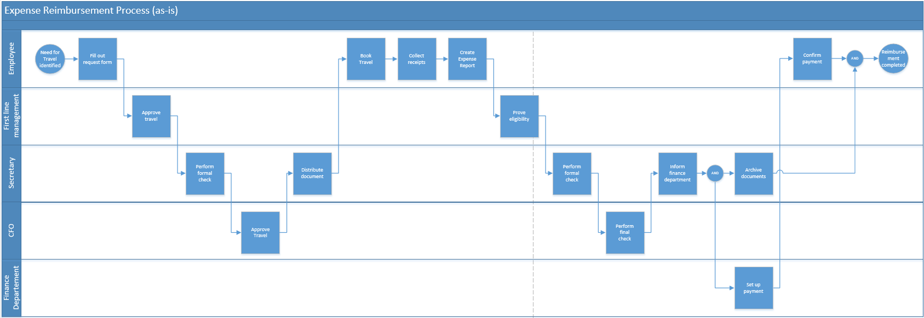
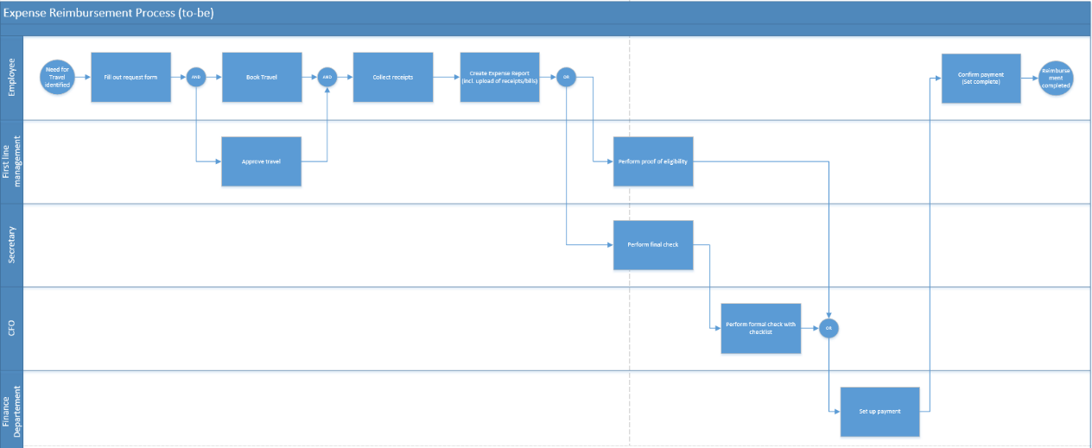
Phase 1 Recap - Stark Sealing solutions
Fast growing German company whose employees travel most of their time
Current process: Sequential, paper-based approach to request travel and file expense reports
Problem: The process takes to much time and threatens to affect customer and employee satisfaction
New process: Parallelized process with database as a backbone
Notes:
Problems with the current process:
The process takes too much of the employees and managers time
If managers or the CFO are not available, the employees may take non-compliant work arounds, can’t book and travel at all, which leads to customer dissatisfaction
Many employees can’t afford paying for more than one business trip in advance.
Process would take ~45 minutes to complete – but documents are in waiting position 95% of the time
Paper-based approach is compliant but not convenient
Difficult to get a history of an employees trip
Difficult to discover potential fraudulent activities
Difficult to get a status of an open request/report
Many errors occur during handover or when comparing requests/reports
Project managers struggle to locate and assign travel-related costs to their projects

Slide 3
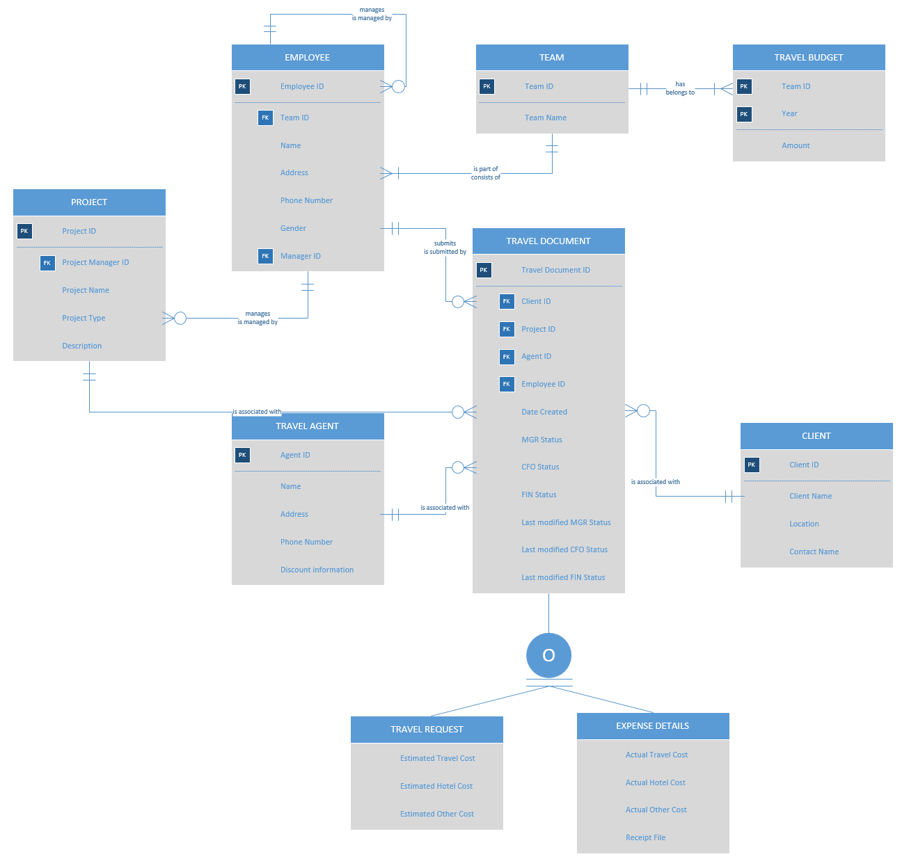
Phase 2 Recap - Entity Relationship Diagram
The project manager can have a view on all travel cost that occurred on his project
The manager and CFO can compare actual and requested cost much easier
The manager and the CFO could easily calculate the percentage of their travel budget already used
Many views: Open travel requests and expense reports, cost per team, etc.
…

Slide 4
Define Data Types and constraints for each table
Ensure data is inserted to the database correctly and useful reports can be generated
Define what data will look like (numeric, character, etc.)
Indicate mandatory vs. nullable values (what can be left out)
Indicate primary keys, foreign keys, unique values, constraints, etc.
COLUMN_NAME | DATA_TYPE | NULLABLE | DATA_DEFAULT |  | COMMENTS
TRAVEL_DOCUMENT_ID | NUMBER | No |  | Auto generate sequence start from 1 to 99999999 | Primary Key
CLIENT_ID | NUMBER | Yes |  |  | FK to Client
PROJECT_ID | NUMBER | Yes |  |  | FK to Project
AGENT_ID | NUMBER | Yes |  |  | FK to Travel Agent
EMPLOYEE_ID | NUMBER | Yes |  |  | FK to Employee
CREATED_DATE | TIMESTAMP(6) WITH LOCAL TIME ZONE | Yes |  | CURRENT_TIMESTAMP | null
MGR_STATUS | NUMBER | No |  | 1
CFO_STATUS | NUMBER | No |  | 1
FIN_STATUS | NUMBER | No |  | 1
MGR_LAST_MODIFICATION | TIMESTAMP(6) WITH LOCAL TIME ZONE | N/A |  | CURRENT_TIMESTAMP | null
CFO_LAST_MODIFICATION | TIMESTAMP(6) WITH LOCAL TIME ZONE | N/A |  | CURRENT_TIMESTAMP | null
FIN_LAST_MODIFICATION | TIMESTAMP(6) WITH LOCAL TIME ZONE | N/A |  | CURRENT_TIMESTAMP | null

Slide 5
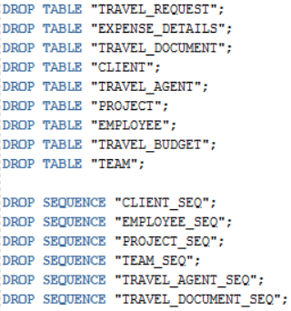
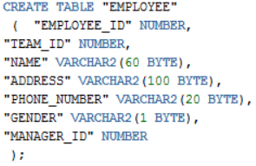
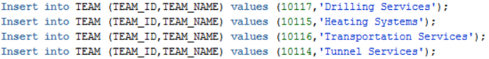
Create database and insert sample data
To create the actual database, we wrote a series of
Drop functions to clean out the database
Sequences to make sure the system handles primary key generated for us.
Create table commands, including data types and constraints
To test the database
We created tables in excel for each of the relations in the ER diagram
We imported them into SQL Developer and exported a series of insert commands

Slide 6
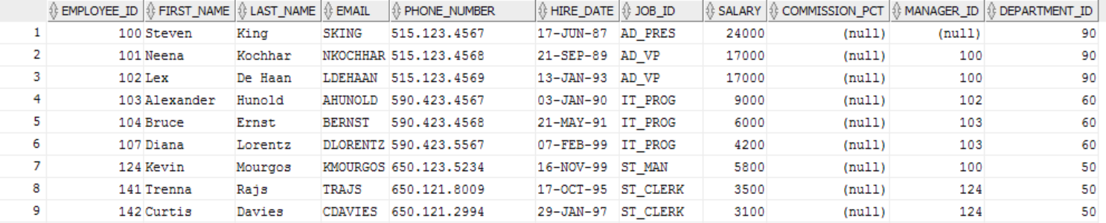
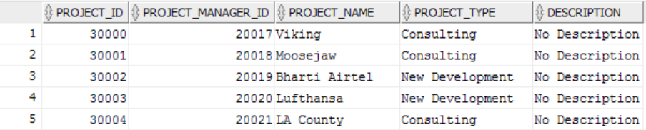
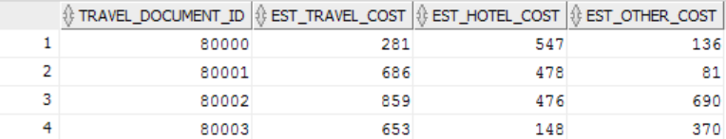
Sample data
Employee
Project
TravelRequest

Slide 7
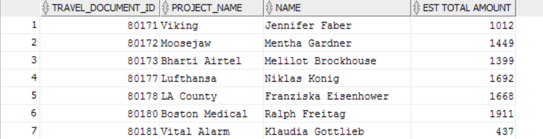
SQL Queries (1)
PROJECT MANAGER CAN SEE PENDING TRAVEL REQUESTS (Total Estimated) FOR THEIR PROJECT
SELECT b.TRAVEL_DOCUMENT_ID, e.PROJECT_NAME, c.NAME, f.EST_TRAVEL_COST + f.EST_OTHER_COST + f.EST_HOTEL_COST AS "EST TOTAL AMOUNT" FROM TRAVEL_DOCUMENT b JOIN TRAVEL_REQUEST f ON b.TRAVEL_DOCUMENT_ID = f.TRAVEL_DOCUMENT_ID JOIN PROJECT e ON b.PROJECT_ID = e.PROJECT_ID JOIN EMPLOYEE c ON b.EMPLOYEE_ID = c.EMPLOYEE_ID JOIN TEAM d ON c.TEAM_ID = d.TEAM_ID WHERE b.MGR_STATUS = 1;

Slide 8

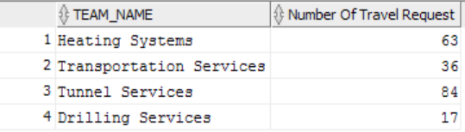
SQL Queries (2,3)
STATUS INFORMATION ON HOW WELL THE NEW PROCESS AND THE DATABASE PERFORM (HOW MANY REPORTS HAVE WHICH STATUS)
SELECT CASE MGR_STATUS WHEN 1 THEN 'In Process' WHEN 2 THEN 'Approved' WHEN 3 THEN 'Rejected' END AS "MANAGER_STATUS", count(1) AS "TOTAL_REPORTS" FROM TRAVEL_DOCUMENT GROUP BY MGR_STATUS;
Number of travel requests per team (evaluate which teams may need a higher travel budget)
SELECT d.team_name, count(1) AS "Number Of Travel Request"
from travel_request a join travel_document b
on a.travel_document_id= b.travel_document_id
join employee c
on b.employee_id= c.employee_id
join TEAM d
on c.team_id = d.team_id
group by d.team_name;

Slide 9
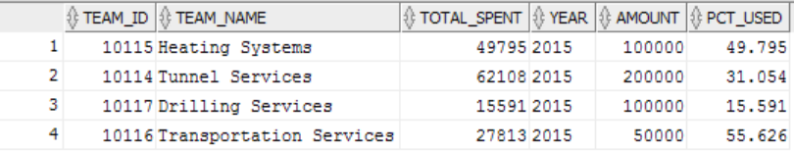
SQL Queries (4)
CHECK WHICH TEAMS ARE LIKELY TO GO OVER TRAVEL BUDGET (EXPENSES SO FAR / BUDGET) * 100
SELECT AA.TEAM_ID, AA.TEAM_NAME, AA.TOTAL_SPENT, BB.YEAR, BB.AMOUNT,
(AA.TOTAL_SPENT/BB.AMOUNT) * 100 AS PCT_USED
FROM (
SELECT D.TEAM_ID, D.TEAM_NAME, SUM(A.TOTAL_SPENT) AS "TOTAL_SPENT"
FROM ( SELECT TRAVEL_DOCUMENT_ID,
ACT_HOTEL_COST + ACT_OTHER_COST + ACT_TRAVEL_COST AS "TOTAL_SPENT" FROM EXPENSE_DETAILS) A
JOIN TRAVEL_DOCUMENT B ON
A.TRAVEL_DOCUMENT_ID = B.TRAVEL_DOCUMENT_ID
JOIN EMPLOYEE C ON
B.EMPLOYEE_ID = C.EMPLOYEE_ID
JOIN TEAM D ON
C.TEAM_ID = D.TEAM_ID
WHERE
EXTRACT(year FROM B.CREATED_DATE) = &year
GROUP BY D.TEAM_ID,D.TEAM_NAME ) AA
JOIN
TRAVEL_BUDGET BB
ON AA.TEAM_ID = BB.TEAMID AND BB.YEAR = &year;
Notes:
Next the fourth sql query
Let image that higher executives want to know how much each team spent on traveling compare to travel budget on specific year.
This report will help executive understand how budget on each team going. Is it exceed total budget or not.
If it’s necessary, executives may decide to increase travel budget on specific team to catch up with team usage.
To get this report, we have to get total expense detail which is actual spent amount. Join it with travel document, employee and team. Combine it with sum function to get
Total spent for each team.
After that we join previous result with team budget for comparing between total spent and total budget.
As you can see, we also use substitution variable for year, user can put something like 2015 for comparing spent and budget on 2015.
We also calculate percent used by spent divide budget amount multiply by 100.
And this is snapshot of our report. Heating system team has used nearly fifty thousand. it is nearly fifty percent of total 2015 budget.

Slide 10
SQL Queries (5)
List of open travel requests for a manager, compare amounts in travel requests to amounts in expense report to make approval process flow faster
SELECT A.TRAVEL_DOCUMENT_ID, B.NAME, B.GENDER,
CASE A.MGR_STATUS
WHEN 1 THEN 'In Process'
WHEN 2 THEN 'Approved'
WHEN 3 THEN 'Rejected'
END AS STATUS,
TR.EST_HOTEL_COST + TR.EST_OTHER_COST + TR.EST_TRAVEL_COST AS "ESTIMATED_COST",
NVL2(ED.TRAVEL_DOCUMENT_ID, TO_CHAR(ED.ACT_HOTEL_COST + ED.ACT_TRAVEL_COST + ED.ACT_OTHER_COST), 'N/A') AS "ACTUAL COST",
NVL2(ED.TRAVEL_DOCUMENT_ID, TO_CHAR((TR.EST_HOTEL_COST + TR.EST_OTHER_COST + TR.EST_TRAVEL_COST) - (ED.ACT_HOTEL_COST + ED.ACT_TRAVEL_COST + ED.ACT_OTHER_COST)), 'N/A') AS "DIFF(EST - ACT)",
A.CREATED_DATE FROM
TRAVEL_DOCUMENT A JOIN EMPLOYEE B
ON A.EMPLOYEE_ID = B.EMPLOYEE_ID
JOIN TRAVEL_REQUEST TR ON A.TRAVEL_DOCUMENT_ID = TR.TRAVEL_DOCUMENT_ID
LEFT JOIN EXPENSE_DETAILS ED ON A.TRAVEL_DOCUMENT_ID = ED.TRAVEL_DOCUMENT_ID
JOIN EMPLOYEE C
ON B.MANAGER_ID = C.EMPLOYEE_ID
WHERE MGR_STATUS = 2
AND C.EMPLOYEE_ID = &MANAGER_ID;

Slide 11
SQL Trigger
Trigger is special kind of procedure that automatically executes when specific event occurs. We use it to update LAST_MODIFICATION timestamp on each statuses.
CREATE OR REPLACE TRIGGER "TRAVEL_DOCUMENT_UPDATE" BEFORE UPDATE OF FIN_STATUS,CFO_STATUS,MGR_STATUS ON TRAVEL_DOCUMENT FOR EACH ROW BEGIN IF :OLD.FIN_STATUS != :NEW.FIN_STATUS THEN :NEW.FIN_LAST_MODIFICATION := CURRENT_TIMESTAMP; END IF; IF :OLD.CFO_STATUS != :NEW.CFO_STATUS THEN :NEW.CFO_LAST_MODIFICATION := CURRENT_TIMESTAMP; END IF; IF :OLD.MGR_STATUS != :NEW.MGR_STATUS THEN :NEW.MGR_LAST_MODIFICATION := CURRENT_TIMESTAMP; END IF; END;
UPDATE TRAVEL_DOCUMENT SET MGR_STATUS = 2 WHERE TRAVEL_DOCUMENT_ID = 80001;

Slide 12
THANK YOU!

