Slide 1
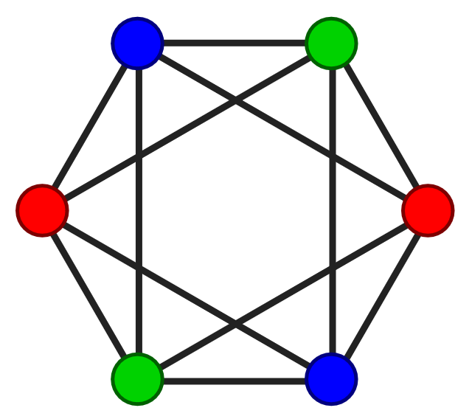
Project Title
Graph coloring Algorithm Implementation
-midterm checkpoints
Presented by
Versha Khare

Slide 2
MIDTERM CHECKPOINTS Implemented in this project
1. Created input Mycielski graph of 21 vertices and 42 edges.
2. Implemented Algorithm – Backtracking , Greedy BFS & DFS , Welsh Powell on input graph
3. Captured output and its execution time.
4. Compared performance of all implemented algorithm
5. Applied Backtracking algorithm on solving Sudoku Puzzle.
6.Created GitHub repo.

Slide 3
Graph coloring Algorithm Implemented
Backtracking
Greedy Algorithm using DFS
Greedy Algorithm using BFS
Welsh Powell

Slide 4
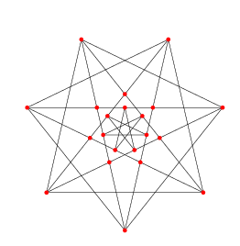
Graph Used while Implementing
The Brinkmann graph is a Mycielski graph(Triangle free graph) of 21 vertices and 42 edges.
The graph is implemented in code using adjacency list.

Slide 5
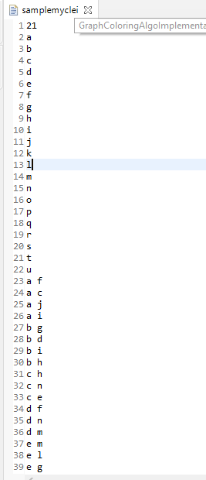
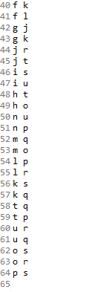
Input Graph in Code - Screenshot
Screenshot has all 21 vertices(a to u) and 42 edges

Slide 6
Backtracking
In Backtracking technique , we assign colors one by one to vertices .We color a single vertex and its adjacent vertex with different color.
Algorithm – Steps to color Graph
Confirm whether it is valid to color one of the current vertex with one of the color (by checking whether any of its adjacent vertices are colored with the same color).
If yes, then color it and otherwise color it with different color.
Check whether all vertices are colored or not.
If not, then take next adjacent uncolored vertex.
If no other color is available, then backtrack (i.e., un-color last colored vertex).

Slide 7
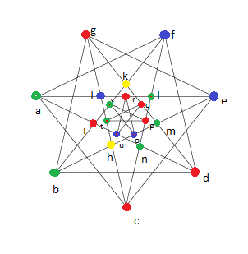
Backtracking results
Output Image →
colored fully using four colors – 7vertices-Red , 5vertices- Blue , 7vertices-green , 2vertices-yellow (Side image shows colored graph)
Execution time- in Eclipse while running it took 165-172 millisecond to color the given graph. It includes graph creation as well.
Backtracking Time complexity: using backtracking is also kind of brute force approach. O(m^v) , where m is number of colors used , v vertices. , complexity is exponentially huge.

Slide 8
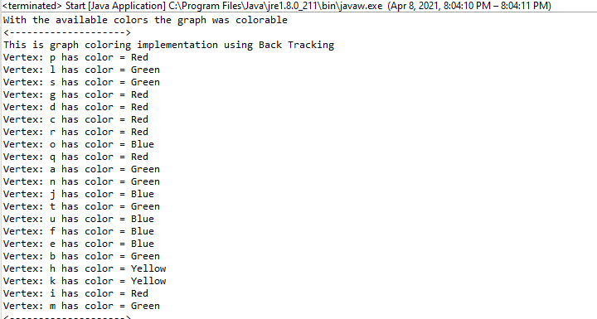
Screenshot BACKTRACKING- eclipse Console

Slide 9
Greedy Algorithm using DFS
Steps:
1.Color first vertex with first color.
2. Do below step for remaining V-1 vertices:
Consider current vertex(use DFS algorithm to traverse and color ) and color it with lowest numbered color that has not been used in previously adjacent vertices. If all previous used colors appear on adjacent vertices , assign new color.
Depth First Search (DFS) algorithm traverses a graph in a depth ward flow and uses a stack to get the next vertex to start a search, when a dead end occurs in any iteration.

Slide 10
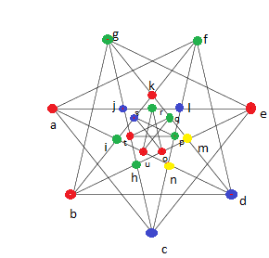
Greedy DFS RESult results
Output graph →
colored fully using four colors – 7vertices-Red , 5vertices-Blue , 7vertices-green , 2vertices-yellow (Side image shows colored output graph)
Execution time- in Eclipse while running it took 120-130 millisecond to color the given graph . It includes creation of graph as well.
Greedy DFS Time complexity: O(v^2 + e) in worst case . This technique, not always use minimum colors as number of colors depend on the order vertex is processed.

Slide 11
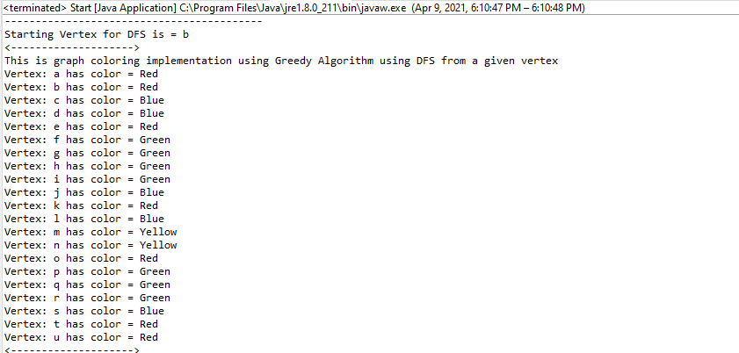
Screenshot Greedy DFS – Eclipse Console

Slide 12
Greedy Algo using BFS
Steps:
1.Color first vertex with first color.
2. Do below step for remaining V-1 vertices:
Consider current vertex(use BFS algorithm to traverse and color ) and color it with lowest numbered color that has not been used in previously adjacent vertices. If all previous used colors appear on adjacent vertices , assign new color.
Breadth First Search (BFS) algorithm traverses a graph in a breadth ward flow and uses a queue to remember to get the next vertex to start a search, when a dead end occurs in any iteration.

Slide 13
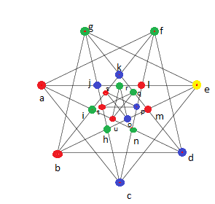
Greedy BFS Result results
Output Graph →
colored fully using four colors – 7vertices-Red ,6 vertices- Blue , 7 vertices-green , 1vertices-yellow (Side image shows colored output graph)
Execution time- in Eclipse while running it took 115-135 millisecond to color the given graph. It includes Graph creation as well.
Greedy BFS Time complexity: O(v^2 + e) in worst case . This technique, not always use minimum colors as number of colors depend on the order vertex is processed.

Slide 14
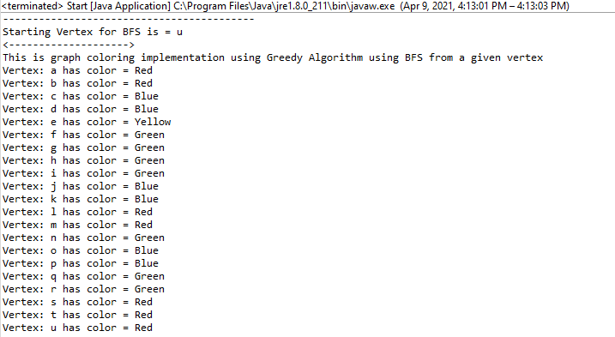
Screenshot Greedy BFS- Eclipse console

Slide 15
WELSH POWELL
Steps:
Step 1: All vertices are sorted in the decreasing value of their degree in a list V.
Step 2: Colors are ordered in a list C.
Step 3: The first non-colored vertex v in V is colored with the first available color in C. available means a color that was not previously used by the algorithm.
Step 4: The remaining part of the ordered list V is traversed, and the same color is allocated to every vertex for which no adjacent vertex has the same color.
Step 5: Steps 3 and 4 are applied iteratively until all the vertices have been colored.

Slide 16
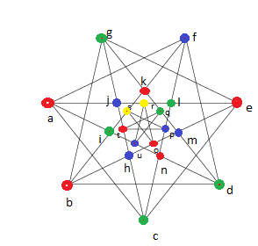
Welsh Powell results
Output Graph →
colored fully using four colors – 7vertices-Red , 6vertices-Blue , 6vertices-green , 2vertices-yellow(Side image shows colored graph)
Execution time- in Eclipse while running it took 52-80 millisecond to color the given graph. It includes Graph creation as well.
Welsh powell Run Time complexity: use at most deg(G)+1 colors, where deg(G) –largest degree in the graph.

Slide 17
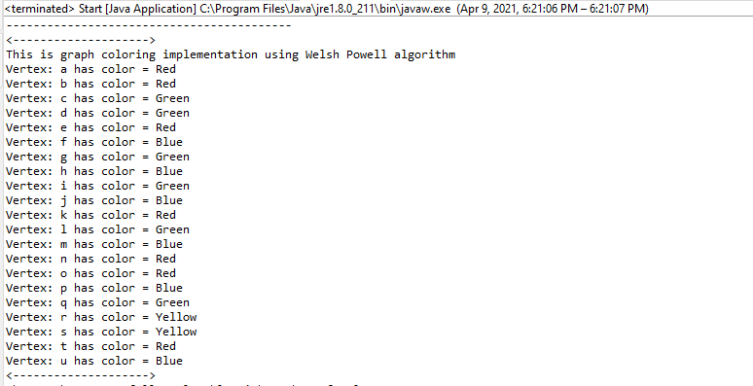

Screenshot Welsh-powell– Eclipse console

Slide 18
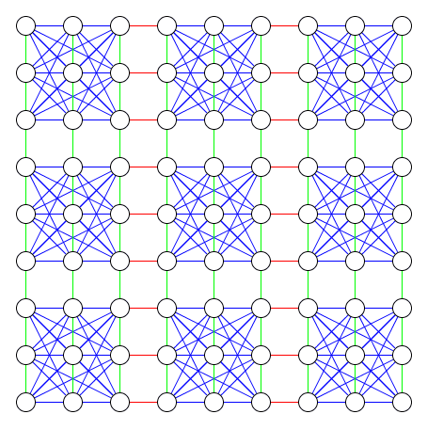
Sudoku Solver Application using graph coloring technique
A Sudoku puzzle can be taken as a graph (9*9) with 81 vertices, one for each cell, and two vertices are connected by an edge if they cannot be assigned the same value. For example - all cells in the same row, column will have edges between their corresponding vertices.
Each node (or cell) has an edge to every other node (cell) in its respective column, row, and 3 x 3 grid.
we can say that Sudoku puzzle can be viewed as Graph that can be solved by Graph Coloring with a Chromatic Number, G = 9.

Slide 19
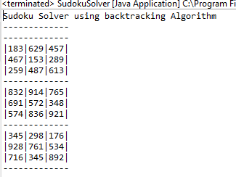
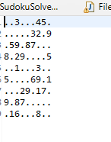
Sudoku solver results
Input-
Output-

Slide 20
Performance Comparison
Input graph | Backtracking Algorithm | Greedy BFS Algorithm | Greedy DFS Algorithm | Welsh-Powell Algorithm
Mycielski graph (21 vertices, 42 edges) Total time (graph creation + Algo implementation) | 165-172 millisecond 7 vertices - red 7 vertices -green 5 vertices -blue 2 vertices -yellow | 115-135 millisecond 7 vertices -Red 7 vertices -Green 6 vertices -Blue 1 vertex – yellow | 120-130 millisecond 7 vertices - red 7 vertices -green 5 vertices -blue 2 vertices -yellow | 52-80 millisecond 7 vertices- Red 6 vertices –blue 6 vertices –green 2 vertices -yellow
Runtime Complexity | O(m^v) , where m is number of colors used , v vertices | O(v^2 + e) in worst case | O(v^2 + e) in worst case | at most deg(G)+1 colors

Slide 21
Conclusion
1. While implementing Algorithm on input graph (21 vertices , 42 edges) we can see that Welsh Powell algorithm take less time than Greedy BFS ,Greedy DFS and Backtracking to color graph.
2. On doing runtime analysis of implemented algorithm – Welsh Powell is best technique to color graph as runtime for Welsh Powell depends on degree of graph which will be less than other implemented Algorithm (O(v^2 + e) , O(m^v) )
3.As different techniques shows different behavior when coloring different graph , it can show different execution time on another graph.

Slide 22
Tools/Software/Reference used
1.Eclipse IDE
2. Programming Language – JAVA
3. GitHub
Reference –
input graph- https://mathworld.wolfram.com/BrinkmannGraph.html
Algo ref- https://www.researchgate.net/publication/309585874_A_Performance_Comparison_of_Graph_Coloring_Algorithms
https://www.cs.cornell.edu/courses/cs3110/2012sp/recitations/rec21-graphs/rec21.html

Slide 23
GitHub repo
https://github.com/versha-khare/GraphColoringImplementation
Above git hub link has Readme section , which has steps to import & run the source code.

