Slide 1
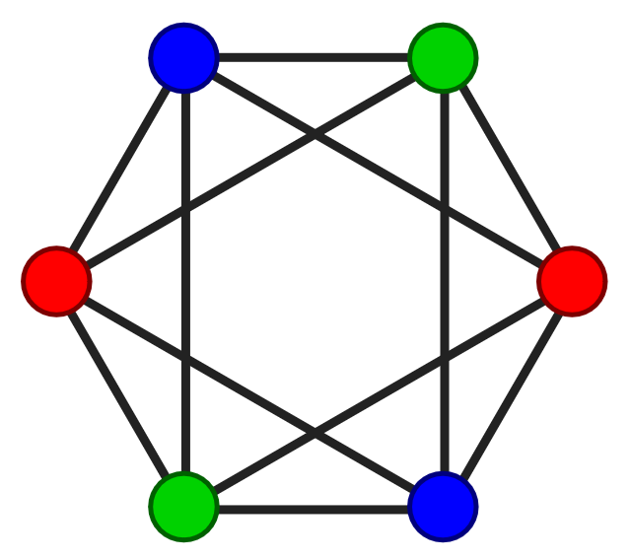
Project Title
Graph coloring Algorithm Implementation
-Final Project
Presented by
Versha Khare

Slide 2
FINAL/MIDTERM Checkpoints
MIDTERM CHECKPOINTS
FINAL CHECKPOINTS
1. Created input Mycielski graph of 21 vertices and 42 edges.
2. Implemented Algorithm – Backtracking , Greedy BFS & DFS , Welsh Powell on input graph
3. Captured output and its execution time.
4. Compared performance of all implemented algorithm
5. Applied Backtracking algorithm on solving Sudoku Puzzle.
6.Created GitHub repo.
1. Created input graph of 30 vertices and 75 edges (Foster cage graph).
2. Implemented Algorithm – Backtracking , Greedy BFS & DFS , Welsh Powell on input graph
3.Implemented greedy algorithm – Dsatur(Degree of Saturation) graph coloring.
4.Captured output and its execution time.
5.Compared performance of all algorithm on input graph.

Slide 3
GRAPH COLORING PROBLEM-
The problem of coloring the adjacent regions in a graph with minimum different number of colors . It is used to solve a variety of real-world problems like map coloring, timetabling and scheduling . Graph coloring is associated with two types of coloring as vertex and edge coloring . The goal of the both types of coloring is to color the whole graph without conflicts. Therefore, adjacent vertices or adjacent edges must be colored with different colors .
The number of the least possible colors to be used for Graph Coloring Problem is called chromatic number .
As the number of vertices or edges in a graph increases, the complexity of the problem also increases. Because of this, each algorithm can not find the chromatic number of the problems and may also be different in their executing times. Due to this, graph coloring problem is known an NP-hard problem

Slide 4
Graph coloring Algorithm Implemented
Backtracking
Greedy Algorithm using DFS
Greedy Algorithm using BFS
Welsh-Powell Algorithm
DAstur Algorithm

Slide 5
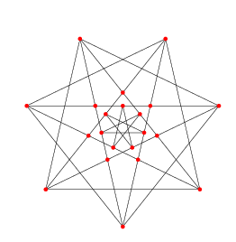
Graph Used while Implementing(mid-term)
The Brinkmann graph is a Mycielski graph(Triangle free graph) of 21 vertices and 42 edges.
The graph is implemented in code using adjacency list.

Slide 6
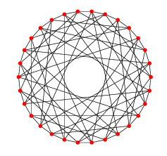
Graph Used while Implementing(Final)
The Foster Cage graph of 30 vertices and 75 edges.
The graph is implemented in code using adjacency list.

Slide 7
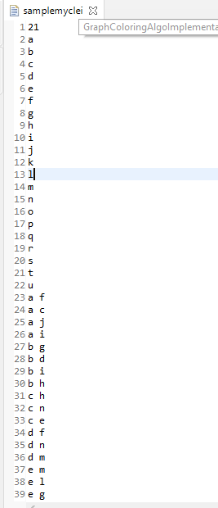
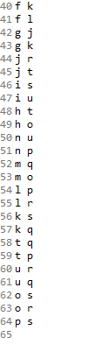
Input Graph in Code – Screenshot(mid-term)
Screenshot has all 21 vertices(a to u) and 42 edges

Slide 8
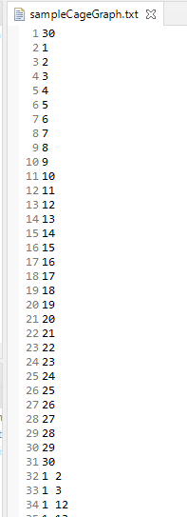
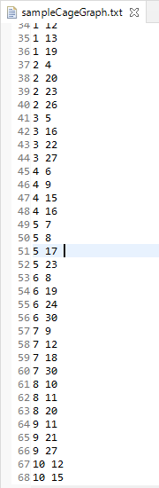
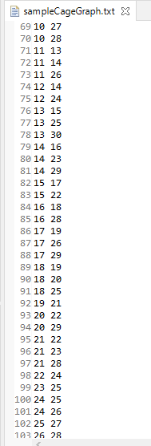

Input Graph in Code – Screenshot(Final)
Screenshot has all 30 vertices(1 to 30) and 75 edges

Slide 9
Backtracking
In Backtracking technique , we assign colors one by one to vertices .We color a single vertex and its adjacent vertex with different color.
Algorithm – Steps to color Graph
Different colors:
Confirm whether it is valid to color one of the current vertex with one of the color (by checking whether any of its adjacent vertices are colored with the same color).
If yes, then color it and otherwise color it with different color.
Check whether all vertices are colored or not.
If not, then take next adjacent uncolored vertex.
If no other color is available, then backtrack (i.e., un-color last colored vertex).
Here, backtracking means to stop further recursive calls on adjacent vertices by returning false

Slide 10
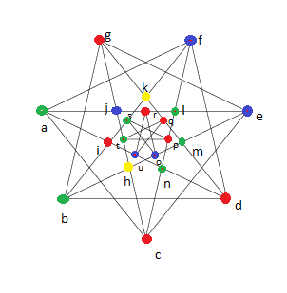
Backtracking results (Mid-term)
Output Image →
colored fully using four colors – 7vertices-Red , 5vertices- Blue , 7vertices-green , 2vertices-yellow (Side image shows colored graph)
Execution time- in Eclipse while running it took 165-172 millisecond to color the given graph. It includes graph creation as well.
Backtracking Time complexity: using backtracking is also kind of brute force approach. O(m^v) , where m is number of colors used , v vertices. , complexity is exponentially huge.

Slide 11
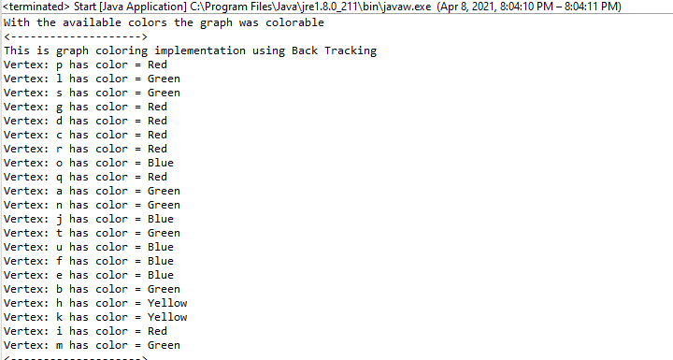
Screenshot BACKTRACKING- eclipse Console(mid-term)

Slide 12
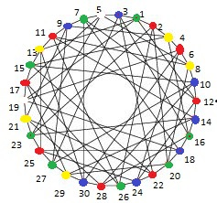
Backtracking results(FINAL)
Output Image →
colored fully using five colors – 8vertices-Red , 7vertices- Blue , 8vertices-green , 5vertices-yellow 2vertices-White(Side image shows colored graph)
Execution time- in Eclipse while running it took 950-970 millisecond to color the given graph. It includes graph creation as well.
Backtracking Time complexity: using backtracking is also kind of brute force approach. O(m^v) , where m is number of colors used , v vertices. , complexity is exponentially huge.

Slide 13
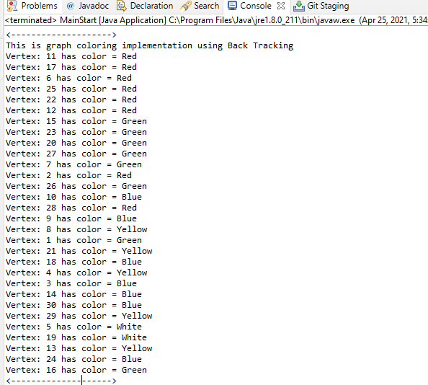
Screenshot BACKTRACKING- eclipse Console(FINAL)

Slide 14
Greedy Algorithm using DFS
Steps:
1.Color first vertex with first color.
2. Do below step for remaining V-1 vertices:
Consider current vertex(use DFS algorithm to traverse and color ) and color it with lowest numbered color that has not been used in previously adjacent vertices. If all previous used colors appear on adjacent vertices , assign new color.
Depth First Search (DFS) algorithm traverses a graph in a depth ward flow and uses a stack to get the next vertex to start a search, when a dead end occurs in any iteration.

Slide 15
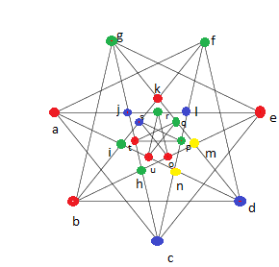
Greedy DFS results (MID-TERM)
Output graph →
colored fully using four colors – 7vertices-Red , 5vertices-Blue , 7vertices-green , 2vertices-yellow (Side image shows colored output graph)
Execution time- in Eclipse while running it took 120-130 millisecond to color the given graph . It includes creation of graph as well.
Greedy DFS Time complexity: O(v^2 + e) in worst case . This technique, not always use minimum colors as number of colors depend on the order vertex is processed.

Slide 16
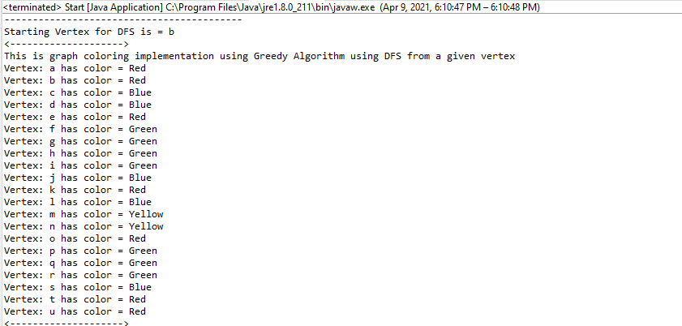
Screenshot Greedy DFS – Eclipse Console (MIDTERM)

Slide 17
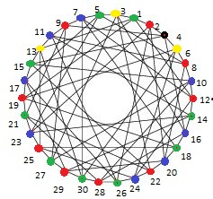
Greedy DFS results (FINAL)
Output graph →
colored fully using five colors – 9vertices-Red , 8vertices-Blue , 9vertices-green , 3vertices-yellow, 1vertex-Black(Side image shows colored output graph)
Execution time- in Eclipse while running it took 820-850 millisecond to color the given graph . It includes creation of graph as well.
Greedy DFS Time complexity: O(v^2 + e) in worst case . This technique, not always use minimum colors as number of colors depend on the order vertex is processed.

Slide 18
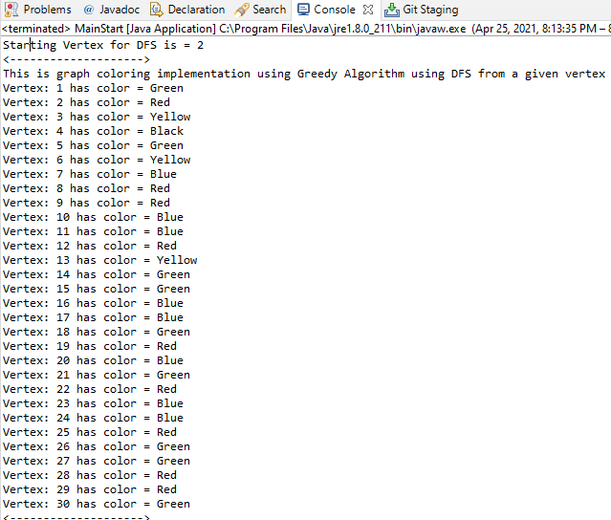
Screenshot Greedy DFS – Eclipse Console(FINAL)

Slide 19
Greedy Algo using BFS
Steps:
1.Color first vertex with first color.
2. Do below step for remaining V-1 vertices:
Consider current vertex(use BFS algorithm to traverse and color ) and color it with lowest numbered color that has not been used in previously adjacent vertices. If all previous used colors appear on adjacent vertices , assign new color.
Breadth First Search (BFS) algorithm traverses a graph in a breadth ward flow and uses a queue to remember to get the next vertex to start a search, when a dead end occurs in any iteration.

Slide 20
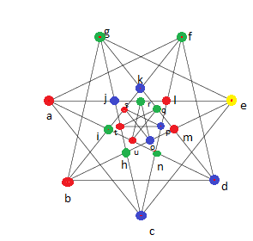
Greedy BFS results (mid-term)
Output Graph →
colored fully using four colors – 7vertices-Red ,6 vertices- Blue , 7 vertices-green , 1vertices-yellow (Side image shows colored output graph)
Execution time- in Eclipse while running it took 115-135 millisecond to color the given graph. It includes Graph creation as well.
Greedy BFS Time complexity: O(v^2 + e) in worst case . This technique, not always use minimum colors as number of colors depend on the order vertex is processed.

Slide 21
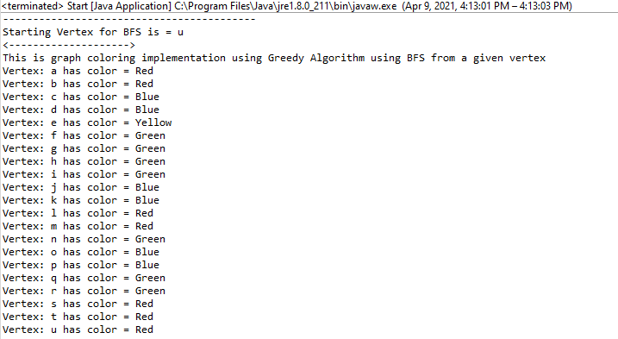
Screenshot Greedy BFS- Eclipse console(mid-term)

Slide 22
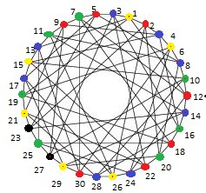
Greedy BFS results (FINAL)
Output Graph →
colored fully using five colors – 7vertices-Red ,8 vertices- Blue , 7 vertices-green , 6vertices-yellow ,2vertices-black(Side image shows colored output graph)
Execution time- in Eclipse while running it took 901-920 millisecond to color the given graph. It includes Graph creation as well.
Greedy BFS Time complexity: O(v^2 + e) in worst case . This technique, not always use minimum colors as number of colors depend on the order vertex is processed.

Slide 23
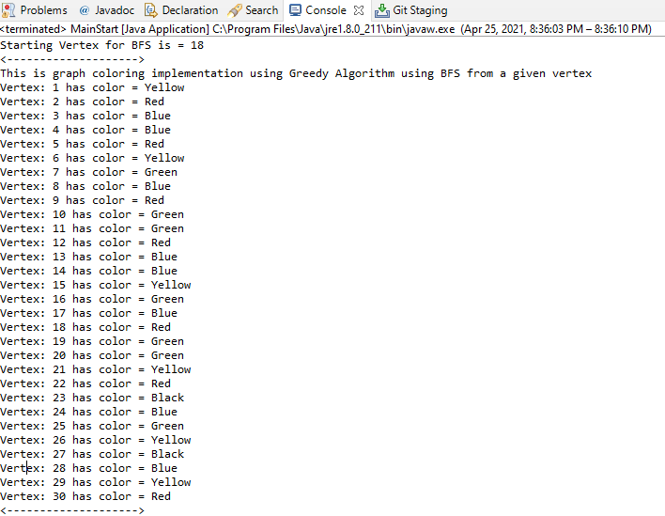
Screenshot Greedy BFS- Eclipse console(FINAL)

Slide 24
WELSH POWELL
Steps:
Step 1: All vertices are sorted in the decreasing value of their degree in a list V.
Step 2: Colors are ordered in a list C.
Step 3: The first non-colored vertex v in V is colored with the first available color in C. available means a color that was not previously used by the algorithm.
Step 4: The remaining part of the ordered list V is traversed, and the same color is allocated to every vertex for which no adjacent vertex has the same color.
Step 5: Steps 3 and 4 are applied iteratively until all the vertices have been colored.

Slide 25
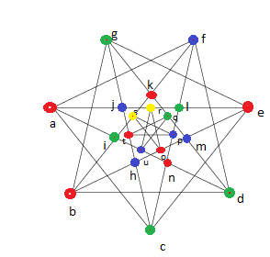
Welsh Powell results(mid-term)
Output Graph →
colored fully using four colors – 7vertices-Red , 6vertices-Blue , 6vertices-green , 2vertices-yellow(Side image shows colored graph)
Execution time- in Eclipse while running it took 52-80 millisecond to color the given graph. It includes Graph creation as well.
Welsh powell Run Time complexity: use at most deg(G)+1 colors, where deg(G) –largest degree in the graph.

Slide 26
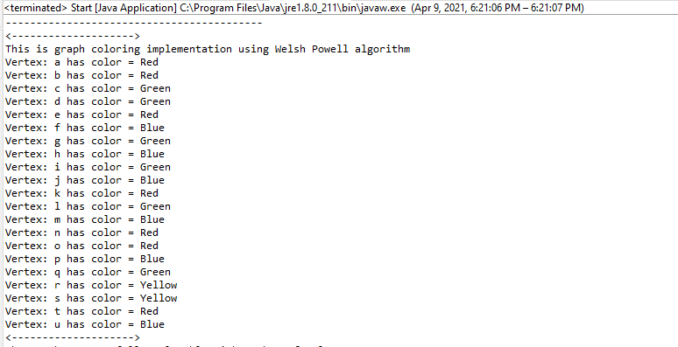

Screenshot Welsh-powell– Eclipse console(mid-term)

Slide 27
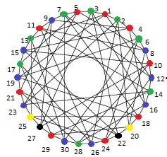
Welsh Powell results(FINAL)
Output Graph →
colored fully using five colors – 9vertices-Red , 9vertices-Blue , 8vertices-green , 2vertices-yellow, 2vertices-Black(Side image shows colored graph)
Execution time- in Eclipse while running it took 881-900 millisecond to color the given graph. It includes Graph creation as well.
Welsh powell Run Time complexity: use at most deg(G)+1 colors, where deg(G) –largest degree in the graph.

Slide 28
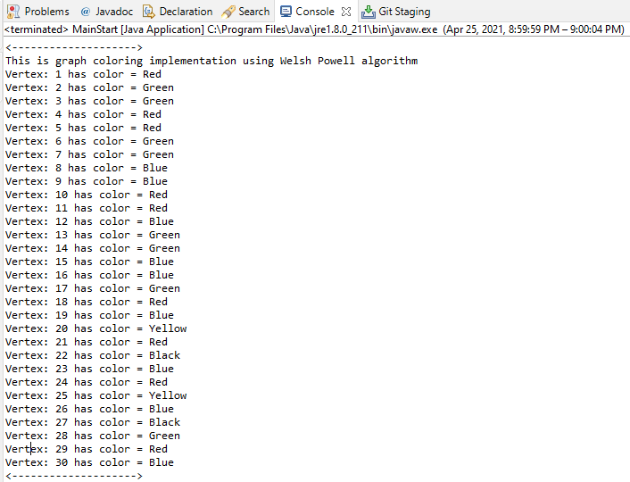
Screenshot Welsh-powell– Eclipse console(FINAL)

Slide 29
Degree of saturation- Dsatur Graph Coloring Algorithm
Pseudocode-
For the given graph 𝐺, the set of the vertices is described as 𝑉={𝑣1,𝑣2,…..,𝑣𝑛} and the set of the colors of the vertices is described as 𝑅={𝑟1,𝑟2,…,𝑟𝑘}. The steps of the DSATUR algorithm:
Step 1: The vertex degree of each vertex is calculated, and the vertices degrees are added to the degree set 𝐷𝑒𝑔(𝑣𝑖), such that 𝑖=1,2,…,𝑛.
Step 2: The uncolored vertex that has the largest degree in the degree set 𝐷𝑒𝑔(𝑣𝑖) is selected for coloring. The selected vertex is colored with first color. s
Step 3: Firstly, calculate the number adjacent vertices which are colored with different colors for every uncolored vertex. After that, the uncolored vertex whose number of adjacent vertices colored with different colors is the maximum is selected for coloring. If more than one vertex provide this condition, the vertex which has the largest degree among them is selected.
Step 4: Firstly, the selected vertex is tried to color with the colors in the color set. If the colors in the color set are not appropriate to color the vertex, a new color is defined. The new color is added to the color set and appointed to the selected vertex.
Step 5: If the uncolored vertex exists, it is returned to the step 3. Otherwise, the program is terminated.
In an empirical comparison by Lewis 2015, DSatur produced significantly better vertex colorings than the greedy algorithm on random graphs with edge probability p = 0.5 at varying number of vertices, while in turn producing significantly worse colourings than the Recursive Largest First algorithm

Slide 30
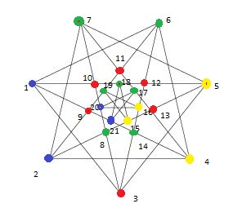
DsaTUR Results First GRAPH
Output Graph →
colored fully using five colors –Execution time- in Eclipse while running it took 12-15 millisecond to color the given graph.
Run Time complexity: Worst case complexity – O(n^2)
This input graph has all vertices with same degree is slightly hard to color using DSatur algorithm, got 4 to 5 conflicts. Manually resolved those conflicts.

Slide 31
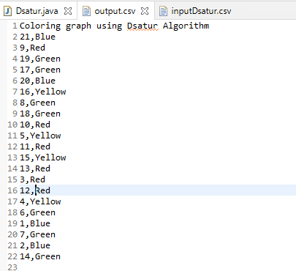
Screenshot from Dsatur ALGO Eclipse

Slide 32
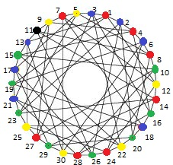
DsaTUR Results Second GRAPH
Output Graph →
colored fully using five colors –Execution time- in Eclipse while running it took 27-30 millisecond to color the given graph.
Run Time complexity: Worst case complexity – O(n^2)
This input graph has all vertices with same degree is slightly hard to color using DSatur algorithm, got 4 to 5 conflicts. Manually resolved those conflicts.

Slide 33
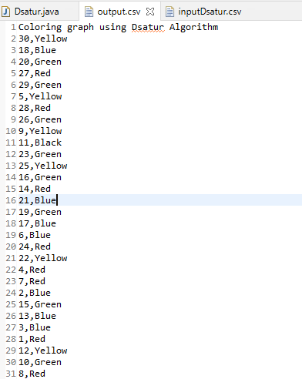
Screenshot from Dsatur ALGO Eclipse

Slide 34
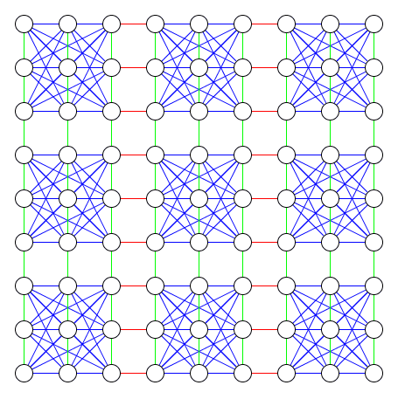
Sudoku Solver Application using graph coloring technique
A Sudoku puzzle can be taken as a graph (9*9) with 81 vertices, one for each cell, and two vertices are connected by an edge if they cannot be assigned the same value. For example - all cells in the same row, column will have edges between their corresponding vertices.
Each node (or cell) has an edge to every other node (cell) in its respective column, row, and 3 x 3 grid.
we can say that Sudoku puzzle can be viewed as Graph that can be solved by Graph Coloring with a Chromatic Number, G = 9.

Slide 35
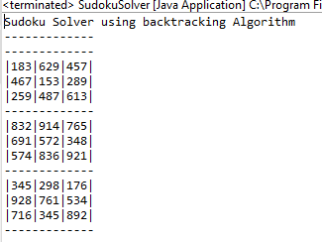
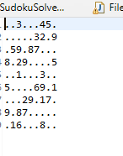
Sudoku solver results
Input-
Output-

Slide 36
Performance Comparison
Input graph | Backtracking Algorithm | Greedy BFS Algorithm | Greedy DFS Algorithm | Welsh-Powell Algorithm | DASTUR Algorithm
MIDTERM - Mycielski graph (21 vertices, 42 edges) Total time (graph creation + Algo implementation) | 165-172millisecond 7 vertices - red 7 vertices -green 5 vertices -blue 2 vertices -yellow | 115-135 millisecond 7 vertices -Red 7 vertices -Green 6 vertices -Blue 1 vertex – yellow | 120-130 millisecond 7 vertices - red 7 vertices -green 5 vertices -blue 2 vertices -yellow | 52-80 millisecond 7 vertices- Red 6 vertices –blue 6 vertices –green 2 vertices -yellow | 12-15 millisec 6vertices –Red 4vertices-blue 7vertices-green 4vertices-yellow
FINAL – Foster cage graph(30 vertices, 75 edges) Total time | 950-970 Millisecond 8 vertices – Red 7 vertices – Blue 8 vertices – Green 5 vertices – Yellow 2 vertices - White | 901-920Millisecond 7 vertices – Red 8 vertices – Blue 7 vertices – Green 6 vertices – Yellow 2 vertices - Black | 820-850Millisecond 9 vertices – Red 8 vertices – Blue 9 vertices – Green 3 vertices – Yellow 1 vertices - Black | 881-900millisecond 9 vertices – Red 9 vertices – Blue 8 vertices – Green 2 vertices – Yellow 2 vertices - Black | 27-30 millisec 8 vertices – Red 7 vertices-blue 8vertices-green 6vertices-yellow 1vertices-Black
Runtime Complexity | O(m^v) , where m is number of colors used , v vertices | O(v^2 + e) in worst case | O(v^2 + e) in worst case | at most deg(G)+1 colors | O(n^2) worst case

Slide 37
Conclusion (Mid-term)
1. While implementing Algorithm on input graph (21 vertices , 42 edges) we can see that Welsh Powell algorithm take less time than Greedy BFS ,Greedy DFS and Backtracking to color graph.
2. On doing runtime analysis of implemented algorithm – Welsh Powell is best technique to color graph as runtime for Welsh Powell depends on degree of graph which will be less than other implemented Algorithm (O(v^2 + e) , O(m^v) )
3.As different techniques shows different behavior when coloring different graph , it can show different execution time on another graph.

Slide 38
Conclusion (FINAL)
1. While implementing Algorithm on input graph (30 vertices , 75 edges) we can see that Greedy DFS & Welsh Powell algorithm take less time than Greedy BFS , Backtracking to color graph.
2. Dastur Algorithm implementation on first input graph(21vertices , 42 edges ) and second input graph(30 vertices , 75 edges) took less time than other algorithm. But it got 4 -5 conflicts.
3. On doing runtime analysis of implemented algorithm – Welsh Powell is best technique to color graph as runtime for Welsh Powell depends on degree of graph which will be less than other implemented Algorithm (O(v^2 + e) , O(m^v) , O(n^2) )
4.As different techniques shows different behavior when coloring different graph , it can show different execution time on another graph.

Slide 39
Tools/Software/Reference used
1.Eclipse IDE
2. Programming Language – JAVA
3. GitHub
Reference –
input graph- https://mathworld.wolfram.com/BrinkmannGraph.html
https://mathworld.wolfram.com/FosterCage.html
Algo ref- https://www.researchgate.net/publication/309585874_A_Performance_Comparison_of_Graph_Coloring_Algorithms
https://www.cs.cornell.edu/courses/cs3110/2012sp/recitations/rec21-graphs/rec21.html
https://www.researchgate.net/publication/221002648_Heuristic_methods_for_graph_coloring_problems

Slide 40
GitHub repo
https://github.com/versha-khare/GraphColoringImplementation
Above git hub link has Readme section , which has steps to import & run the source code.

