Slide 1
S.A.R.A Smart AI refrigeration assistant

Slide 2
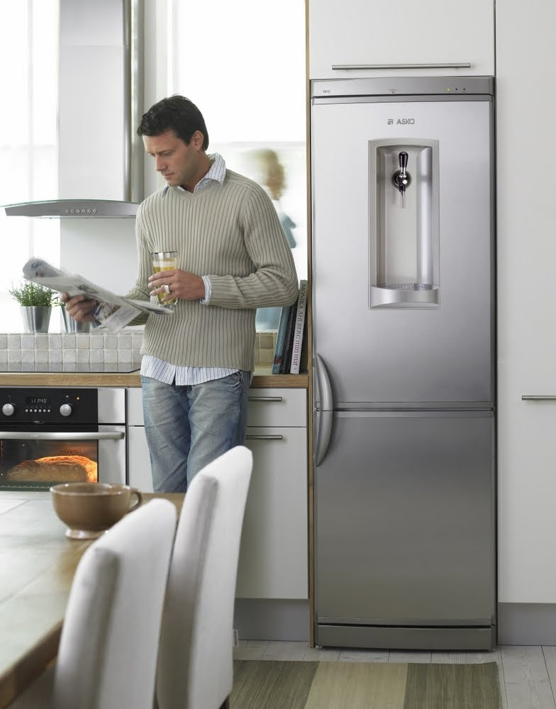
Project analysis slide 3
Project Overview
What is S.A.R.A?
Sara is an AI-powered fridge assistant, introducing a variety of smart features like recipe recommendation, decay-detection and grocery-tracking through AIML, web-scraping and OpenCV technologies.
This assistant can interact with the user through a progressive web application while the data processing is entirely cloud-based. The data required for the recommendation algorithm was acquired by leveraging the web scraping technologies. Its smart features include Recipe recommendation based on the availability of food-items inside the refrigerator, grocery-tracking to prevent excess stocking and alerting the user in case of prolonged storage to prevent food decay.
This Photo by Unknown Author is licensed under CC BY-SA-NC

Slide 3
Project analysis slide 2
Project Analysis
Prediction Algorithm
Scrapping the web
S.A.R.A
API Routing
Data Cleaning
Front End Prototype
Topic Modelling

Slide 4
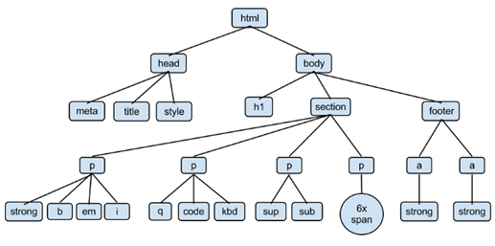
Web Scrapping
Manually generating a huge quantity of data would have consumed a lot of time, human effort and computational resources.
“BeautifulSoup”, a python-based web scraping library capable of automating the entire process of data extraction from the internet website efficiently out of XML and HTML files was used.
For S.A.R.A, the URLs of the three websites from which the data was extracted are as follows:
a. http://www.foodnetwork.com
b. http://allrecipes.com
c. http://www.epicurious.com

Slide 5
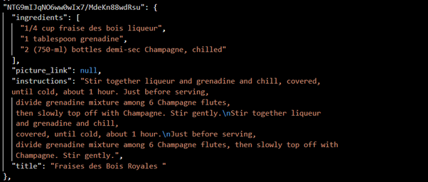
Web Scrapping
The tags that were extracted from these websites for each recipes are:
a. Ingredients
b. Instructions
Title
All these recipes were converted into JavaScript Object Notation and saved into the raw data file.
Example of a recipes inside the json file is given here.

Slide 6
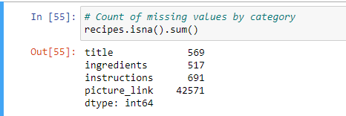
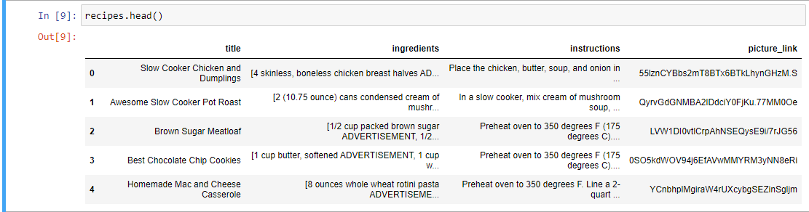
Data Cleaning
The Data acquired from the scrapping required cleaning before it can be used, some of the techniques used are:
Regex
Removing Null Rows
Removing non-alphabetic characters

Slide 7
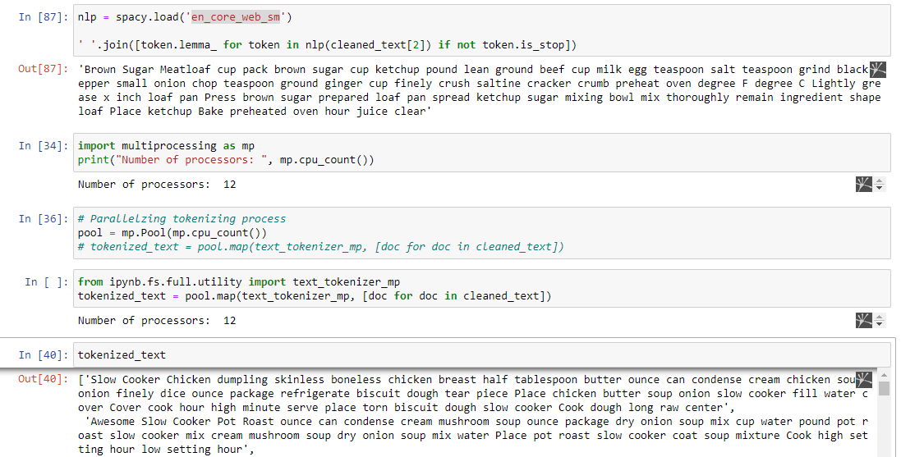
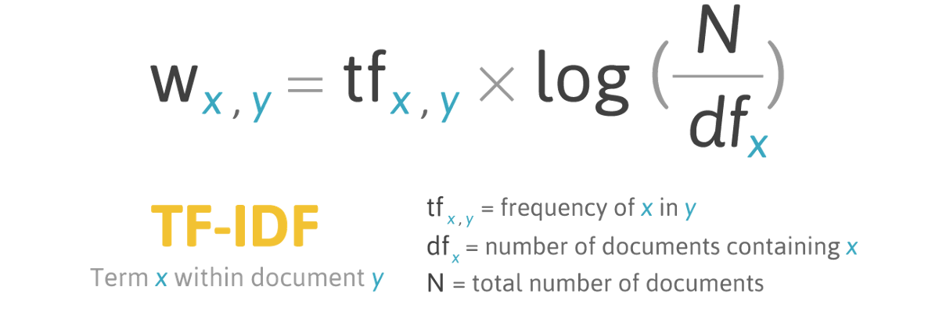
Topic Modeling
Before Data can be modelling into various topics, it was tokenized.
Tokenization is defined as an algorithm that breaks the raw text into words and sentences called tokens.
Conversion of these blocks of text into something quantitative is required to prepare prediction out of it, word embeddings are used just for the same.
This tokenized text was then used to generate word embeddings, using the TF-IDF vectorizer.

Slide 8
Project analysis slide 4
Topic Modelling
Topics
Raw Recipe Data
Cleaning
Tokenization
Keywords
Stage 1
Stage 2
Stage 3
Topic Modelling refers to the process of automatically identifying topics present in a text object and derive hidden patterns exhibited by text corpus. This allows better decision making, search engines and NLP applications to use word embeddings.
Documents

Slide 9
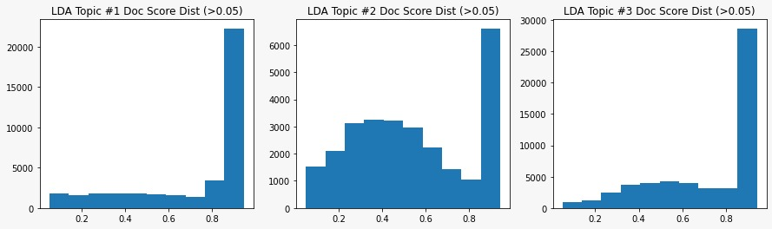
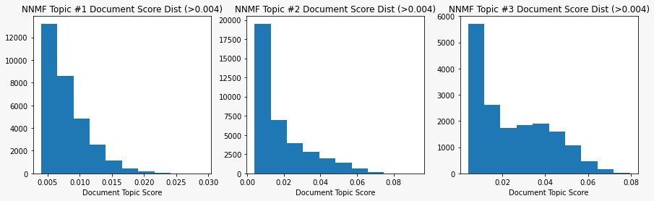
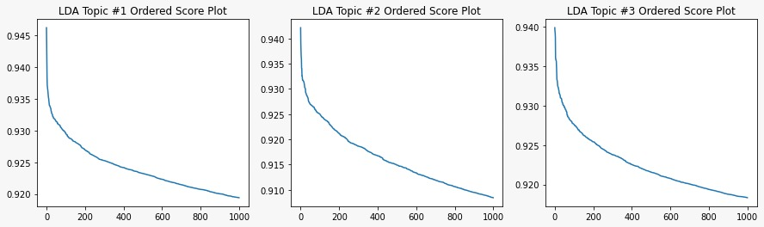
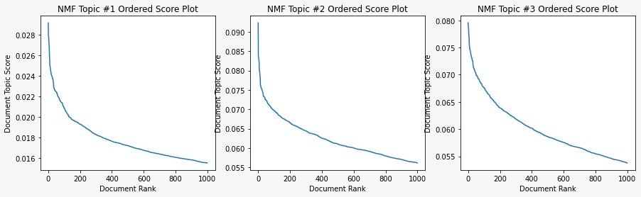
Project analysis slide 3
LDA vs NNMF
There are two algorithms that can be used for topic modelling which are well received by the community:
1. LDA: Latent Dirichlet Allocation
2. NNMF: Non-negative matrix factorization
LDA
NNMF
Choosing number of documents to which keywords are assigned
Choosing number of documents per topic from which keywords are pulled

Slide 10
Project analysis slide 5
Training Parameters
From the above observations, NNMF was chosen due to its distinction on topics. Also, the following parameters were chosen for training of the model
Number of topics per corpora
Number of top documents within each topic
Keywords to extract from each topic
50
200
25
Number of top docs per topic
The length of word-radius ( number of neighbors)
2000
4
Now the system must distribute weight between title, text, and categories to make the searching adequate.
The chosen weights for each of them are as follows:
• Weight for title: 0.2
• Weight for text: 0.3
• Weight for categories: 0.5

Slide 11
Thank You

