Slide 1
JAVA PROGRAMMING
2023/10/20 16:00 PM

Slide 2
Conditional Statements
Java Arrays
Java OOP

Slide 3
CONDITIONAL STATEMENTS
If-Else
Switch Case
Continue and Break
While Loop
For Loop
For Each
Nested Loop

Slide 4
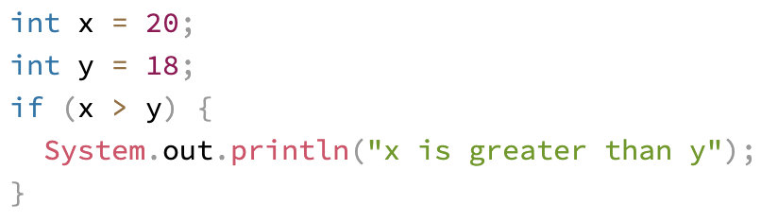
If-Else
if (condition) { // block of code to be executed if the condition is true }
if: specify a block of code to be executed, if a specified condition is true.
if is in lowercase letters. Uppercase letters (If or IF) will generate an error.

Slide 5
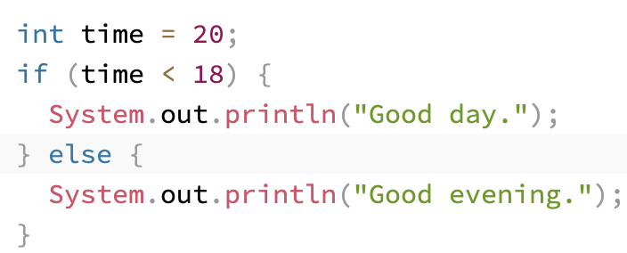
If-Else (cont.)
if (condition) {
// block of code to be executed if the condition is true
} else {
// block of code to be executed if the condition is false
}
else: specify a block of code to be executed, if the same condition is false.
When using else, there is no condition block.

Slide 6
If-Else (cont.)
if (condition1) {
// block of code to be executed if condition1 is true
} else if (condition2) {
// block of code to be executed if the condition1 is false and condition2 is true
} else {
// block of code to be executed if the condition1 is false and condition2 is false
}
else if: specify a new condition to test, if the first condition is false.
cf) Python - elif

Slide 7
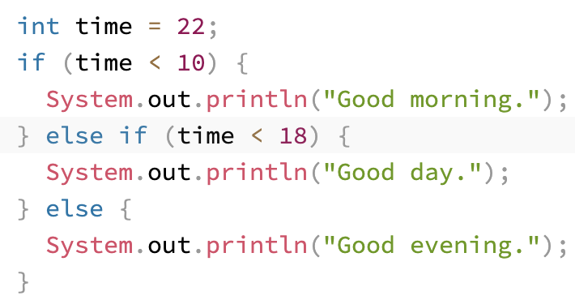
If-Else – Example
In the example above:
time (22) is greater than 10, so the first condition is false.
The next condition, in the else if statement, is also false.
So we move on to the else condition since condition1 and condition2 is both false.
⇒ print to the screen "Good evening"

Slide 8
Switch Case
switch(expression) {
case x:
// code block
break;
case y:
// code block
break;
default:
// code block
}
Instead of writing many if-else statements, you can use the switch statement.
The switch statement specifies many alternative blocks of code to be executed
It selects one of many code blocks to be executed.

Slide 9
Switch Case (cont.)
The switch expression is evaluated once.
The value of the expression is compared with the values of each case.
If there is a match, the associated block of code is executed.
The break and default keywords are optional. (will be described later)

Slide 10
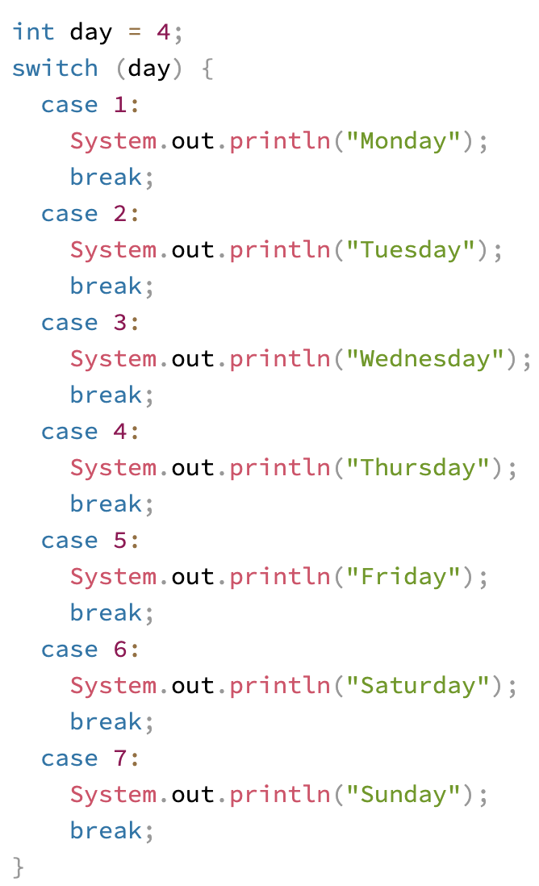
Switch Case – Example
The example uses the weekday number to calculate the weekday name.
day = 4 ⇒ prints “Thursday” to screen.

Slide 11
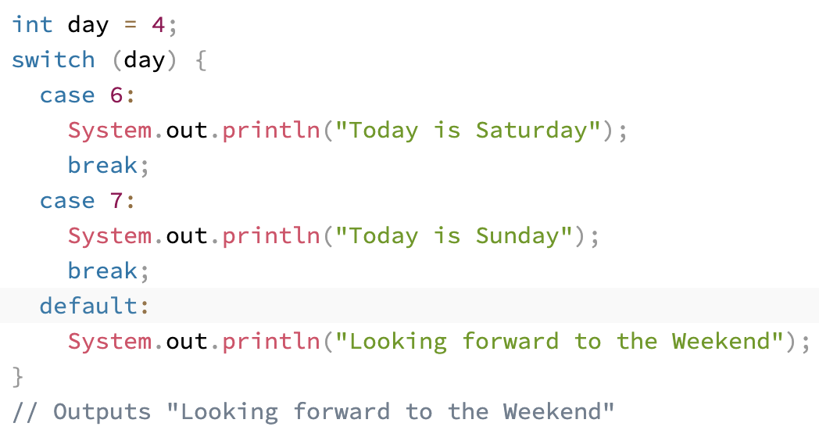
Switch Case – default
The default keyword specifies some code to run if there is no case match.
Note that if the default statement is used as the last statement in a switch block, it does not need a break.

Slide 12
Continue and Break
Break
When Java reaches a break keyword, it breaks out of the switch block.
The break statement can also be used to jump out of a loop.
This will stop the execution of more code and case testing inside the block.
When a match is found, and the job is done, it's time for a break. ⇒ There is no need for more testing.
A break can save a lot of execution time because it "ignores" the execution of all the rest of the code in the switch block.

Slide 13
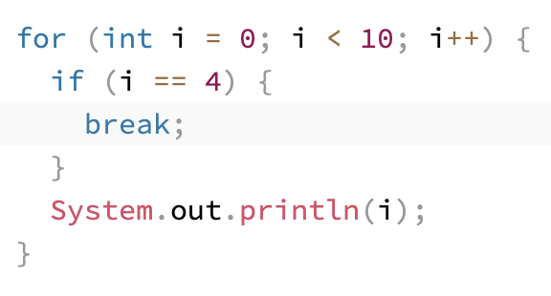

Continue and Break – Break Example 1
The for loop running when i == 4, code breaks the loop → does not run the print method → to jump out of the loop.

Slide 14
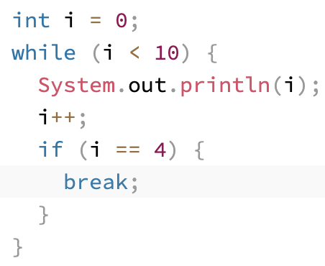

Continue and Break – Break Example 2
You can also use break in while loops.
In this example, when the variable i becomes 4, the while loop breaks.

Slide 15
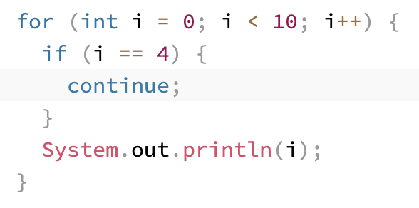

Continue and Break (cont.) – Continue Example 1
Continue
Breaks one iteration (in the loop), if a specified condition occurs, and continues with the next iteration in the loop.
This example the for loop will break one iteration when the value of i reaches 4.
Continues with the next iteration, i = 5, and prints number until 9.

Slide 16
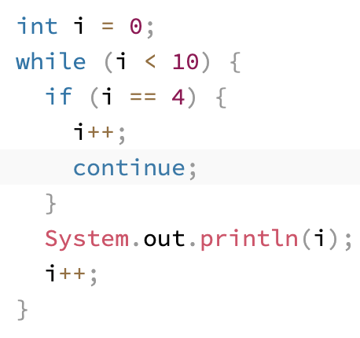

Continue and Break – Continue Example 2
You can also use continue in while loops.
In this example, when the variable i becomes 4, the inner loop continues and does not print on the console.

Slide 17
While Loop
while (condition) {
// code block to be executed
}
The while loop loops through a block of code as long as a specified condition is true.
Loops can execute a block of code as long as a specified condition is reached.
Loops are handy because they save time, reduce errors, and they make code more readable.
Do not forget to increase the variable used in the condition, otherwise the loop will never end.

Slide 18
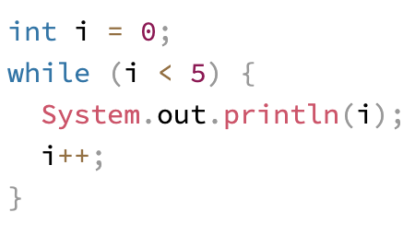

While Loop – Example
In the example, the code in the loop will run, over and over again, as long as a variable (i) is less than 5.

Slide 19
For Loop
for (statement 1; statement 2; statement 3) {
// code block to be executed
}
When you know exactly how many times you want to loop through a block of code, use the for loop instead of a while loop.
Statement 1 : executed (one time) before the execution of the code block.
Statement 2 : defines the condition for executing the code block.
Statement 3 : executed (every time) after the code block has been executed.

Slide 20
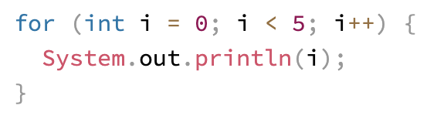
For Loop – Example 1
The example will print the numbers 0 to 4. (0 1 2 3 4)
① Statement 1 sets a variable before the loop starts (int i = 0).
② Statement 2 defines the condition for the loop to run (i must be less than 5). If the condition is true, the loop will start over again, if it is false, the loop will end.
③ Statement 3 increases a value (i++) each time the code block in the loop has been executed.

Slide 21
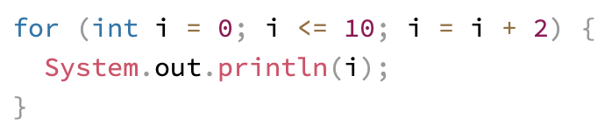
For Loop – Example 2
This example will only print even values between 0 and 10: (0 2 4 6 8 10)
① Statement 1 sets a variable before the loop starts (int i = 0).
② Statement 2 defines the condition for the loop to run (i must be less or same as 10). If the condition is true, the loop will start over again, if it is false, the loop will end.
③ Statement 3 increases a value (i+2) each time the code block in the loop has been executed.

Slide 22
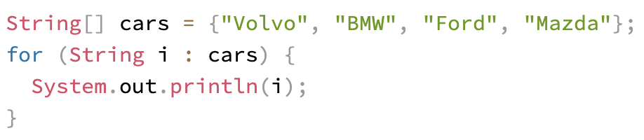
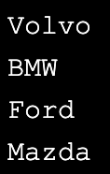
For Each Loop
for (type variableName : arrayName) {
// code block to be executed
}
For-each loop is used exclusively to loop through elements in an array.
The following example outputs all elements in the cars array.

Slide 23
Nested Loop
// Outer Loop
for (statement 1; statement 2; statement 3) {
// code block to be executed
// Inner Loop
for (statement 1; statement 2; statement 3) {
// code block to be executed
}
}
It is also possible to place a loop inside another loop.
The "inner loop" will be executed one time for each iteration of the "outer loop”.

Slide 24
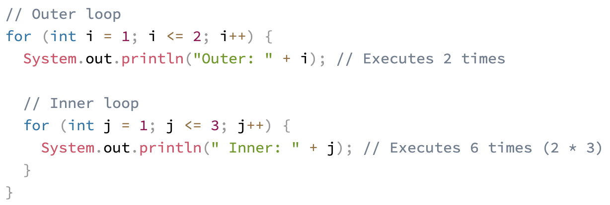
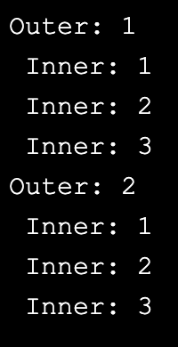
Nested Loop – Example
In this example:
Outer loop runs 2 times.
Inner loop runs 3 times per one outer loop execution.

Slide 25
JAVA ARRAYS
Java Arrays
Java Arrays Loop
Java Array Types

Slide 26
Java Arrays
type[] arrayName;
type[] arrayName = new type[arraySize];
An object of homogeneous collection of variables.
immutable
access an array element by referring to the index number. (starts from [0])
can handle a large amount of data by iteration. (for loop)
arrayName.length: returns the number of size of the array in int type

Slide 27
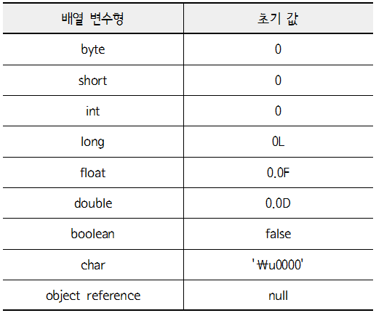
Java Arrays (cont.)
int[] intArr = new int[5];
int[] myNum = {10, 20, 30, 40};
String[] cars = {"Volvo", "BMW", "Ford", "Mazda"};
Declaration and initialization can be done together in one line of code.
Default value of array:

Slide 28
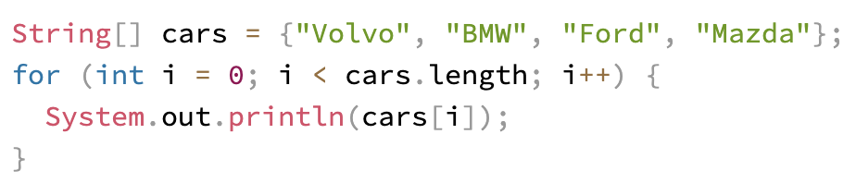
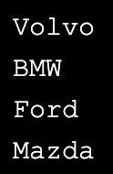
Java Arrays Loop
Loop Through an Array
Loop through the array elements with the for loop
Use the length property to specify how many times the loop should run.
Example:

Slide 29
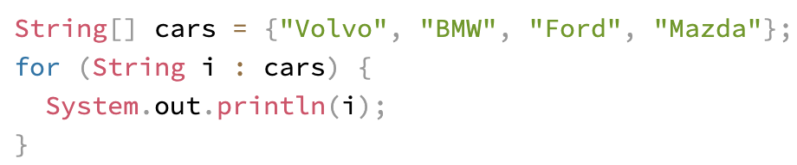
Java Arrays Loop (cont.)
Loop Through an Array with For-Each
Use "for-each" loop, which is used exclusively to loop through elements in arrays:
Example:
for each String element (called i - as in index) in cars, print out the value of i.
for (type variable : arrayname) {
...
}

Slide 30
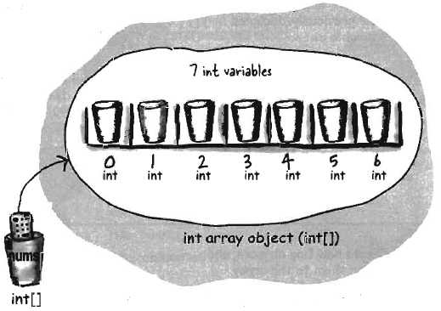
Java Array Types
Array of Primitive Types
① Declare an int array variable. ② Create an int array with a length, and assign it to the previously declared variable.
③ Give each element in the array an int value. ※ elements in an array are just variables!

Slide 31
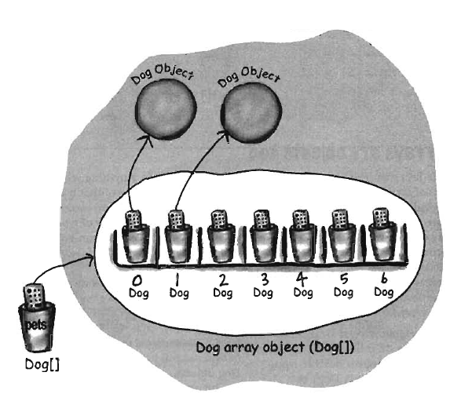
Java Array Types (cont.)
Array of Objects
① Declare an array variable. ② Create an object array with a length, and assign it to the previously declared variable.
③ Create new objects, and assign them to the array elements.

Slide 32
Java Array Types (cont.)
Accessing an object in an array
Typically use dot notation (.) to access object’s instance variable and methods.
If an object is in an array, there is no actual reference variable. ⇒ Need to use array notation.
Dog[] myDogs = new Dog[3];
myDogs[0] = new Dog();
myDogs[0].name = “Fido”;
myDogs[0].bark();

Slide 33
Java Array Types – Test
< 애완동물 키우기 프로그램 >
1. 클래스 구조
- 애완동물 이름 (String)
- 애완동물 개월 수 (int)
- 애완동물 종류 (String)
- 애완동물이 배고픈지 (boolean)
2. 메뉴 (애완동물은 최대 5마리까지 등록 가능)
1) Pet 등록하기
- 등록된 애완동물이 5마리를 초과할 경우, "더 이상 기를 수 없습니다!"를 출력
- 이름, 개월 수, 종류 입력 받기
- 배고픔은 기본으로 true (배고픈 상태가 기본 상태)
2) Pet 정보 보기
- 모든 동물의 정보를 출력
- 현재 어떤 동물이 배고픈지 이름 출력
- 평균 개월 수 출력
3) Pet 밥 주기
- 누구에게 밥을 주겠습니까? (이름 입력)
- 해당 이름을 가진 애완동물의 배고픔 상태 false로 변경
4) 종료하기
- "**, ㅁㅁ, ㅇㅇ, ㅎㅎ (애완동물들 이름)이가 슬퍼합니다. 그래도 가실거예요?"
출력 후 "예"를 입력 받으면 프로그램 종료
Notes:
come back later after class instantiation

Slide 34
JAVA OOP
Java OOP
Java Class
Java Objects
Java Methods
Java Constructors
Java Modifiers
Garbage Collection

Slide 35
Java OOP
Procedural programming is about writing procedures or methods that perform operations on the data.
Object-oriented programming is about creating objects that contain both data and methods.
The "Don't Repeat Yourself" (DRY) principle is about reducing the repetition of code. You should extract out the codes that are common for the application, and place them at a single place and reuse them instead of repeating it.

Slide 36
Java OOP (cont.)
Object-oriented programming has several advantages over procedural programming:
OOP is faster and easier to execute.
OOP provides a clear structure for the programs.
OOP helps to keep the Java code DRY "Don't Repeat Yourself", and makes the code easier to maintain, modify and debug.
OOP makes it possible to create full reusable applications with less code and shorter development time.

Slide 37
Java OOP (cont.)
Java is an object-oriented programming language.
Everything in Java is associated with classes and objects, along with its attributes and methods.
For example: in real life, a car is an object.
The car has attributes, such as weight and color.
The car has methods, such as drive and brake.

Slide 38
Java Class
A class is like an object constructor, or a "blueprint" for creating objects.
An object is created from a class.
To create a class, use the keyword class.
To create an object of a class, specify the class name, followed by the object name, and use the keyword new.

Slide 39
Java Class (cont.)
Main Class: The class containing the main class of the Java program.
One Java program can consist of several classes, but should contain one main method.

Slide 40
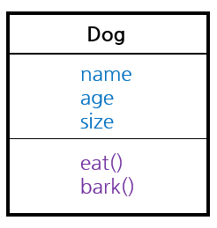
Java Class (cont.)
A class consists of variables and methods.
instance variables
methods

Slide 41
Java Class (cont.)
A class is like a blueprint. ⇒ Every object is created from a specific class.
CLASS
Instance variable
methods
OBJECT
OBJECT
OBJECT
Instance variable
Instance variable
Instance variable
methods
methods
methods

Slide 42
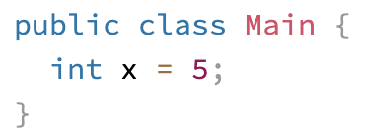
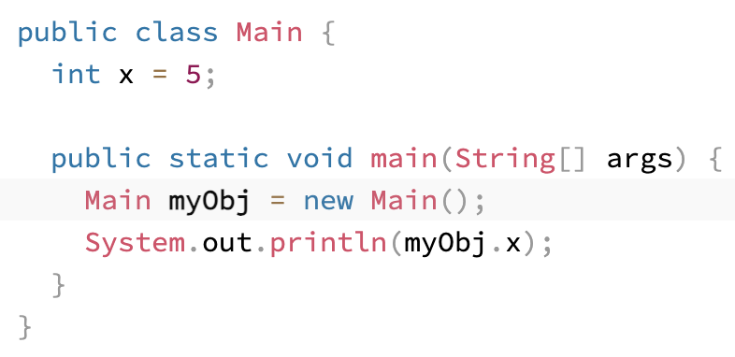

Java Class – Example
Create a class called “Main” with a variable x:
Create an object called "myObj" and print the value of x:

Slide 43



Java Objects
An object is created from a class.
To create an object of a class, specify the class name, followed by the object name, and use the keyword new.
className() ⇒ class constructor
Dog myDog = new Dog();
keyword for creating an object
Object reference 변수 선언: Dog myDog
Object 생성: new Dog()
Object와 reference 연결: =
reference 유형과 object 유형이 같아야 함

Slide 44
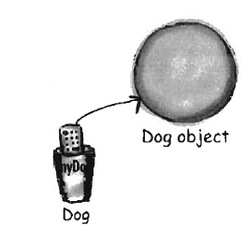

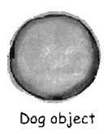
Java Objects (cont.)
Object · Instance vs Reference
Dog myDog = new Dog();
① Declare a reference variable Dog myDog
② Create an object new Dog()
③ Link the object and the reference =

Slide 45
Java Objects (cont.)
Object
knows: instance variables
does: methods
name = “choco”
age = 3
size = 1
name = “happy”
age = 7
size = 4
name = “toto”
age = 9
size = 3
eat()
bark()
eat()
bark()
eat()
bark()

Slide 46
Java Objects (cont.)
Accessing Attributes and Methods
use dot notation (.)
objectName.instanceVariable
objectName.method( )
Example:
myDog.name
myDog.age = 3;
myDog.bark(); ⇒ 멍멍!

Slide 47
Java Methods
A method is a block of code which only runs when it is called.
You can pass data, known as parameters, into a method.
Methods are used to perform certain actions.
Why use methods? ⇒ To reuse code: define the code once, and use it many times.

Slide 48
Java Methods (cont.)
Method Naming Conventions
Use verbs that represent the actual function of the method.
Use camel-case, start with an upper-case letter without blanks.
ex) my_first_method( ) → myFirstMethod( )
Return Type
The data type of the result of running a method.
One method returns only one value.

Slide 49
Java Methods (cont.)
Create a Method
A method must be declared within a class.
It is defined with the name of the method, followed by parentheses ( ).
Java provides some pre-defined methods, such as System.out.println().
You can also create your own methods to perform certain actions.

Slide 50
Java Methods (cont.)
Create a Method
public class className {
static void methodName( ) {
// code to be executed
}
}
methodName( ): the name of the method
static : means the method belongs to the Main class and is not an object.
void : means that this method does not have a return value.

Slide 51
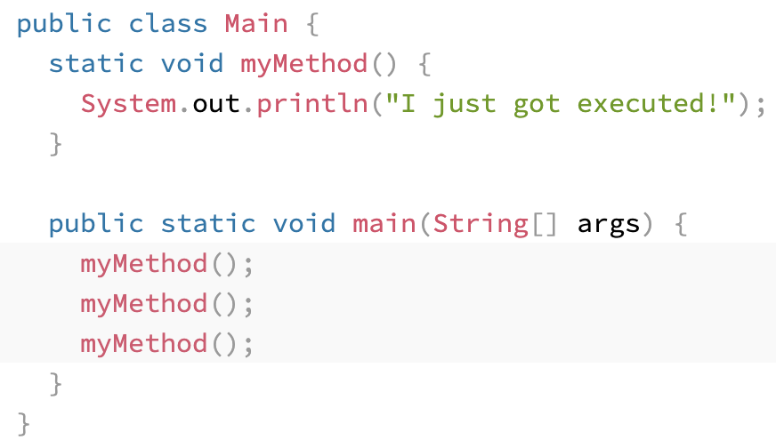
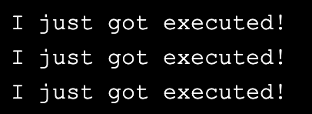
Java Methods (cont.)
Call / Invoke a Method
To call a method in Java, write the method's name followed by two parentheses () and a semicolon ;
A method can also be called multiple times.

Slide 52
Java Methods (cont.)
Parameters and Arguments
Information can be passed to methods as parameter.
Parameters act as variables inside the method.
Parameters are specified after the method name, inside the parentheses ( ).
You can add as many parameters as you want, just separate them with a comma.
When a parameter is passed to the method, it is called an argument.

Slide 53
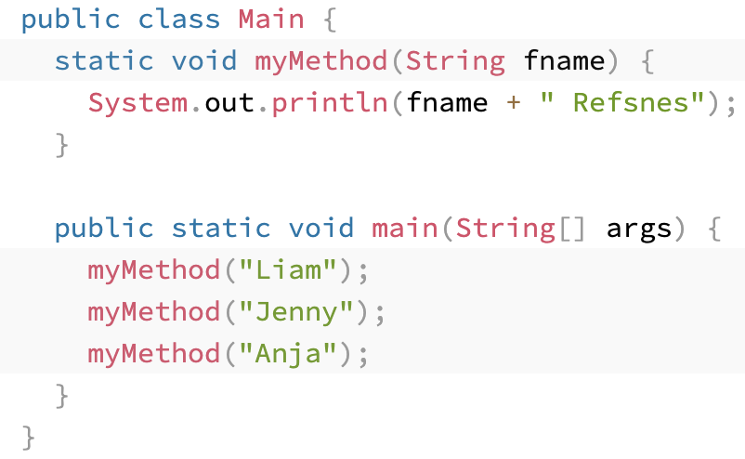
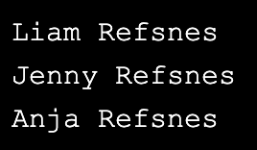
Java Methods – Example 1
This example has a method that takes a String called fname as parameter.
When the method is called, we pass along a first name, which is used inside the method to print the full name.
fname is a parameter, while Liam, Jenny and Anja are arguments.

Slide 54
Java Methods (cont.)
Multiple Parameters
You can have as many parameters in a method as you like:
When working with multiple parameters, the method call must have the same number of arguments as there are parameters, and the arguments must be passed in the same order.

Slide 55
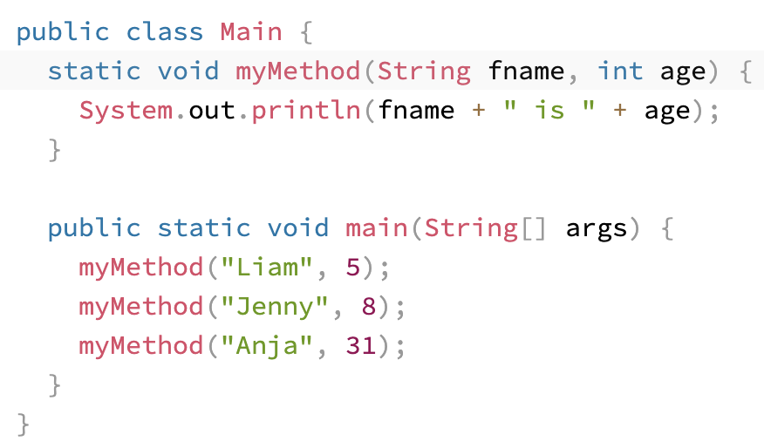
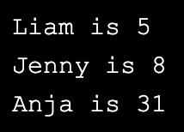
Java Methods – Example 2

Slide 56
Java Methods – Return Values
The void keyword indicates that the method should not return a value.
If you want the method to return a value ⇒ use a primitive data type (such as int, char, etc.) instead of void. And use the return keyword inside the method.

Slide 57
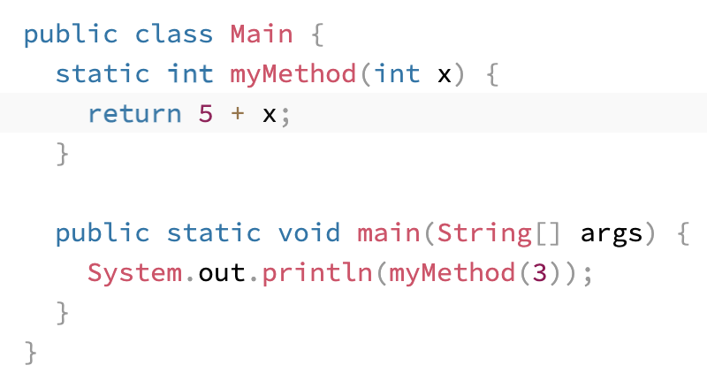

Java Methods – Return Values (Example 1)
This example returns the sum of a method's parameter (x) and 5.

Slide 58
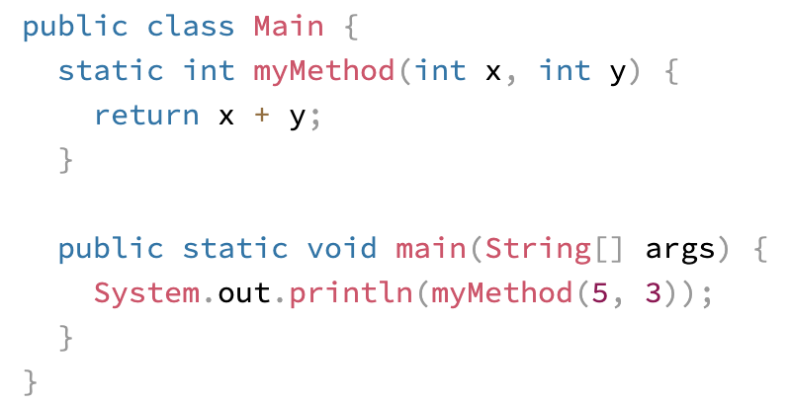

Java Methods – Return Values (Example 2)
This example returns the sum of a method's two parameters (x, y).

Slide 59
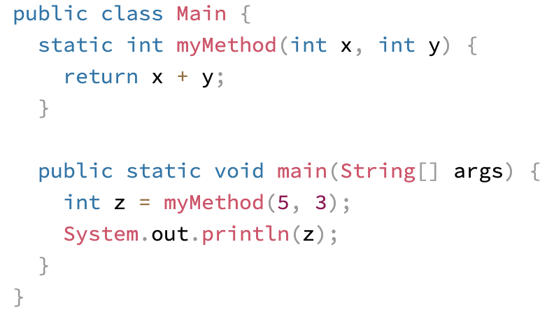

Java Methods – Return Values (Example 3)
You can also store the result in a variable. (recommended, as it is easier to read and maintain)
This example binds int z with the return value of myMethod(5, 3)

Slide 60
Java Methods – Test 1
별 출력
Scanner를 이용하여 숫자 5을 입력받으면 별 5개를 출력하는 method 생성.
한 class file 내에서 method 생성, main method 내에서 작성한 method 실행.
static 키워드 사용 필수!
public class D_Method_Test_01 {
static void starMaker(int a) {
//
}
public static void main(String[] args) {
Scanner sc = new Scanner(System.in);
int a = sc.nextInt();
starMaker(a);
}
}

Slide 61
Java Methods – Test 2
<학생 마라톤 기록>
가장 기록이 좋은 학생을 찾아서 그 학생의 이름과 마라톤 기록을 몇 시간 몇 분(예, 4시간 15분)의 형식으로 출력하기
String [] names = {"초코", "해피", "또또", "양파", "계피", "소금", "감자", "쫑쫑", "메리", "냥냥", "야옹", "냐옹", "시츄", "포메", "요키", "말티"}
int [] times = {341, 273, 278, 329, 445, 402, 388, 275, 243, 334, 412, 393, 299, 343, 317, 265}
- 배열을 입력으로 취해, 최단 기록 보유 학생에 대응하는 인덱스를 찾고, 그에 대응하는 인덱스, 시간, 분을 배열로 리턴하는 메소드를 작성
- 그 인덱스에 해당하는 이름을 출력 (main)
- 이 메소드를 각 학생의 기록으로 이루어진 배열에 적용하여 실행
- 반환된 배열을 통해 이름과 시간을 출력

Slide 62
Java Methods – Test 2 (cont.)
public class Marathon {
public int[] findSmallest(int[] arr){
return [];
}
public int[] findBiggest(){
//
}
public static void main(String [] args){
//names, times 배열 임의 지정
A a = new A();
int[] final = a.findSmallest(times);
String finalName = names[final[0]]
System.out.println(finalName)
System.out.println(final[1]+ “시간” + final[2] + “분”);
}
}

Slide 63
Java Constructors
A constructor in Java is a special method that is used to initialize objects.
The constructor is called when an object of a class is created.
The constructor name must match the class name, and cannot have a return type
It can be used to set initial values for object attributes.
The constructor is called when the object is created.
All classes have constructors by default: if you do not create a class constructor yourself, Java creates one for you.

Slide 64
Java Constructors – Example
public class Main {
int x;
public Main() {
x = 5;
}
public static void main(String[] args) {
Main myObj = new Main();
System.out.println(myObj.x); }
}
Create a Main Class with a class attribute int x.
Create a class constructor for the Main class Main( )
Create an object of class Main ⇒ call the constructor

Slide 65

Java Modifiers
Access Modifiers: controls the access level
Non-Access Modifiers: do not control access level, but provides other functionality
The public keyword is an access modifier, meaning that it is used to set the access level for classes, attributes, methods and constructors.

Slide 66
Java Modifiers (cont.)
Access Modifiers
For classes, you can use either public or default:
Modifier | Description
public | The class is accessible by any other class.
default | The class is only accessible by classes in the same package. This is used when you don't specify a modifier.

Slide 67
Java Modifiers (cont.)
Access Modifiers
For attributes, methods and constructors, you can use the one of the following:
Modifier | Description
public | The code is accessible by any other class.
private | The code is only accessible within the declared class.
default | The code is only accessible in the same package. This is used when you don't specify a modifier.
protected | The code is accessible in the same package and subclasses.

Slide 68
Java Modifiers (cont.)
Non-Access Modifiers
For classes, you can use either final or abstract:
Modifier | Description
final | The class cannot be inherited by other classes.
abstract | The class cannot be used to create objects. (To access an abstract class, it must be inherited from another class.)

Slide 69
Java Modifiers (cont.)
Non-Access Modifiers
For attributes and methods, you can use the one of the following:
Modifier | Description
final | Attributes and methods cannot be overridden/modified,
static | Attributes and methods belongs to the class, rather than an object.
abstract | Can only be used in an abstract class, and can only be used on methods. The method does not have a body. The body is provided by the subclass (inherited from).

Slide 70
Java Modifiers (cont.)
final
If you don't want the to override existing attribute values, declare attributes as final.
myObj.x = 50; will generate an error: cannot assign a value to a final variable
myObj.PI = 25; will generate an error: cannot assign a value to a final variable
public class Main {
final int x = 10;
final double PI = 3.14;
public static void main(String[] args) {
Main myObj = new Main();
myObj.x = 50;
myObj.PI = 25;
System.out.println(myObj.x);
}
}

Slide 71
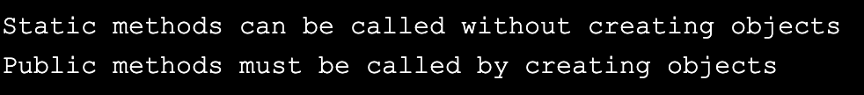
Java Modifiers (cont.)
static
A static method means that it can be accessed without creating an object of the class, unlike public.
public class Main {
static void myStaticMethod() { // Static method
System.out.println("Static methods can be called without creating objects");
}
public void myPublicMethod() { // Public method
System.out.println("Public methods must be called by creating objects");
}
public static void main(String[ ] args) { // Main method
myStaticMethod(); // Call the static method
// myPublicMethod(); // This would output an error
Main myObj = new Main(); // Create an object of Main
myObj.myPublicMethod(); // Call the public method
}
}

Slide 72
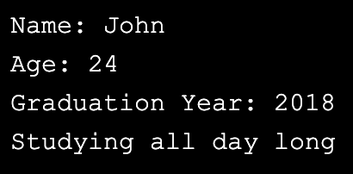

Java Modifiers (cont.)
abstract
An abstract method belongs to an abstract class, and it does not have a body.
The body is provided by the subclass:
// Main.java - abstract class abstract class Main {
public String fname = "John";
public int age = 24;
public abstract void study(); //abstract method
}
// Subclass (inherit from Main)
class Student extends Main {
public int graduationYear = 2018;
public void study() { // the body of the abstract method
System.out.println("Studying all day");
}
}
// Second.java
class Second {
public static void main(String[] args) {
// create an object of the Student class // inherits attributes· methods from Main
Student myObj = new Student();
System.out.println("Name: " + myObj.fname);
System.out.println("Age: " + myObj.age);
System.out.println("Graduation Year: " + myObj.graduationYear);
myObj.study(); // call abstract method }
}

Slide 73
Java Final Test – Student.java, Student_Info.java
<학생 정보 프로그램 생성>
* 메인 메소드용 클래스 1개, 설계용 클래스 1개
1. 설계용 클래스
- 이름, 국어, 영어, 수학점수, 총점, 평균, 등급
2. 메인용 클래스
ex) 객체생성 방법 = person s1 = new person();
menu: while (true) {
switch( ) {
case 1: 학생 정보 입력
- 이름, 국영수를 입력
- 총점, 평균, 등급 계산하여 객체에 저장
- 평균 90 이상 : A
80 이상 90 이하 : B
70 이상 80 이하 : C
60 이상 70 이하 : D
60 미만 : F
case 2: 학생 정보 출력
- 이름, 평균, 등급 출력
case 3: 결과 보기
- 평균이 85.5 이상이면 합격/ 미만이면 불합격
case 4: 종료 하기
break menu;
default:
- "오류" 출력
}
}

Slide 74


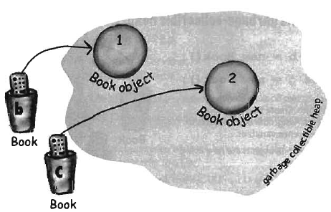
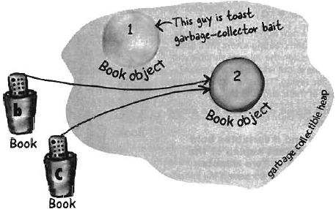
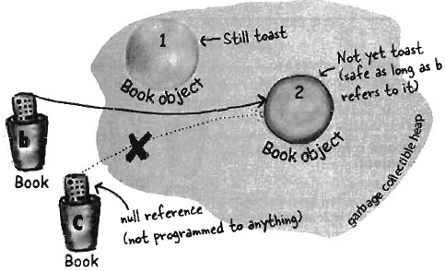
Garbage Collection
Garbage Collection tracks each and every object available in the JVM heap space, and removes the unused ones.
Basically, Garbage Collection works in two simple steps, known as Mark and Sweep:
Mark – garbage collector identifies which pieces of memory are in use and which aren’t.
Sweep – removes objects identified during the “mark” phase.
레퍼런스가 없는 객체 (1)는 가비지 컬렉션의 대상

Slide 75
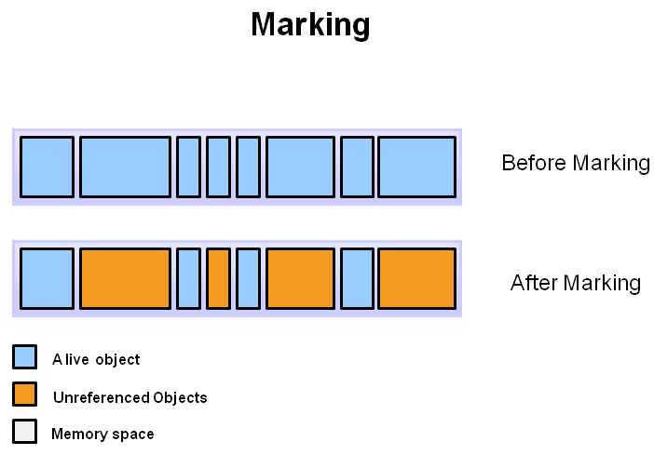
Garbage Collection (cont.)
Marking
This is where the garbage collector identifies which pieces of memory are in use and which are not.
Referenced objects are shown in blue.
Unreferenced objects are shown in gold.
All objects are scanned in the marking phase to make this determination.

Slide 76
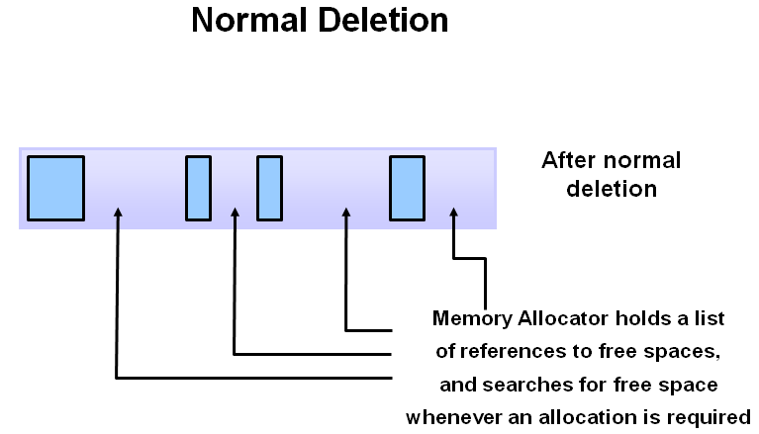
Garbage Collection (cont.)
Normal Deletion
Normal deletion removes unreferenced objects leaving referenced objects and pointers to free space.
The memory allocator holds references to blocks of free space where new object can be allocated.

