Slide 1


TensorFlow Ops
Introduction to TensorFlow
18/05/2017

Slide 2
Agenda
Constants, variables and basic operations
Tensor types
Placeholders and feeding inputs
Lazy loading

Slide 3
Go to Git
https://github.com/vertcli/pervasive_academy_introduction_tensorflow

Slide 4

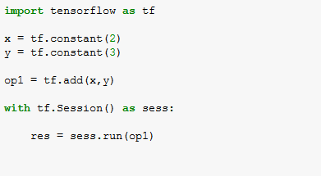
Your first TensorFlow program

Slide 5
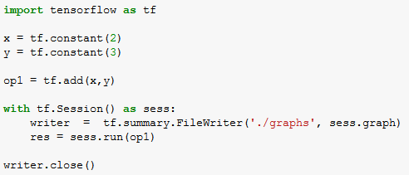
Visualize it with TensorBoard!

Slide 6
Run your program
Go to terminal, run:
$ tensorboard --logdir="./graphs" --port 6006
Then open your browser and go to: http://localhost:6006/

Slide 7
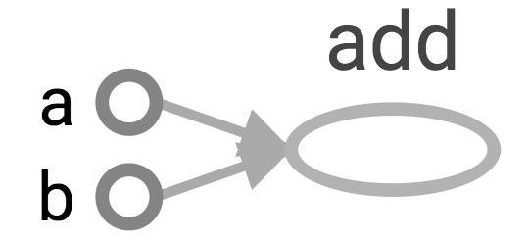
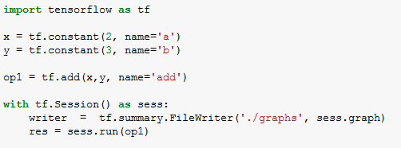
Explicitly name them

Slide 8
Learn to use TensorBoard well and often.
It will help a lot when you build complicated models.

Slide 9
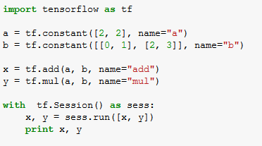
Constants
tf.constant(value, dtype=None, shape=None, name='Const', verify_shape=False)
>> [5 8] [6 12]

Slide 10
Tensors filled with a specific value
tf.zeros(shape, dtype=tf.float32, name=None)
(Similar to numpy.zeros)
more compact than other constants in the graph def
→ faster startup (esp.in distributed)

Slide 11
Tensors filled with a specific value
tf.zeros_like(input_tensor, dtype=None, name=None, optimize=True)
(Similar to numpy.zeros_like)
Creates a tensor of shape and type (unless type is specified) as the input_tensor but all elements are zeros.

Slide 12
Tensors filled with a specific value
tf.ones(shape, dtype=tf.float32, name=None)
(Similar to numpy.ones)

Slide 13
Tensors filled with a specific value
tf.ones_like(input_tensor, dtype=None, name=None, optimize=True)
(Similar to numpy.ones_like)
Creates a tensor of shape and type (unless type is specified) as the input_tensor but all elements are ones.

Slide 14
Tensors filled with a specific value
tf.fill(dims, value, name=None)
(In numpy: Create an array ‘a’ and then use a.fill(value))
Creates a tensor filled with a scalar value

Slide 15
Constants as sequences
tf.linspace(start, stop, num, name=None) # slightly different from np.linspace
tf.linspace(10.0, 13.0, 4) ==> [10.0 11.0 12.0 13.0]
tf.range(start, limit=None, delta=1, dtype=None, name='range')
tf.range(3, 18, 3) ==> [3, 6, 9, 12, 15]
tf.range(limit=5) ==> [0, 1, 2, 3, 4]
Tensor objects are not iterable:
for _ in tf.range(4): # TypeError

Slide 16
Randomly generated constants
tf.random_normal(shape, mean=0.0, stddev=1.0, dtype=tf.float32, seed=None, name=None)
tf.truncated_normal(shape, mean=0.0, stddev=1.0, dtype=tf.float32, seed=None, name=None)
tf.random_uniform(shape, minval=0, maxval=None, dtype=tf.float32, seed=None, name=None)
tf.random_shuffle(value, seed=None, name=None)
tf.random_crop(value, size, seed=None, name=None)
tf.multinomial(logits, num_samples, seed=None, name=None)
tf.random_gamma(shape, alpha, beta=None, dtype=tf.float32, seed=None, name=None)

Slide 17
Randomly generated constants
tf.set_random_seed(seed)

Slide 18
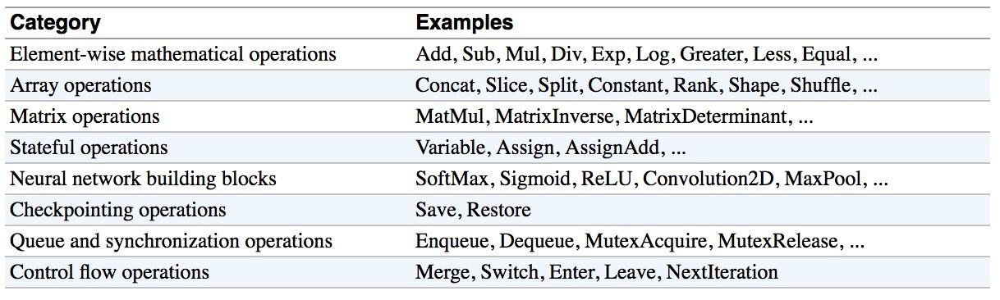
Operations
Table from “Fundamental of Deep Learning”

Slide 19
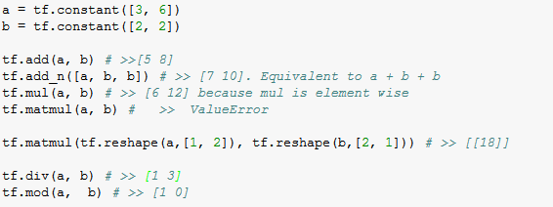
Operations
Pretty standard, quite similar to numpy. See TensorFlow documentation

Slide 20
Exercise
01_intro

Slide 21
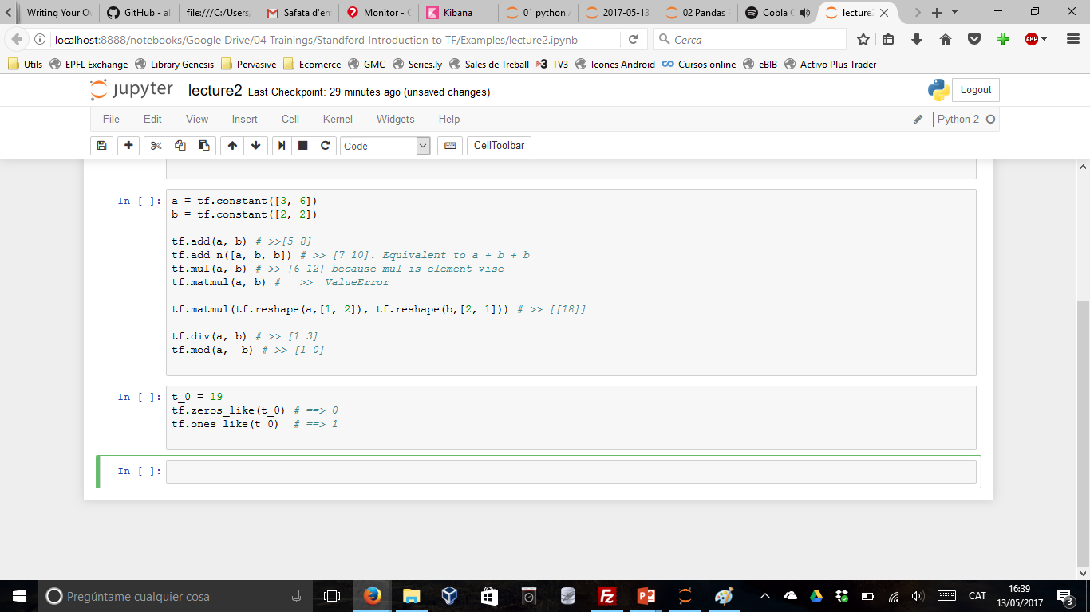
TensorFlow Data Types
TensorFlow takes Python natives types: boolean, numeric (int, float), strings
0-d tensor, or "scalar":

Slide 22

TensorFlow Data Types
TensorFlow takes Python natives types: boolean, numeric (int, float), strings
0-d tensor, or "scalar":
1-d tensor, or "vector“:

Slide 23

TensorFlow Data Types
TensorFlow takes Python natives types: boolean, numeric (int, float), strings
0-d tensor, or "scalar":
1-d tensor, or "vector“:

Slide 24
TensorFlow Data Types
TensorFlow takes Python natives types: boolean, numeric (int, float), strings
0-d tensor, or "scalar":
1-d tensor, or "vector“:

Slide 25

TensorFlow Data Types
TensorFlow takes Python natives types: boolean, numeric (int, float), strings
2-d tensor, or "matrix":

Slide 26
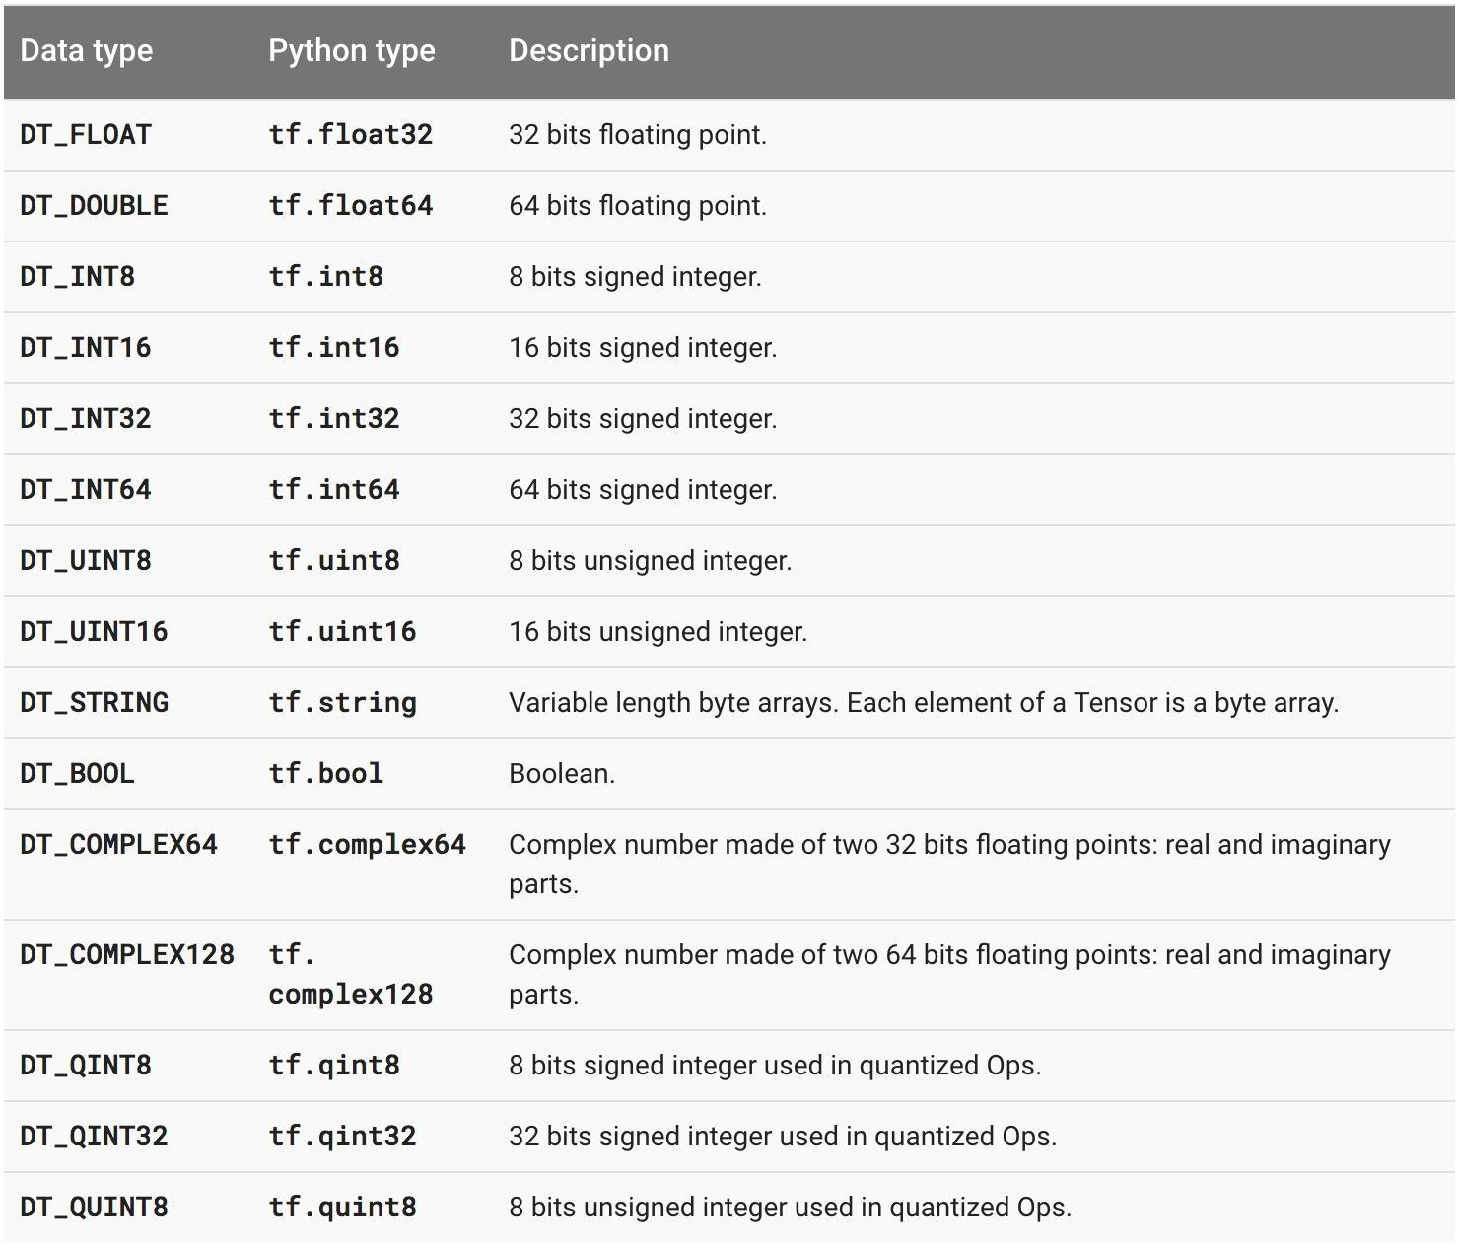
TensorFlow Data Types

Slide 27
TF vs NP Data Types
TensorFlow integrates seamlessly with NumPy
tf.int32 == np.int32 # True
Can pass numpy types to TensorFlow ops
tf.ones([2, 2], np.float32) # ⇒ [[1.0 1.0], [1.0 1.0]]
For tf.Session.run(fetches):
If the requested fetch is a Tensor , then the output of will be a NumPy ndarray.

Slide 28
TensorFlow Data Types
Do not use Python native types for tensors because TensorFlow has to infer Python type

Slide 29
TensorFlow Data Types
Beware when using NumPy arrays because NumPy and TensorFlow might become not so compatible in the future!

Slide 30
What’s wrong with constants?

Slide 31
Other than being constant ...

Slide 32
What’s wrong with constants?
Constants are stored in the graph definition

Slide 33
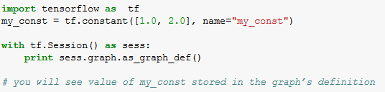
Print out the graph def

Slide 34
This makes loading graphs expensive when constants are big

Slide 35
Only use constants for primitive types.
Use variables for more data that requires more memory

Slide 36
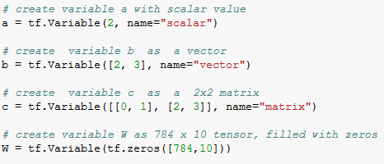
Variables

Slide 37
Variables
Why tf.constant but tf.Variable and not tf.variable?

Slide 38
Variables
tf.Variable is a class, but tf.constant is an op

Slide 39
How about variables?
tf.Variable holds several ops:
x = tf.Variable(...)
x.initializer # init op
x.value() # read op
x.assign(...) # write op
x.assign_add(...) # and more

Slide 40

You have to initialize your variables
The easiest way is initializing all variables at once:

Slide 41

You have to initialize your variables
The easiest way is initializing all variables at once:
But you can initialize a set of variables:

Slide 42

You have to initialize your variables
Or a single variable:

Slide 43
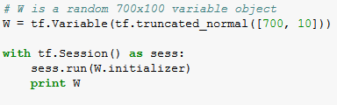
Eval() a variable
>> Tensor("Variable/read:0", shape=(700, 10), dtype=float32)

Slide 44
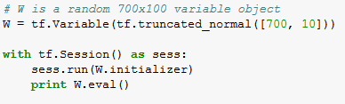
Eval() a variable
>> [[-0.76781619 -0.67020458
-0.90904623]
[-0.36763489 -0.65037876 -1.52936983 ...,
0.44387451]
...,
1.15333688 ..., -0.98434633 -1.25692499
0.19320194 -0.38379928
[-0.12753558 0.52571583
-0.02646019]
1.03265858 ..., 0.59978199 -0.91293705
[ 0.19076447 -0.62968266 -1.97970271 ..., -1.48389161
1.46369624]]
0.68170643

Slide 45

tf.Variable.assign()
What do you think this will return?

Slide 46

tf.Variable.assign()
Uh, why?

Slide 47
tf.Variable.assign()
W.assign(100) doesn’t assign the value 100 to W. It creates an assign op, and that op needs to be run to take effect.

Slide 48
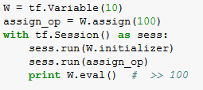
tf.Variable.assign()

Slide 49

tf.Variable.assign()
You don’t need to initialize variable because assign_op does it for you

Slide 50
tf.Variable.assign()
In fact, initializer op is the assign op that assigns the variable’s initial value to the variable itself.

Slide 51
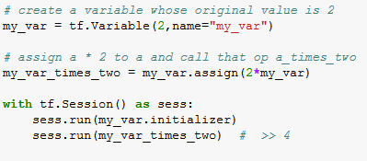
tf.Variable.assign()

Slide 52
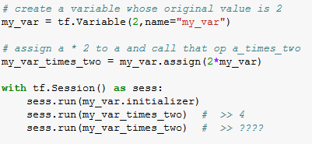
tf.Variable.assign()
What do you think this will return?

Slide 53
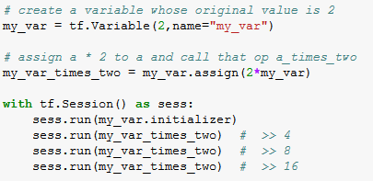
tf.Variable.assign()
It assign 2 * my_var to a every time my_var_times_two is fetched.

Slide 54
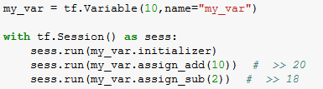
assign_add() and assign_sub()
assign_add() and assign_sub() can’t initialize the variable my_var for you because these ops need the original value of my_var

Slide 55
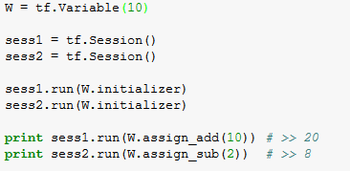
Each session maintains its own copy of variable

Slide 56

Use a variable to initialize another variable
Want to declare U = 2 * W
Not so safe (but quite common)

Slide 57

Use a variable to initialize another variable
Want to declare U = 2 * W
(It is safer if W is initialized before its value is used to initialize U)

Slide 58
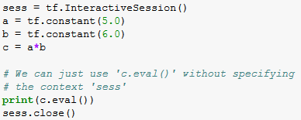
Session vs InteractiveSession
You sometimes see InteractiveSession instead of Session
The only difference is that an InteractiveSession makes itself the default

Slide 59
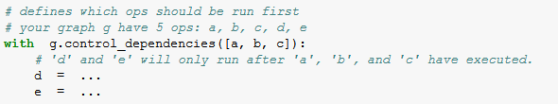
Control Dependencies
tf.Graph.control_dependencies(control_inputs)

Slide 60
Exercise
02_variables

Slide 61
Placeholders

Slide 62
A quick reminder
A TF program often has 2 phases:
Assemble a graph
Use a session to execute operations in the graph.

Slide 63
Placeholders
A TF program often has 2 phases:
Assemble a graph
Use a session to execute operations in the graph.
Can assemble the graph first without knowing the values needed for computation?

Slide 64
Placeholders
A TF program often has 2 phases:
Assemble a graph
Use a session to execute operations in the graph.
Can assemble the graph first without knowing the values needed for computation?
Analogy:
We can define the function f(x, y) = x*2 + y without knowing the values of x and y. Variables x and y are placeholders for the actual values.

Slide 65
Why placeholders?
We, or our clients, can later supply their own data when they need to execute the computation.

Slide 66
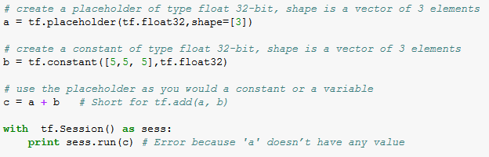
Placeholders
tf.placeholder(dtype, shape=None, name=None)

Slide 67
Feed the values to placeholders using a dictionary

Slide 68
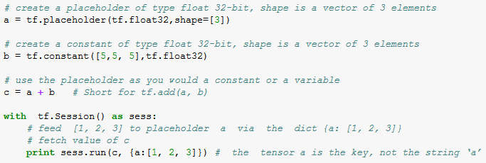
Placeholders
tf.placeholder(dtype, shape=None, name=None)
# >> [6, 7, 8]

Slide 69
Placeholders
tf.placeholder(dtype, shape=None, name=None)
shape=None means that tensor of any shape will be accepted as value for placeholder.
shape=None is easy to construct graphs, but nightmarish for debugging

Slide 70
Placeholders
tf.placeholder(dtype, shape=None, name=None)
shape=None also breaks all following shape inference, which makes many ops not work because they expect certain rank.

Slide 71

What if want to feed multiple data points in?
We feed all the values in, one at a time

Slide 72
You can feed_dict any feedable tensor.
Placeholder is just a way to indicate that something must be fed

Slide 73
tf.Graph.is_feedable(tensor)
# True if and only if tensor is feedable.

Slide 74
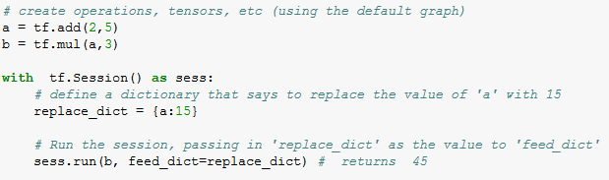
Feeding values to TF ops

Slide 75
Exercises
02_feed_dict

Slide 76
What’s lazy loading?

Slide 77
Exercise
02_normal_loading
02_lazy_loading

Slide 78
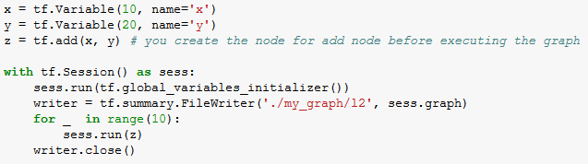
Lazy loading Example
Normal loading:

Slide 79
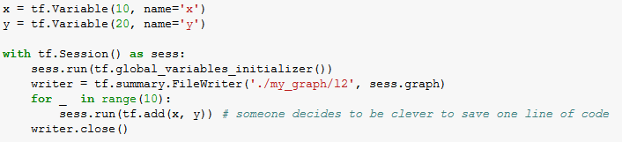
Lazy loading Example
Lazy loading:

Slide 80
Both give the same value of z. What’s the problem?

Slide 81
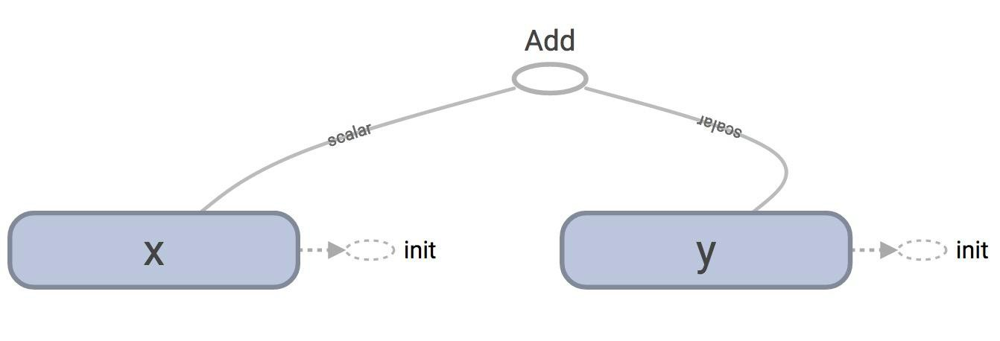
TensorBoard
Normal loading

Slide 82
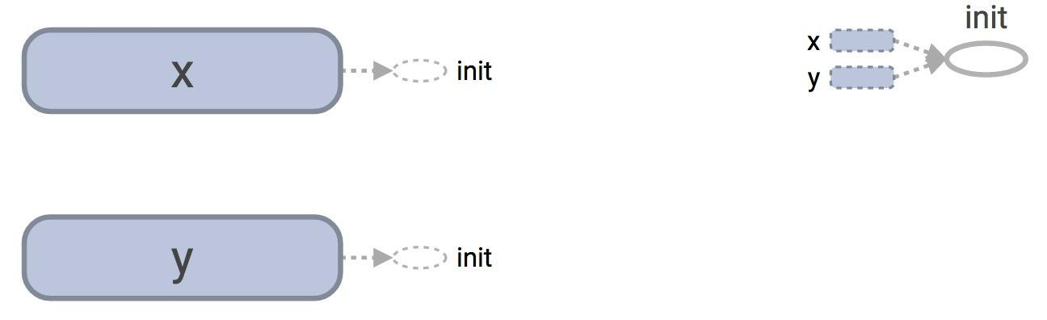
TensorBoard
Lazy loading (just missing the node Add, bad for reading graph, but not a bug)

Slide 83
tf.get_default_graph().as_graph_def()
Normal loading:
node {
name: "Add" op: "Add"
input: "x/read" input: "y/read" attr {
key: "T" value {
type: DT_INT32
}
}
}
Node “Add” added once to the graph definition

Slide 84
tf.get_default_graph().as_graph_def()
Lazy loading:
node {
name: "Add" op: "Add"
...
}
...
node {
name: "Add_9" op: "Add"
...
}
Node “Add” added 10 times to the graph definition
Or as many times as you want to compute z

Slide 85
Imagine you want to compute an op thousands of times!

Slide 86
Solution
Separate definition of ops from computing/running ops

Slide 87
BREAK!!!

