Slide 1
Data analysis for single-cell genomics
This is not an advanced R-programming course

Slide 2
What do you need to analyse [single-cell omics] data?
You need
Domain specific knowledege (biological field) +
Data analysis mindset (abstraction, working with numbers) +
Knowledge of tools (process data files, visualise, conclude)
You need to understand the concepts to ask the right questions.

Slide 3
Focus of the course
Learn concepts of high-throughput data analysis, instead of coding syntax.
Develop abstract thinking to find the common core in various problems.
Analyse publicly available single-cell transcriptomic datasets to practice some of the skills.

Slide 4
Concepts of high-throughput data analysis
Learn concepts of high-throughput data analysis, instead of coding syntax
While syntax of base-R is stable, the syntax of R-packages or, BioInfo software is not
They expire in 2-3 years
Consequence:
We gonna learn a lot of machine learning concepts.
There is gonna be limited amount of coding.
Exceptions:
Basic coding in bash, using the linux terminal.

Slide 5
Develop abstract thinking to solve various problems
Throughout the entire course we transform biological problems into numeric problems.
With this, we can find concepts how to generally solve them
Although we essentially do math, we can explain these in plain words, so you won’t be burdened with a lot of equations.
This will allow you take one step back, and think on a higher level in whatever domain you will be.

Slide 6
Single-cell transcriptomics is booming, and its going to reach you
What is so special about single-cell mRNA-sequencing, that it worth your time?
This is the most widespread method to date
Consequence:
You have access to a lot of data, that you can use it for yourself.
The method will become available to you soon.
We will have an outlook to other x-omics fields

Slide 7
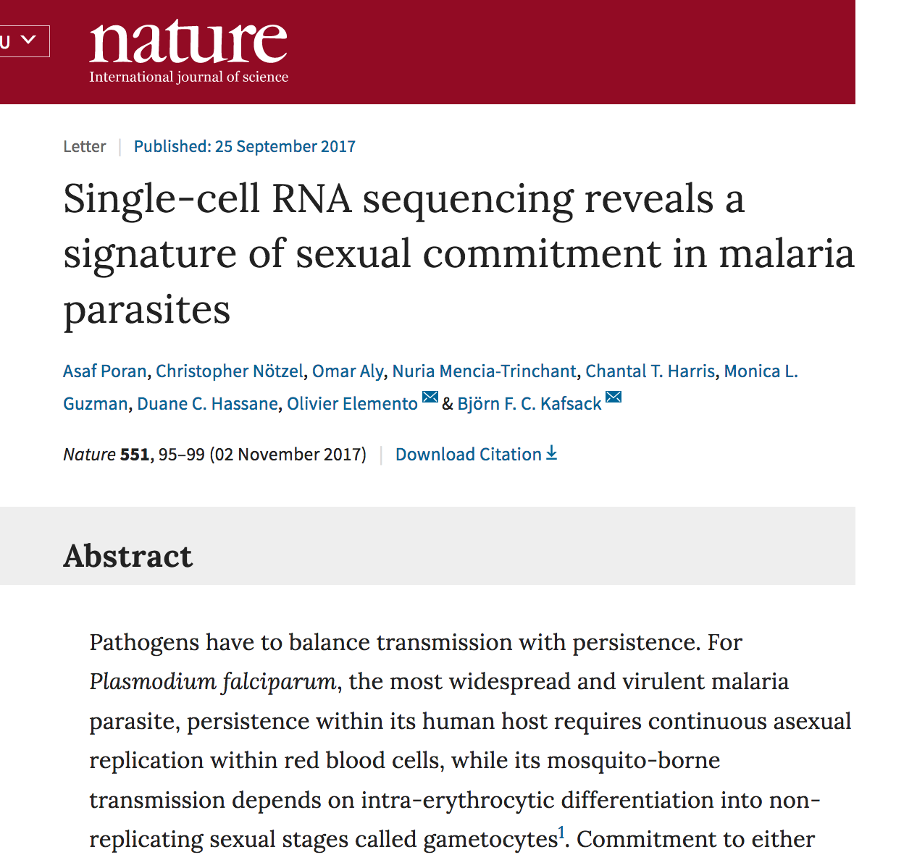
Field is booming and it reaches the parasitology field
Screen Shot 2018-08-05 at 20.18.49

Slide 8
{width=700px}

Slide 9
You can now mearure host-pathogen interaction in the same cell!
Parasite - host-cell / virus - host-cell
How do transcriptional changes in the parasite affect the host cell?

Slide 10
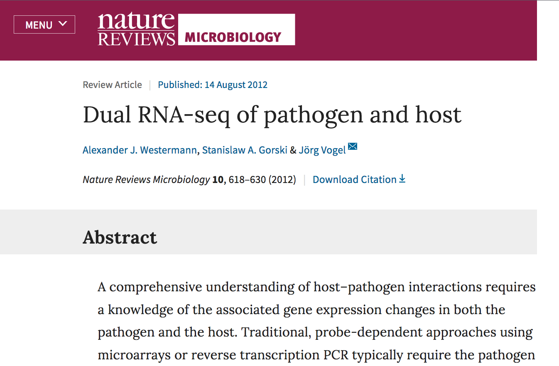
Screen Shot 2018-08-05 at 20.18.26

Slide 11
{width=700px}

Slide 12
Heterogeneity of individual parasites may be a key feature
How does heterogeneity:
Help to overcome the immune system (arms race)?
How does it arise, and
How is it controlled?
Screen Shot 2018-08-05 at 20.26.55

Slide 13
Access to publicly available single-cell transcriptomics dataset
They are typically required to share the data. If lucky, they provide: - a gene expression matrix (.xlsx), or you have to download the - raw data (.fastq files )

Slide 14
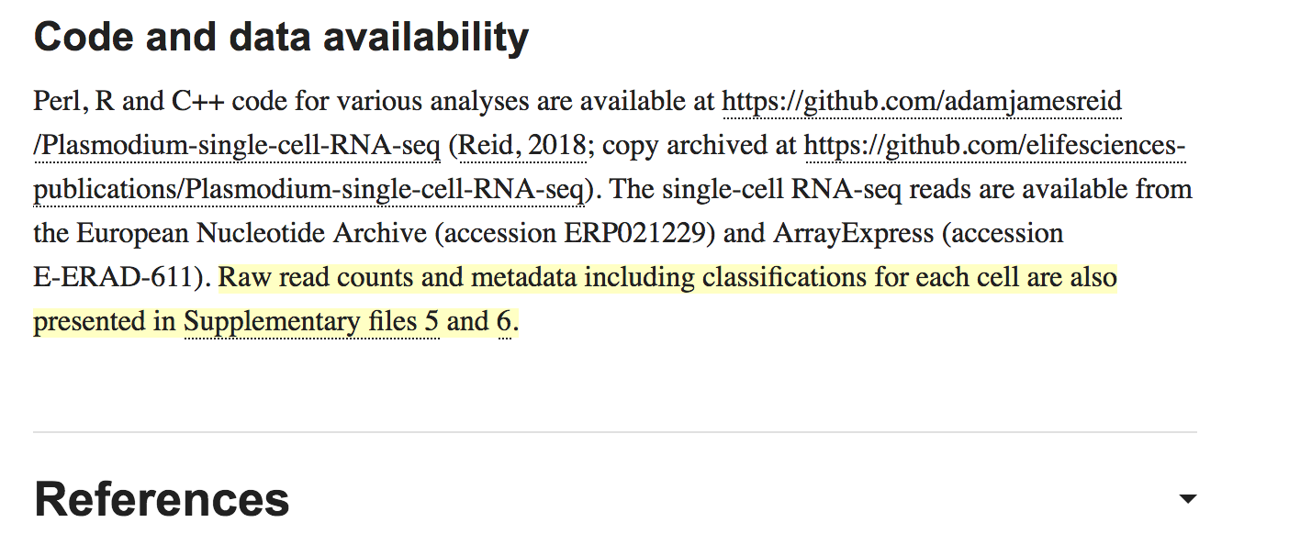
Screen Shot 2018-08-05 at 20.24.49

Slide 15
We are standing on the shoulders of anonym giants
A Disclaimer
This course material is based on hundreds of sources published on the web. Referencing each half sentence and graph was a task beyond my capacities, hereby I thank all authors making their work publicly available, and apologise to unnamed authors. Consequently, I would not like take credit for this course is “my achievement” or “my original work”. I only hope that it will be useful for learning.

Slide 16
Some notable sources:
Kolodziejczyk, Aleksandra A., Jong Kyoung Kim, Valentine Svensson, John C. Marioni, and Sarah A. Teichmann. 2015. “The Technology and Biology of Single-Cell RNA Sequencing.” *Molecular Cell- 58 (4). Elsevier BV: 610–20. doi:[10.1016/j.molcel.2015.04.005](https://doi.org/10.1016/j.molcel.2015.04.005).
https://github.com/hemberg-lab/scRNA.seq.course/
Korflab UNIX course

Slide 17
Overview - Approximate schedule
Next generation sequencing
History & Concepts in sc-seq
scRNA-seq Experiments
Analysis of scRNA-seq data
Data
Unix intro (P)
Analysis pipeline
File formats
Tools & software
Example dataset analysis with Seurat (P)
(Novel & experimental data analysis)

Slide 18
Data analysis is part of the experiment - it’s not something for later
To consult the statistician after an experiment is finished is often merely to ask him to conduct a post mortem examination. He can perhaps say what the experiment died of.”
R.A. Fisher, 1938
Your first take home message.

