Slide 1
Next generation sequencing (NGS)

Slide 2
History of DNA/RNA sequencing

Slide 3
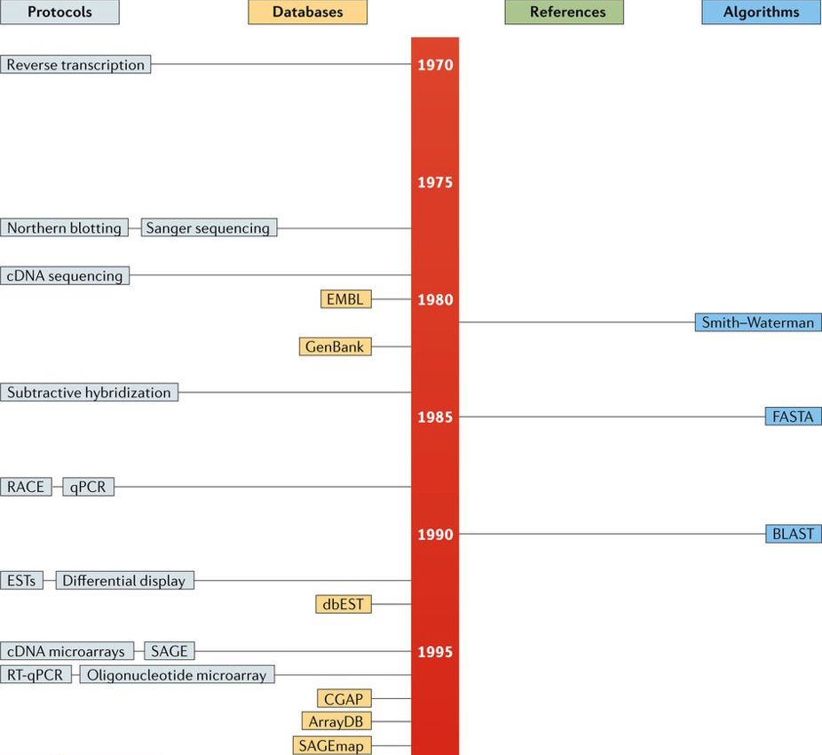
Sanger sequencing is developed in the late ’70s
nrg.2017.96-f1 1

Slide 4
> Source: Cieślik - 2018

Slide 5
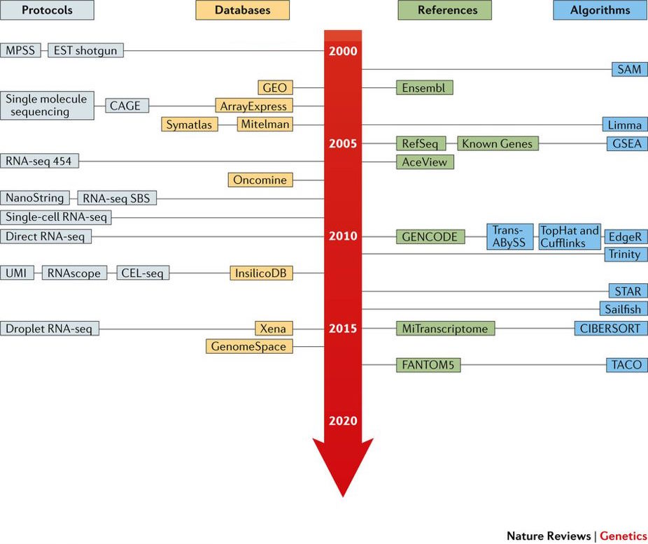
RNA-seq emerged shortly after NGS from 2005
nrg.2017.96-f1 2

Slide 6
Source: Cieślik - 2018 Also see: rna-seqblog.com

Slide 7
Sanger sequencing
A.k.a: Capillary sequencing or first-generation sequencing
the first sequencing method still used
uses labeled terminating codons
Separation by electrophoresis / chromatography (~sep by length)
Readout in chromatogram

Slide 8
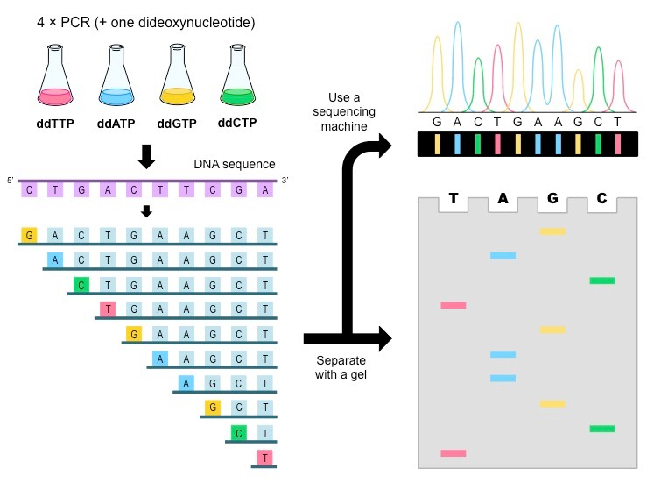
Principle of Sanger sequencing
dna-sequencing_med

Slide 9
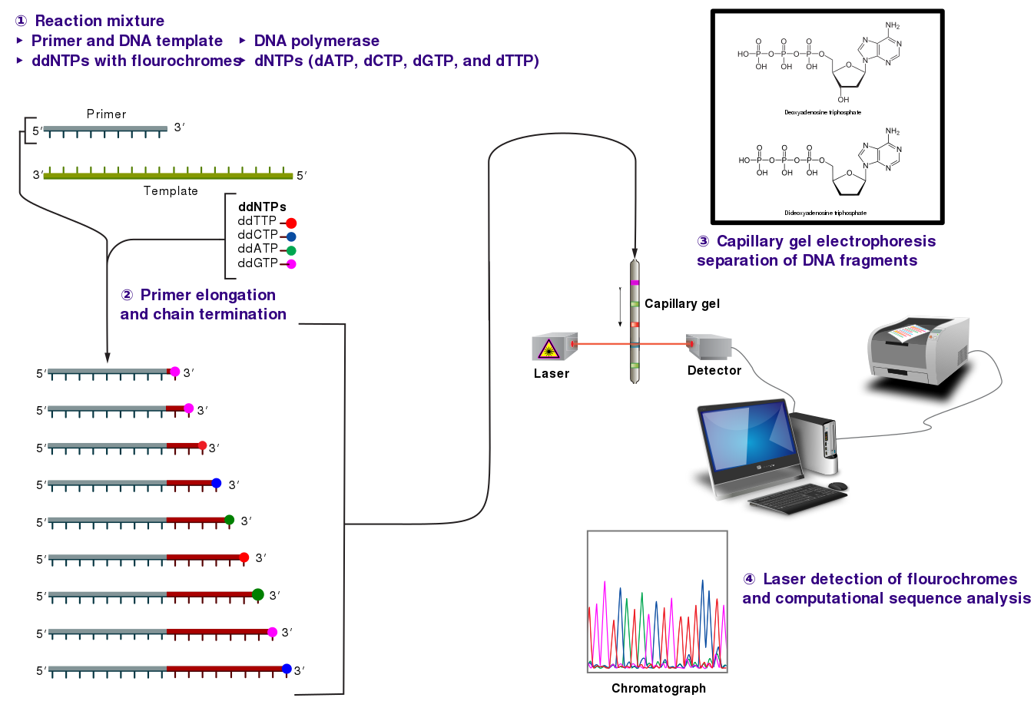
The whole setup to date
Sanger-sequencing

Slide 10
Wikipedia

Slide 11
Next generation sequencing
Different NGS platforms / configurations and sequencing chemistry.
Illumina
PAC-bio
Ion-torrent
New comer: Nano-pore (very different)
Shared properties
massive parallel sequencing
spatially separated, clonally amplified DNA molecules

Slide 12
Illumina Sequencing

Slide 13
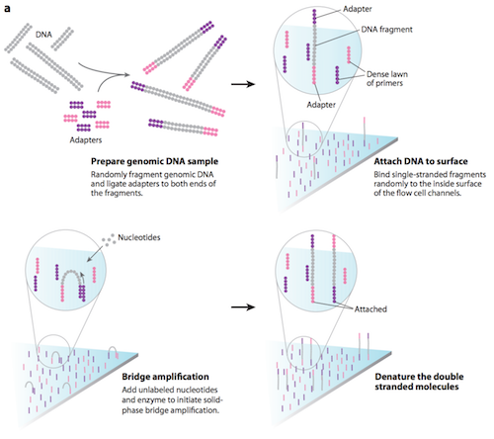
Amplification on the flow cell by bridge PCR
NGS1

Slide 14
Source: https://wiki.mcmaster.ca/

Slide 15
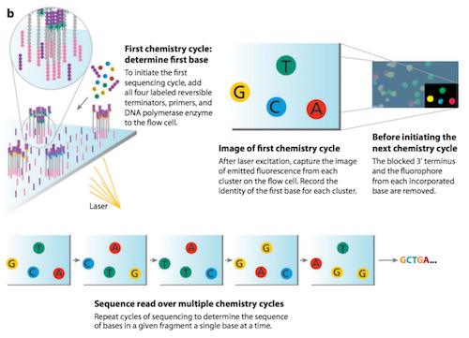
Sequencing of clones (local clusters) by adding coloured nucleotides
NGS2.illumina_2

Slide 16
Source: https://wiki.mcmaster.ca/

Slide 17
Sequencing by synthesis
Adding four fluorescently-labelled reversible terminator nucleotides, primers, and DNA polymerase to the flow cell.
The primer attaches to the illumina adapter of the DNA being sequenced.
The DNA polymerase then binds to the primer and adds the first fluorescently-labelled terminator nucleotide (base) to the new DNA strand.
The coloured terminator nucleotides stops it
All strands arrive to the same point in sequence with the
Microscopy (colour dots)
Cleave terminating residue
Repeat

Slide 18
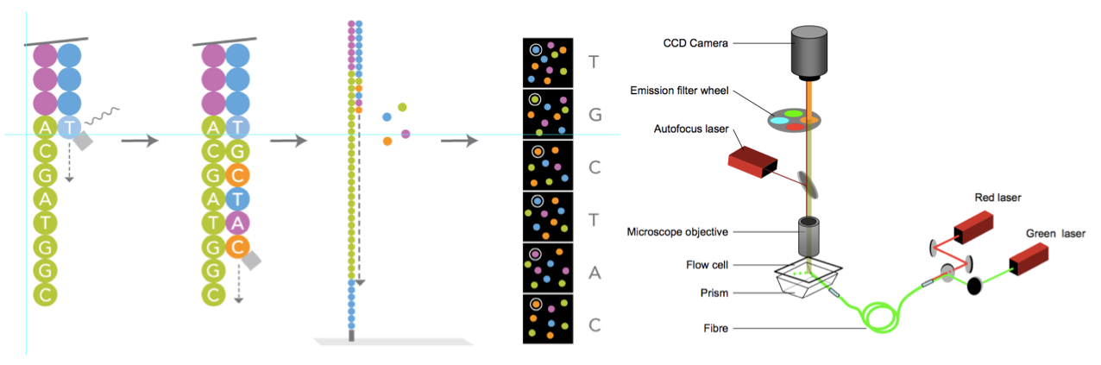
Sequencing by synthesis - Overview
Seq.steps

Slide 19
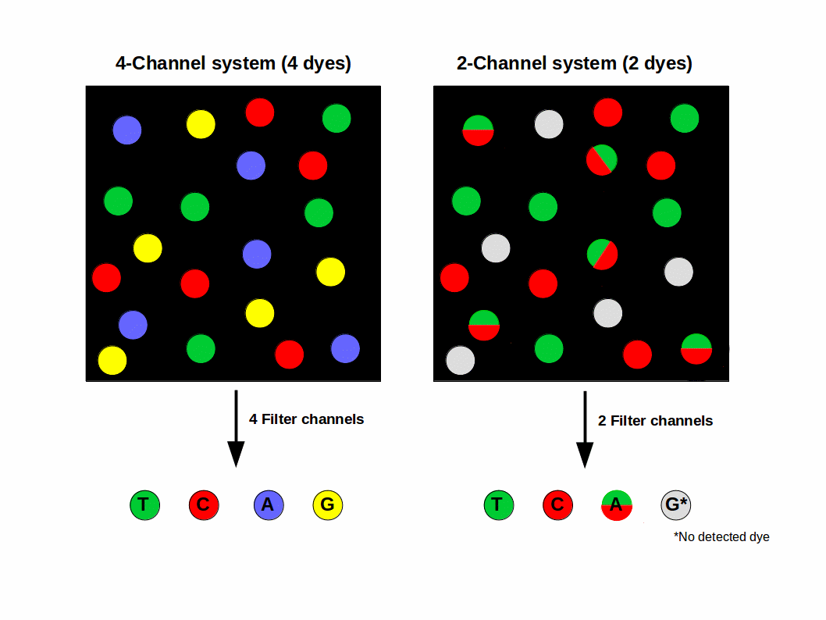
Newer sequencers use only two colours to cut down the cost
Seq.colors

Slide 20
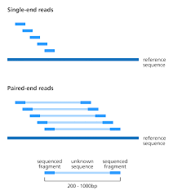
Single & paired-end sequencing
Paired.end.seq

Slide 21
Source: Devon Ryan

Slide 22
sc-Seq uses paired-end sequencing
Most scRNASeq protocols are sequenced with paired-end sequencing.
Barcode sequences may occur in one or both reads depending on the protocol employed.
Typically: one read with the CBC and UMI , other read for transcript sequence (used for mapping).
Reads will be mapped as if they are single-end sequenced despite actually being paired end.

