Slide 1
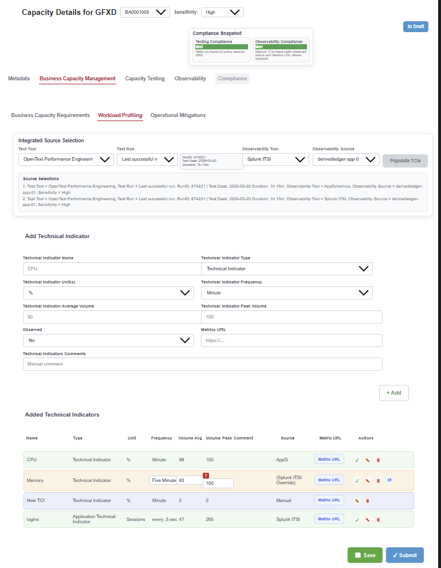
BCM Integration PoC

Slide 2
Problem Statement
- Time consuming manual lookups from multiple systems
- Lack of confidence in data
- Inconsistent capacity entries
- Delayed submissions

Slide 3
Proposed – E2E Architecture
UI Layer
(TCI Forms)
Integration Layer
(API Orchestration)
Data Layer
(Integration Data Store)
User Actions
Approve/Override
Policy Engine
(Window Logic)
Audit Module
(External)
Connectors
AppD / Splunk / Test Tools

Slide 4
Key Integration & UI Components
- Observability adapters (AppD, Splunk ITSI, Athene)
- Test tool connectors (OpenText, JMeter, ICE)
- Data normalization layer
- UI orchestration service
- Source Selection Panel (tool + run)
- Populate TCIs on Change of Source
- Inline editing & override controls
- Source provenance tracking for effectiveness & confidence measurement
- Testing Compliance (policy-based)
- Observability Compliance
- Real-time status indicators
- Future: Predictive breach analytics

Slide 5
Business Benefits
- Faster submission
- Improved data accuracy
- Multi pillar data population
- Potentially populate BCIs*
- Plug-and-play connectors
- Multi-tool support
- Scalable data model
- Future AI/ML integration

Slide 6
Challenges
BCI data can be very complex to aggregate
Risks around rework when migrating to Splunk ITSI
Testing time and Edge cases.

Slide 7
Next Steps
Demo Working PoC on AppD & Perf Testing
Gather feedback from GBI Champs & ITSOs
Produce an implementation Roadmap
Sizing and Sprint planning

