Slide 1
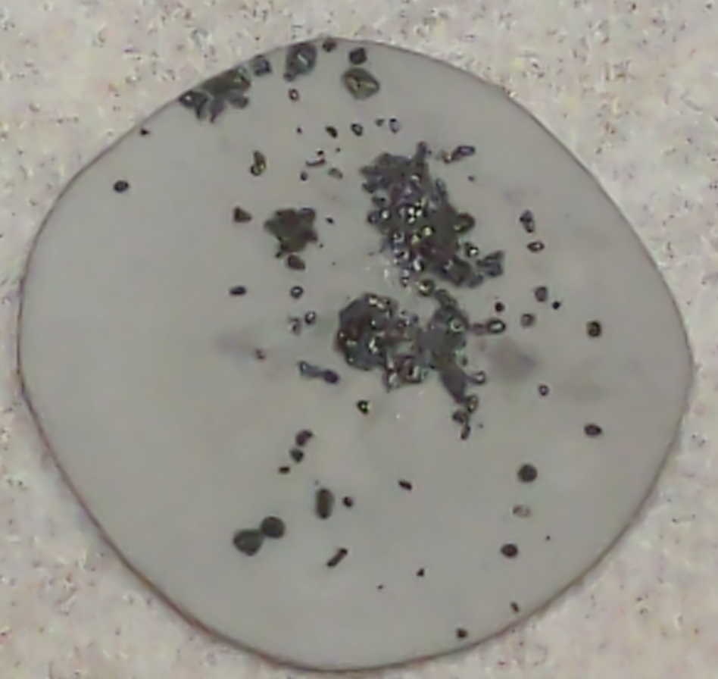
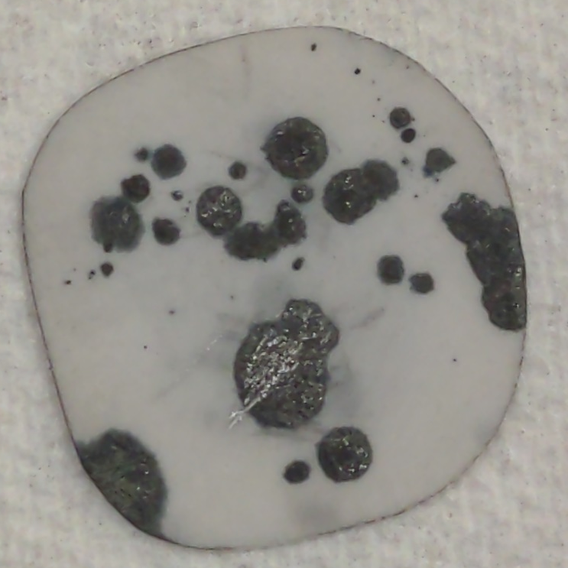
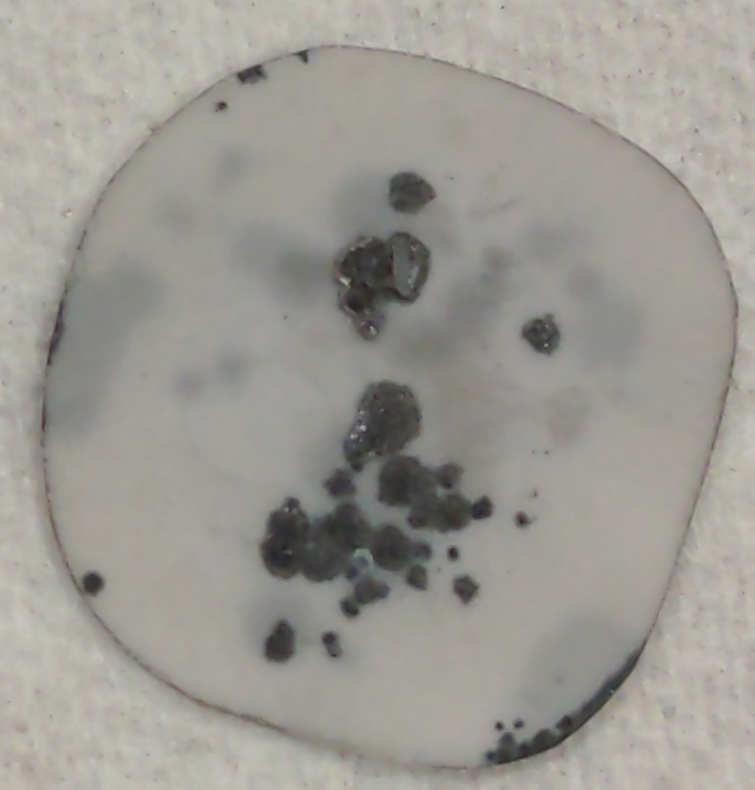
Top Powder
Middle Powder
Bottom Powder
Graphite Crucible
Alumina Plate
Nickel
Induction Coils
IR Signal (to pyrometer)

Slide 2
