Slide 1
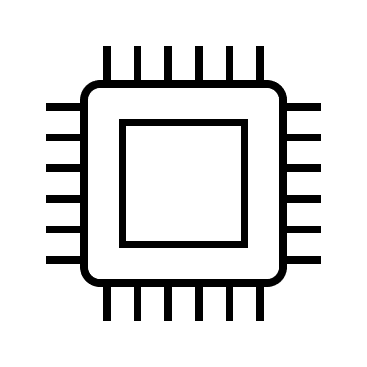
Fixturing Cables
(with slack)
Control Computer (LabVIEW + DAQ)
Pyrometer
Pyrometer Holder
Quartz Disc
Recirculating
Water Chiller
Heating Head
Induction Generator
+
-
Pressure
Sensor
Bellows
T-Station 85
(Pump)
Support Stand with Clamps

