Slide 1
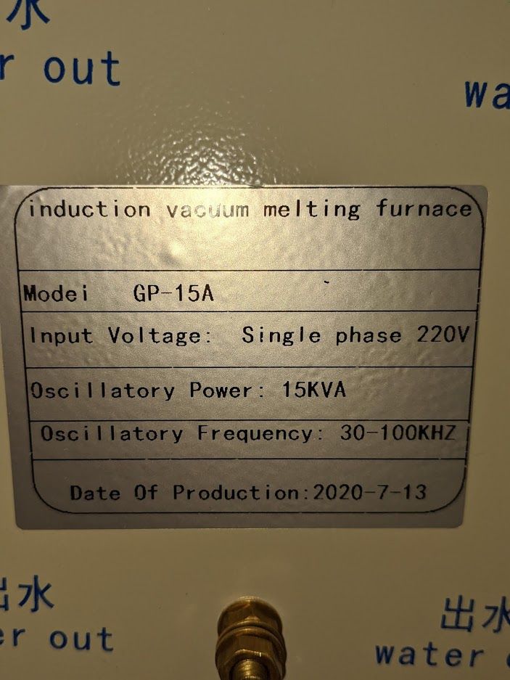
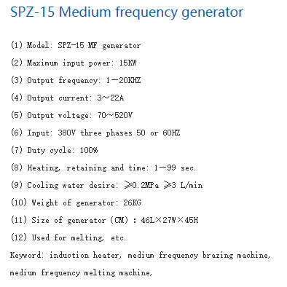
Incorrect Model
Correct Model

Slide 2
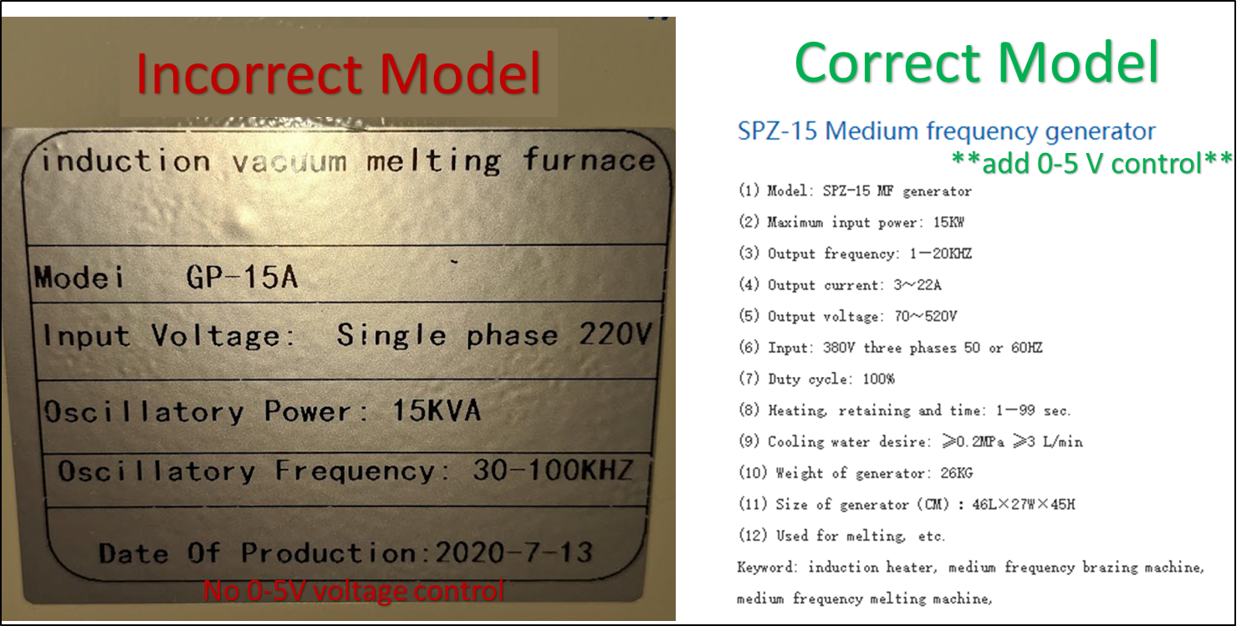

Slide 3
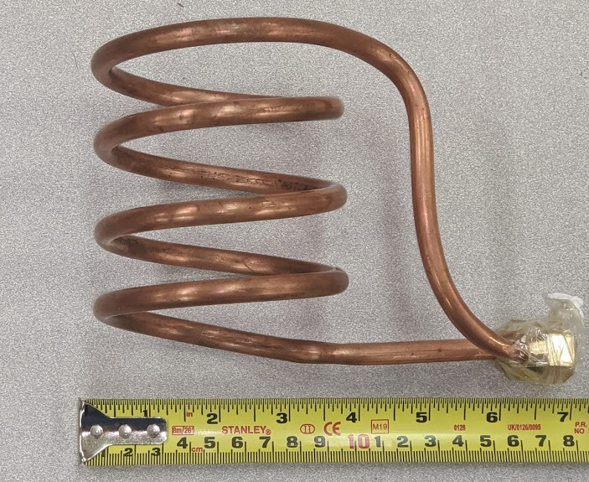
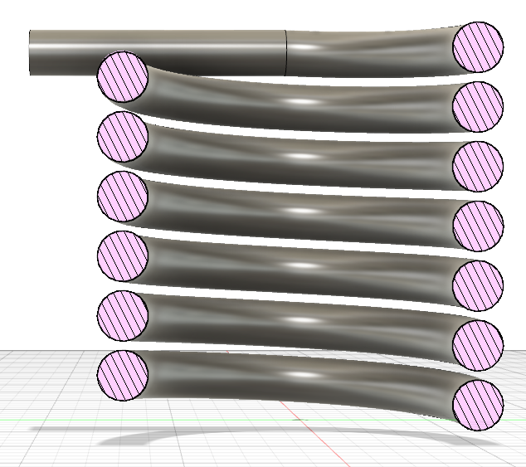
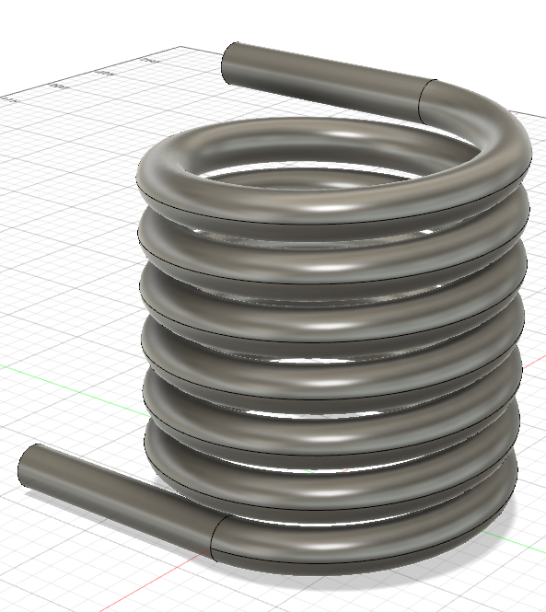
Incorrect Coil
Correct coil
2.5” ID
Spacing is too big
Need more coils
3”
6.5 loops
Coil is too tall

Slide 4
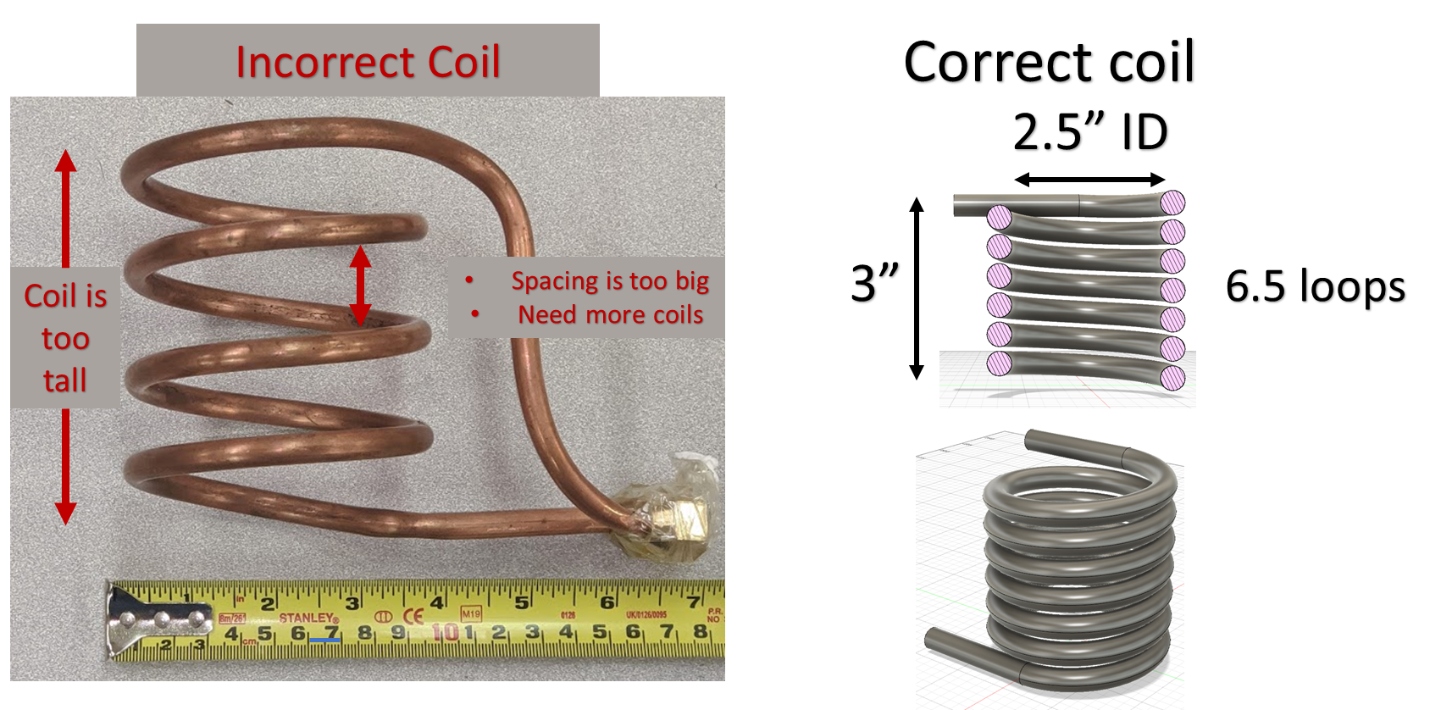

Slide 5
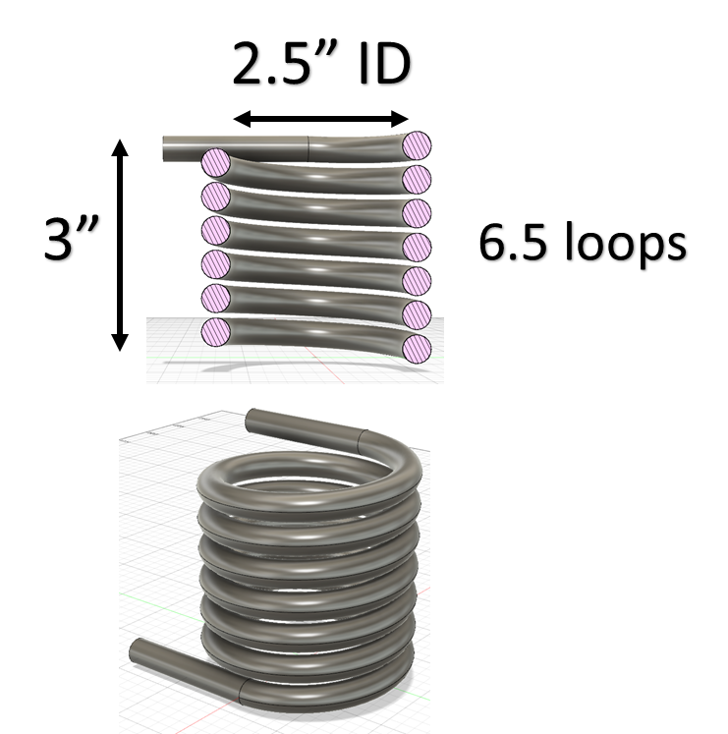

Slide 6
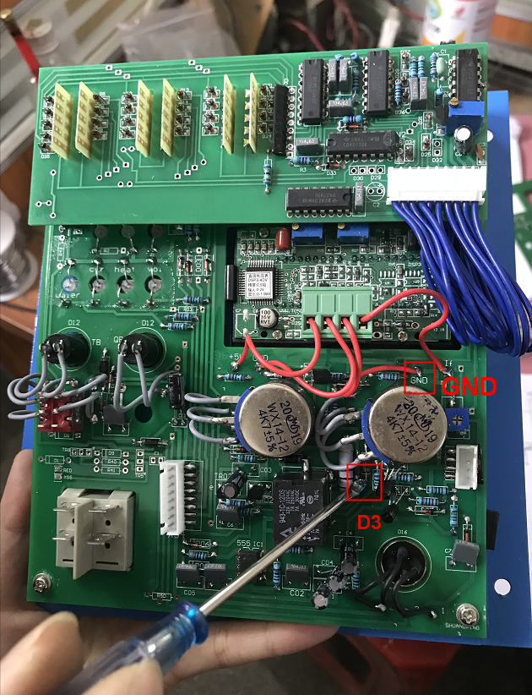
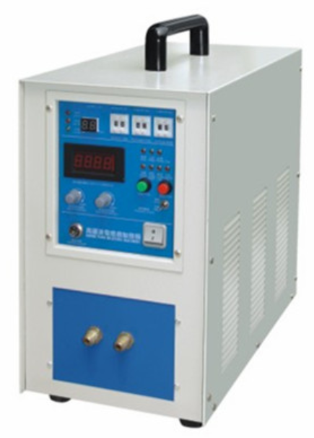
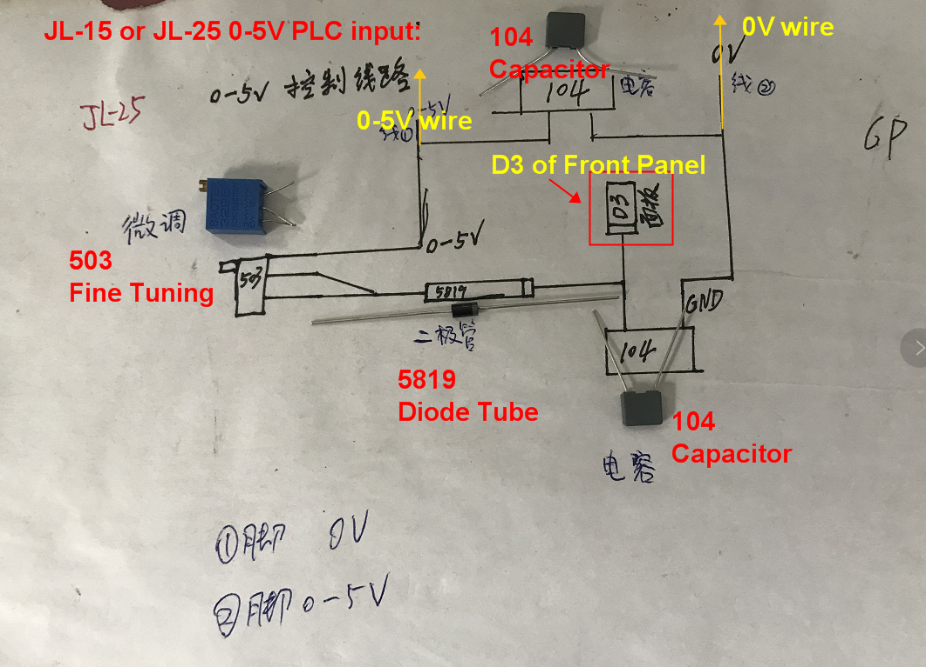
Modification of Temp Control
Notes:
Basing off of different supplier. Just need to attach one wire to D3 and one wire to GND. Then supply the 0-5V to D3. Simple enough.

Slide 7
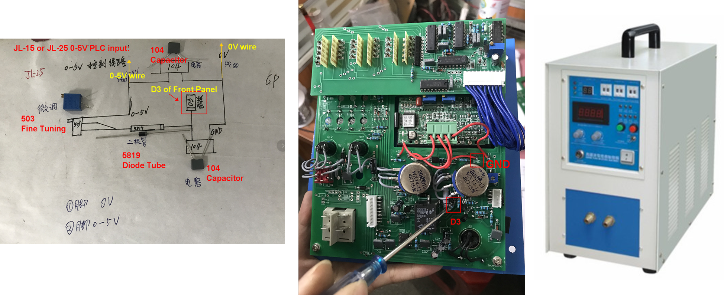

Slide 8
Order correct coils
Notes:
https://biz.alibaba.com/ta/detail.htm?orderId=65119374001023338

