Slide 1
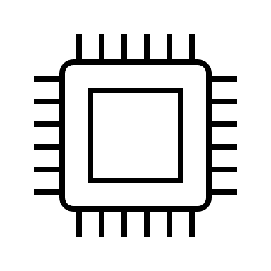
chamber-stand-marker
Fixturing Cables
(to ceiling)
Pyrometer
Pyrometer Housing
Quartz Disc
Quartz Tube (Vacuum Chamber)
KF40 Fitting
Induction
Generator
+
Heating
Head
Crucible
-
Induction Coil
Ethylene Glycol Coolant
Pressure
Sensor
KF40 Cross
Bellows
Recirculating
Chiller
Turbo Pumping
Station
Relief Valve
Support Stand

