Slide 1
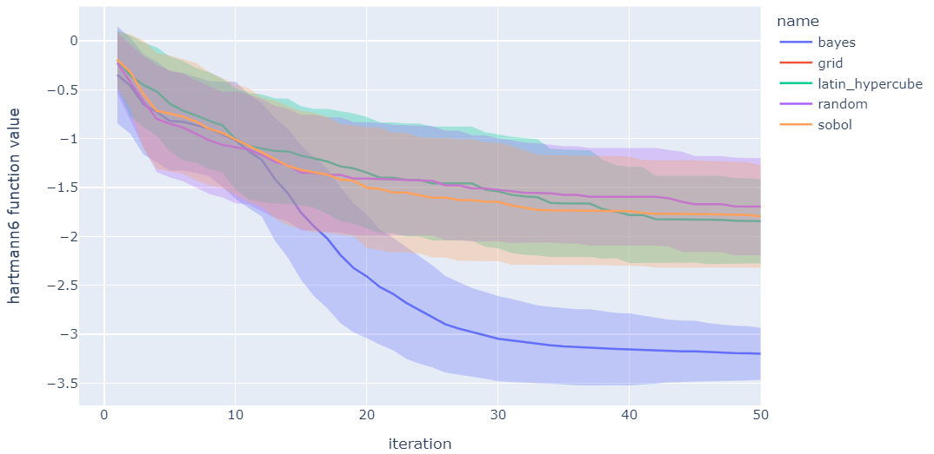
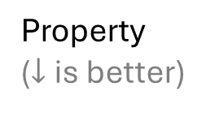
Bayesian optimization is a machine learning technique that works well in the limit of low data and many variables
Property
($↓$ is better)
Design of Experiments
(Traditional)
Bayesian Optimization
0
50
Experiment #
Baird et al. Matter (2022)
Notes:
, primarily because we are almost always in a very low data regime with high-dimensional search spaces. You'll get a funny look or a curt remark from a reviewer if you try to train a neural network on a few dozen points. These tend to overfit and have poor uncertainty quantification. Bayesian optimization, on the other hand, is incredibly good at quantifying uncertainty and balancing exploration of new designs with fine-tuning existing ones.

Slide 2
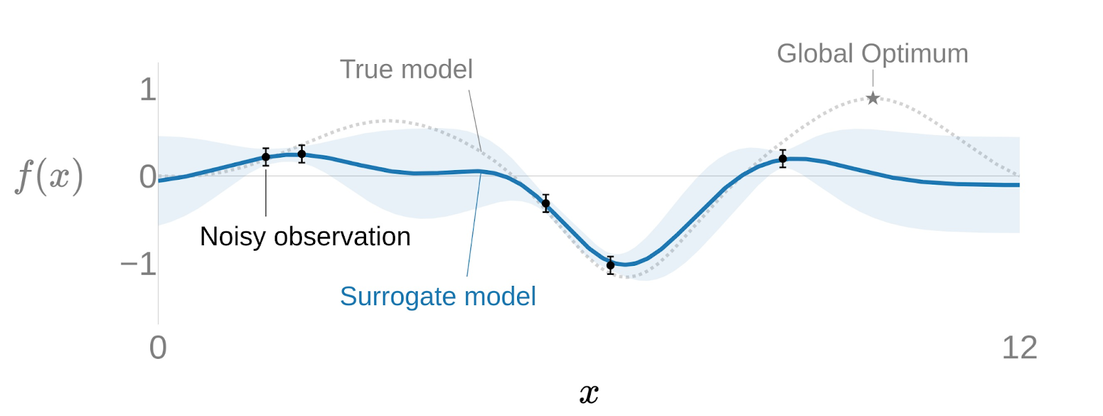
A surrogate model predicts properties and quantifies uncertainty

Slide 3
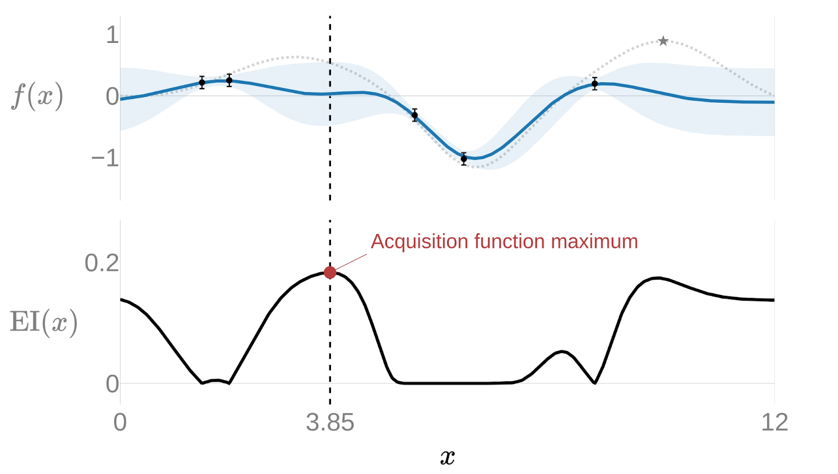
The acquisition function guides how to select the next experiment (in this case, neither the max predicted nor the max uncertainty)

Slide 4
This Bayesian optimization loop continues iteratively (1) add data, (2) fit surrogate model (3) optimize acquisition function

Slide 5
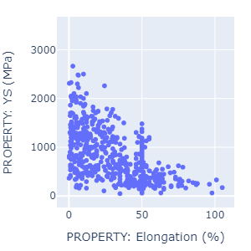
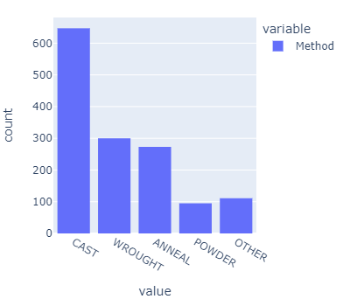

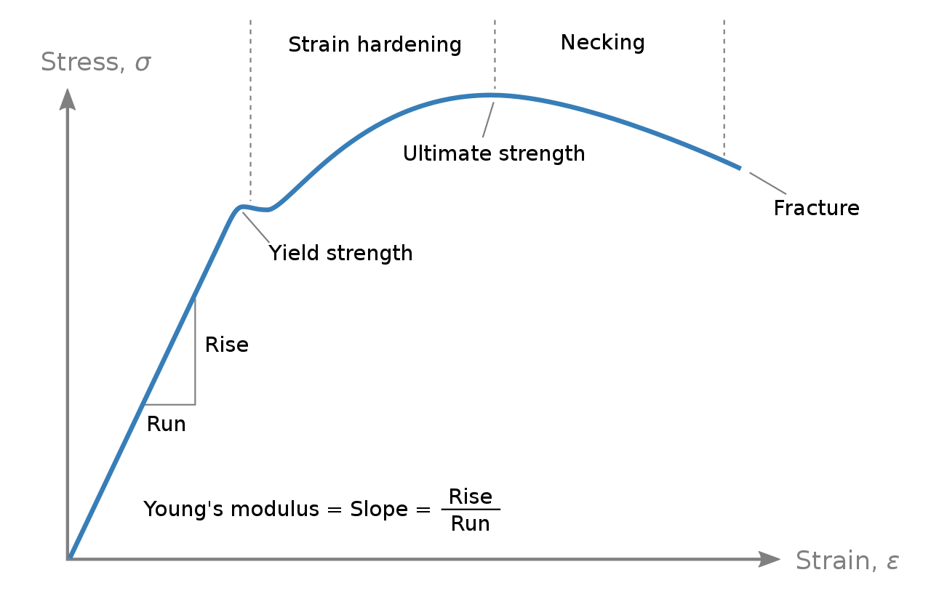

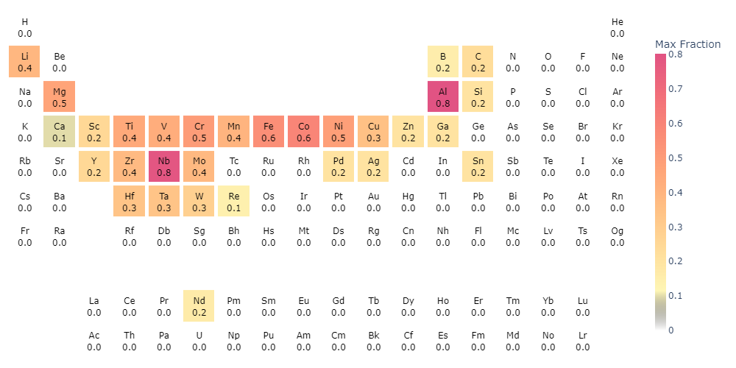
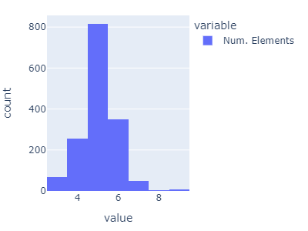
Real-world materials discovery tasks such as alloy design require more than “vanilla” optimization
Multi-task
Multi-objective
Mixed Continuous/Categorical
Compositional Linear Constraint
$$x_{\text{Al}}+x_{\text{Si}}+x_{\text{Nb}}+…+x_{\text{Sn}}=1.0$$
NchooseK
nonlinear constraint
High-dimensional

Slide 6
Real-world materials discovery tasks such as alloy design require more than “vanilla” optimization
Multi-task
Multi-objective
Mixed Continuous/Categorical
Compositional Linear Constraint
NchooseK
nonlinear constraint
High-dimensional
Notes:
Wave my magic wand to rearrange the text

Slide 7
Real-world materials discovery tasks require more than “vanilla” optimization
Multi-task
Single | Multi
Multi-objective
Single | Multi
Mixed Continuous/Categorical
Continuous | Cont. + Categorical
Compositional Linear Constraint
No Constraint | Linear Constraint
High-dimensional
Low dim. | High dim.
NchooseK
nonlinear constraint
No Constraint | Nonlinear Constraint

Slide 8
Real-world materials discovery tasks require more than “vanilla” optimization
Basic
Multi-task
Single | Multi
Multi-objective
Single | Multi
Mixed Continuous/Categorical
Continuous | Cont. + Categorical
Compositional Linear Constraint
No Constraint | Linear Constraint
High-dimensional
Low dim. | High dim.
NchooseK
nonlinear constraint
No Constraint | Nonlinear Constraint

Slide 9
Real-world materials discovery tasks require more than “vanilla” optimization
Advanced
Multi-task
Single | Multi
Multi-objective
Single | Multi
Mixed Continuous/Categorical
Continuous | Cont. + Categorical
Compositional Linear Constraint
No Constraint | Linear Constraint
High-dimensional
Low dim. | High dim.
NchooseK
nonlinear constraint
No Constraint | Nonlinear Constraint

Slide 10
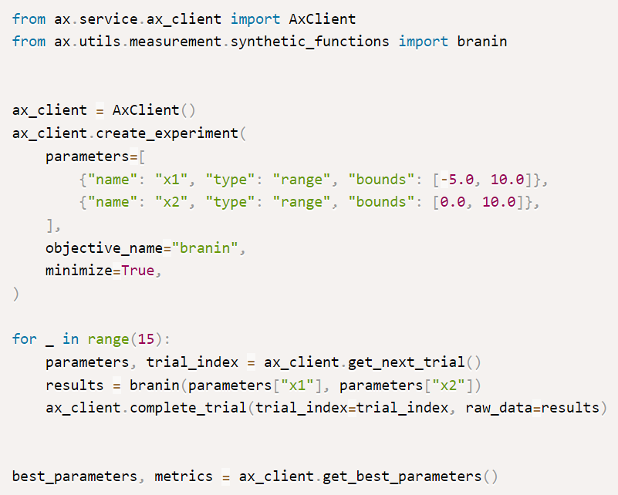
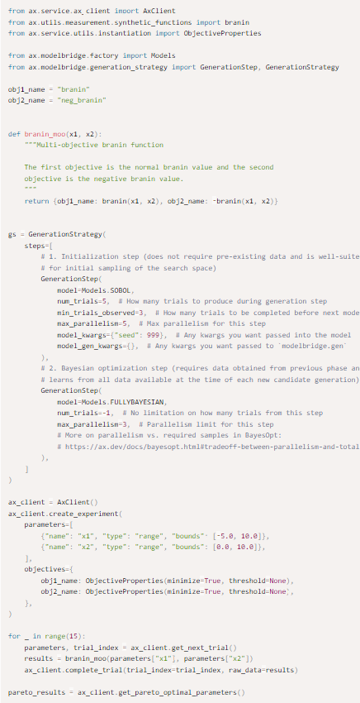
Honegumi lets you quickly create advanced BO examples
Basic
Advanced
Single obj. | Multi obj.
Single obj. | Multi obj.
Single task | Multi task
Single task | Multi task
Continuous | Cont. + Cat.
Continuous | Cont. + Cat.
No Constraint | Linear
No Constraint | Linear
Low dim. | High dim.
Low dim. | High dim.
No Constraint | Nonlinear
No Constraint | Nonlinear
Pairs well with LLMs
21 lines
62 lines
3x

Slide 11
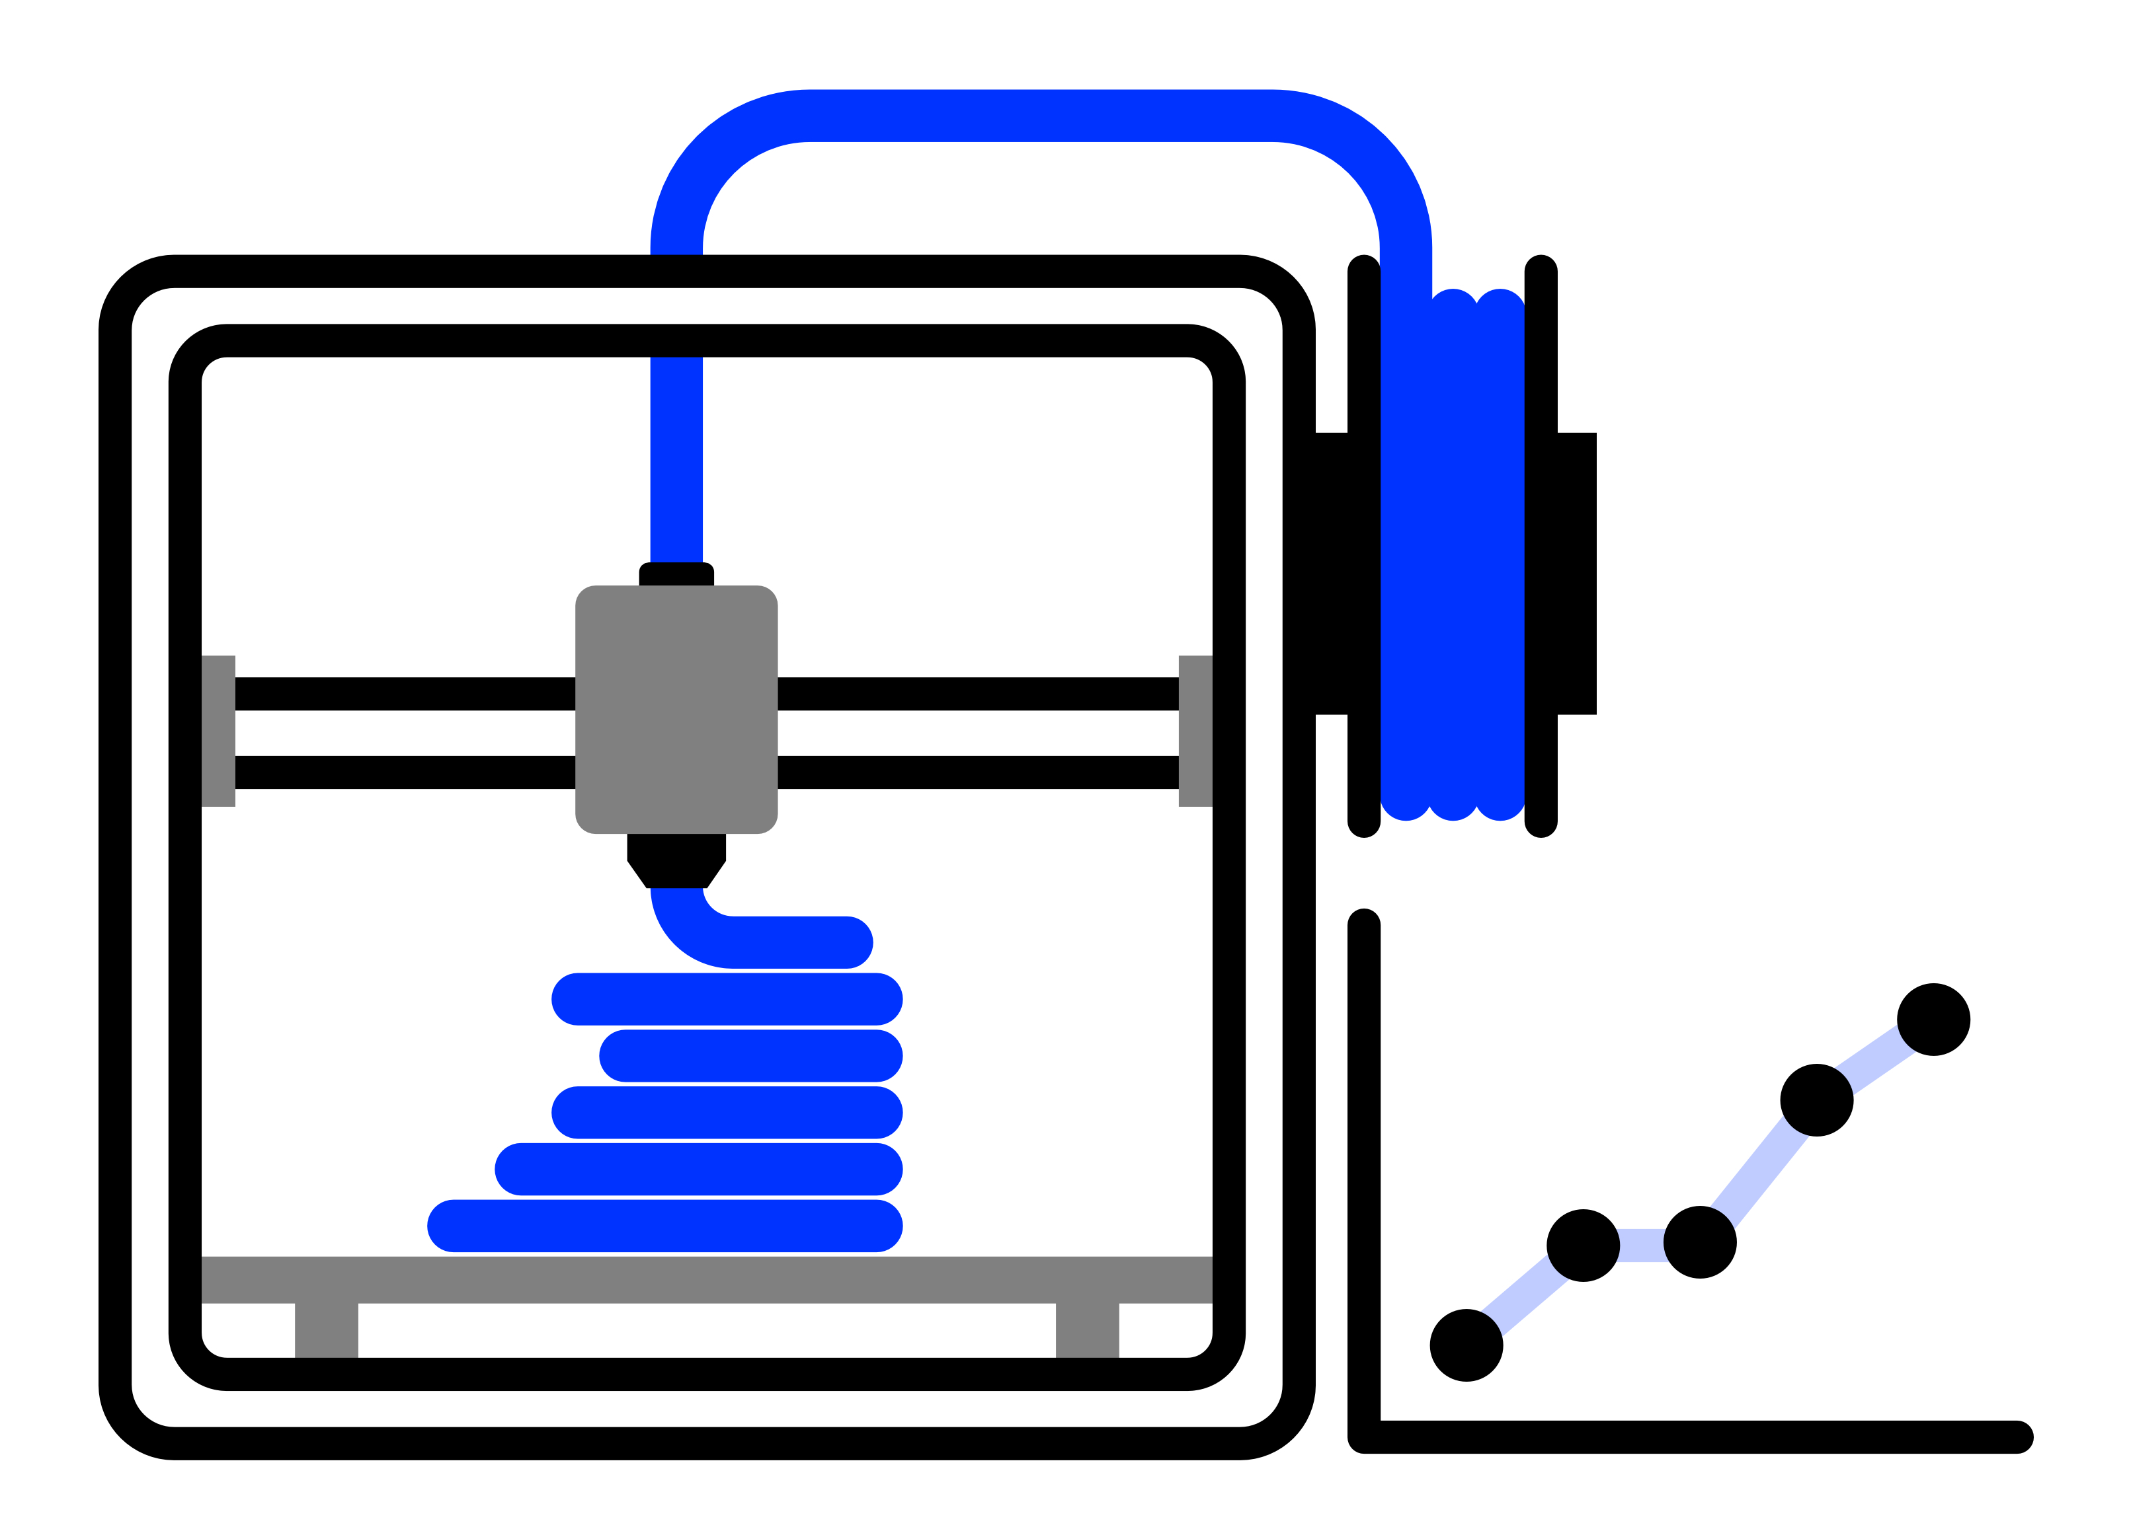
Maximize the strength of a 3D printed part as a function of internal geometry and printer settings

