Slide 1
Explainable Pneumonia Detection on Chest X-Rays with DenseNet121
Computer Vision: Project 2
Nayan, Pratyay, Richard

Slide 2
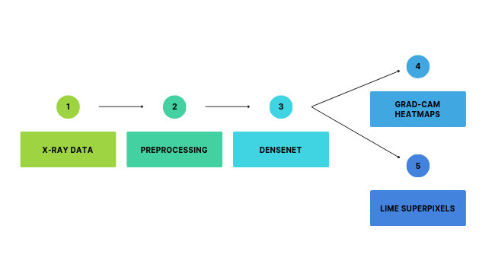
Explainable Pneumonia Detection Pipeline
Our goal was to classify chest X-rays as Normal or Pneumonia using a CNN and generate explanations using two XAI methods: Grad-CAM and LIME.
We fine-tuned a pre trained DenseNet121 model rather than training from scratch because it performs well on medical imaging tasks and is lightweight enough for a 4GB GPU.

Slide 3
Dataset & Preprocessing Pipeline
Dataset: Chest X-Ray Pneumonia (Kaggle) with two classes: Normal / Pneumonia.
Split original dataset → train / val (80/20) / test.
Preprocessing steps:
  Convert to grayscale
  Resize 224×224 to match DenseNet
  Expand grayscale to 3 channels
  Normalize using dataset mean/std
  Train augmentations: horizontal flip
Split | Normal | Pneumonia | Total
Train | 1072 | 3100 | 4172
Val | 269 | 775 | 1044
Test | 234 | 390 | 624

Slide 4
Model Architecture & Training Setup
Pre trained DenseNet121 chosen for:
  Good medical image performance
  Efficiency
  Dense connectivity helps gradient flow
Final classifier replaced with:
  BatchNorm
  Dropout(0.4)
  Linear(2)
Loss
  Cross Entropy
Optimizer
  Adam
    lr = 1e-4
    weight_decay = 1e-4
Regularization
  dropout + weight decay + augmentation
Mixed-precision training (AMP)
  for 4GB GPU
Early stopping implemented

Slide 5
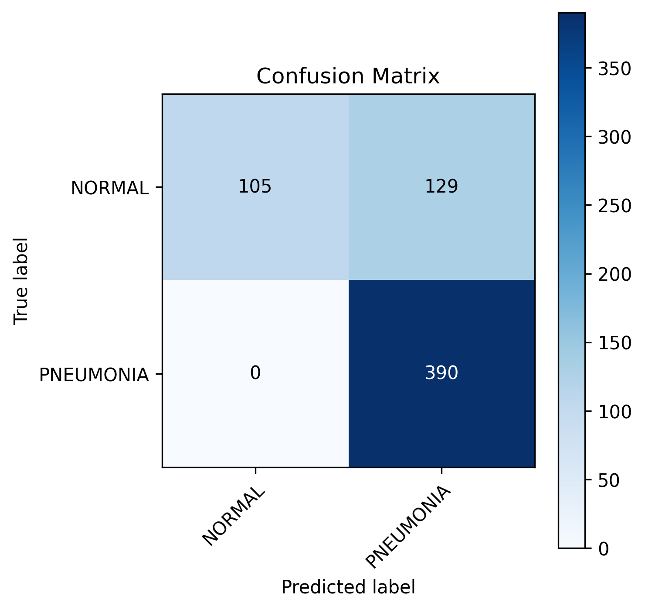
Model Performance on Test Set
=== METRICS SUMMARY ===
Accuracy: 0.7933
Sensitivity: 1.0000
Specificity: 0.4487
Precision: 0.7514
F1 Score: 0.8581

Slide 6
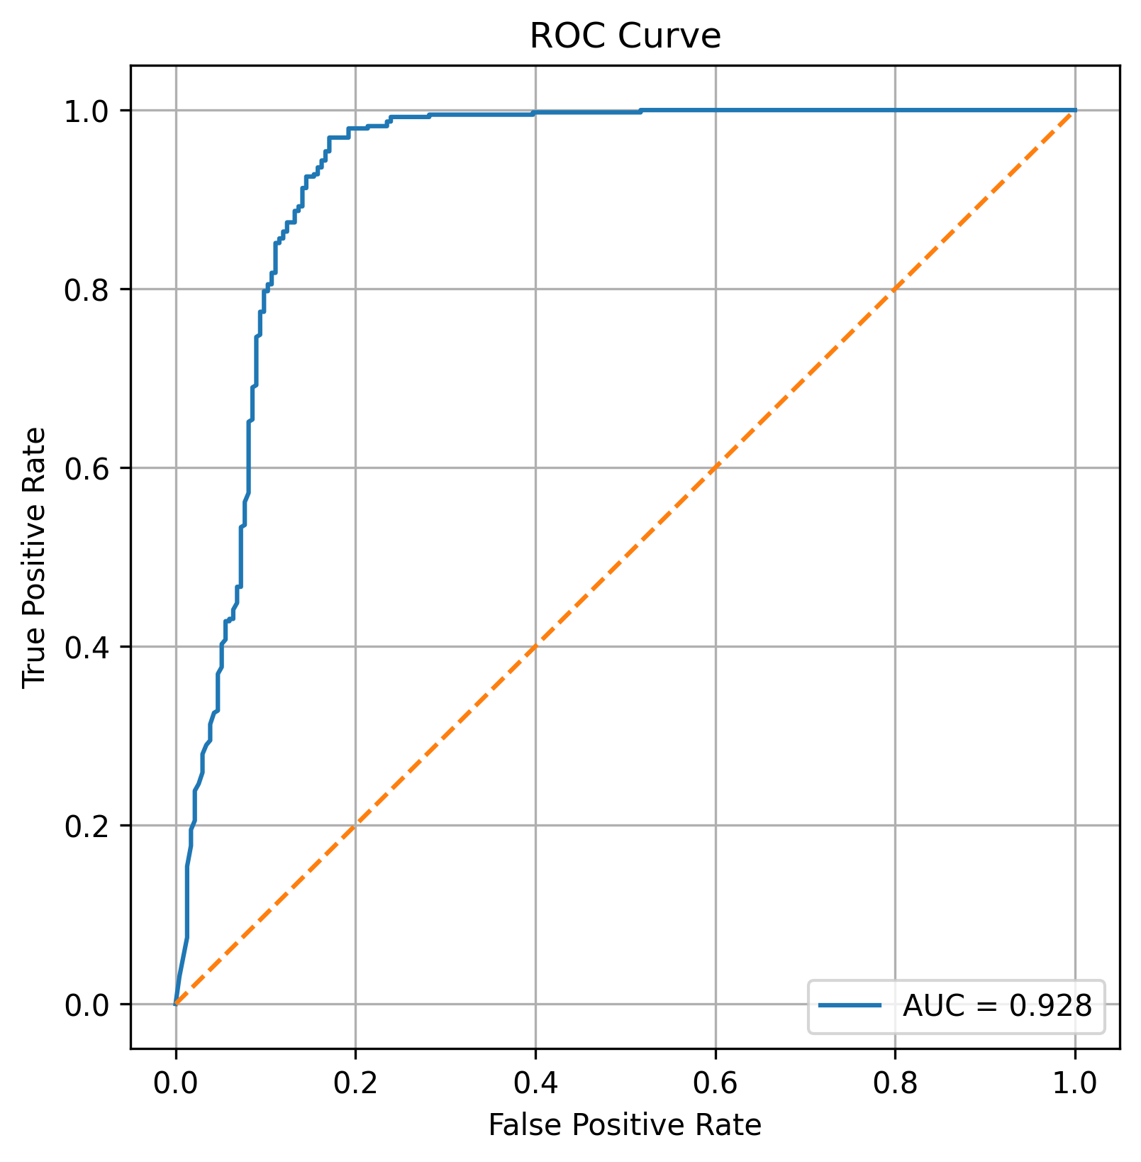
ROC Curve & AUC Score
The ROC curve shows the trade-off between sensitivity (true positive rate) and specificity (1 - false positive rate) across all classification thresholds for our pneumonia classifier.
The curve rises steeply toward the top-left corner, indicating that the model correctly identifies pneumonia cases with high sensitivity while keeping false positives relatively low.
The AUC of 0.928 demonstrates strong discriminatory ability – the model can reliably distinguish between Normal and Pneumonia X-rays far better than random guessing (orange diagonal line).

Slide 7
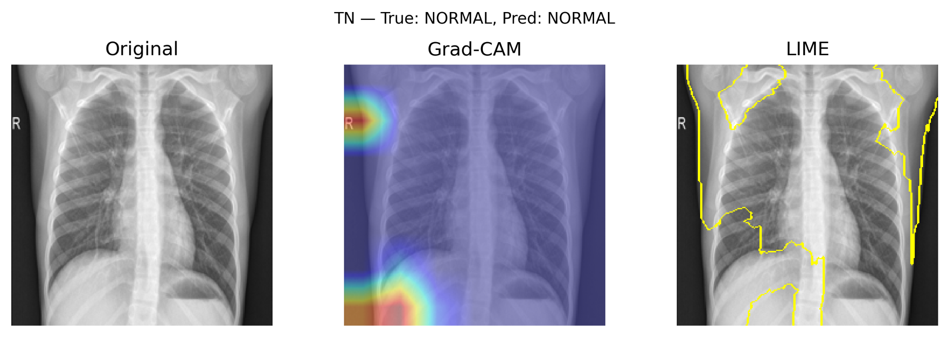
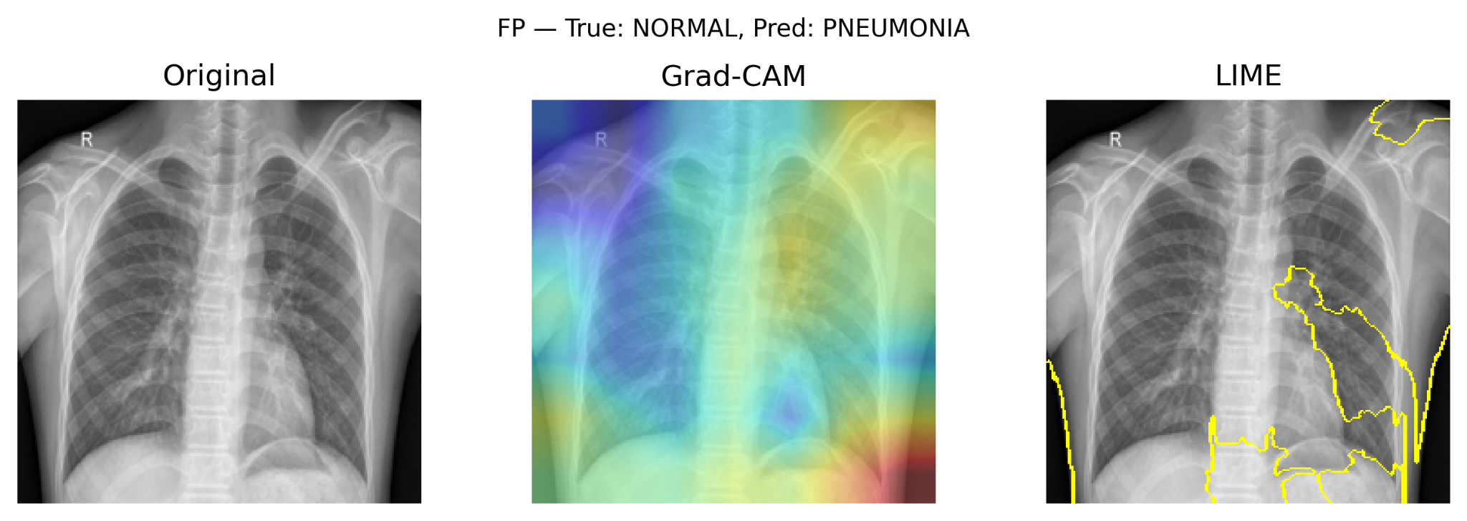
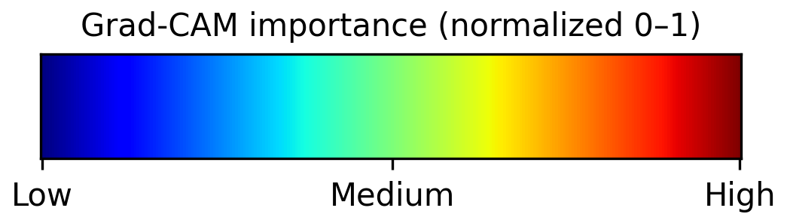
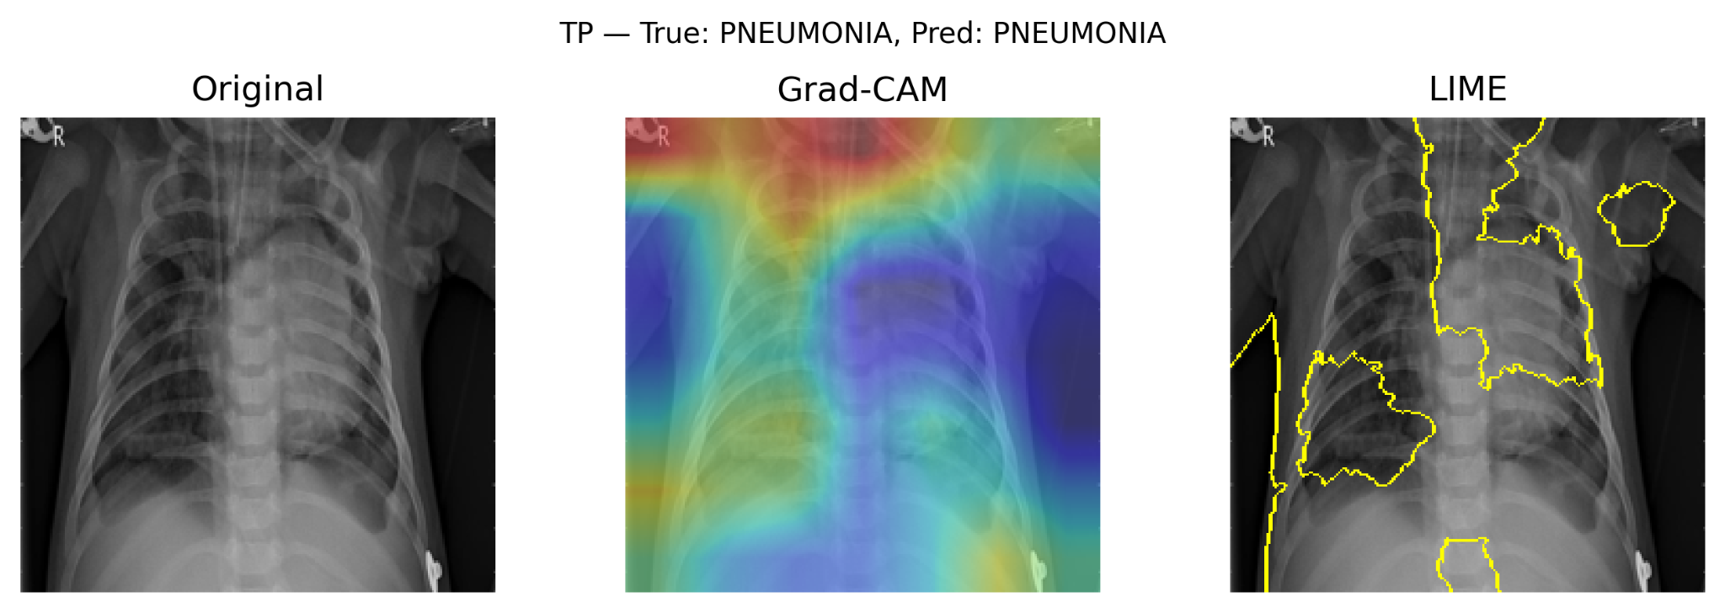
Explainability Results:
Grad-CAM v. LIME
Grad-CAM produces a smooth heatmap showing where the model looks.
LIME segments the image into superpixels – contiguous regions of similar intensity and texture – and evaluates their performance by measuring how masking each region affects the model’s prediction.
The highlighted superpixel regions (outlined in yellow) represent areas that locally contribute most to the predicted class.

Slide 8
Critical Analysis of XAI Methods
Grad-CAM
Strengths
Class-discriminative
Smooth, interpretable heatmaps
Low computation cost
Limitations
Coarse localization
Layer-dependent
Does not show what features (texture, shape) were used
LIME
Strengths
Model-Agnostic
Highlights discrete interpretable regions
Limitations
Unstable (different runs -> different masks)
Sensitive to superpixel segmentation
May highlight irrelevant edges

