Slide 1
Campus Connect Kenya
The Trusted Logical Layer for the Modern Comrade

Slide 2
The Fragmented Campus Experience
Students operate in the dark, leading to missed opportunities.
• Scams thrive in unverified public social groups.
• Critical academic/housing info is scattered.
• Result: Low user safety and communication loss.

Slide 3
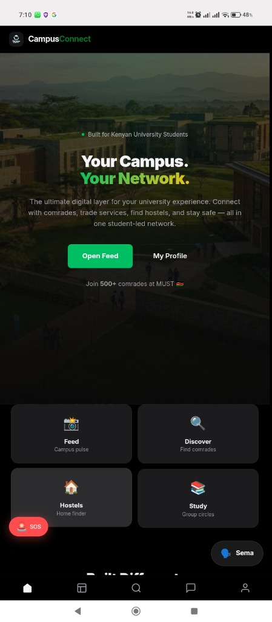
Bridging the Trust Gap
A centralized, real-time ecosystem built exclusively for students.
• Secure .ac.ke authentication foundation.
• Combines marketplace, social, and safety hubs.
• A unique alternative to fragmented platforms.

Slide 4
Multi-Stream Data Intelligence
Dynamic data driving every interaction.
• User: Profiles, Commerce, Reviews.
• Admin: Announcements & Timetables.
• System: Real-time SOS telemetry.

Slide 5
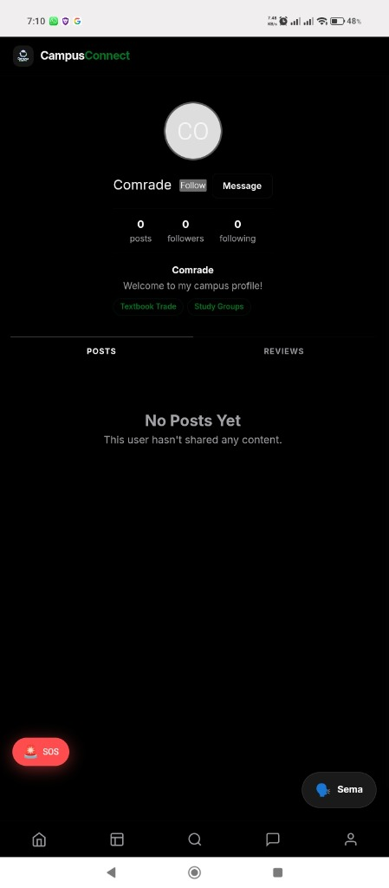
The Currency of Trust
Data is our filter for a high-trust campus economy.
• Verified domain marks prioritize genuine actors.
• Reputation metrics and 5-star ratings deter scams.
• Strategic Relevance: Physical & Digital Safety.

Slide 6
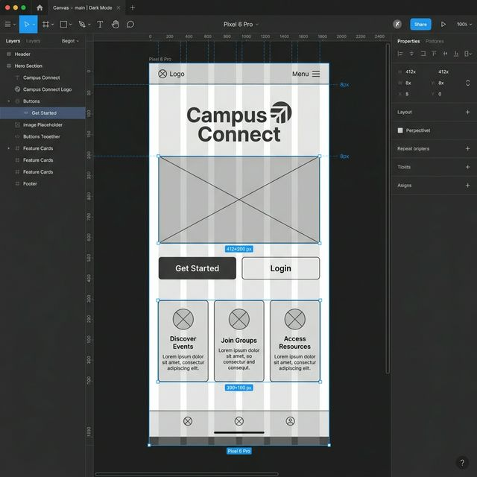
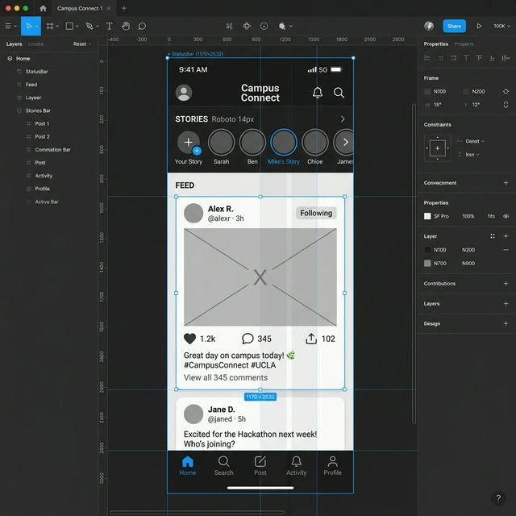
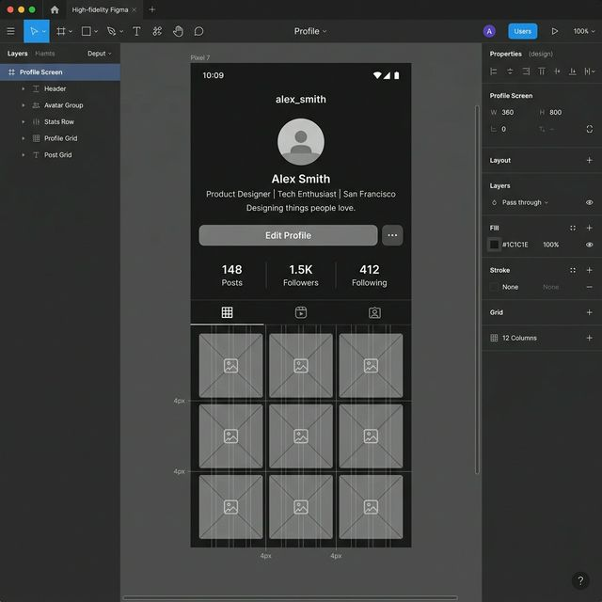
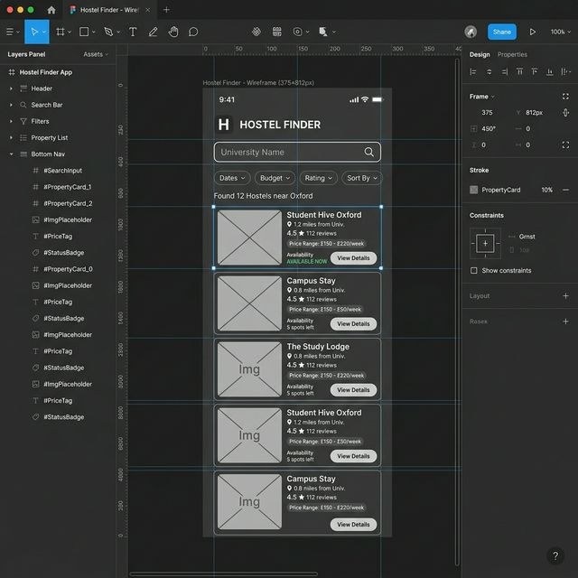
Blueprint.

Slide 7
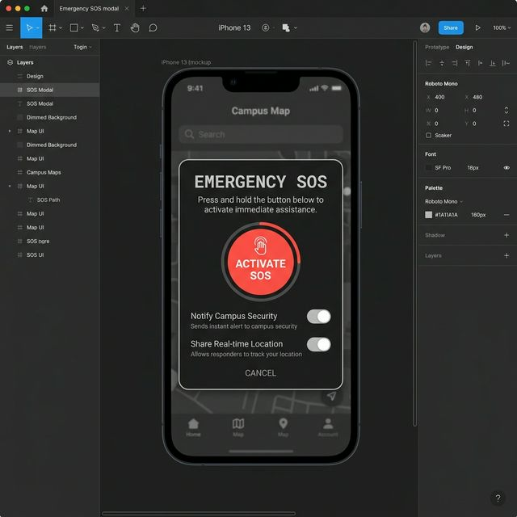
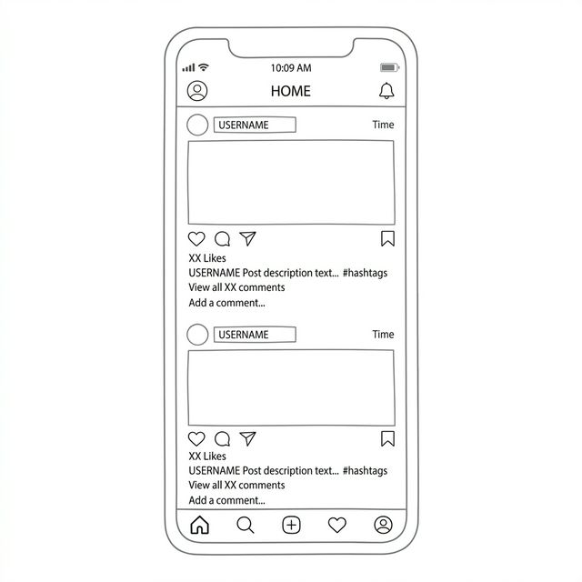
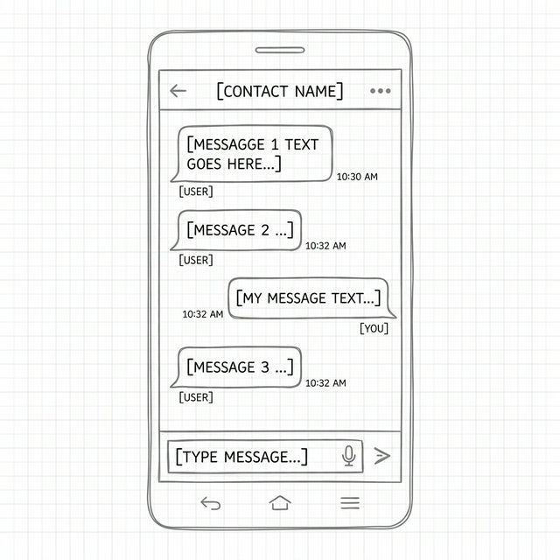
Blueprint -(Safety & Discovery screens).

Slide 8
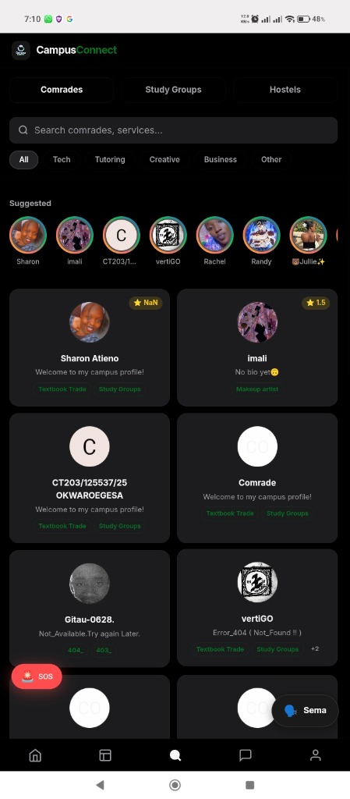
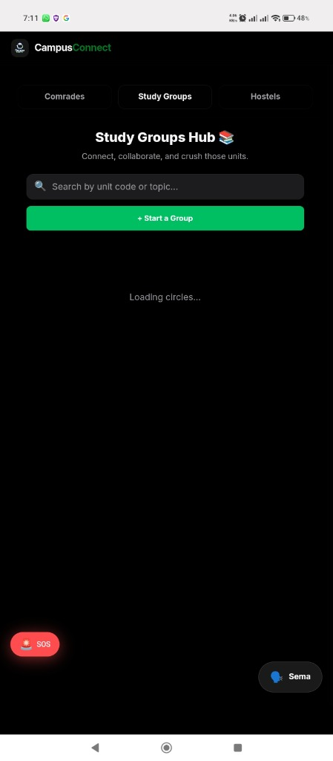
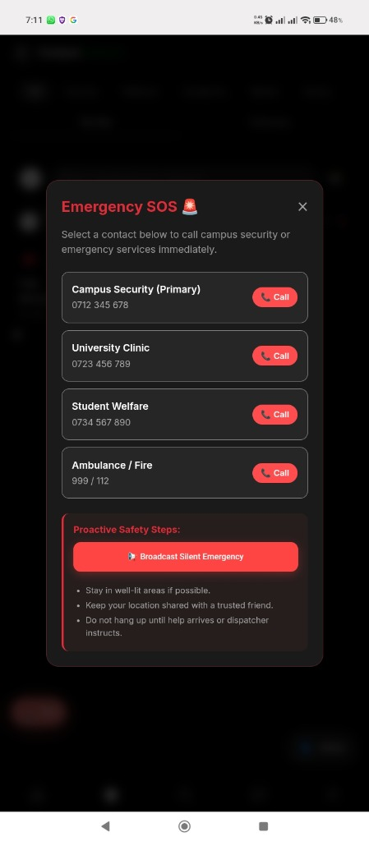
Functional Showcase: The Comrade Hub

Slide 9
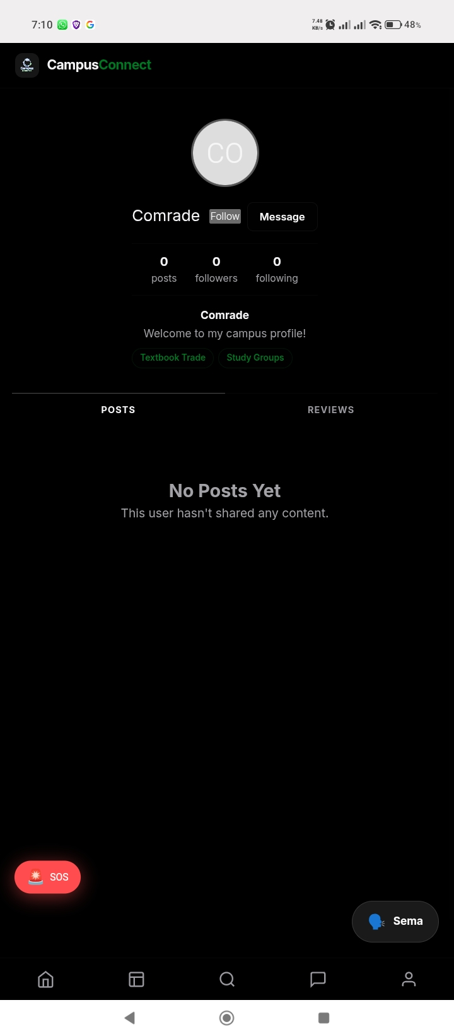
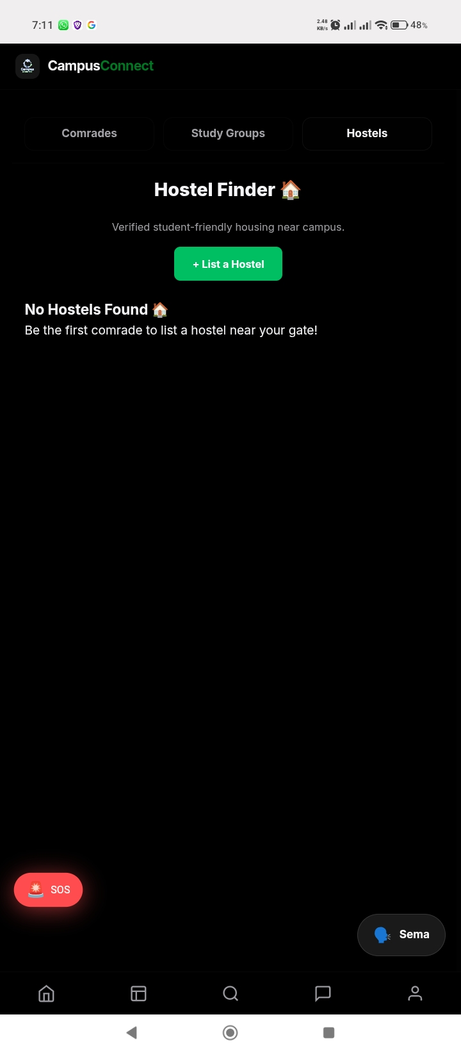
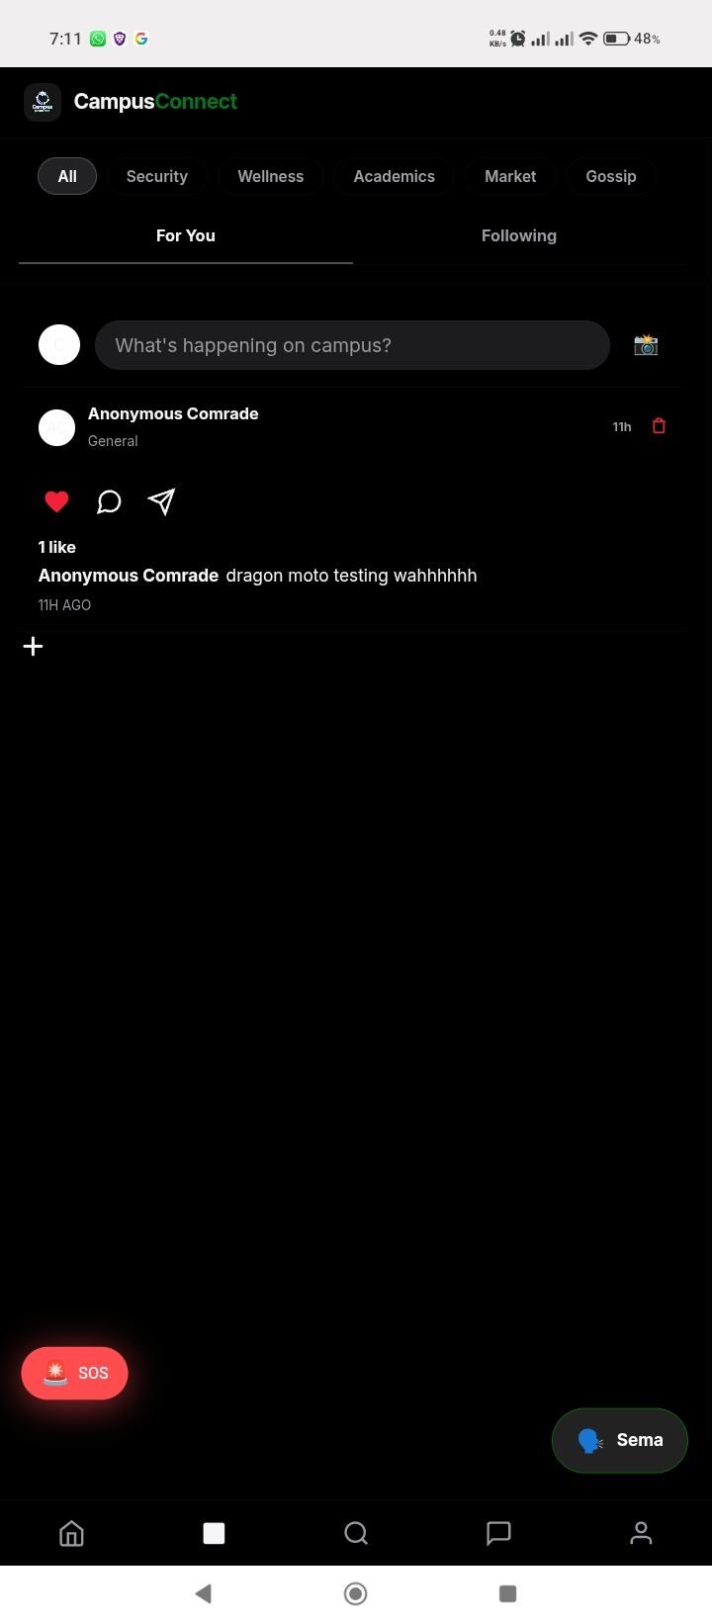
Functional Showcase: The Comrade Hub

Slide 10
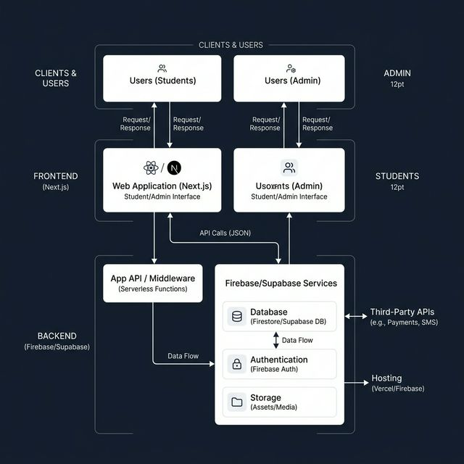
Systems Thinking Architecture
Interconnecting Users, Technology, and Unified Logic.
• Next.js/Firebase Hybrid Cloud architecture.
• Johns Hopkins parallel: Safety is an essential driver.
• A self-sustaining loop of trade and security.

Slide 11

User-Obsessed Design Strategy
Designed to solve the daily struggles of student life.
• A dedicated marketplace for side-hustles.
• One-tap verified housing (Hostel Finder).
• Community-led academic support (Study Groups).

Slide 12
Justification of Technical Decisions
Strategic choices based on evidence, not assumptions.
• Root Cause Analysis: Solved trust, not just tech.
• Assumption: Utility drives higher retention than social.
• Evidence-Based: Next.js + Firebase for speed.

Slide 13
Driving Institutional Impact
Transforming how students live, trade, and connect.
• Proactive SOS: Digital trigger to physical security.
• Democratization: Removing trade barriers for students.
• Synergy: Unified departmental academic tribes.

Slide 14
Future Horizons & Continuous Pacing
The roadmap for next-gen campus integration.
• Current: Network adoption hurdles.
• Future: Lipa-na-M-Pesa native API integration.
• Scale: Deploying across all national universities.

Slide 15
The New National Standard
Fragmentation is now a unified comrade system.
• Practical, scalable, and highly integrated.
• The Future of Digital Campus Life.

Slide 16
Questions & Discussions

