Slide 1
Campus Connect Web App
The Verified Ecosystem for Comrades CCU 3150: Integrated Thinking in Computing Group 5 (The Masterminds)

Slide 2
2. Problem Identification & Impact
Kenyan University campuses lack a single, verified ecosystem.
Where: Amplified across high-population campuses.
Who: Students face scams; Admins face decentralized chaos.
Why it matters: Unverified peers lead to dangerous P2P interactions and missed opportunities.

Slide 3
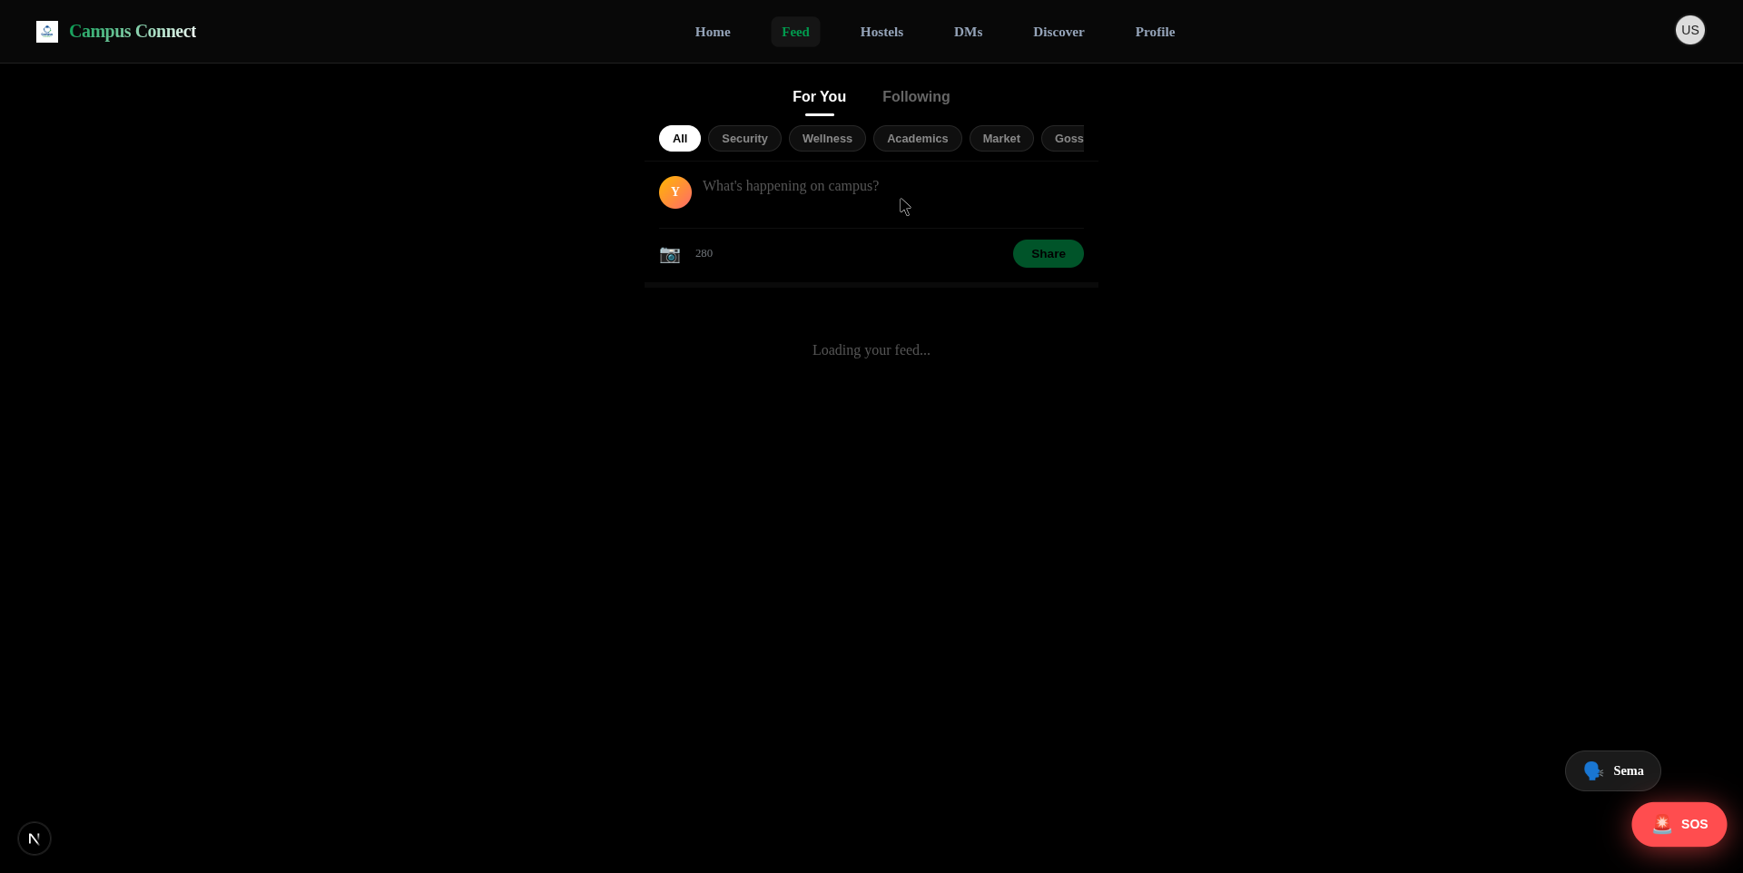
3. Selected Innovative Solution
Campus Connect: A holistic, high-trust social utility.
Innovative Edge: Integrating 'Sema' safety layers directly into the social peer-market.
Compared to WhatsApp/Email: We provide strict domain verification (.ac.ke) out-of-the-box.
Feasible, low-cost hybrid cloud architecture.

Slide 4
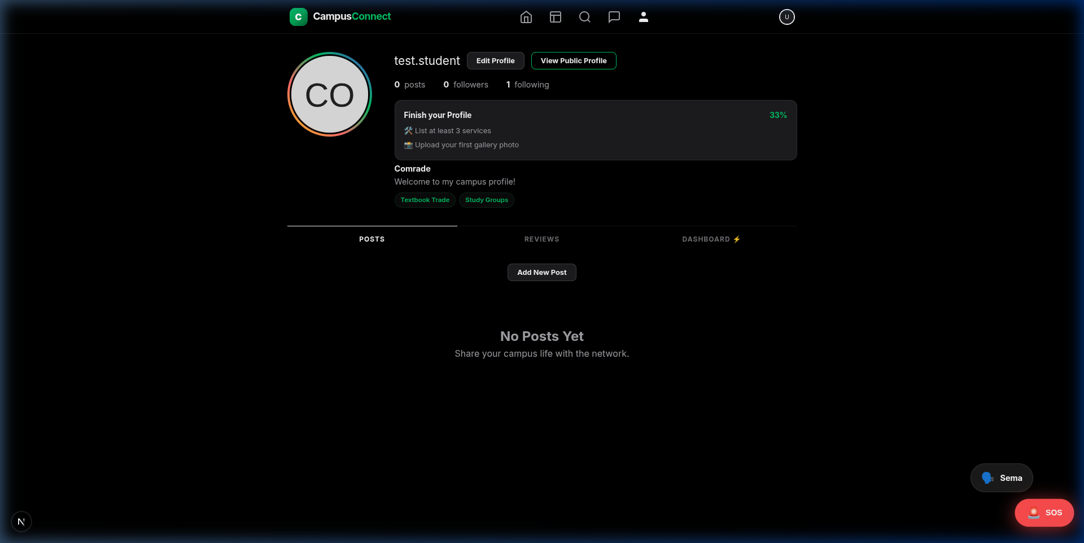
4. Data Source
Fueling the Trust Algorithm:
Where from: 100% User-Generated & Administrative inputs.
Types: Verified .ac.ke emails (Core ID), 5-Star Ratings (Reputation).
System Data: Geolocation matrices for Emergency SOS.

Slide 5
5. Data Understanding
Reputation is the currency of peer interaction.
Key Variable: Verified vs. Anonymous interactions.
Feature Importance: Review scores dictate hierarchy; bad actors are algorithmically suppressed.
Relevance: Data ensures physical and digital student safety.

Slide 6
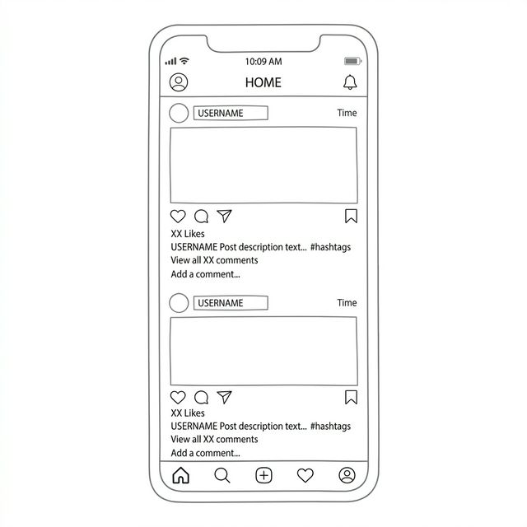
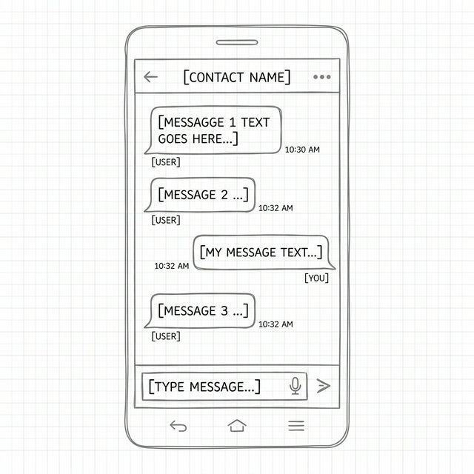
6. Proposed System Overview
Input (Student Need) → Process (Domain Auth) → Output (Secure Connection)

Slide 7
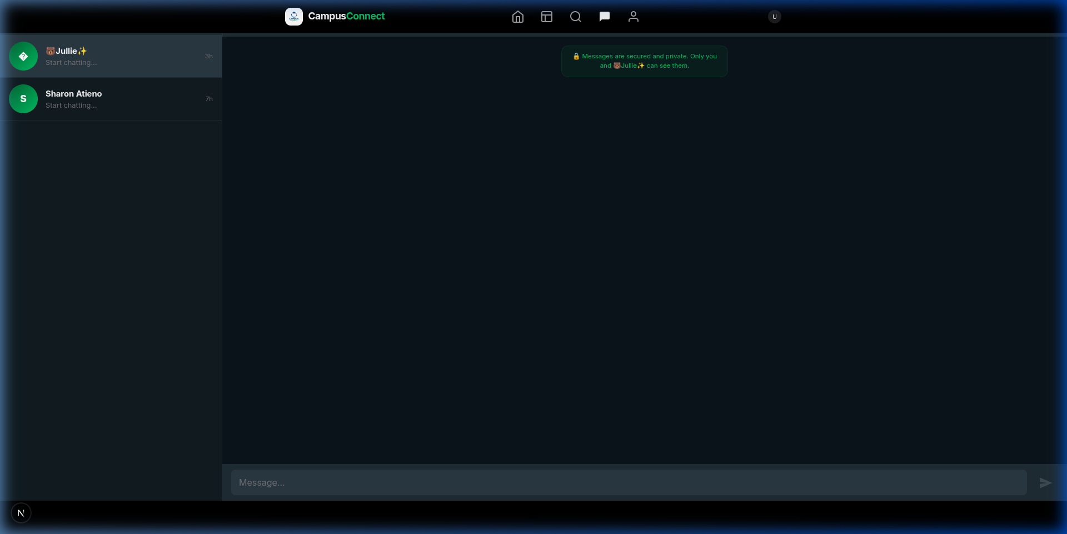
7. System Analysis (Systems Thinking)
Everything is connected. Support drives the core.
Users ↔ Technology ↔ Trust Data.
Johns Hopkins parallel: Safety & Auth aren't 'admin tasks', they are the foundation.
Input: Unverified student. Output: Managed, moderated ecosystem.

Slide 8
8. Empathize (Design Thinking)
Designing for the vulnerable student.
Users: Students fighting financial constraints and isolation.
Needs: A localized side-hustle market and instant peer support.
Challenges: Fear of scams on public Facebook/WhatsApp groups.

Slide 9
9. Critical Thinking Techniques
Root Cause Analysis & Assumption Checking
Root Cause: Commerce fails not from lack of supply, but lack of trust.
Assumption Assessed: Students want utility, not just 'another social media app'.
Evidence-Based: Data structures built to directly answer security fears.

Slide 10
10. Benefits of the Solution
Seamless, safe, and highly synergistic.
Physical Safety: Emergency SOS tied directly to verified peers.
Economic: Democratizes the student market without scam risks.
Social: Cross-departmental connection and study groups.

Slide 11
11. Limitations & Improvements
Where we pivot next:
Current Barrier: Network latency outside main campus zones.
Current Barrier: Cold-start problem for adoption.
Future Innovation: Deep Lipa-na-M-Pesa integration.

Slide 12
12. Conclusion
Campus Connect isn't just an app. It's a holistic ecosystem.
Transforms a fragmented university experience into a unified, high-performance platform.
Built strictly on Systems Thinking fundamentals.

Slide 13
Thank You. Questions?

