Slide 1
Campus Connect Web App

Slide 2
2. Problem Identification & Impact
Fragmented University digital ecosystems lead to safety risks.
• Students face scams on unvetted platforms.
• Lack of centralized academic & social synergy.

Slide 3
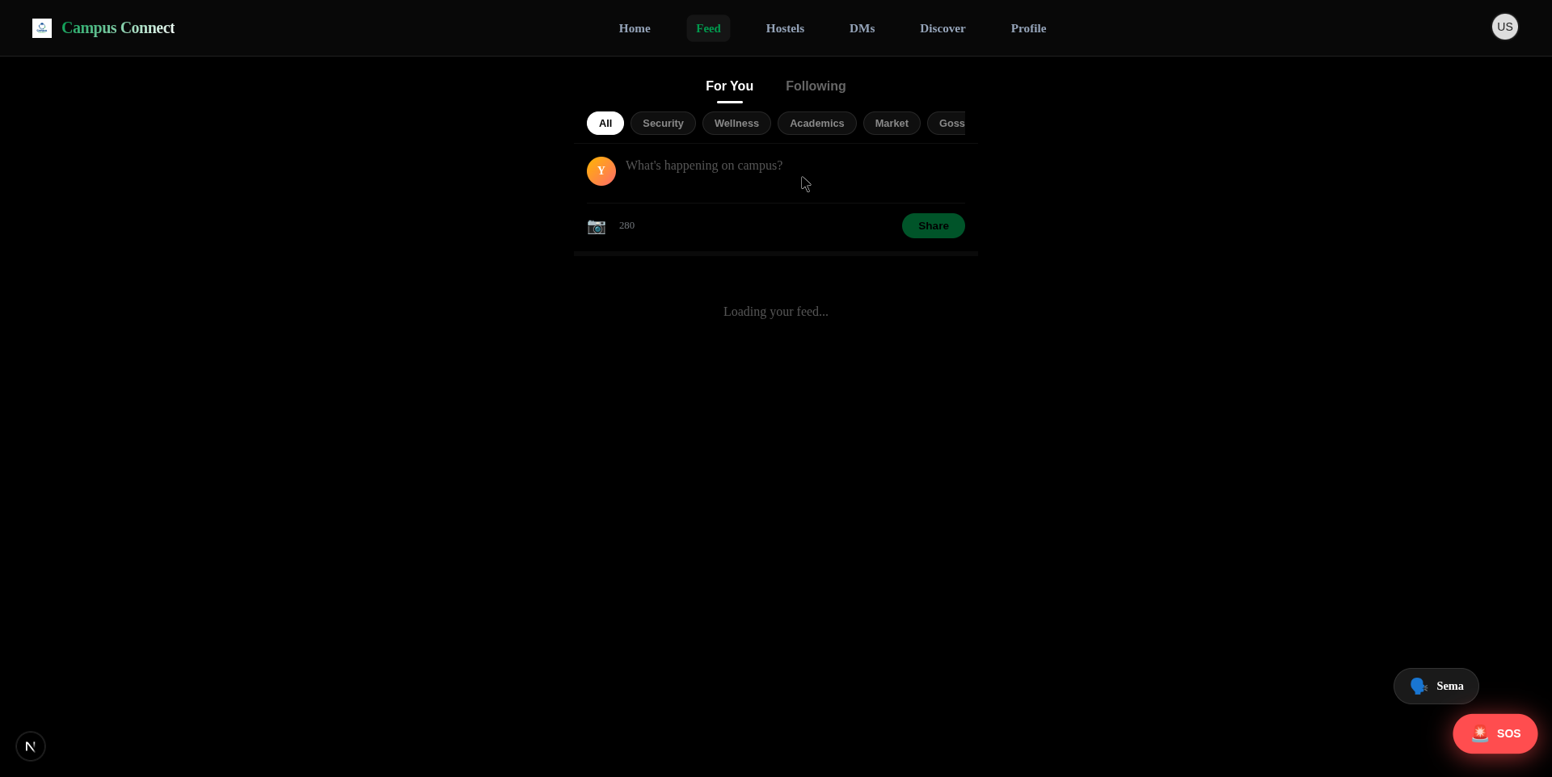
3. Selected Innovative Solution
High-trust social utility ecosystem.
• Safe-comms & verified commerce (.ac.ke auth).
• Integrated safety layers (Sema & SOS).

Slide 4
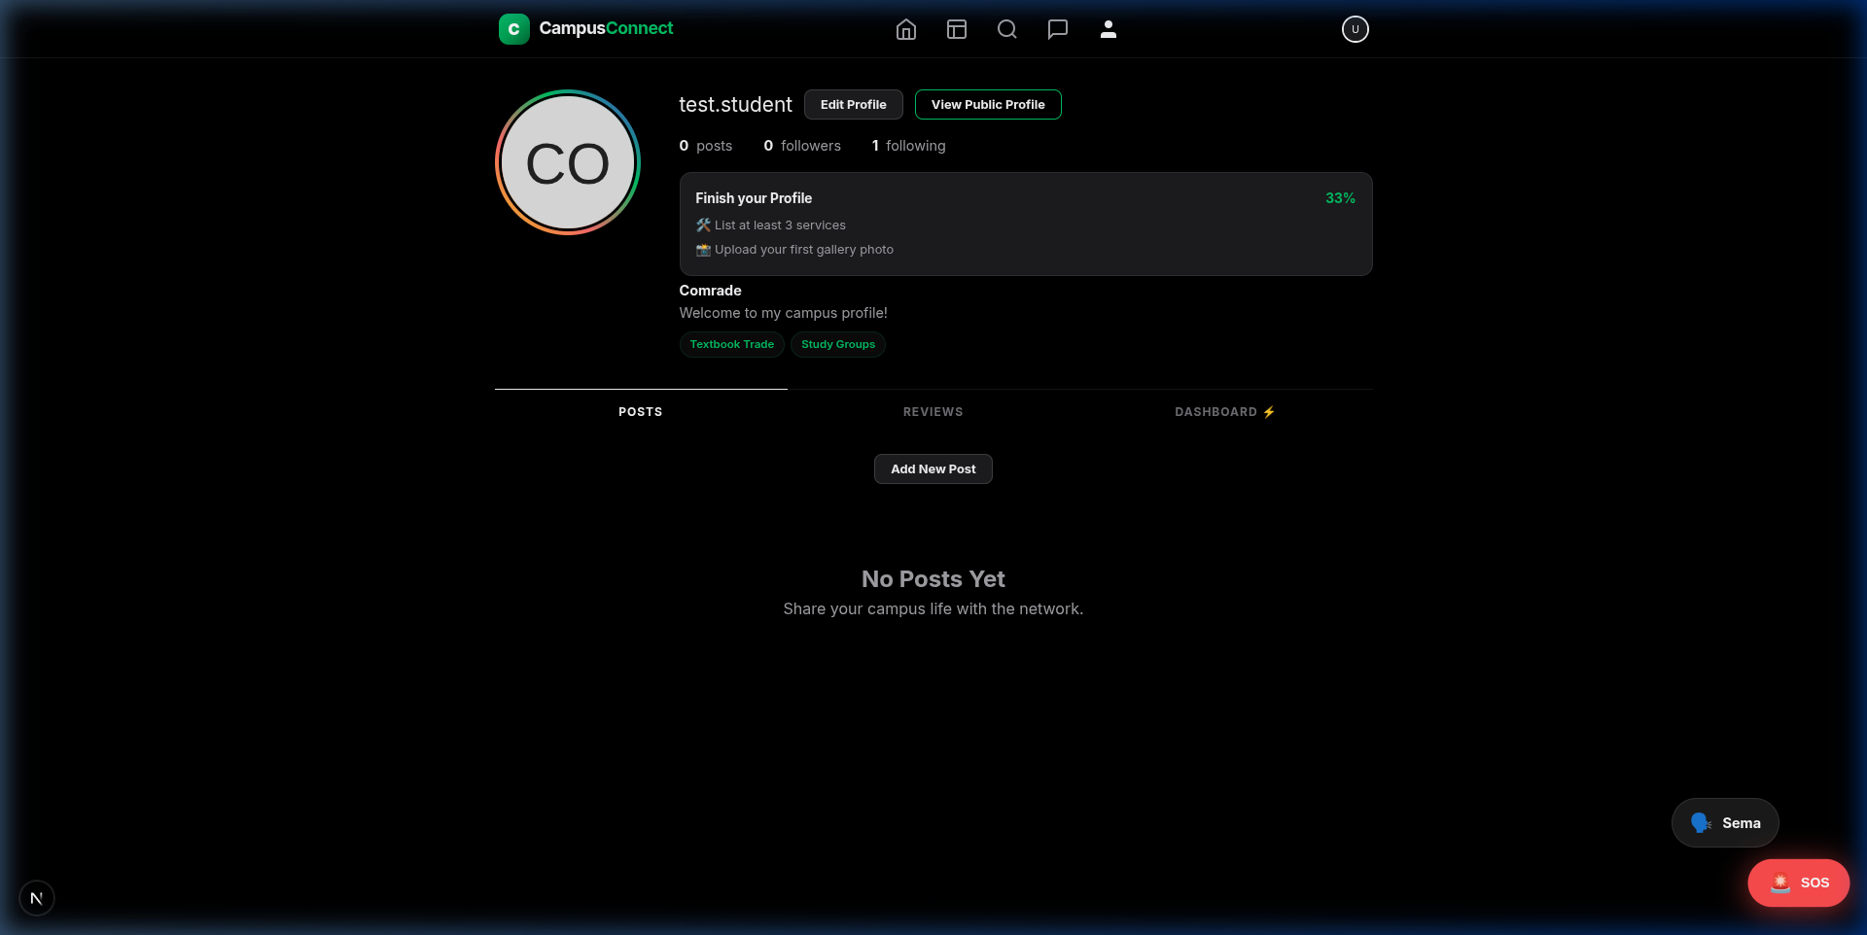
4. Data Source
Verified & Crowdsourced Intelligence
• Real-time university domain verification.
• Peer-to-peer reputation metrics.

Slide 5
5. Data Understanding
Trust as a primary data variable.
• Reputation scores dictate hierarchy.
• Emergency telemetry ensures rapid response.

Slide 6
6. Proposed System Overview
From Input to Verified Action
• User request → Domain Validation → Secure Hub Output.

Slide 7
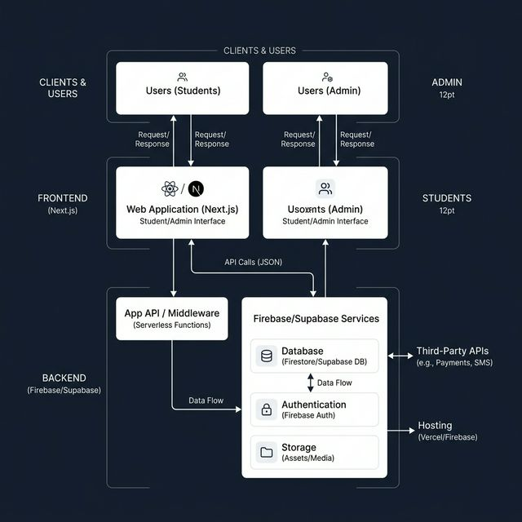
7. System Analysis (Systems Thinking)
Components, Relationships, and Dynamic Flow
• Components: Users (Students/Admin), Tech (Next.js/Firebase), Data (Auth/Reputation).
• Relationships: Integration where trust drives commerce and safety drives engagement.
• Inputs/Outputs: Unverified student data (I) → Domain validation → Verified Ecosystem (O).
• Case Study: Like Johns Hopkins, support units (Auth/SOS) are our system foundation.

Slide 8
8. Empathize (Design Thinking)
Designing for student safety and connection.
• Localized market for students, by students.

Slide 9
9. Critical Thinking Techniques
Root Cause Analysis & Assumption Checking
• Solved the trust gap, not just the communication gap.

Slide 10
10. Benefits of the Solution
High-trust, native-feeling, and scalable.
• Physical security + Economic democratization.

Slide 11
11. Limitations & Improvements
Barriers to entry & expansion.
• Need for M-Pesa API & broader domain support.

Slide 12
12. Conclusion
The Future of Kenyan Campus Life.
• A unified platform built on systems thinking.

Slide 13
Thank You. Questions?

