Slide 1
Campus Connect Kenya
Integrated Thinking in Computing - Group 5

Slide 2
2. Problem Identification & Impact
Fragmented campus ecosystems create risk.
• Students face scams on unvetted apps.
• Centralized academic info is missing.
• Impact: Low-trust campus economy.

Slide 3
3. Selected Innovative Solution
A Unified high-trust Student Layer.
• Verified .ac.ke ecosystem.
• Integrated safety (Sema & SOS).
• Feasible, student-focused tool.

Slide 4
4. Data Source
Verified University intelligence.
• Real-time domain validation.
• User-generated trust metrics.
• System-led safety telemetry.

Slide 5
5. Data Understanding
Reputation is our core feature.
• Review scores filter bad actors.
• Data ensures physical student safety.
• Transparent trust architecture.

Slide 6
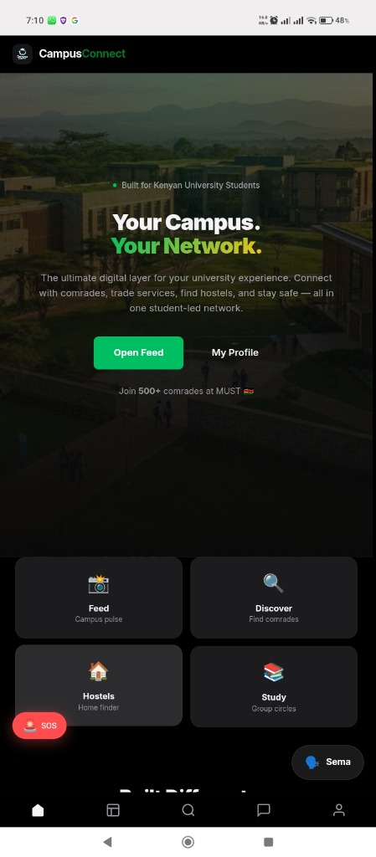
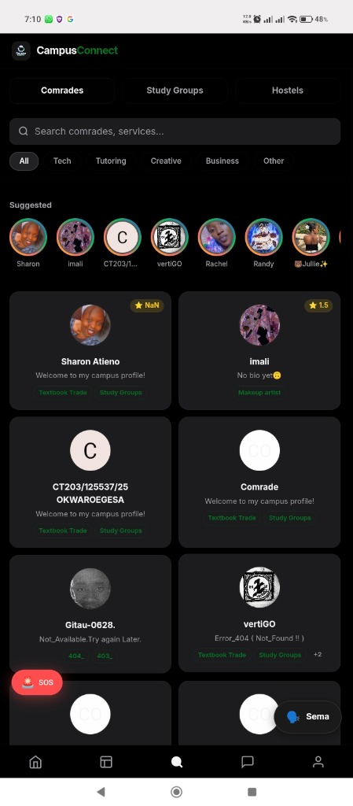
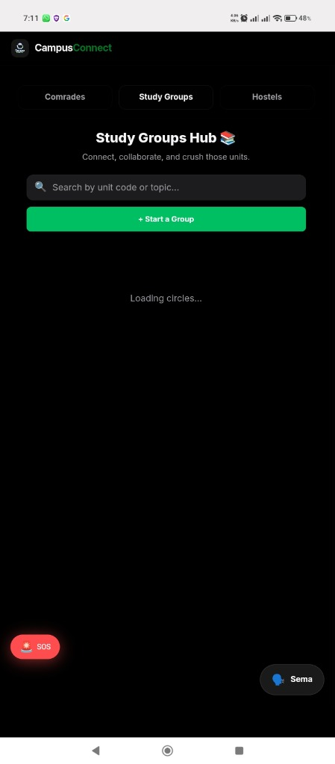
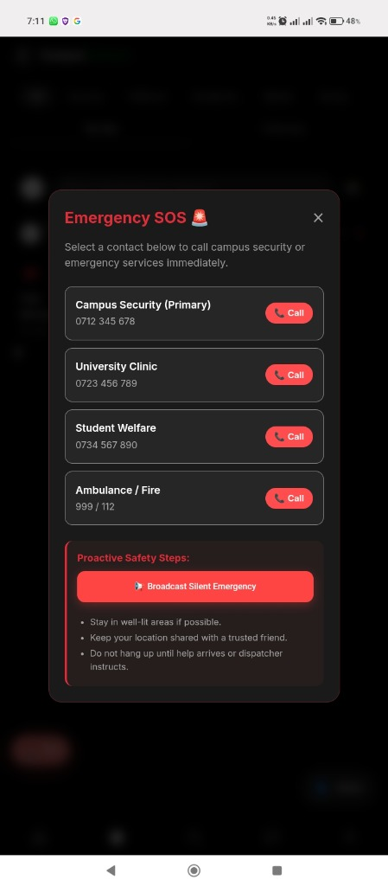
6. Proposed System Overview: Example Showcase

Slide 7
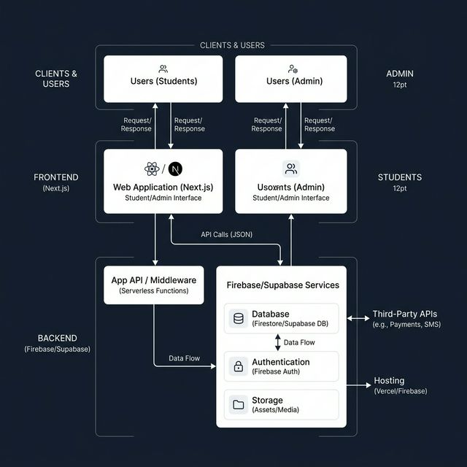
7. System Analysis (Systems Thinking)
A Holistic Interconnected Network
• Users ↔ Tech ↔ Trust Data.
• Support units are core foundations.
• Input: Unverified → Output: Secure Hub.

Slide 8
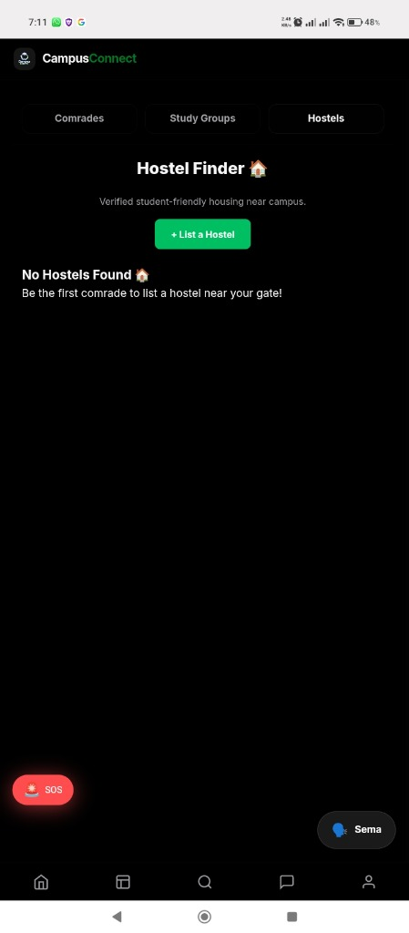
8. Empathize (Design Thinking)
Designing for Student Security.
• Safe side-hustles.
• Affordable housing search.
• Peer study collaboration.

Slide 9
9. Critical Thinking Techniques
Root Cause & Assumption Analysis
• Problem is trust, not communication.
• Assumption: Utility over Social Media.
• Evidence: Data-driven security choice.

Slide 10
10. Benefits of the Solution
Safety, Community, and Economy.
• One-tap emergency protection.
• Democratized peer marketplace.
• Synergistic campus connection.

Slide 11
11. Limitations & Improvements
Expansion and Optimization.
• Constraint: Initial network adoption.
• Expansion: Full M-Pesa API integration.
• Future: Multicampus scalability.

Slide 12
12. Conclusion
One Campus. One Secure Network.
• Transforming fragmentation into unity.
• The Future of Digital Campus Life.

Slide 13
THANK YOU. Questions?

