Slide 1
Campus Connect Web App

Slide 2
2. Problem Identification & Impact
Fragmented ecosystems lead to safety & economic risks.
• Unverified peers lead to scams.
• No centralized campus layers.

Slide 3
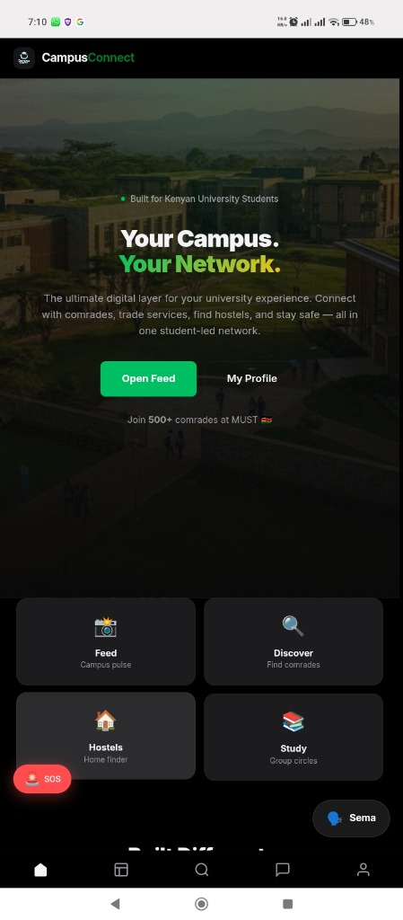
3. Selected Innovative Solution
The Ultimate Student Layer
• Verified .ac.ke ecosystem.
• Safety & Commerce integration.

Slide 4
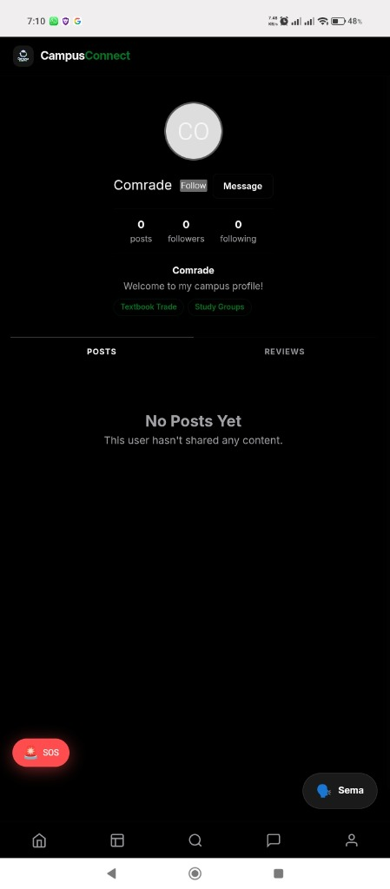
4. Data Source
Verified University Intel
• .ac.ke Domain Verification.
• Verified Profiles & Reputations.

Slide 5
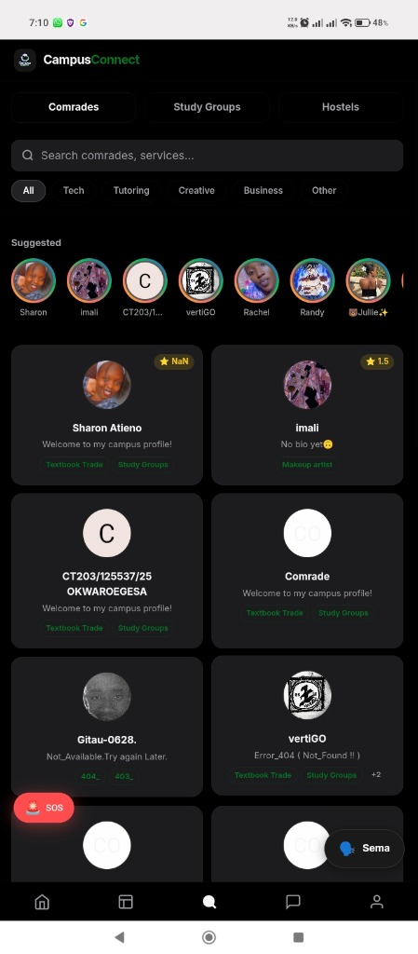
5. Data Understanding
Trust-Centered Data Hierarchy
• Reputation metrics drive visibility.
• Verified status prevents fake actors.

Slide 6
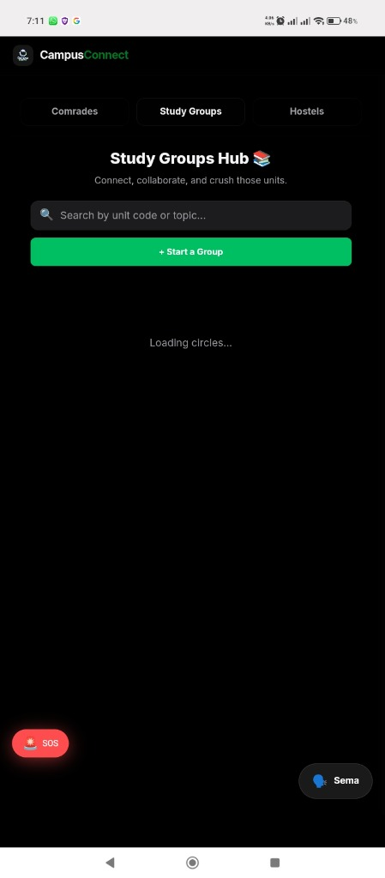
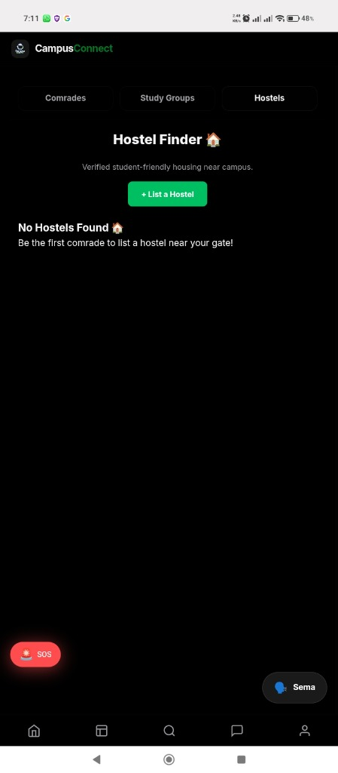
6. Proposed System Overview

Slide 7
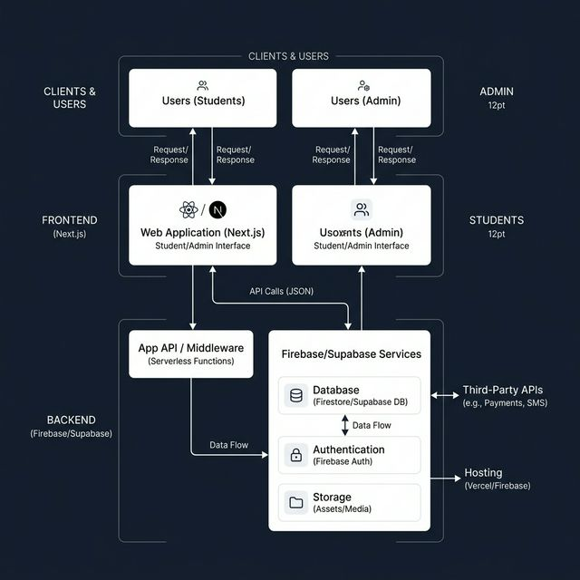
7. System Analysis (Systems Thinking)
A Holistic, Interconnected Network
• Components: Users, Tech, Data.
• Support units drive the core reliability.

Slide 8
8. Empathize (Design Thinking)
Focusing on Student Needs
• Safe side-hustles.
• Affordable, verified housing.
• Academic collaboration hubs.

Slide 9
9. Critical Thinking Techniques
Root Cause & Assumption Analysis
• Problem: Not lack of tools, but lack of trust.
• Assumption: Students prefer verified networks over public socials.

Slide 10
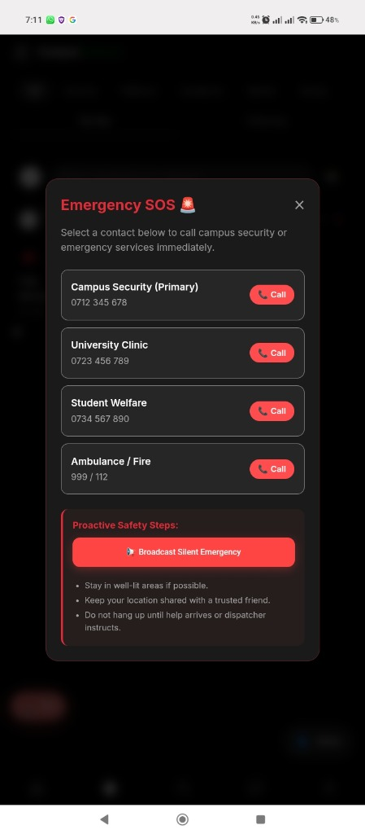
10. Benefits: Safety & Community
Proactive Protection for Comrades
• Instant Emergency SOS system.
• Direct connection to campus security.

Slide 11
11. Limitations & Future Improvements
Scaling beyond the campus gates.
• Need for native M-Pesa API.
• Expansion to all public and private universities.

Slide 12
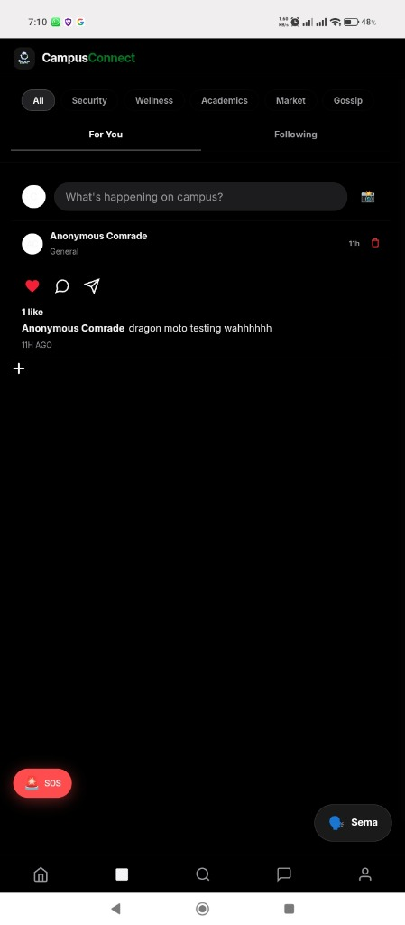
12. Conclusion
One Campus. One Verified Network.
• Built on systems thinking to solve real-world student problems.

Slide 13
Thank You. Questions?

