Slide 1
Campus Connect Kenya
(Visual Presentation)
CCU 3150: Integrated Thinking in Computing
Group 5 (The Masterminds)

Slide 2
Problem Identification
Problem: Fragmented university digital ecosystems.
Result: Unsafe peer commerce, scattered academic comms.
Impact: Students fall victim to scams; miss vital opportunities.

Slide 3
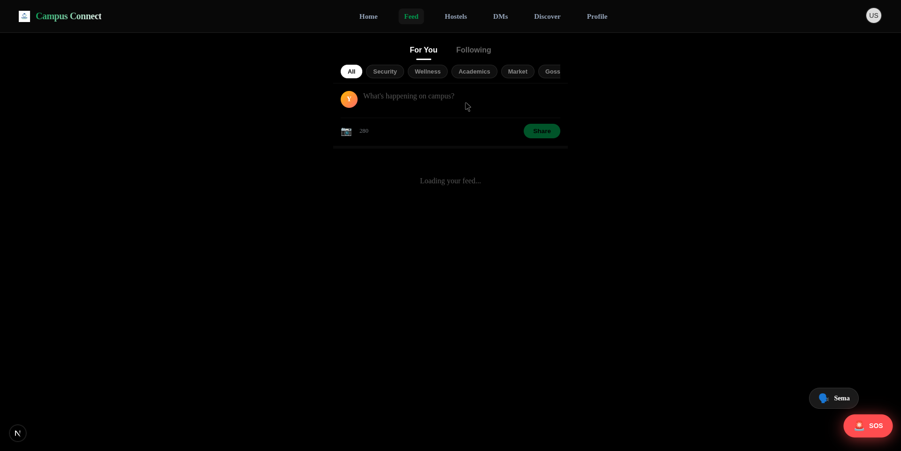
Our Innovative Solution
Campus Connect Web App
• Centralized high-trust network (.ac.ke authentication).
• Integrates peer commerce, social feeds, and safety.

Slide 4
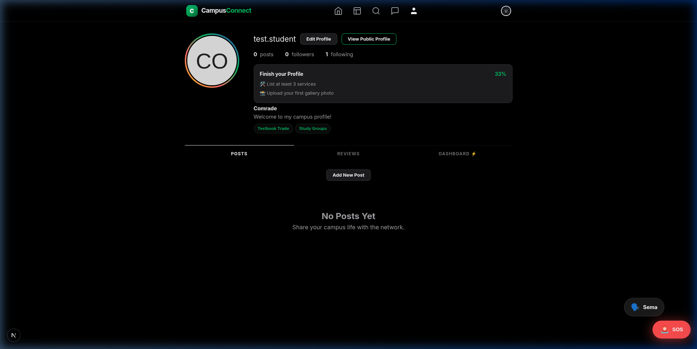
Data Sources & Understanding
User-generated: Verified profiles, marketplace ratings.
• System-generated: Emergency SOS geolocation.
• Why? High-trust peer-review data deters scams.

Slide 5
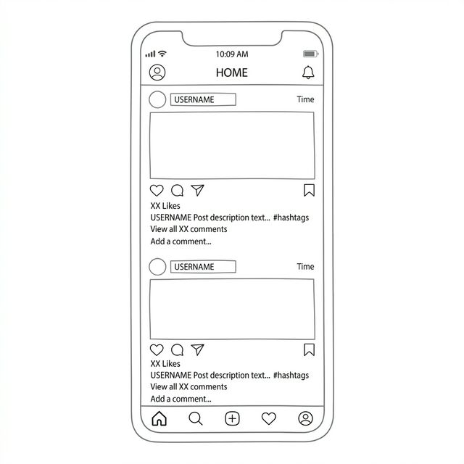
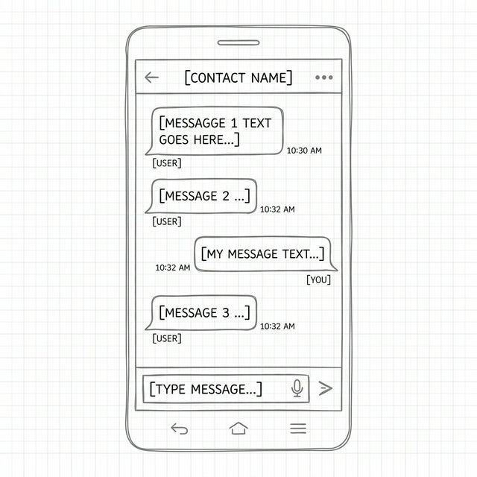
System Wireframes (Early Iteration)
Layout structuring priority:
• Native mobile ergonomics.
• Edge-to-edge content blocks.
• Clear navigational tabs.

Slide 6
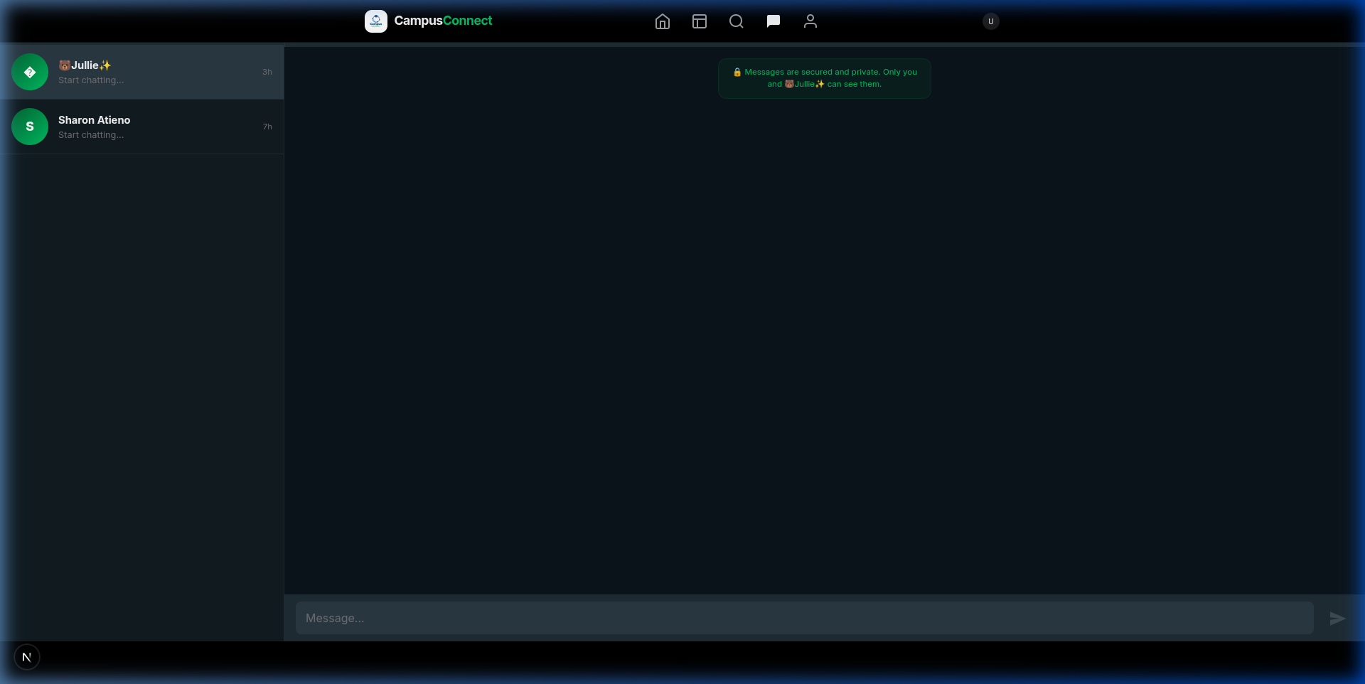
Proposed System Overview (Final Output)
Real-Time Messaging:
• Desktop WhatsApp-style Immutable Interface.
• Edge-to-edge chat UI.
• Fully synchronized across mobile & web.

Slide 7
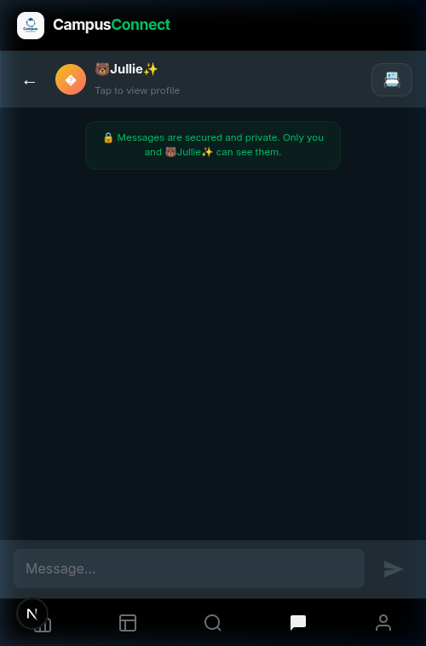
Systems Thinking Integration
Safety features are not 'support'.
• They are the core driver of the ecosystem.
• Integrated Emergency SOS triggers directly in the UI.

Slide 8
Empathize (Design Thinking)
Users: Verified Students, Administrators, Security.
Needs: Trust, fast comms, centralized commerce.
Interaction: Rapid P2P trade under a moderated umbrella.

Slide 9
Critical Thinking Techniques
Root Cause Analysis: Commerce failure is a trust issue.
Assumption Checking: Validated needs through user data.
Evidence-Based: Analyzed Johns Hopkins cases for system dynamics.

Slide 10
Conclusion
Benefits: Unifies the campus experience securely.
Limitations/Future: Requires strong M-Pesa integration.
Conclusion: Campus Connect is the ultimate Comrade Ecosystem.

