Slide 1
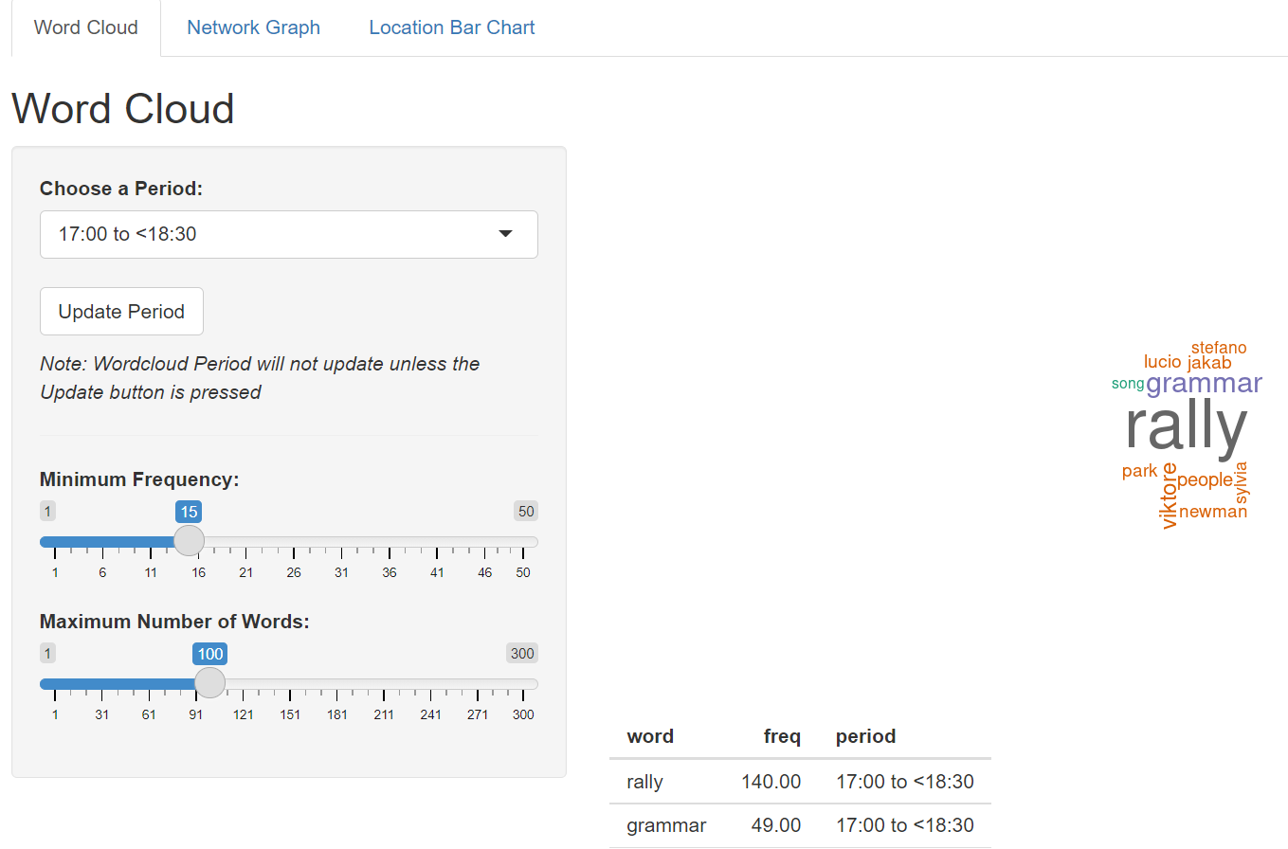
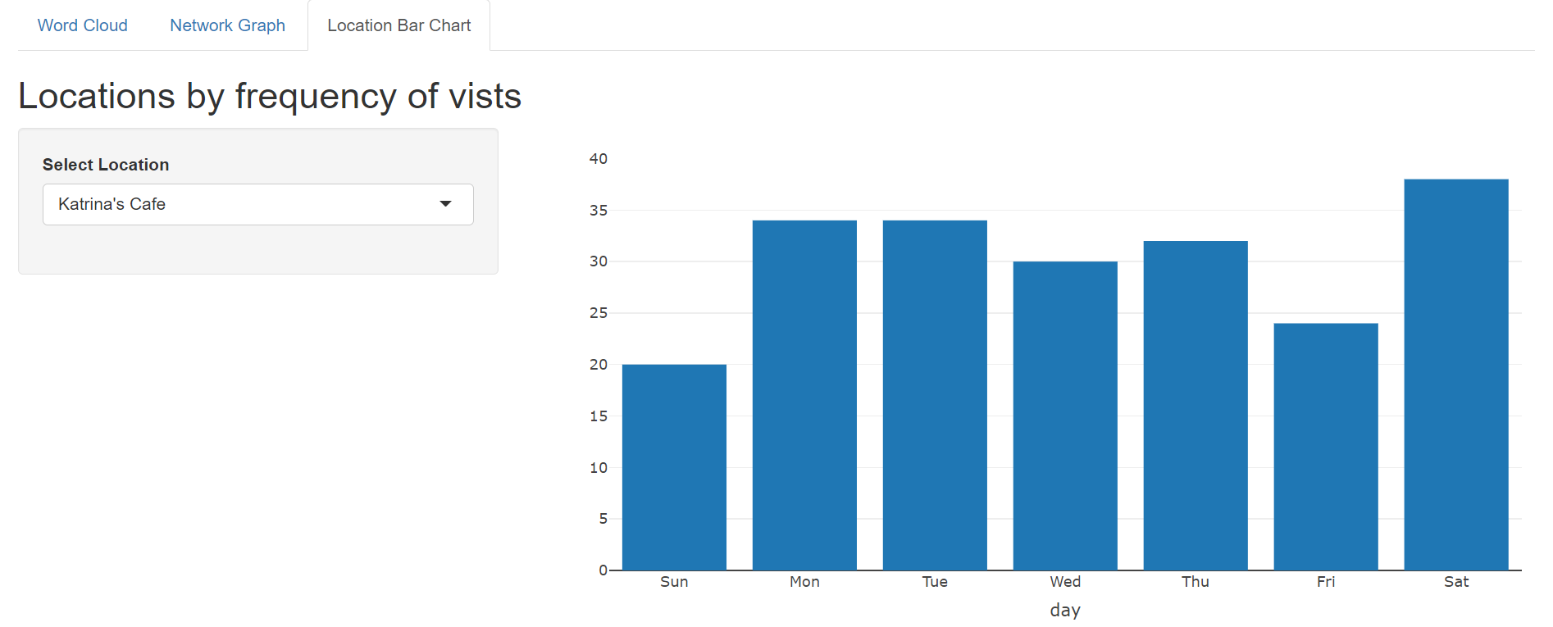
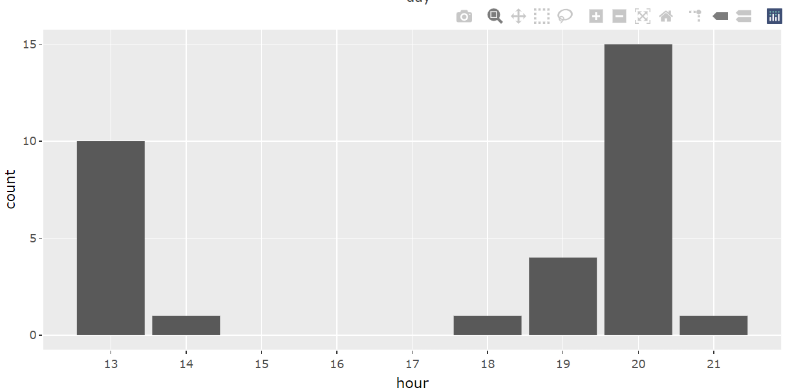
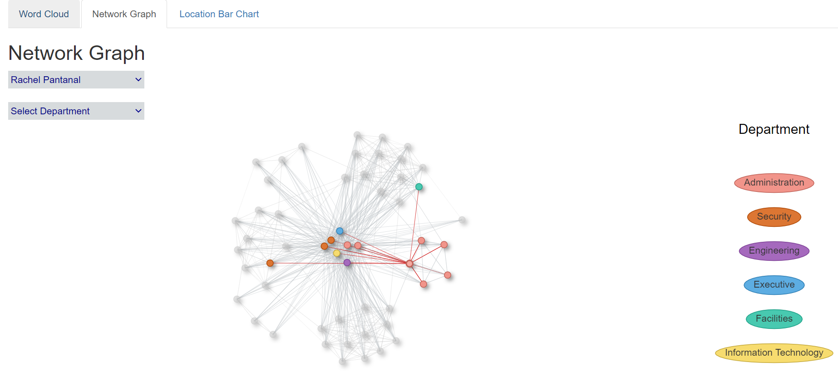

Slide 2




(a) Whole Period
(b) 17:00 to <18:30
(c) 18:30 to <20:00
(d) 20:00 to 21:34

Slide 3
