Slide 1
Sustainable Energy in
Puerto Rico
How soon can we expect this future?

Slide 2
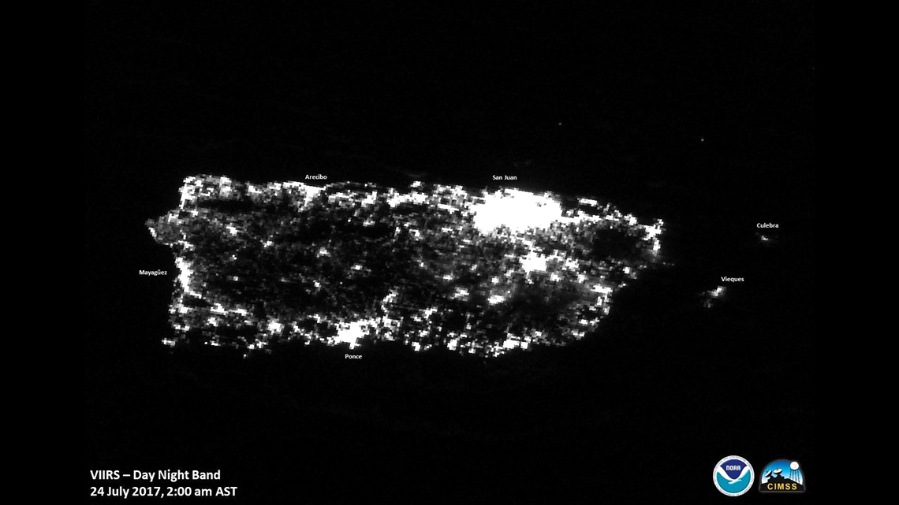
Project Objective
In this project we take on the ambitious goal set by the government of Puerto Rico to have a 40% sustainable energy grid by 2025.
Our primary objective is to conduct an assessment of the accuracy in this ambitious target and analyze the progress made towards the transition to sustainable energy within Puerto Rico.

Slide 3
Supporting Data
According to the US Energy Information Administration (EIA)
“Puerto Rico consumes almost 70 times more energy than it produces.”
“Puerto Rico’s energy consumption per capita is is about one-third of the 50 U.S. states.
Information from: eia.gov

Slide 4
Description
Our approach to tackle this goal was to gather the rate of change to renewable energy over the years from Puerto Rico and other comparable countries. Using the dataset that provides global information for energy usage for the past 20 years.

Slide 5
SQL Part
We wanted to find a correlation with solar panel installation in Puerto Rico with the renewable energy growth.
Issue:
We spent a LOT of time trying to find this type of data
We were not successful finding this type of data

Slide 6
What NEXT? 1. We created new schemas directly in MySQL Workbench 2. We added 2 additional tables in SQL to validate global correlations and validate % of people without energy globally Hypothesis: % of families that could potentially benefit from Renewable energy Issue: Some data DISAPPEARED * Had to spend additional time loading the data through the Python

Slide 7
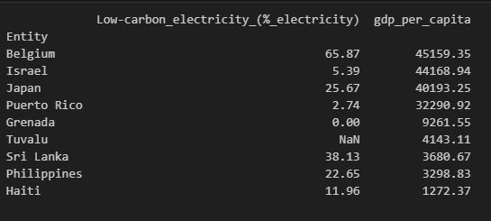
Insights
In our initial research, we hypothesized there might be a correlation between population density, gdp per capita and the percentage of renewable energy available in these countries.
In this hypothesis we used a groupby method to filter these countries by population density and a value sort by highest gdp per capita.
In our comparison, we found no direct correlation with gdp per capita and the percentage of renewable energy. Puerto Rico is 4th in gdp per capita, however is 7th in low carbon energy percentage out of 10 countries.

Slide 8
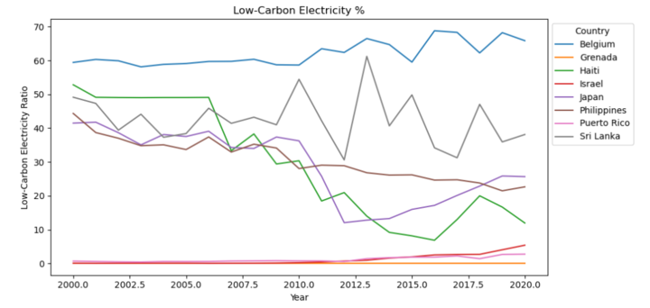
How do we achieve this? With Data…
With the dataset we created a model to compare the renewable energy rates over the last 20 years with these countries that have similar population density to Puerto Rico.

Slide 9
Which are the renewable energies in PR?
01
Solar Energy
02
Wind Energy
03
Hydropower
04
Biomass
Typically obtained with solar farms or private solar panels. (residential, industrial & commercial)
Punta Lima and Santa Isabel wind farms to name a few in PR.
There are only a few in PR and are very outdated, there were talks to update the operating ones to modern standards.
Biomass in the island is very limited due to regulations, this is renewable with the least presence.

Slide 10
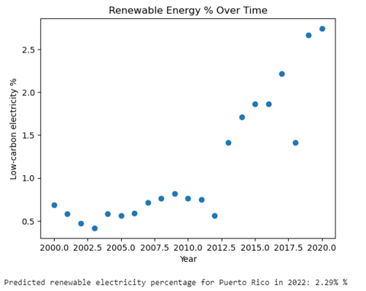
What we found…
Rate of change
Utilizing a Linear Regression model we were able to find the Predicted renewable electricity percentage for Puerto Rico in 2025 is 2.70%
With an average rate of change of 0.10350205 per year.
To reach 100% sustainable energy by 2050, Puerto Rico needs a rate of change of 3.49% per year.

Slide 11
Conclusion
In conclusion, with our findings of Puerto Rico’s current fossil dependence and amount of renewable energy available.
The 40% renewable energy goal by 2025 proposed by the government, and 100% renewable energy by 2050 was not viable based on the Rate of Change in Puerto Rico.
Our predictions with the current rate of change estimate a 2.57% for 2025 and 4.95% for 2050. This was based specifically on a Linear Approach based on the data available.

Slide 12
Thanks!
Does anyone have any questions?

Slide 13
Data field Overview
Entity: The name of the country or region for which the data is reported.
Year: The year for which the data is reported, ranging from 2000 to 2020.
Access to electricity (% of population): The percentage of population with access to electricity.
Renewable-electricity-generating-capacity-per-capita: Installed Renewable energy capacity per person
Financial flows to developing countries (US $): Aid and assistance from developed countries for clean energy projects.
Renewable energy share in total final energy consumption (%): Percentage of renewable energy in final energy consumption.
Electricity from fossil fuels (TWh): Electricity generated from fossil fuels (coal, oil, gas) in terawatt-hours.
Electricity from renewables (TWh): Electricity generated from renewable sources (hydro, solar, wind, etc.) in terawatt-hours.
Low-carbon electricity (% electricity): Percentage of electricity from low-carbon sources (nuclear and renewables).
Primary energy consumption per capita (kWh/person): Energy consumption per person in kilowatt-hours.
GDP growth (annual %): Annual GDP growth rate based on constant local currency.
GDP per capita: Gross domestic product per person.
Density (P/Km2): Population density in persons per square kilometer.
Land Area (Km2): Total land area in square kilometers.

Slide 14
Methods
Import
Drop
Replace
Rename
Filter
Mean
LinearRegression
Visualizations
Functions
Grouping

Slide 15
Conclusion
In conclusion, with our findings of Puerto Rico’s current fossil dependence and amount of renewable energy available.
The 40% renewable energy goal by 2025 proposed by the government, and 100% renewable energy by 2050 was not viable based on the Rate of Change in Puerto Rico.
Our predictions with the current rate of change estimate a 2.57% for 2025 and 4.95% for 2050. This was based specifically on a Linear Approach based on the data available.

