Slide 1
AI-BASED CRIME SCENE EVIDENCE PRIORITIZATION
IBM × NFSU AI Hackathon
Problem Statement 03
Team: CodeX
AI-assisted forensic evidence triage

Slide 2
THE PROBLEM
• Crime scenes can contain many different evidence items.
• Investigators need to decide which evidence deserves attention first.
• Manual triage can make it difficult to organize evidence quickly.
• Some evidence may require urgent or specialized forensic examination.
• The challenge is to turn an evidence list into a clear, structured examination priority.
2

Slide 3
OUR SOLUTION
• A Bob-powered AI evidence triage assistant for crime-scene investigators.
• The investigator provides a crime/evidence description.
• The system analyzes each evidence item and classifies its evidence type.
• It assigns a forensic priority, recommends an examination, identifies urgency, and explains the reasoning.
• The final output is a ranked examination plan for FSL submission.
3

Slide 4
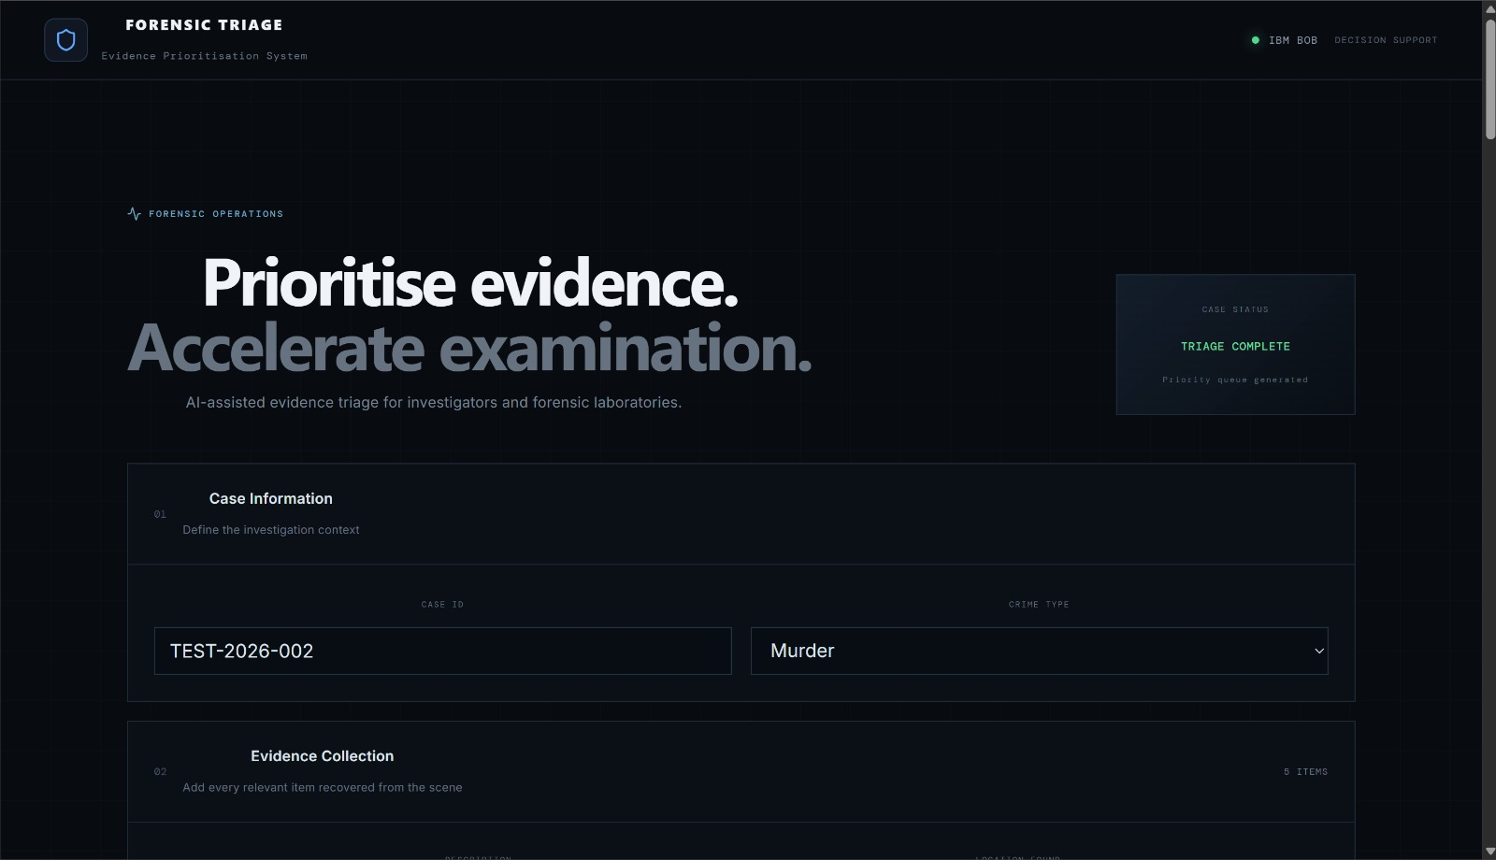
DEMONSTRATION

Slide 5
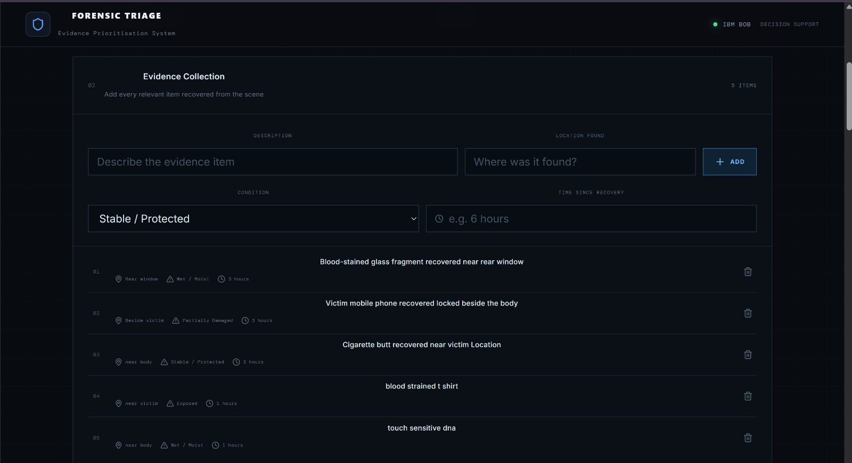

Slide 7
HOW THE SYSTEM WORKS
INVESTIGATOR INPUT
FASTAPI BACKEND
AI ANALYSIS
CLASSIFICATION + PRIORITY
FSL EXAMINATION PLAN
Input → analysis → prioritization → recommended examination order
4

Slide 8
KEY FEATURES & OUTPUT
• Evidence classification — e.g., biological, digital, impression and physical evidence.
• Priority assessment — highlights evidence requiring earlier attention.
• Recommended forensic examination — suggests the relevant examination/testing type.
• Urgency flag — identifies items that may need specialized or timely testing.
• Ranked examination order — presents evidence in a structured sequence with reasons.
Example output
Blood-stained knife → Biological/physical
Priority → High
Examination → DNA/fingerprint analysis
5

Slide 9
TECHNOLOGY STACK
• IBM Bob — AI-assisted development and project workflow.
• Python — core backend programming language.
• FastAPI — REST API/backend framework.
• Pydantic — structured request/response data validation.
• AI API integration — sends evidence descriptions for AI analysis.
• Swagger/OpenAPI — used to test and demonstrate the backend endpoint.
6

Slide 10
DEMO SCENARIO
• Crime type: Murder
• Evidence: blood-stained knife found near the victim, with possible fingerprints.
• The investigator submits the evidence description through the analysis endpoint.
• The AI returns a structured assessment: evidence category, priority, recommended examination, urgency and reasoning.
• The result can then be presented as a prioritized examination plan.
7

Slide 11
IMPACT, LIMITATIONS & FUTURE SCOPE
• Impact: helps organize large evidence sets into a clear triage workflow.
• Transparency: each priority should be accompanied by an explanation.
• Human-in-the-loop: the tool supports investigators; it does not replace forensic experts.
• Future scope: investigator-friendly web UI, evidence history, report/PDF generation, stronger rule-based forensic validation, and secure integration with authorized forensic systems.
• Thank you — Questions?
8

