Slide 1
Hw 3
Input
Let the user enter ten numbers.
Output
The user enter ten numbers
Sort from large to small(bubble sort)
Sort from small to large(selection sort)

Slide 2
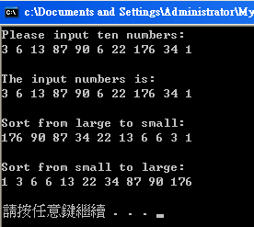
Hw 3

