Slide 1
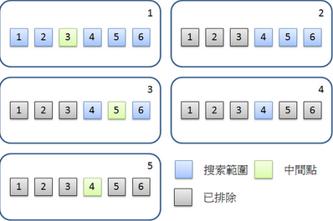
Hw 4
int BinarySearch(int A[],int key,int left,int right )

Slide 2
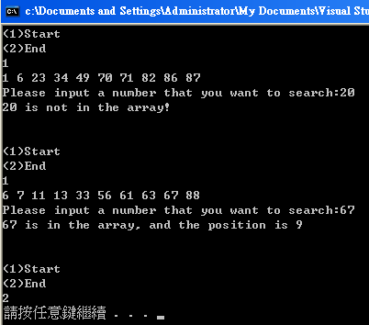
Hw 4

