Slide 1
Hw 5
char ID[11];
Cin >> ID; //input A123456789
Strlen(ID);
int A = char B – ‘0’;
bool InputID //判斷輸入長度是否正確
bool CheckID //判斷輸入身分證是否正確
A | 1 | 2 | 3 | 4 | 5 | 6 | 7 | 8 | 9 | \0

Slide 2
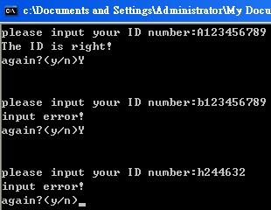
Hw 5

