Slide 1
Hw 6
Input
A string(terminated by #).
Output
The words that sorted(using pointer) and
original.
Need sub-function

Slide 2
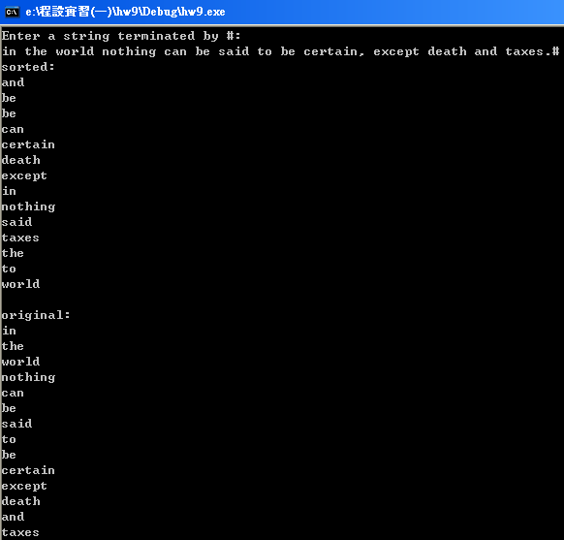
Hw 6

