Slide 1
Hw 7
Input
Enter the number of primes.
Output
All of primes.
Need “new” and “delete”

Slide 2
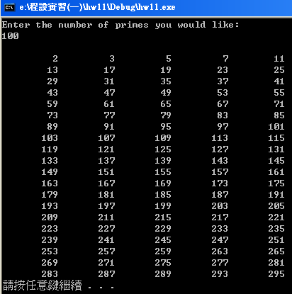
Hw 7

