Slide 1
Hw 8
Input
User can enter the new data in file.
Output
Show scores of all students.
(學期成績 = coursework*0.3 + midTerm*0.3 + finalTerm*0.4)
Need two functions.

Slide 2
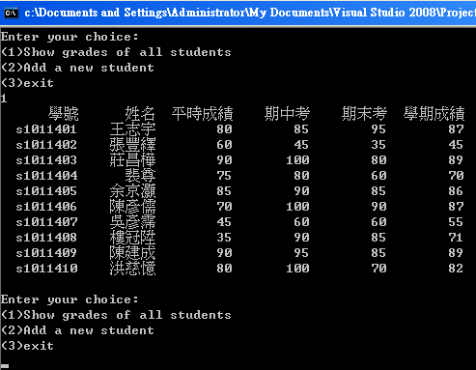
Hw 8

Slide 3
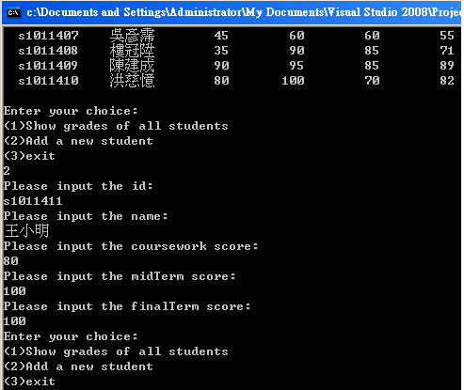
Hw 8

Slide 4
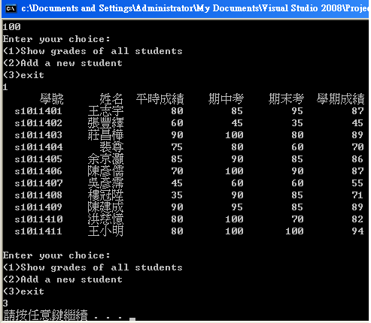
Hw 8

