Slide 1
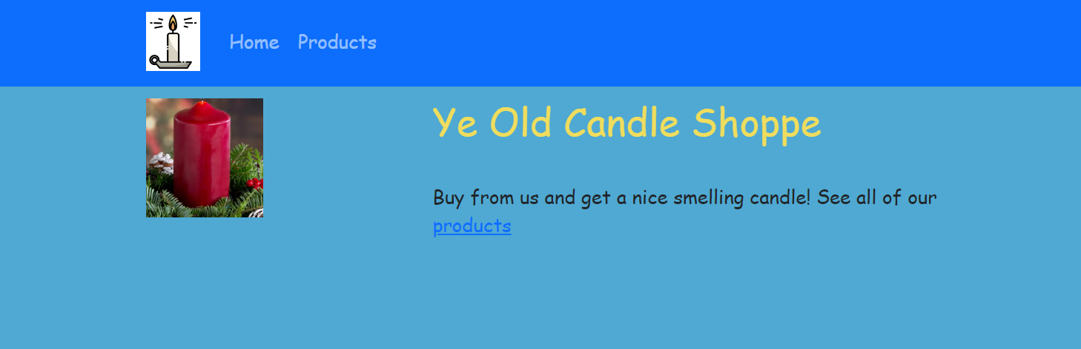
Use react to build this site …
Site needs to be build with react-bootstrap.
Images are on moodle
Font is Comic Sans MS
This area is 25% and this ares is 75%
Nav must work
Color is #F0DD5D
Use link to link to products
Color is #4FA9D2

Slide 2
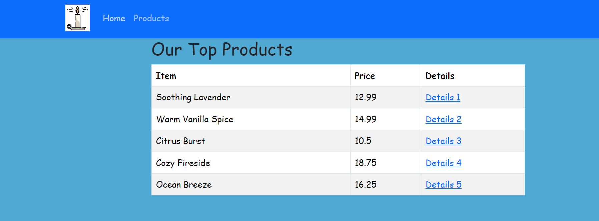
When click nav button or link on home page see top product (Comic Sans MS font)
List out items in a react-bootstrap table that is striped (data is on moodle). List Item, Price, and Details link
Provide a series of links to the ‘details’ of each item (see next slide). Use Link not href

Slide 3
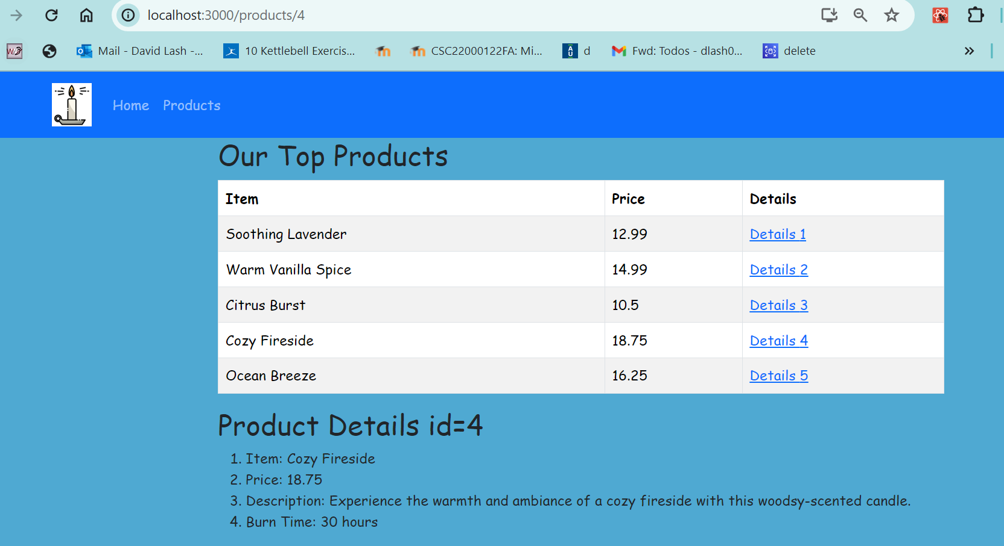
On click of the details …. Render the ‘details’ under the table … note the URL that is used
(products/4 in this case)
The links do not re-render the entire page but load the content under the table
Hint: to do this part, you will need to review the router V6 material that uses outlet (under nested routes).
Hint2: To do this, you *might* have to look up how to pass prop via a Link … I used this page: https://ui.dev/react-router-pass-props-to-link

Slide 4
let candles = [ { "id": "1", "name": "Soothing Lavender", "price": 12.99, "description": "A calming lavender-scented candle, perfect for relaxation.", "details": { "burn_time": "20 hours" } }, { "id": "2", "name": "Warm Vanilla Spice", "price": 14.99, "description": "Indulge in the sweet and comforting aroma of warm vanilla with a hint of spice.", "details": { "burn_time": "25 hours" } }, { "id": "3", "name": "Citrus Burst", "price": 10.50, "description": "Energize your space with the invigorating fragrance of citrus fruits.", "details": { "burn_time": "18 hours" } }, { "id": "4", "name": "Cozy Fireside", "price": 18.75, "description": "Experience the warmth and ambiance of a cozy fireside with this woodsy-scented candle.", "details": { "burn_time": "30 hours" } }, { "id": "5", "name": "Ocean Breeze", "price": 16.25, "description": "Bring the freshness of the ocean into your home with this breezy scented candle.", "details": { "burn_time": "22 hours" } } ]
Put this data in Products.js.
Have products.js send the data to ProductsList
(see next Slide)
Do not duplicate the data in ProductsList but pass it
Down as props

Slide 5
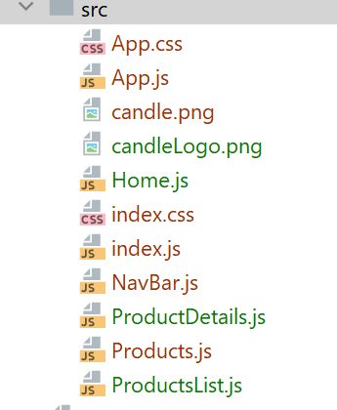
React Further hints/details
My React App has these components
The Main all
Img files
Home page
The Nav Bar Component
Products -> Has main page and data and send data to ProductList
ProductList shows the table and uses ProductDetails to provide details on the item clicked (via nested routes)

Slide 6
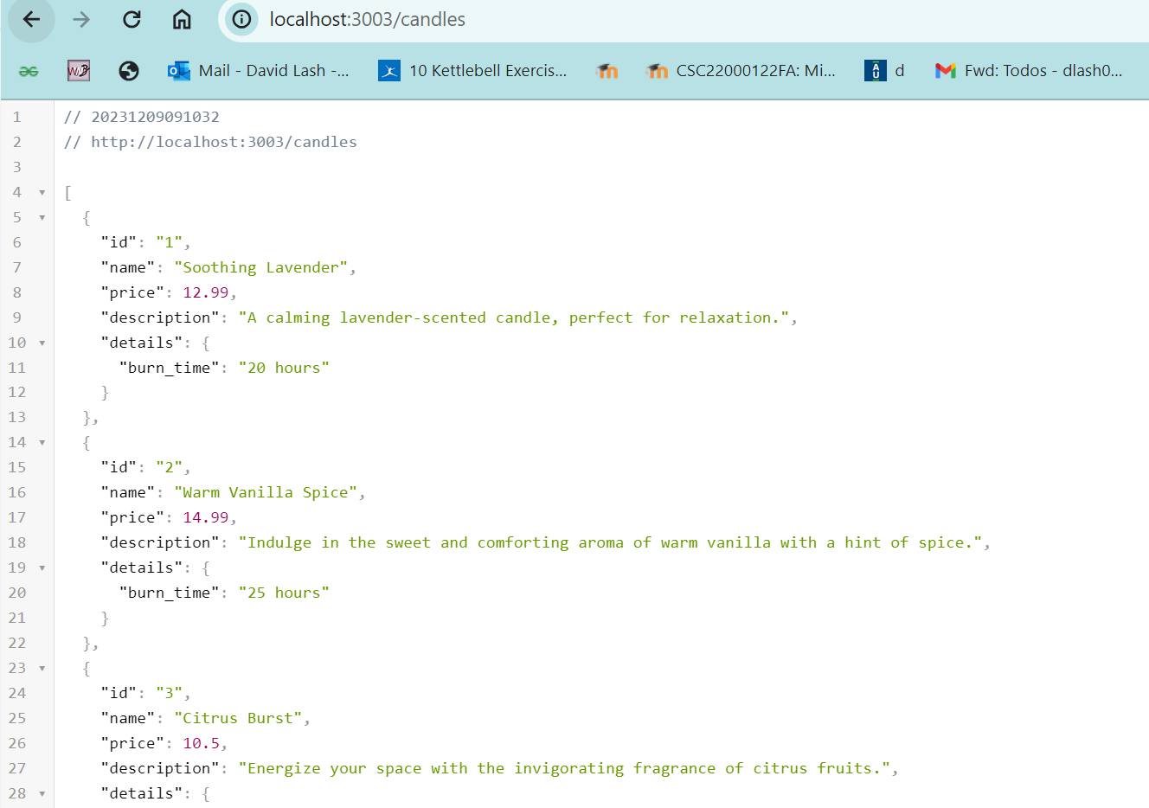
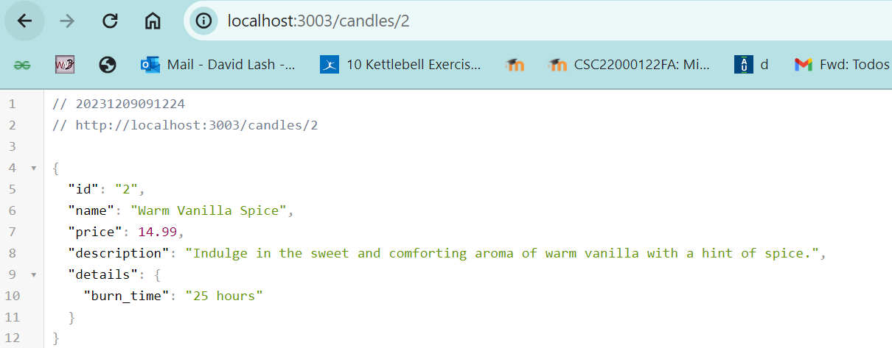
Part II – Build a node app that produces JSON output for Candles
Create routes for candles -> responds with
all candles And candle/id that shows only 1 candle

Slide 7
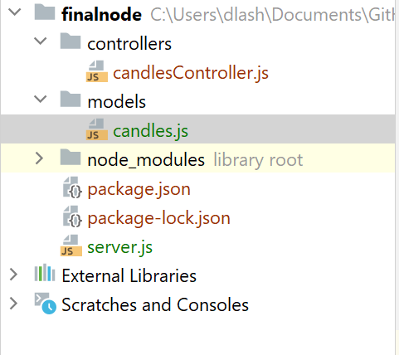
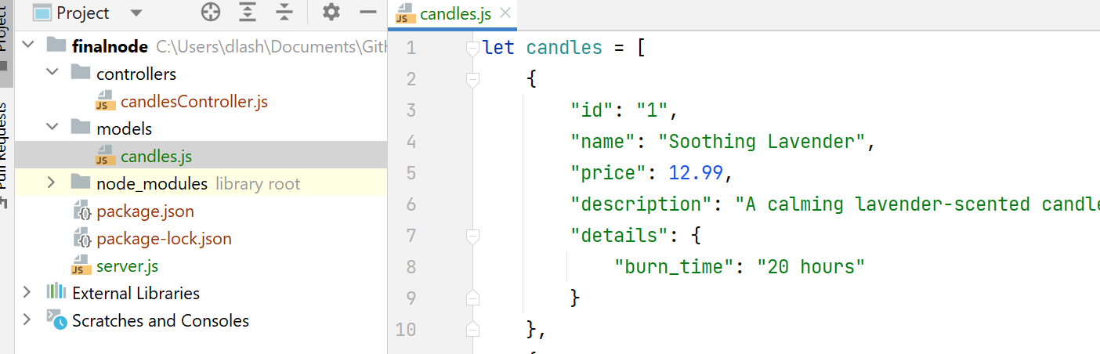
Node --- Details
Details
1. You can place the routes inside the server.js
2. Have each route call the candles controller
3. The controller should get the data from the candles model. Include methods in the model to:
a. fetchAll()
b. findById( id )
4. Note you will place the candles JSON data at the top of your models/candles.js like this:

Slide 8
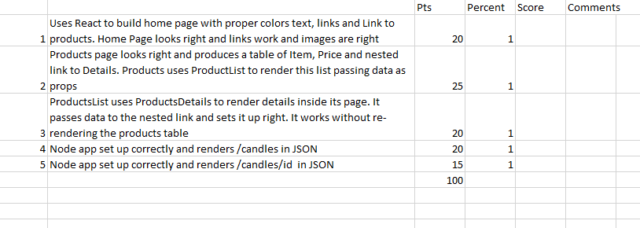
Rubric

Slide 9
What to hand in
All of your code:
Upload the react portion to the react folder
Include a screen shot of the working code for /home and /products
Upload the node portion to the node folder
Include a screen shot of each of the 2 routes

