Slide 1
Chapter 13 (2)
National Income Accounting and
the Balance
of Payments

Slide 2
Preview
National income accounts
  measures of national income
  measures of value of production
  measures of value of expenditure
National saving, investment, and the current account
Balance of payments accounts

Slide 3
The National Income Accounts
Records the value of national income that results from production and expenditure.
  Producers earn income from buyers who spend money on goods and services.
  The amount of expenditure by buyers =
  the amount of income for sellers =
  the value of production.
  National income is often defined to be the income earned by a nation’s factors of production.

Slide 4
The National Income Accounts (cont.)
Gross national product (GNP) is the value of all final goods and services produced by a nation’s factors of production in a given
time period.
  What are factors of production? Factors that are used to produce goods and services: workers (labor services), physical capital (like buildings and equipment), natural resources and others.
  The value of final goods and services produced by US-owned factors of production are counted as US GNP.

Slide 5
The National Income Accounts (cont.)
GNP is calculated by adding the value of expenditure on final goods and services produced:
  Consumption: expenditure by domestic consumers
  Investment: expenditure by firms on buildings & equipment
  Government purchases: expenditure by governments on goods and services
  Current account balance (exports minus imports): net expenditure by foreigners on domestic goods and services

Slide 6
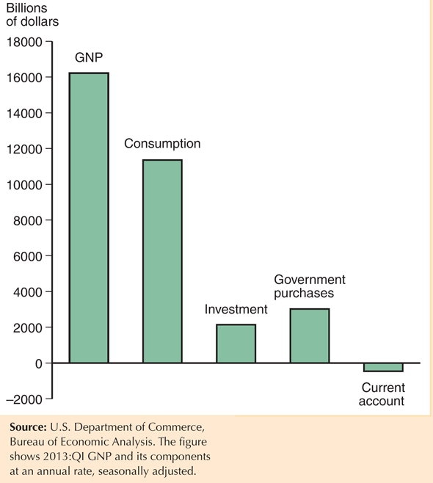
Fig. 13-1: U.S. GNP and Its Components

Slide 7
The National Income Accounts (cont.)
GNP is one measure of national income, but a more precise measure of national income is GNP adjusted for following:
  Depreciation of physical capital results in a loss of income to capital owners, so the amount of depreciation is subtracted from GNP.
  Unilateral transfers to and from other countries can change national income: payments of expatriate workers sent to their home countries, foreign aid and pension payments sent to expatriate retirees.

Slide 8
The National Income Accounts (cont.)
Another approximate measure of national income is gross domestic product (GDP):
  – Gross domestic product measures the final value of all goods and services that are produced within a country in a given time period.
  – GDP = GNP – payments from foreign countries for factors of production + payments to foreign countries for factors of production

Slide 9
National Income Accounting for an Open Economy
The national income identity for an open economy is
Y = C + I + G + EX – IM
= C + I + G + CA
Expenditure by domestic individuals and institutions
Net expenditure by foreign individuals and institutions

Slide 10
National Income Accounting for an Open Economy (cont.)
CA = EX – IM = Y – (C + I + G )
When production > domestic expenditure, exports > imports: current account > 0 and trade balance > 0
  when a country exports more than it imports, it earns more income from exports than it spends on imports
  net foreign wealth is increasing
When production < domestic expenditure, exports < imports: current account < 0 and trade balance < 0
  when a country exports less than it imports, it earns less income from exports than it spends on imports
  net foreign wealth is decreasing

Slide 11
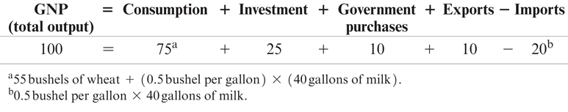
Table 13-1: National Income Accounts for Agraria, an Open Economy (bushels of wheat)

Slide 12
Saving and the Current Account
National saving (S) = national income (Y) that is not spent on consumption (C) or government purchases (G).
S = Y – C – G
An open economy can save by building up its capital stock or by acquiring foreign wealth.
S = I + CA

Slide 13
Private and Government Saving
  Private saving is the part of disposable income (national income, Y, minus taxes, T) that is saved rather than consumed:
  S^{p} = Y - T – C
Government saving is net tax revenue, T, minus government purchases, G:
S^{g} = T - G
Private and government saving add up to national saving.
S = (Y – T – C) + (T – G) = S^{p} + S^{g}

Slide 14
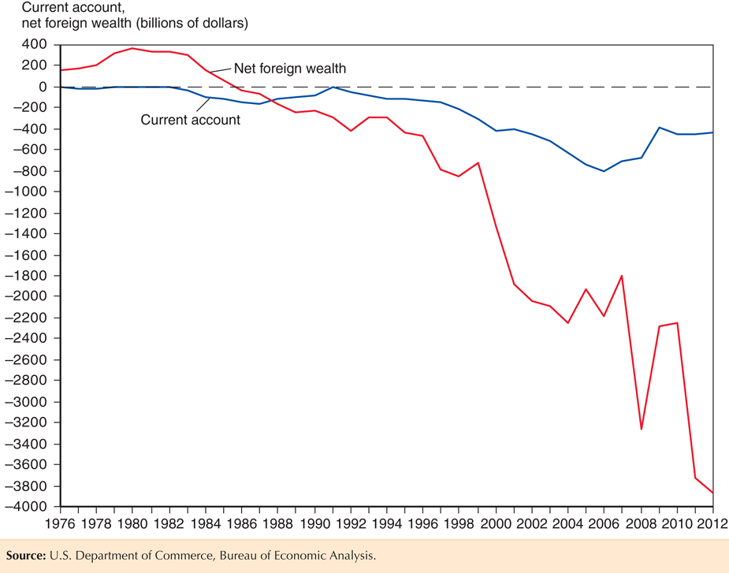
Fig. 13-2: The U.S. Current Account and Net International Investment Position, 1976–2012

Slide 15
Balance of Payments Accounts
A country’s balance of payments accounts accounts for its payments to and its receipts from foreigners.
An international transaction involves two parties, and each transaction enters the accounts twice: once as a credit (+) and once as a debit (–).

Slide 16
Balance of Payments Accounts (cont.)
The balance of payments accounts are separated into 3 broad accounts:
  current account: accounts for flows of goods and services (imports and exports).
  financial account: accounts for flows of financial assets (financial capital).
  capital account: flows of special categories of assets (capital): typically nonmarket, non-produced, or intangible assets like debt forgiveness, copyrights and trademarks.

Slide 17
Example of Balance of Payments Accounting
You import a fax machine from Olivetti.
Olivetti deposits your check in a U.S. bank.
Fax machine (current account, U.S. good import) –$80
Bank deposit (financial account, U.S. asset sale) +$80

Slide 18
Example of Balance of Payments Accounting (cont.)
You buy lunch in France and pay by credit card.
French restaurant receives payment from your credit card company.
Meal purchase (current account, U.S. service import) –$30
Sale of credit card claim (financial account, U.S. asset sale) +$30

Slide 19
Example of Balance of Payments Accounting (cont.)
You buy a share of BP.
BP deposits the money in a U.S. bank.
Stock purchase (financial account, U.S. asset purchase) –$90
Bank deposit (financial account, U.S. asset sale) +$90

Slide 20
Example of Balance of Payments Accounting (cont.)
U.S. banks forgive a $50 M debt owed by the government of Argentina through debt restructuring.
U.S. banks who hold the debt thereby reduce the debt by crediting Argentina's bank accounts.
Debt forgiveness (capital account, U.S. transfer payment) –$50 M
Reduction in bank’s claims (financial account, U.S. asset sale) +$50 M

Slide 21
How Do the Balance of Payments Accounts Balance?
Due to the double entry of each transaction, the balance of payments accounts will balance by the following equation:
current account +
financial account +
capital account = 0

Slide 22
Balance of Payments Accounts
The 3 broad accounts are more finely divided:
Current account: imports and exports
    merchandise (goods like DVDs)
    services (payments for legal services, shipping services, tourist meals, etc.)
    income receipts (interest and dividend payments, earnings of firms and workers operating in foreign countries)

Slide 23
Balance of Payments Accounts (cont.)
Current account: net unilateral transfers
    gifts (transfers) across countries that do not purchase a good or service nor serve as income for goods and services produced
Capital account: records special transfers of assets, but this is a minor account for the U.S.

Slide 24
Balance of Payments Accounts (cont.)
Financial account: the difference between sales of domestic assets to foreigners and purchases of foreign assets by domestic citizens.
Financial inflow
  Foreigners loan to domestic citizens by buying domestic assets.
  Domestic assets sold to foreigners are a credit (+) because the domestic economy acquires money during the transaction.
Financial outflow
  Domestic citizens loan to foreigners by buying foreign assets.
  Foreign assets purchased by domestic citizens are a debit (–) because the domestic economy gives up money during the transaction.

Slide 25
Balance of Payments Accounts (cont.)
Financial account has at least 3 subcategories:
    Official (international) reserve assets
    All other assets
    Statistical discrepancy

Slide 26
Balance of Payments Accounts (cont.)
Statistical discrepancy
  Data from a transaction may come from different sources that differ in coverage, accuracy, and timing.
  The balance of payments accounts therefore seldom balance in practice.
  The statistical discrepancy is the account added to or subtracted from the financial account to make it balance with the current account and capital account.

Slide 27
Balance of Payments Accounts (cont.)
Official (international) reserve assets: foreign assets held by central banks to cushion against financial instability.
  Assets include government bonds, currency, gold, and accounts at the International Monetary Fund.
  Official reserve assets owned by (sold to) foreign central banks are a credit (+) because the domestic central bank can spend more money to cushion against instability.
  Official reserve assets owned by (purchased by) the domestic central bank are a debit (–) because the domestic central bank can spend less money to cushion against instability.

Slide 28
Balance of Payments Accounts (cont.)
The negative value of the official reserve assets is called the official settlements balance or “balance of payments.”
  It is the sum of the current account, the capital account, the nonreserve portion of the financial account, and the statistical discrepancy.
  A negative official settlements balance may indicate that a country
    is depleting its official international reserve assets, or
    may be incurring large debts to foreign central banks so that the domestic central bank can spend a lot to protect against financial instability.

Slide 29
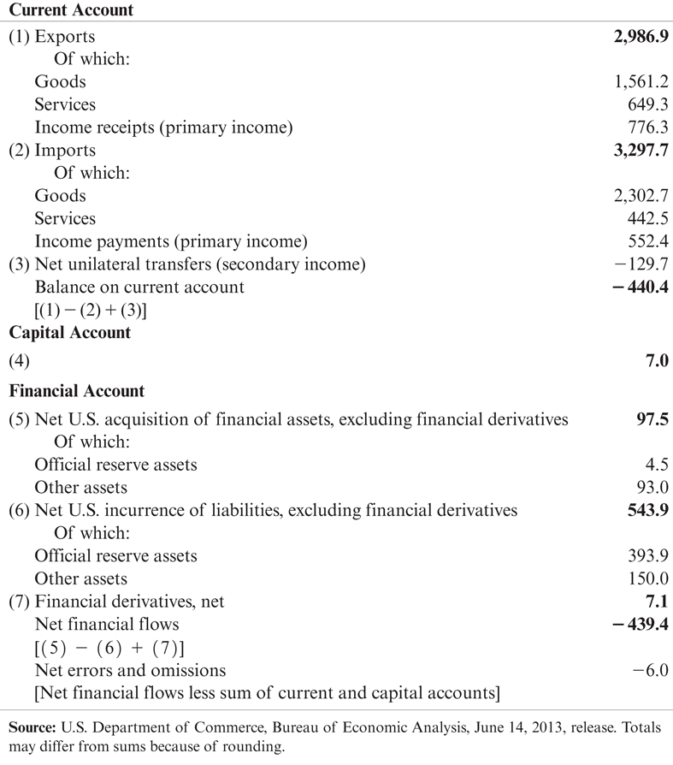
Table 13-2: U.S. Balance of Payments Accounts for 2012 (billions of dollars)

Slide 30
U.S. Balance of Payments Accounts
The U.S. has the most negative net foreign wealth in the world, and so is therefore the world’s largest debtor nation.
Its current account deficit in 2012 was $440 billion dollars, so that net foreign wealth continues to decrease.
The value of foreign assets held by the U.S. has grown since 1980, but liabilities of the U.S. (debt held by foreigners) has grown faster.

Slide 31
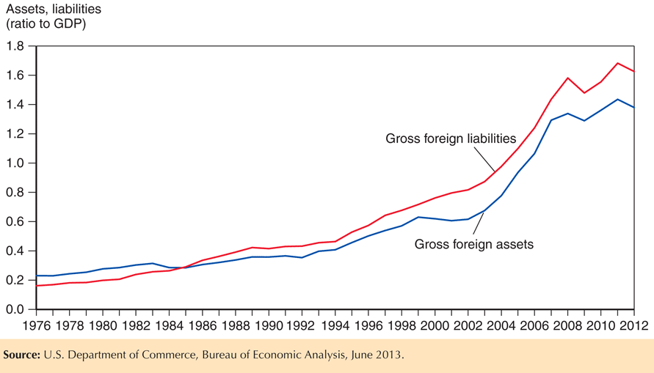
Fig. 13-3: U.S. Gross Foreign Assets and Liabilities, 1976-2012

Slide 32
U.S. Balance of Payments Accounts (cont.)
About 70% of foreign assets held by the U.S. are denominated in foreign currencies and almost all of U.S. liabilities (debt) are denominated in dollars.
Changes in the exchange rate influence value of net foreign wealth (gross foreign assets minus gross foreign liabilities).
  Appreciation of the value of foreign currencies makes foreign assets held by the U.S. more valuable, but does not change the dollar value of dollar-denominated debt for the U.S.

Slide 33
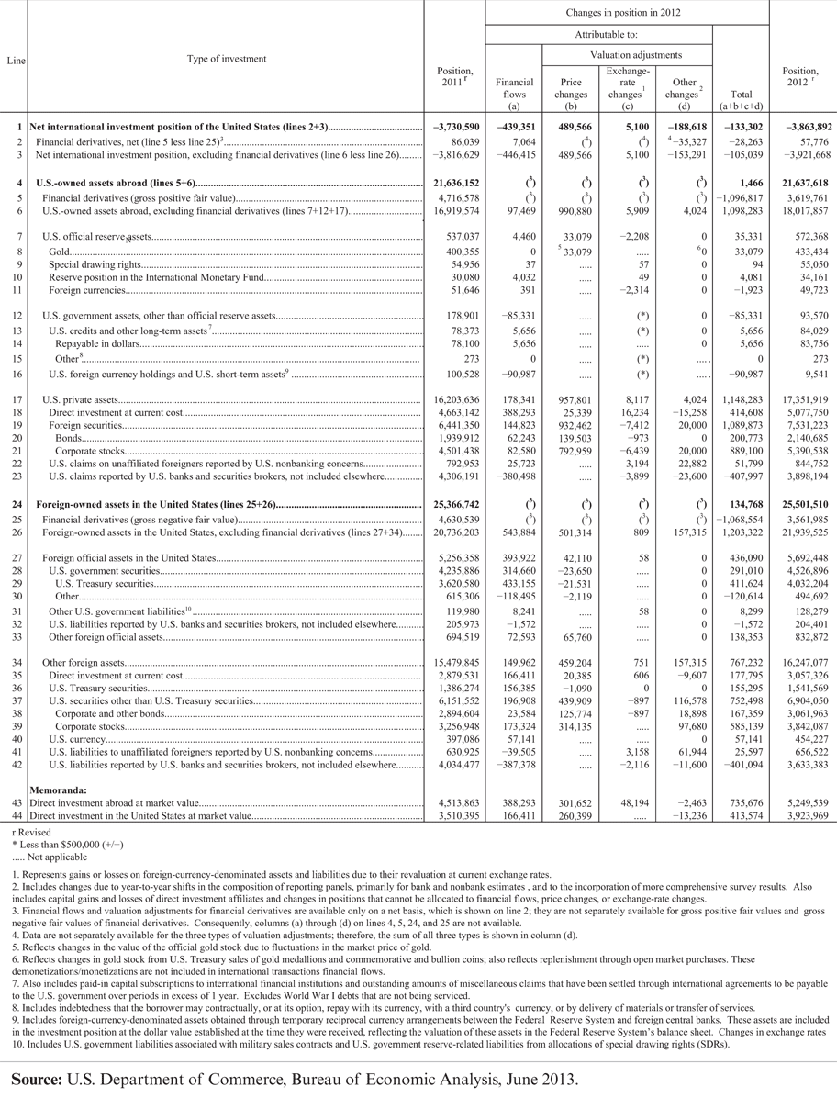
Table 13-3: International Investment Position of the United States at Year End, 2008 and 2009 (millions of dollars)

Slide 34
Summary
A country’s GNP is roughly equal to the income received by its factors of production.
In an open economy, GNP equals the sum of consumption, investment, government purchases, and the current account.
GDP is equal to GNP minus net income from foreign countries for factors of production. It measures the value of output produced within a country’s borders.

Slide 35
Summary (cont.)
National saving minus domestic investment equals the current account (≈ exports minus imports).
The current account equals the country’s net foreign investment (net outflows of financial assets).
The balance of payments accounts records flows of goods & services and flows of financial assets across countries.
  It has 3 parts: current account, capital account, and financial account, which balance each other.
  Transactions of goods and services appear in the current account; transactions of financial assets appear in the financial account.

Slide 36
Summary (cont.)
Official international reserve assets are a component of the financial account, which records official assets held by central banks.
The official settlements balance is the negative value of official international reserve assets, and it shows a central bank’s holdings of foreign assets relative to foreign central banks’ holdings of domestic assets.
The U.S. is the largest debtor nation, and its foreign debt continues to grow because its current account continues to be negative.

