Slide 1
Chapter 14 (3)
Exchange Rates
and the Foreign Exchange Market:
An Asset Approach

Slide 2
Preview
The basics of exchange rates
Exchange rates and the prices of goods
The foreign exchange markets
The demand of currency and other assets
A model of foreign exchange markets
  role of interest rates on currency deposits
  role of expectations of exchange rates

Slide 3
Definitions of Exchange Rates
Exchange rates are quoted as foreign currency per unit of domestic currency or domestic currency per unit of foreign currency.
  How much can be exchanged for one dollar? ¥97.385/$
  How much can be exchanged for one yen? $$0.01027/¥
Exchange rates allow us to denominate the cost or price of a good or service in a common currency.
  How much does a Nissan cost? ¥2,500,000
  Or, ¥2,500,000 x $0.01027/¥ = $25,672.50

Slide 4
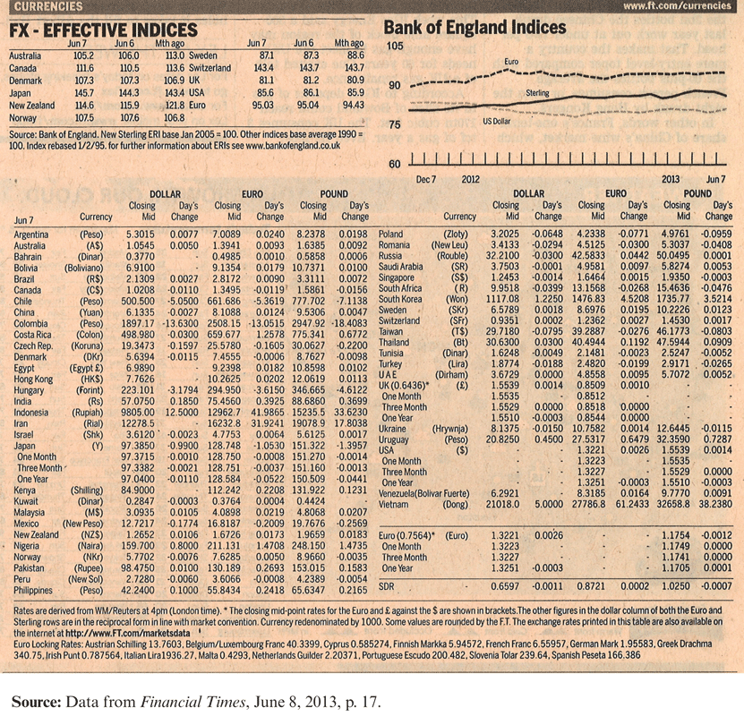
Table 14-1: Exchange Rate Quotations

Slide 5
Depreciation and Appreciation
Depreciation is a decrease in the value of a currency relative to another currency.
  A depreciated currency is less valuable (less expensive) and therefore can be exchanged for (can buy) a smaller amount of foreign currency.
  $1/€ → $1.20/€ means that the dollar has depreciated relative to the euro. It now takes $1.20 to buy one euro, so that the dollar is less valuable.
  The euro has appreciated relative to the dollar:
  it is now more valuable.

Slide 6
Depreciation and Appreciation (cont.)
Appreciation is an increase in the value of a currency relative to another currency.
  An appreciated currency is more valuable (more expensive) and therefore can be exchanged for (can buy) a larger amount of foreign currency.
  $1/€ → $0.90/€ means that the dollar has appreciated relative to the euro. It now takes
  only $0.90 to buy one euro, so that the dollar is more valuable.
  The euro has depreciated relative to the dollar:
  it is now less valuable.

Slide 7
Depreciation and Appreciation (cont.)
A depreciated currency is less valuable, and therefore it can buy fewer foreign produced goods that are denominated in foreign currency.
  A Nissan costs ¥2,500,000 x $0.01027/¥ = $25,672.50
  Less expensive than $27,962.50 at $0.011185/¥
A depreciated currency means that imports are more expensive and domestically produced goods and exports are less expensive.
A depreciated currency lowers the price of exports relative to the price of imports.

Slide 8
Depreciation and Appreciation (cont.)
An appreciated currency is more valuable, and therefore it can buy more foreign produced goods that are denominated in foreign currency.
  A Nissan costs ¥2,500,000 = $27,962.50 at $0.011185/¥
  becomes less expensive $25,000 at $0.010/¥
An appreciated currency means that imports are less expensive and domestically produced goods and exports are more expensive.
An appreciated currency raises the price of exports relative to the price of imports.

Slide 9
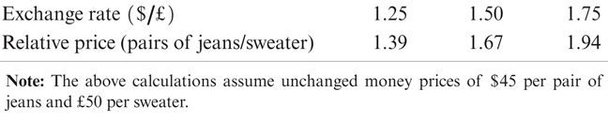
Table 14-2: $/£ Exchange Rates and the Relative Price of American Designer Jeans and British Sweaters

Slide 10
Foreign Exchange Markets
The set of markets where foreign currencies and other assets are exchanged for domestic ones
  Institutions buy and sell deposits of currencies or other assets for investment purposes.
The daily volume of foreign exchange transactions was $4.0 trillion in April 2010
  up from $500 billion in 1989.
Most transactions (85% in April 2010) exchange foreign currencies for U.S. dollars.

Slide 11
Foreign Exchange Markets (cont.)
The participants:
Commercial banks and other depository institutions: transactions involve buying/selling of deposits in different currencies for investment purposes.
Non-bank financial institutions (mutual funds, hedge funds, securities firms, insurance companies, pension funds) may buy/sell foreign assets for investment.
Non-financial businesses conduct foreign currency transactions to buy/sell goods, services and assets.
Central banks: conduct official international
reserves transactions.

Slide 12
Foreign Exchange Markets (cont.)
Buying and selling in the foreign exchange market are dominated by commercial and investment banks.
  Inter-bank transactions of deposits in foreign currencies occur in amounts $1 million or more
  per transaction.
  Central banks sometimes intervene, but the direct effects of their transactions are small and transitory in many countries.

Slide 13
Foreign Exchange Markets (cont.)
Computer and telecommunications technology transmit information rapidly and have integrated markets.
The integration of financial markets implies that there can be no significant differences in exchange rates across locations.
  Arbitrage: buy at low price and sell at higher price for a profit.
  If the euro were to sell for $1.1 in New York and $1.2 in London, could buy euros in New York (where cheaper) and sell them in London at a profit.

Slide 14
Spot Rates and Forward Rates
Spot rates are exchange rates for currency exchanges “on the spot,” or when trading is executed in the present.
Forward rates are exchange rates for currency exchanges that will occur at a future (“forward”) date.
  Forward dates are typically 30, 90, 180, or 360 days in the future.
  Rates are negotiated between two parties in the present, but the exchange occurs in the future.

Slide 15
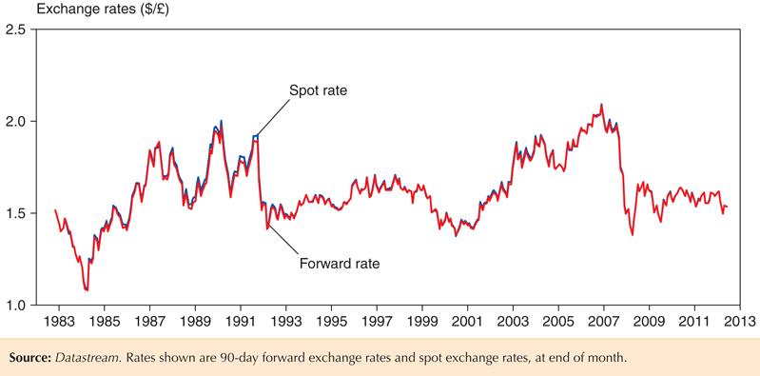
Fig. 14-1: Dollar/Pound Spot and Forward Exchange Rates, 1983–2013

Slide 16
Other Methods of Currency Exchange
Foreign exchange swaps: a combination of a spot sale with a forward repurchase.
  Swaps allow parties to meet each other’s needs for a temporary amount of time and often cost less in fees than separate transactions.
  For example, suppose Toyota receives $1 million from American sales, plans to use it to pay its California suppliers in three months, but wants to invest the money in euro bonds in the meantime.

Slide 17
Other Methods of Currency Exchange (cont.)
Futures contracts: a contract designed by a third party for a standard amount of foreign currency delivered/received on a standard date.
  Contracts can be bought and sold in markets, and only the current owner is obliged to fulfill the contract.

Slide 18
Other Methods of Currency Exchange (cont.)
Options contracts: a contract designed by a third party for a standard amount of foreign currency delivered/received on or before a standard date.
  Contracts can be bought and sold in markets.
  A contract gives the owner the option, but not obligation, of buying or selling currency if the need arises.

Slide 19
The Demand of Currency Deposits
What influences the demand of (willingness to buy) deposits denominated in domestic or foreign currency?
Factors that influence the return on assets determine the demand of those assets.

Slide 20
The Demand of Currency Deposits (cont.)
Rate of return: the percentage change in value that an asset offers during a time period.
  The annual return for $100 savings deposit with an interest rate of 2% is $100 x 1.02 = $102, so that the rate of return = ($102 – $100)/$100 = 2%.
Real rate of return: inflation-adjusted rate of return,
  which represents the additional amount of goods & services that can be purchased with earnings from the asset.
  The real rate of return for the above savings deposit when inflation is 1.5% is 2% – 1.5% = 0.5%. After accounting for the rise in the prices of goods and services, the asset can purchase 0.5% more goods and services after 1 year.

Slide 21
The Demand of Currency Deposits (cont.)
If prices are fixed, the inflation rate is 0% and (nominal) rates of return = real rates of return.
Because trading of deposits in different currencies occurs on a daily basis, we often assume that prices do not change from day to day.
  A good assumption to make for the short run.

Slide 22
The Demand of Currency Deposits (cont.)
Risk of holding assets also influences decisions about whether to buy them.
Liquidity of an asset, or ease of using the asset to buy goods and services, also influences the willingness to buy assets.

Slide 23
The Demand of Currency Deposits (cont.)
But we assume that risk and liquidity of currency
deposits in foreign exchange markets are essentially the same, regardless of their currency denomination.
  Risk and liquidity are only of secondary importance when deciding to buy or sell currency deposits.
  Importers and exporters may be concerned about risk and liquidity, but they make up a small fraction of the market.

Slide 24
The Demand of Currency Deposits (cont.)
We therefore say that investors are primarily concerned about the rates of return on currency deposits.
Rates of return that investors expect to earn are determined by
  interest rates that the assets will earn
  expectations about appreciation or depreciation

Slide 25
The Demand of Currency Deposits (cont.)
A currency deposit’s interest rate is the amount of a currency that an individual or institution can earn by lending a unit of the currency for a year.
The rate of return for a deposit in domestic currency is the interest rate that the deposit earns.
To compare the rate of return on a deposit in domestic currency with one in foreign currency, consider
  the interest rate for the foreign currency deposit
  the expected rate of appreciation or depreciation of the foreign currency relative to the domestic currency.

Slide 26
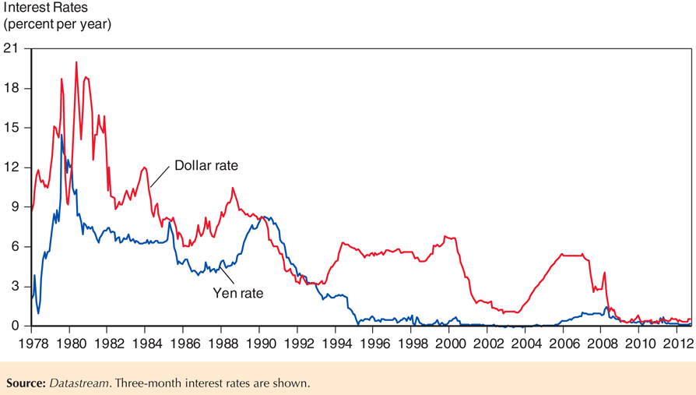
Fig. 14-2: Interest Rates on Dollar and Yen Deposits, 1978–2013

Slide 27
The Demand of Currency Deposits (cont.)
Suppose the interest rate on a dollar deposit is 2%.
Suppose the interest rate on a euro deposit is 4%.
Does a euro deposit yield a higher expected rate
of return?
  Suppose today the exchange rate is $1/€1, and the expected rate one year in the future is $0.97/€1.
  $100 can be exchanged today for €100.
  These €100 will yield €104 after one year.
  These €104 are expected to be worth $0.97/€1 x €104 = $100.88 in one year.

Slide 28
The Demand of Currency Deposits (cont.)
The rate of return in terms of dollars from investing in euro deposits is
  ($100.88 – $100)/$100 = 0.88%.
Let’s compare this rate of return with the rate of return from a dollar deposit.
  The rate of return is simply the interest rate.
  After 1 year the $100 is expected to yield $102:
  ($102 – $100)/$100 = 2%
The euro deposit has a lower expected rate of return: thus, all investors should be willing to dollar deposits and none should be willing to hold euro deposits.

Slide 29
The Demand of Currency Deposits (cont.)
Note that the expected rate of appreciation of the euro was ($0.97 – $1)/$1 = –0.03 = –3%.
We simplify the analysis by saying that the dollar rate of return on euro deposits approximately equals
  the interest rate on euro deposits
  plus the expected rate of appreciation of euro deposits
  4% + –3% = 1% ≈ 0.88%
  R€ + (E^{e}$/€ – E$/€)/E$/€

Slide 30
The Demand of Currency Deposits (cont.)
The difference in the rate of return on dollar deposits and euro deposits is
  R$ – (R€ + (E^{e}$/€ – E$/€)/E$/€ ) =
R$ –R€ –(E^{e}$/€ – E$/€)/E$/€
expected
exchange rate
current
exchange rate
expected rate of return = interest rate on dollar deposits
interest rate
on euro deposits
expected rate of appreciation of the euro
expected rate of return on euro deposits

Slide 31
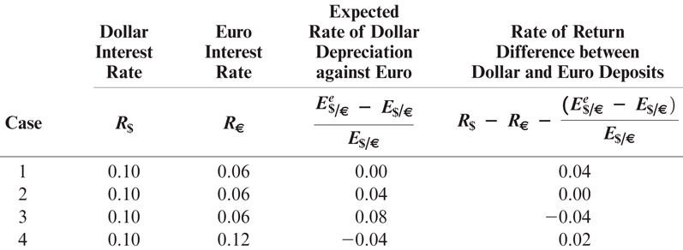
Table 14-3: Comparing Dollar Rates of Return on Dollar and Euro Deposits

Slide 32
Model of Foreign Exchange Markets
We use the
  demand of (rate of return on) dollar denominated deposits
  and the demand of (rate of return on) foreign currency denominated deposits
to construct a model of foreign exchange markets.
This model is in equilibrium when deposits of all currencies offer the same expected rate of return: interest parity.
  Interest parity implies that deposits in all currencies are equally desirable assets.
  Interest parity implies that arbitrage in the foreign exchange market is not possible.

Slide 33
Model of Foreign Exchange Markets (cont.)
Interest parity says:
R$ = R€ + (E^{e}$/€ – E$/€)/E$/€
Why should this condition hold? Suppose it didn’t.
  Suppose R$ > R€ + (E^{e}$/€ – E$/€)/E$/€
  Then no investor would want to hold euro deposits, driving down the demand and price of euros.
  Then all investors would want to hold dollar deposits, driving up the demand and price of dollars.
  The dollar would appreciate and the euro would depreciate, increasing the right side until equality was achieved:
  R$ > R€ + (E^{e}$/€ – E$/€)/E$/€

Slide 34
Model of Foreign Exchange Markets (cont.)
How do changes in the current exchange rate affect the expected rate of return of foreign currency deposits?

Slide 35
Model of Foreign Exchange Markets (cont.)
Depreciation of the domestic currency today lowers the expected rate of return on foreign currency deposits. Why?
  When the domestic currency depreciates, the initial cost of investing in foreign currency deposits increases, thereby lowering the expected rate of return of foreign currency deposits.

Slide 36
Model of Foreign Exchange Markets (cont.)
Appreciation of the domestic currency today raises the expected return of deposits on foreign currency deposits. Why?
  When the domestic currency appreciates, the initial cost of investing in foreign currency deposits decreases, thereby lowering the expected rate of return of foreign currency deposits.

Slide 37
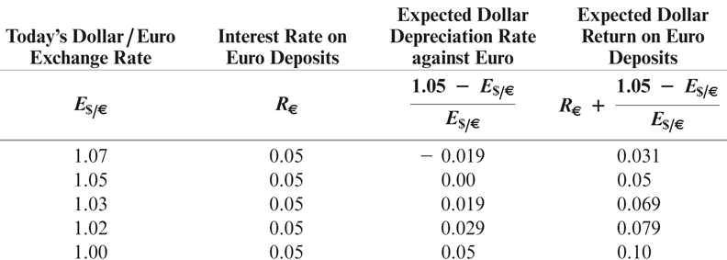
Table 14-4: Today’s Dollar/Euro Exchange Rate and the Expected Dollar Return on Euro Deposits When E^{e}$/€ = $1.05 per Euro

Slide 38
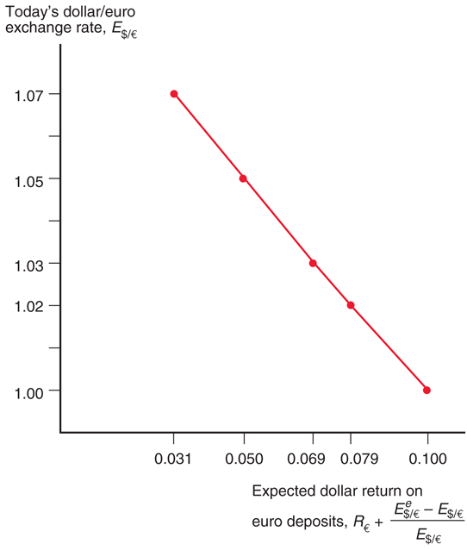
Fig. 14-3: The Relation between the Current Dollar/Euro Exchange Rate and the Expected Dollar Return on Euro Deposits

Slide 39
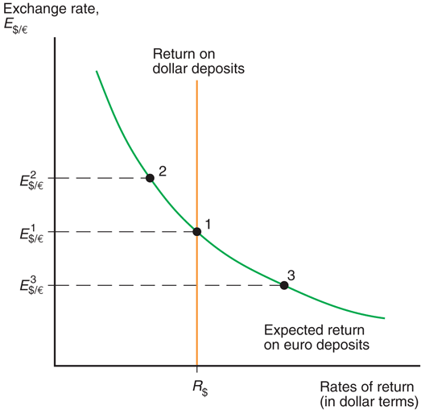
Fig. 14-4: Determination of the Equilibrium Dollar/Euro Exchange Rate

Slide 40
Model of Foreign Exchange Markets (cont.)
The effects of changing interest rates:
  an increase in the interest rate paid on deposits denominated in a particular currency will increase the rate of return on those deposits.
  This leads to an appreciation of the currency.
  Higher interest rates on dollar-denominated assets cause the dollar to appreciate.
  Higher interest rates on euro-denominated assets cause the dollar to depreciate.

Slide 41
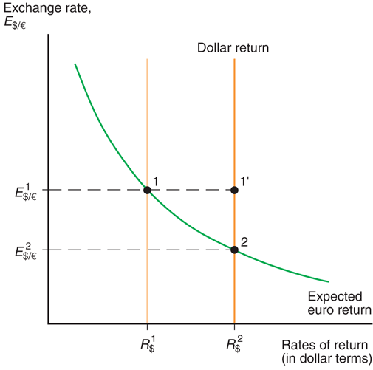
Fig. 14-5: Effect of a Rise in the Dollar Interest Rate

Slide 42
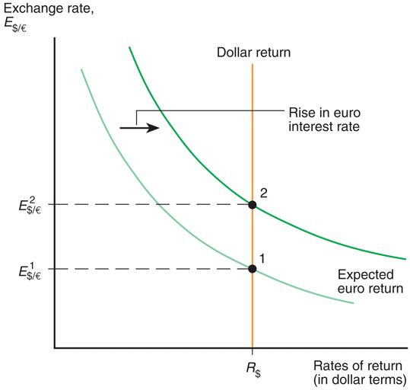
Fig. 14-6: Effect of a Rise in the Euro Interest Rate

Slide 43
The Effect of an Expected Appreciation of the Euro
If people expect the euro to appreciate in the future, then euro-denominated assets will pay in valuable euros, so that these future euros will be able to buy many dollars and many dollar-denominated goods.
  The expected rate of return on euros therefore increases.
  An expected appreciation of a currency leads to an actual appreciation (a self-fulfilling prophecy).
  An expected depreciation of a currency leads to an actual depreciation (a self-fulfilling prophecy).

Slide 44
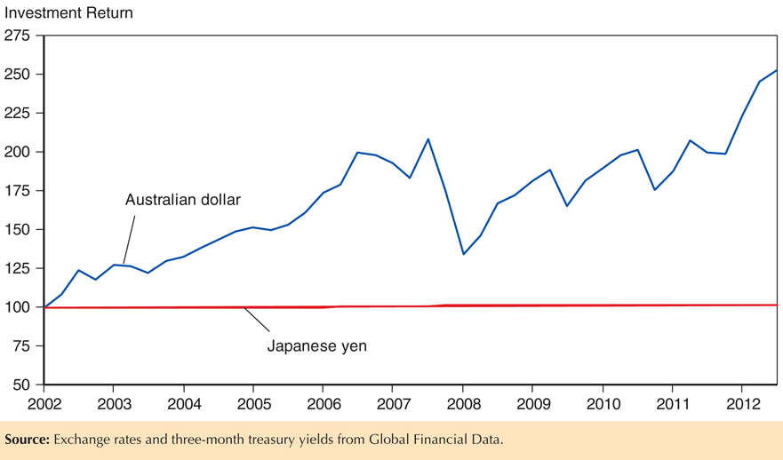
Fig. 14-7: Cumulative Total Investment Return in Australian Dollar Compared to Japanese Yen, 2003-2013

Slide 45
Covered Interest Parity
Covered interest parity relates interest rates across countries and the rate of change between forward exchange rates and the spot exchange rate:
R$ = R€ + (F$/€ – E$/€)/E$/€
where F$/€ is the forward exchange rate.
It says that rates of return on dollar deposits and “covered” foreign currency deposits are the same.
  How could you earn a risk-free return in the foreign exchange markets if covered interest parity did not hold?
  Covered positions using the forward rate involve little risk.

Slide 46
Summary
An exchange rate is the price of one country’s currency in terms of another country’s currency.
  It enables us to translate different countries’ prices into comparable terms.

Slide 47
Summary (cont.)
Depreciation of a currency means that it becomes less valuable and goods denominated in it are less expensive: exports are cheaper and imports more expensive.
Appreciation of a currency means that it becomes more valuable and goods denominated in it are more expensive: exports are more expensive and imports cheaper.

Slide 48
Summary (cont.)
Commercial and investment banks that invest in deposits of different currencies dominate the foreign exchange market.
  Expected rates of return are most important in determining the willingness to hold these deposits.
Rates of return on currency deposits in the foreign exchange market are influenced by interest rates and expected exchange rates.

Slide 49
Summary (cont.)
Equilibrium in the foreign exchange market occurs when rates of returns on deposits in domestic currency and in foreign currency are equal: interest rate parity.
An increase in the interest rate on a currency’s deposit leads to an increase in its expected rate of return and to an appreciation of the currency.

Slide 50
Summary (cont.)
An expected appreciation of a currency leads to an increase in the expected rate of return for that currency, and leads to an actual appreciation.
Covered interest parity says that rates of return on domestic currency deposits and “covered” foreign currency deposits using the forward exchange rate are the same.

