Slide 1
Chapter 17 (6)
Output and the Exchange Rate
in the Short Run

Slide 2
Preview
Determinants of aggregate demand in the short run
A short-run model of output markets
A short-run model of asset markets
A short-run model for both output markets and asset markets
Effects of temporary and permanent changes in monetary and fiscal policies
Adjustment of the current account over time
IS-LM model

Slide 3
Introduction
Long-run models are useful when all prices of inputs and outputs have time to adjust.
In the short run, some prices of inputs and outputs may not have time to adjust, due to labor contracts, costs of adjustment, or imperfect information about willingness of customers to pay at different prices.
This chapter builds on the short-run and long-run models of exchange rates to explain how output is related to exchange rates in the short run.
  It shows how macroeconomic policies can affect production, employment, and the current account.

Slide 4
Determinants of Aggregate Demand
Aggregate demand is the aggregate amount of goods and services that individuals and institutions are willing to buy:
  consumption expenditure
  investment expenditure
  government purchases
  net expenditure by foreigners: the current account

Slide 5
Determinants of Aggregate Demand (cont.)
Determinants of consumption expenditure include:
  Disposable income: income from production (Y) minus taxes (T).
  More disposable income means more consumption expenditure, but consumption typically increases less than the amount that disposable income increases.
  Real interest rates may influence the amount of saving and spending on consumption goods, but we assume that they are relatively unimportant here.
  Wealth may also influence consumption expenditure, but we assume that it is relatively unimportant here.

Slide 6
Determinants of
Aggregate Demand (cont.)
Determinants of the current account include:
  Real exchange rate: prices of foreign products relative to the prices of domestic products, both measured in domestic currency: EP*/P
    As the prices of foreign products rise relative to those of domestic products, expenditure on domestic products rises, and expenditure on foreign products falls.
  Disposable income: more disposable income means more expenditure on foreign products (imports).

Slide 7
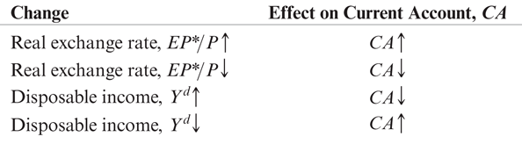
Table 17-1: Factors Determining the Current Account

Slide 8
How Real Exchange Rate Changes Affect the Current Account
The current account measures the value of exports relative to the value of imports:
CA ≈ EX – IM.
  When the real exchange rate EP*/P rises, the prices
  of foreign products rise relative to the prices of
  domestic products.
  The volume of exports that are bought by foreigners rises.
  The volume of imports that are bought by domestic
  residents falls.
  The value of imports in terms of domestic products rises: the value/price of imports rises, since foreign products are more valuable/expensive.

Slide 9
How Real Exchange Rate Changes Affect the Current Account (cont.)
If the volumes of imports and exports do not change much, the value effect may dominate the volume effect when the real exchange rate changes.
  For example, contract obligations to buy fixed amounts of products may cause the volume effect to be small.
However, evidence indicates that for most countries the volume effect dominates the value effect after one year or less.
Let’s assume for now that a real depreciation leads to an increase in the current account: the volume effect dominates the value effect.

Slide 10
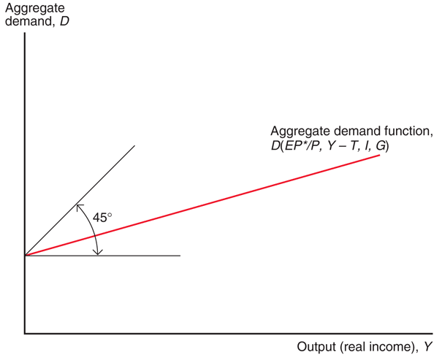
Fig. 17-1: Aggregate Demand as a Function of Output

Slide 11
Determinants of Aggregate Demand
Determinants of the current account include:
  Real exchange rate: an increase in the real exchange rate increases the current account.
  Disposable income: an increase in the disposable income decreases the current account.

Slide 12
Determinants of Aggregate Demand (cont.)
For simplicity, we assume that exogenous political factors determine government purchases G and the level of taxes T.
For simplicity, we currently assume that investment expenditure I is determined by exogenous business decisions.
  A more complicated model shows that investment depends on the cost of spending or borrowing to finance investment: the interest rate.

Slide 13
Determinants of Aggregate Demand (cont.)
Aggregate demand is therefore expressed as:
D = C(Y – T) + I + G + CA(EP*/P, Y – T)
Or more simply: D = D(EP*/P, Y – T, I, G)
Consumption
expenditure
as a function
of disposable
income
Investment
expenditure and
government
purchases, both
exogenous
Current account as
a function of the real
exchange rate and
disposable income.

Slide 14
Determinants of Aggregate Demand (cont.)
Determinants of aggregate demand include:
  Real exchange rate: an increase in the real exchange rate increases the current account, and therefore increases aggregate demand of domestic products.
  Disposable income: an increase in the disposable income increases consumption expenditure, but decreases the current account.
    Since consumption expenditure is usually greater than expenditure on foreign products, the first effect dominates the second effect.
    As income increases for a given level of taxes, aggregate consumption expenditure and aggregate demand increase by less than income.

Slide 15
Short-Run Equilibrium for Aggregate Demand and Output
Equilibrium is achieved when the value of income from production (output) Y equals the value of aggregate demand D.
Y = D(EP*/P, Y – T, I, G)
Aggregate demand as a function of the
real exchange rate, disposable income,
investment expenditure and government
purchases
Value of output
and income from
production

Slide 16
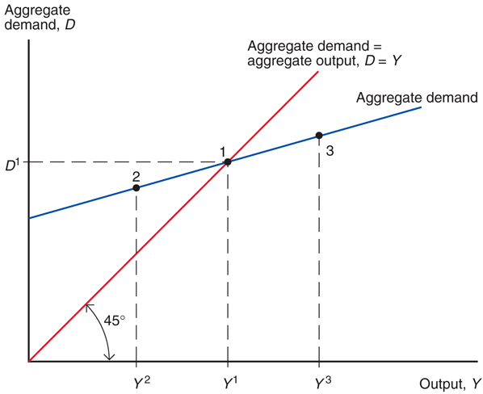
Fig. 17-2: The Determination of Output in the Short Run

Slide 17
Short-Run Equilibrium and the Exchange Rate: DD Schedule
How does the exchange rate affect the short-run equilibrium of aggregate demand and output?
With fixed domestic and foreign levels of average prices, a rise in the nominal exchange rate makes foreign goods and services more expensive relative to domestic goods and services.
A rise in the nominal exchange rate (a domestic currency depreciation) increases aggregate demand of domestic products.
In equilibrium, production will increase to match the higher aggregate demand.

Slide 18
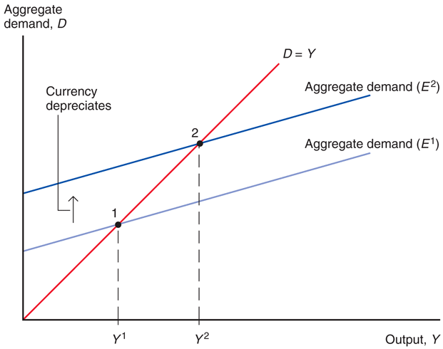
Fig. 17-3: Output Effect of a Currency Depreciation with Fixed Output Prices

Slide 19
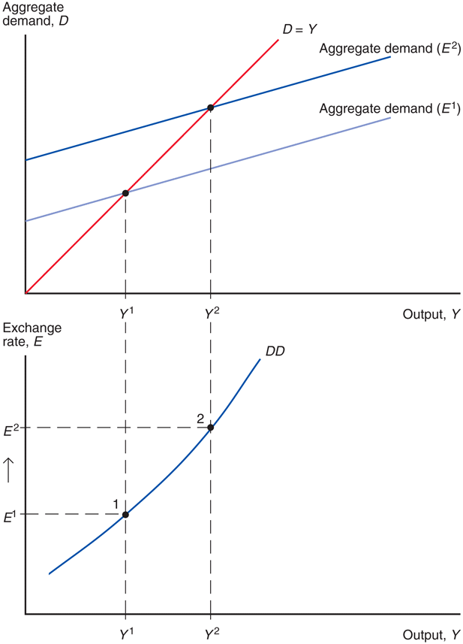
Fig. 17-4: Deriving the DD Schedule

Slide 20
Short-Run Equilibrium and the Exchange Rate: DD Schedule (cont.)
DD schedule
shows combinations of output and the exchange rate at which the output market is in short-run equilibrium (such that aggregate demand = aggregate output).
slopes upward because a rise in the exchange rate causes aggregate demand and aggregate output to rise.

Slide 21
Shifting the DD Curve
Changes in the exchange rate cause movements along a DD curve. Other changes cause it to shift:
Changes in G: more government purchases cause higher aggregate demand and output in equilibrium. Output increases for every exchange rate: the DD curve shifts right.

Slide 22
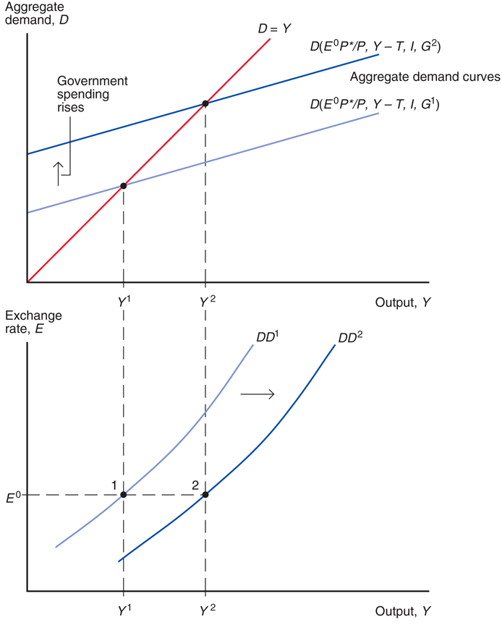
Fig. 17-5: Government Demand and the Position of the DD Schedule

Slide 23
Shifting the DD Curve (cont.)
Changes in T: lower taxes generally increase consumption expenditure, increasing aggregate demand and output in equilibrium for every exchange rate: the DD curve shifts right.
Changes in I: higher investment expenditure is represented by shifting the DD curve right.
Changes in P relative to P*: lower domestic prices relative to foreign prices are represented by shifting the DD curve right.

Slide 24
Shifting the DD Curve (cont.)
Changes in C: willingness to consume more and save less is represented by shifting the DD curve right.
Changes in demand of domestic goods relative to foreign goods: willingness to consume more domestic goods relative to foreign goods is represented by shifting the DD curve right.

Slide 25
Short-Run Equilibrium in Asset Markets
We consider two sets of asset markets:
Foreign exchange markets
  interest parity represents equilibrium:
  R = R* + (E^{e} – E)/E
Money market
  Equilibrium occurs when the quantity of real monetary assets supplied matches the quantity of real monetary assets demanded: M^{s}/P = L(R, Y)
  A rise in income from production causes the demand of real monetary assets to increase.

Slide 26
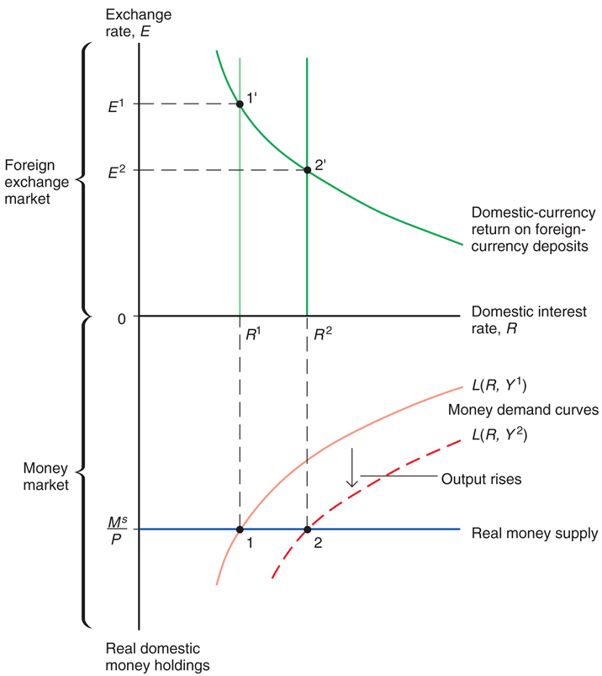
Fig. 17-6: Output and the Exchange Rate in Asset Market Equilibrium

Slide 27
Short-Run Equilibrium in Asset Markets (cont.)
When income and production increase,
  demand of real monetary assets increases,
  leading to an increase in domestic interest rates,
  leading to an appreciation of the domestic currency.
Recall that an appreciation of the domestic currency is represented by a fall in E.
When income and production decrease, the domestic currency depreciates and E rises.

Slide 28
Short-Run Equilibrium in Asset Markets: AA Curve
The inverse relationship between output and exchange rates needed to keep the foreign exchange markets and the money market in equilibrium is summarized as the AA curve.

Slide 29
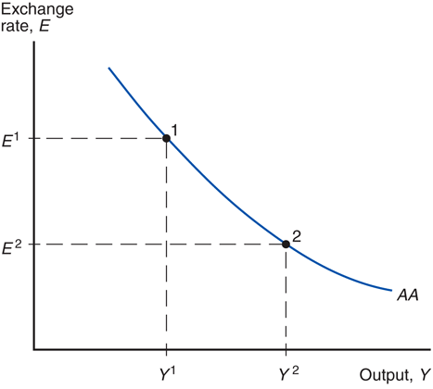
Fig. 17-7: The AA Schedule

Slide 30
Shifting the AA Curve
Changes in M^{s}: an increase in the money supply reduces interest rates in the short run, causing the domestic currency to depreciate (a rise in E) for every Y: the AA curve shifts up (right).

Slide 31
Shifting the AA Curve (cont.)
Changes in P: An increase in the level of average domestic prices decreases the supply of real monetary assets, increasing interest rates, causing the domestic currency to appreciate (a fall in E): the AA curve shifts down (left).
Changes in the demand of real monetary assets: if domestic residents are willing to hold a lower amount of real money assets and more non-monetary assets, interest rates on nonmonetary assets would fall, leading to a depreciation of the domestic currency (a rise in E): the AA curve shifts
up (right).

Slide 32
Shifting the AA Curve (cont.)
Changes in R*: An increase in the foreign interest rates makes foreign currency deposits more attractive, leading to a depreciation of the domestic currency (a rise in E): the AA curve shifts up (right).
Changes in E^{e}: if market participants expect the domestic currency to depreciate in the future, foreign currency deposits become more attractive, causing the domestic currency to depreciate (a rise in E): the AA curve shifts up (right).

Slide 33
Putting the Pieces Together: the DD and AA Curves
A short-run equilibrium means a nominal exchange rate and level of output such that
equilibrium in the output markets holds: aggregate demand equals aggregate output.
equilibrium in the foreign exchange markets holds: interest parity holds.
equilibrium in the money market holds: the quantity of real monetary assets supplied equals the quantity of real monetary assets demanded.

Slide 34
Putting the Pieces Together: the DD and AA Curves (cont.)
A short-run equilibrium occurs at the intersection of the DD and AA curves:
  output markets are in equilibrium on the DD curve
  asset markets are in equilibrium on the AA curve

Slide 35
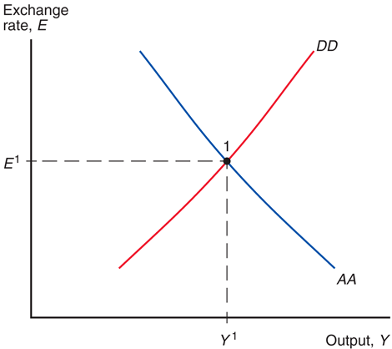
Fig. 17-8: Short-Run Equilibrium: The
Intersection of DD and AA

Slide 36
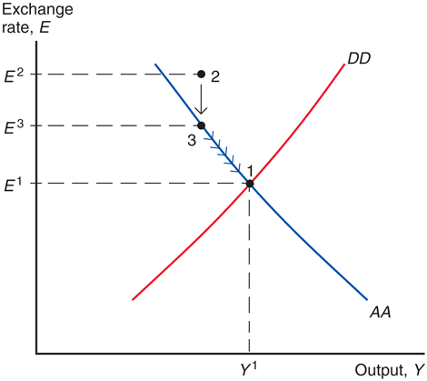
Fig. 17-9: How the Economy Reaches Its Short-Run Equilibrium

Slide 37
Temporary Changes in Monetary and Fiscal Policy
Monetary policy: policy in which the central bank influences the supply of monetary assets.
  Monetary policy is assumed to affect asset markets first.
Fiscal policy: policy in which governments
(fiscal authorities) influence the amount of government purchases and taxes.
  Fiscal policy is assumed to affect aggregate demand and output first.
Temporary policy changes are expected to be reversed in the near future and thus do not affect expectations about exchange rates in the long run.

Slide 38
Temporary Changes in Monetary Policy
An increase in the quantity of monetary assets supplied lowers interest rates in the short run, causing the domestic currency to depreciate (E rises).
  The AA shifts up (right).
  Domestic products relative to foreign products are cheaper, so that aggregate demand and output increase until a new short-run equilibrium is achieved.

Slide 39
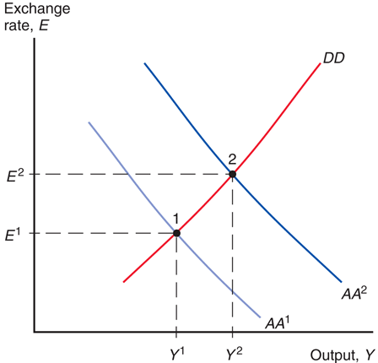
Fig. 17-10: Effects of a Temporary Increase in the Money Supply

Slide 40
Temporary Changes in Fiscal Policy
An increase in government purchases or a decrease in taxes increases aggregate demand and output in the short run.
  The DD curve shifts right.
  Higher output increases the demand for real monetary assets,
    thereby increasing interest rates,
    causing the domestic currency to appreciate
    (E falls).

Slide 41
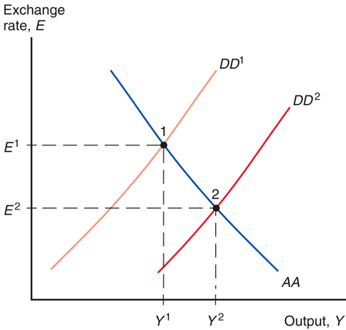
Fig. 17-11: Effects of a Temporary Fiscal Expansion

Slide 42
Policies to Maintain Full Employment
Resources used in the production process can either be over-employed or underemployed.
When resources are used effectively and sustainably, economists say that production is at its potential or natural level.
  When resources are not used effectively, resources are underemployed: high unemployment, few hours worked, idle equipment, lower than normal production of goods and services.
  When resources are not used sustainably, labor is over-employed: low unemployment, many overtime hours, over-utilized equipment, higher than normal production of goods and services.

Slide 43
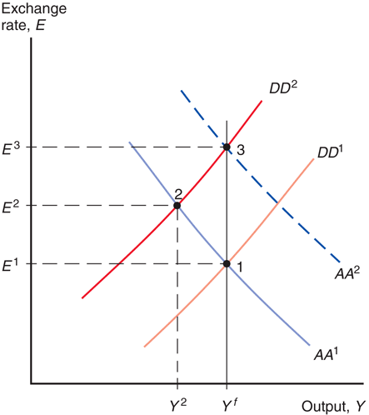
Fig. 17-12: Maintaining Full Employment after a Temporary Fall in World Demand for Domestic Products

Slide 44
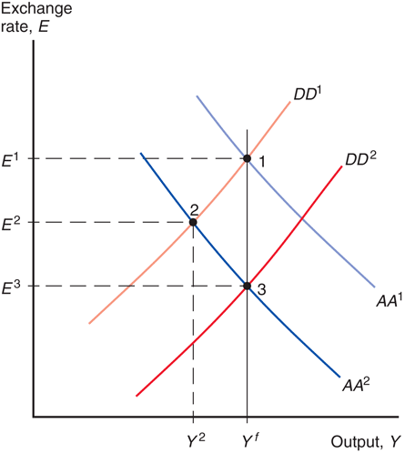
Fig. 17-13: Policies to Maintain Full Employment after a Money Demand Increase

Slide 45
Policies to Maintain Full Employment (cont.)
Policies to maintain full employment may seem easy in theory, but are hard in practice.
We have assumed that prices and expectations do not change, but people may anticipate the effects of policy changes and modify their behavior.
  Workers may require higher wages if they expect overtime and easy employment, and producers may raise prices if they expect high wages and strong demand due to monetary and fiscal policies.
  Fiscal and monetary policies may therefore create price changes and inflation, thereby preventing high output and employment: inflationary bias.

Slide 46
Policies to Maintain Full Employment (cont.)
Economic data are difficult to measure and to understand.
  Policy makers cannot interpret data about asset markets and aggregate demand with certainty, and sometimes they make mistakes.
Changes in policies take time to be implemented and to affect the economy.
  Because they are slow, policies may affect the economy after the effects of an economic change have dissipated.
Policies are sometimes influenced by political or bureaucratic interests.

Slide 47
Permanent Changes in Monetary and Fiscal Policy
“Permanent” policy changes are those that are assumed to modify people’s expectations about exchange rates in the long run.

Slide 48
Permanent Changes in Monetary Policy
A permanent increase in the quantity of monetary assets supplied has several effects:
  It lowers interest rates in the short run and makes people expect future depreciation of the domestic currency, increasing the expected rate of return on foreign currency deposits.
  The domestic currency depreciates (E rises) more than is the case when expectations are constant (Econ Chapter 14/Finance Chapter 3 results).
  The AA curve shifts up (right) more than is the case when expectations are held constant.

Slide 49
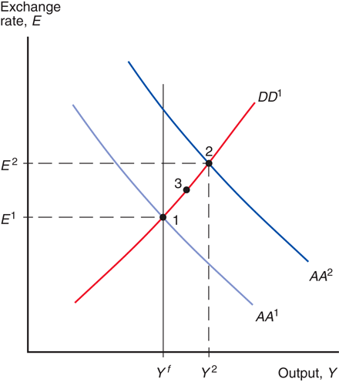
Fig. 17-14: Short-Run Effects of a Permanent Increase in the Money Supply

Slide 50
Effects of Permanent Changes in Monetary Policy in the Long Run
With employment and hours above their normal levels, there is a tendency for wages to rise over time.
With strong demand for goods and services and with increasing wages, producers have an incentive to raise prices over time.
Both higher wages and higher output prices are reflected in a higher level of average prices.
What are the effects of rising prices?

Slide 51
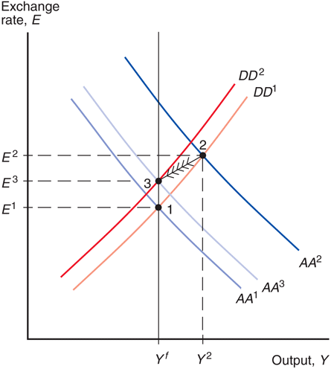
Fig. 17-15: Long-Run Adjustment to a Permanent Increase in the Money Supply

Slide 52
Effects of Permanent Changes in Fiscal Policy
A permanent increase in government purchases or reduction in taxes
  increases aggregate demand
  makes people expect the domestic currency to appreciate in the short run due to increased aggregate demand, thereby reducing the expected rate of return on foreign currency deposits and making the domestic currency appreciate.
The first effect increases aggregate demand of domestic products, the second effect decreases aggregate demand of domestic products (by making them more expensive).

Slide 53
Effects of Permanent Changes in Fiscal Policy (cont.)
If the change in fiscal policy is expected to be permanent, the first and second effects exactly offset each other, so that output remains at its potential or natural (or long run) level.
We say that an increase in government purchases completely crowds out net
exports, due to the effect of the appreciated domestic currency.

Slide 54
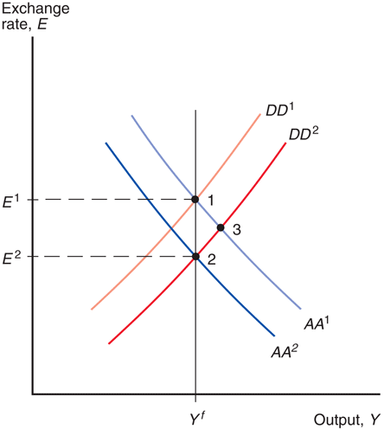
Fig. 17-16: Effects of a Permanent Fiscal Expansion

Slide 55
Macroeconomic Policies and the Current Account
To determine the effect of monetary and fiscal policies on the current account,
  derive the XX curve to represent the combinations of output and exchange rates at which the current account is at its desired level.
As income from production increases, imports increase and the current account decreases when other factors remain constant.
To keep the current account at its desired level, the domestic currency must depreciate as income from production increases: the XX curve should slope upward.

Slide 56
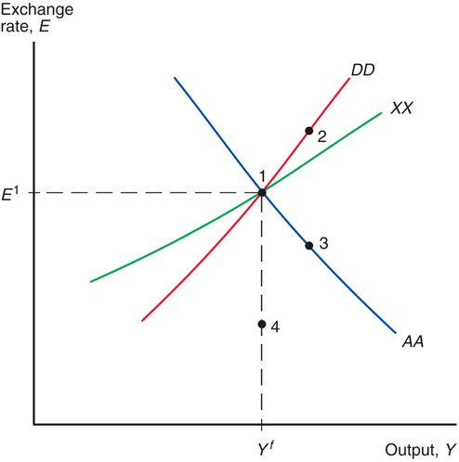
Fig. 17-17: How Macroeconomic
Policies Affect the Current Account

Slide 57
Macroeconomic Policies and the Current Account (cont.)
The XX curve slopes upward but is flatter than the DD curve.
  DD represents equilibrium values of aggregate demand and domestic output.
  As domestic income and production increase, domestic saving increases, which means that aggregate demand (willingness to spend) by domestic residents does not rise as rapidly as income and production.

Slide 58
Macroeconomic Policies and the Current Account (cont.)
  As domestic income and production increase, the domestic currency must depreciate to entice foreigners to increase their demand of domestic products in order to keep the current account (only one component of aggregate demand) at its desired level—on the XX curve.
  As domestic income and production increase, the domestic currency must depreciate more rapidly to entice foreigners to increase their demand of domestic products in order to keep aggregate demand (by domestic residents and foreigners) equal to production—on the DD curve.

Slide 59
Macroeconomic Policies and the Current Account (cont.)
Policies affect the current account through their influence on the value of the domestic currency.
  An increase in the quantity of monetary assets supplied depreciates the domestic currency and often increases the current account in the short run.
  An increase in government purchases or decrease in taxes appreciates the domestic currency and often decreases the current account in the short run.

Slide 60
Value Effect, Volume Effect, and the
J-Curve
If the volume of imports and exports is fixed in the short run, a depreciation of the domestic currency
  will not affect the volume of imports or exports,
  but will increase the value/price of imports in domestic currency and decrease the current account: CA ≈ EX – IM.
  The value of exports in domestic currency does not change.
The current account could immediately decrease after a currency depreciation, then increase gradually as the volume effect begins to dominate the value effect.

Slide 61
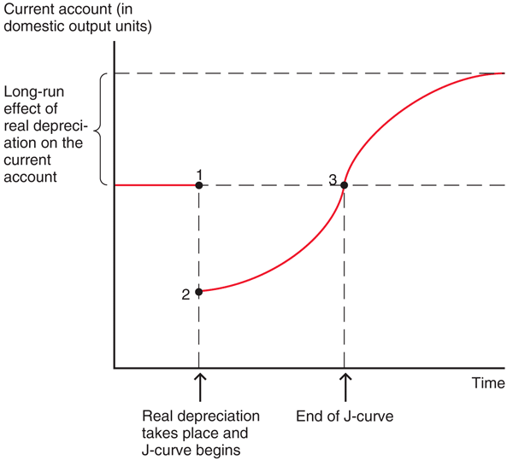
Fig. 17-18: The J-Curve

Slide 62
Value Effect, Volume Effect, and the J-Curve (cont.)
Pass-through from the exchange rate to import prices measures the percentage by which import prices change when the value of the domestic currency changes by 1%.
In the DD-AA model, the pass-through rate is 100%: import prices in domestic currency exactly match a depreciation of the domestic currency.
In reality, pass-through may be less than 100% due to price discrimination in different countries.
  Firms that set prices may decide not to match changes in the exchange rate with changes in prices of foreign products denominated in domestic currency.

Slide 63
Value Effect, Volume Effect, and the J-Curve (cont.)
If prices of foreign products in domestic currency do not change much because of a pass-through rate less than 100%, then
  the value of imports will not rise much after a domestic currency depreciation, and the current account will not fall much, making the J-curve effect smaller.
  the volume of imports and exports will not adjust much over time, since domestic currency prices do not change much.
Pass-through of less than 100% dampens the effect of depreciation or appreciation on the current account.

Slide 64
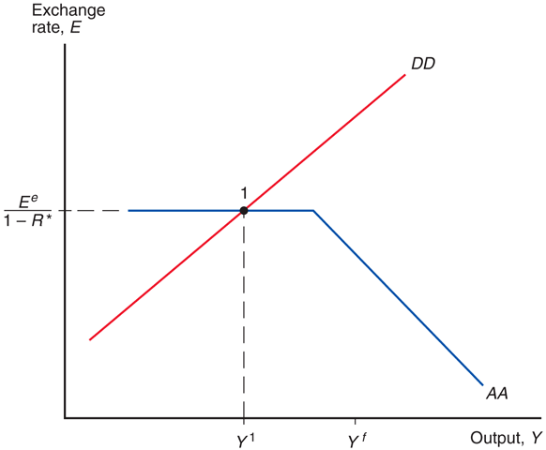
Fig. 17-19: A Low-Output Liquidity Trap

Slide 65
Summary
Aggregate demand is influenced by disposable income and the real exchange rate.
The DD curve shows combinations of exchange rates and output where aggregate demand = aggregate output.
The AA curve shows combinations of exchange rates and output where the foreign exchange markets and money market are in equilibrium.

Slide 66
Summary (cont.)
In the DD-AA model, we assume that a depreciation of the domestic currency leads to an increase in the current account and aggregate demand.
But reality is more complicated, and the
J-curve shows that the value effect at first dominates the volume effect.

Slide 67
Summary (cont.)
A temporary increase in the money supply is predicted to increase output and depreciate the domestic currency.
A permanent increase does both to a larger degree in the short run, but in the long run output returns to its normal level.
A temporary increase in government purchases is predicted to increase output and appreciate the domestic currency.
A permanent increase in government purchases is predicted to completely crowd out net exports, and therefore to have no effect on output.

Slide 68
Chapter 17 (6)
Appendix 1: Intertemporal Trade and Consumption Demand

Slide 69
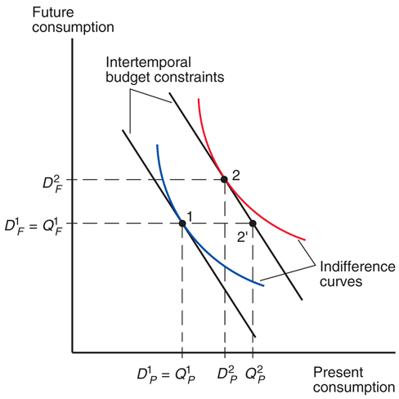
Fig. 17A1-1: Change in Output and Saving

Slide 70
Chapter 17 (6)
Appendix 2: The Marshall-Lerner Condition and Empirical Estimates of Trade Elasticities

Slide 71
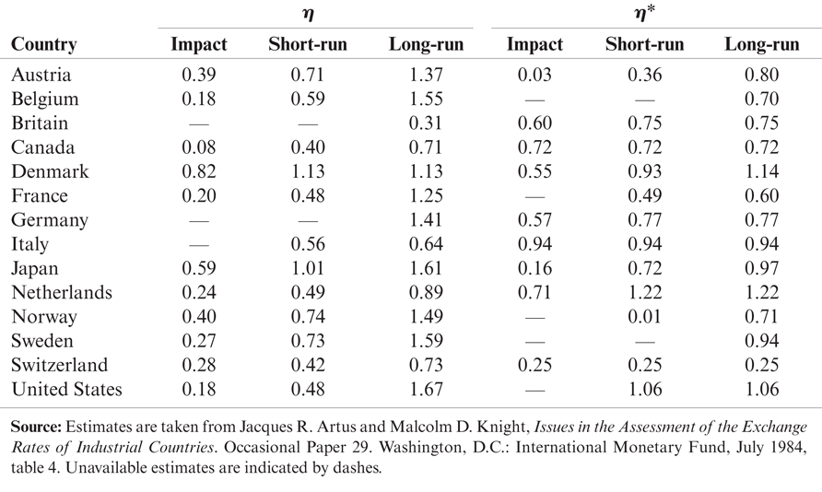
Table 17A2-1: Estimated Price Elasticities for International Trade in Manufactured Goods

