Slide 1
Chapter 19 (8)
International Monetary Systems: An Historical Overview

Slide 2
Preview
Goals of macroeconomic policies—internal and external balance
Gold standard era 1870–1914
International monetary system during interwar period 1918–1939
Bretton Woods system of fixed exchange rates 1944–1973

Slide 3
Preview (cont.)
Collapse of the Bretton Woods system
Arguments for floating exchange rates
Macroeconomic interdependence under a floating exchange rate
Foreign exchange markets since 1973

Slide 4
Macroeconomic Goals
“Internal balance” describes the macroeconomic goals of producing at potential output (at “full employment”) and of price stability (low inflation).
  An unsustainable use of resources (overemployment) tends to increase prices; an ineffective use of resources (underemployment) tends to decrease prices.
Volatile aggregate demand and output tend to create volatile prices.
  Price level movements reduce the economy’s efficiency by making the real value of the monetary unit less certain and thus a less useful guide for economic decisions.

Slide 5
Macroeconomic Goals (cont.)
“External balance” achieved when a current account is
  neither so deeply in deficit that the country may be unable to repay its foreign debts,
  nor so strongly in surplus that foreigners are put in that position.
    For example, pressure on Japan in the 1980s and China in the 2000s.
An intertemporal budget constraint limits each country’s spending over time to levels that it can repay (with interest).

Slide 6
The Open-Economy Trilemma
A country that fixes its currency’s exchange rate while allowing free international capital movements gives up control over domestic monetary policy.
A country that fixes its exchange rate can have control over domestic monetary policy if it restricts international financial flows so that interest parity R = R* need not hold.
Or a country can allow international capital to flow freely and have control over domestic monetary policy if it allows the exchange rate to float.

Slide 7
The Open-Economy Trilemma (cont.)
Impossible for a country to achieve more than two items from the following list:
1. Exchange rate stability.
2. Monetary policy oriented toward domestic goals.
3. Freedom of international capital movements.

Slide 8
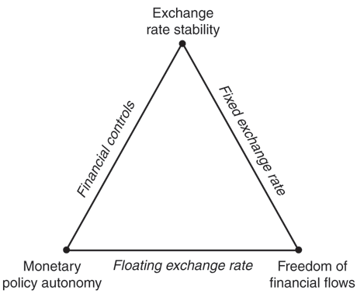
Fig. 19-1: The Monetary Trilemma for Open Economies

Slide 9
Macroeconomic Policy under the Gold Standard 1870–1914
The gold standard from 1870 to 1914 and after 1918 had mechanisms that prevented flows of gold reserves (the balance of payments) from becoming too positive or too negative.
  Prices tended to adjust according the amount of gold circulating in an economy, which had effects on the flows of goods and services: the current account.
  Central banks influenced financial asset flows, so that the nonreserve part of the financial account matched the current account in order to reduce gold outflows or inflows.

Slide 10
Macroeconomic Policy under the Gold Standard (cont.)
Price-specie-flow mechanism is the adjustment of prices as gold (“specie”) flows into or out of a country, causing an adjustment in the flow of goods.
  An inflow of gold tends to inflate prices.
  An outflow of gold tends to deflate prices.
  If a domestic country has a current account surplus in excess of the nonreserve financial account, gold earned from exports flows into the country—raising prices in that country and lowering prices in foreign countries.
    Goods from the domestic country become expensive and goods from foreign countries become cheap, reducing the current account surplus of the domestic country and the deficits of the foreign countries.

Slide 11
Macroeconomic Policy under the Gold Standard (cont.)
Thus, price-specie-flow mechanism of the gold standard could automatically reduce current account surpluses and deficits, achieving a measure of external balance for all countries.

Slide 12
Macroeconomic Policy under the Gold Standard (cont.)
The “Rules of the Game” under the gold standard refer to another adjustment process that was theoretically carried out by central banks:
  The selling of domestic assets to acquire money when gold exited the country as payments for imports. This decreased the money supply and increased interest rates, attracting financial inflows to match a current account deficit.
    This reversed or reduced gold outflows.
  The buying of domestic assets when gold enters the country as income from exports. This increased the money supply and decreased interest rates, reducing financial inflows to match the current account.
    This reversed or reduced gold inflows.

Slide 13
Macroeconomic Policy under the Gold Standard (cont.)
Banks with decreasing gold reserves had a strong incentive to practice the rules of the game: they could not redeem currency without sufficient gold.
Banks with increasing gold reserves had a weak incentive to practice the rules of the game: gold did not earn interest, but domestic assets did.
In practice, central banks with increasing gold reserves seldom followed the rules.
And central banks often sterilized gold flows, trying to prevent any effect on money supplies and prices.

Slide 14
Macroeconomic Policy under the Gold Standard (cont.)
The gold standard’s record for internal balance was mixed.
  The U.S. suffered from deflation, recessions, and financial instability during the 1870s, 1880s, and 1890s while trying to adhere to a gold standard.
  The U.S. unemployment rate was 6.8% on average from 1890 to 1913, but it was less than 5.7% on average from 1946 to 1992.

Slide 15
Interwar Years: 1918–1939
The gold standard was stopped in 1914 due to war, but after 1918 it was attempted again.
  The U.S. reinstated the gold standard from 1919 to 1933 at $20.67 per ounce and from 1934 to 1944 at $35.00 per ounce (a devaluation of the dollar).
  The U.K. reinstated the gold standard from 1925 to 1931.
But countries that adhered to the gold standard for the longest time, without devaluing their currencies, suffered most from reduced output and employment during the 1930s.

Slide 16
Bretton Woods System:
1944–1973
In July 1944, 44 countries met in Bretton Woods, NH, to design the Bretton Woods system:
  a fixed exchange rate against the U.S. dollar and a fixed dollar price of gold ($35 per ounce).
They also established other institutions:
  The International Monetary Fund
  The World Bank
  General Agreement on Trade and Tariffs (GATT), the predecessor to the World Trade Organization (WTO).

Slide 17
International Monetary Fund
The IMF was constructed to lend to countries with persistent balance of payments deficits (or current account deficits), and to approve of devaluations.
  Loans were made from a fund paid for by members in gold and currencies.
  Each country had a quota, which determined its contribution to the fund and the maximum amount it could borrow.
  Large loans were made conditional on the supervision of domestic policies by the IMF: IMF conditionality.
  Devaluations could occur if the IMF determined that the economy was experiencing a “fundamental disequilibrium.”

Slide 18
International Monetary Fund (cont.)
Due to borrowing and occasional devaluations, the IMF was believed to give countries enough flexibility to attain an external balance, yet allow them to maintain an internal balance and stable exchange rates.
  The volatility of exchange rates during 1918–1939, caused by devaluations and the vagaries of the gold standard, was viewed as a source of economic instability.

Slide 19
Bretton Woods System
In order to avoid sudden changes in the financial account (possibly causing a balance of payments crisis), countries in the Bretton Woods system often prevented flows of financial assets across countries.
Yet they encouraged flows of goods and services because of the view that trade benefits all economies.
  Currencies were gradually made convertible (exchangeable) between member countries to encourage trade in goods and services valued in different currencies.

Slide 20
Bretton Woods System (cont.)
Under a system of fixed exchange rates, all countries but the U.S. had ineffective monetary policies for internal balance.
The principal tool for internal balance was fiscal policy (government purchases or taxes).
The principal tools for external balance were borrowing from the IMF, restrictions on financial asset flows, and infrequent changes in exchange rates.

Slide 21
Policies for Internal and External Balance
Suppose internal balance in the short run occurs when production is at potential output or when “full employment” equals aggregate demand:
Y^{f} = C + I + G + CA(EP*/P, A)
= A + CA(EP*/P, A)
An increase in government purchases (or a decrease in taxes) increases aggregate demand and output above its full employment level.
To restore internal balance in the short run, a revaluation (a fall in E) must occur.

Slide 22
Policies for Internal and External Balance (cont.)
Suppose external balance in the short run occurs when the current account achieves some value X:
CA(EP*/P, Y – T) = X
An increase in government purchases (or a decrease in taxes) increases aggregate demand, output and income, decreasing the current account.
To restore external balance in the short run, a devaluation (a rise in E) must occur.

Slide 23
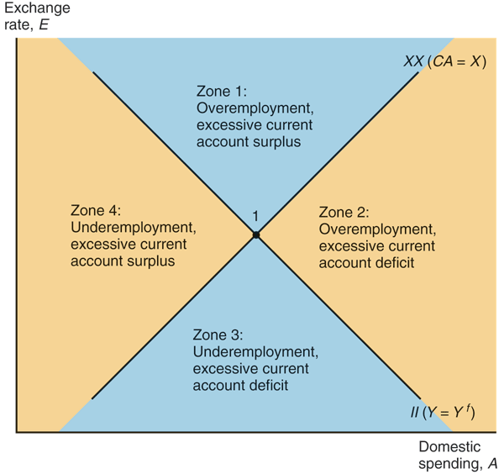
Fig. 19-2: Internal Balance (II), External Balance (XX), and the “Four Zones of Economic Discomfort”

Slide 24
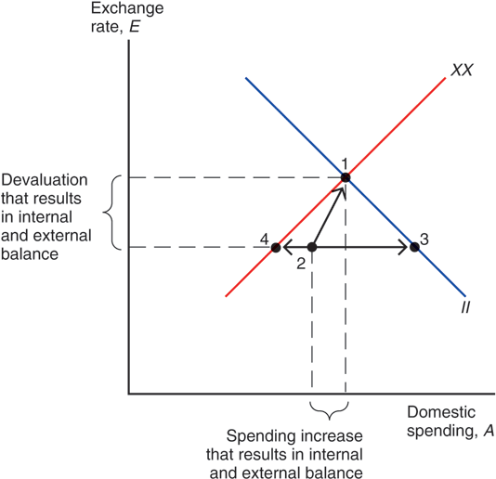
Fig. 19-3: Policies to Bring about Internal and External Balance

Slide 25
Policies for Internal and External Balance (cont.)
But under the fixed exchange rates of the Bretton Woods system, devaluations were supposed to be infrequent, and fiscal policy was supposed to be the main policy tool to achieve both internal and external balance.
But in general, fiscal policy cannot attain both internal balance and external balance at the same time.
A devaluation, however, can attain both internal balance and external balance at the same time.

Slide 26
Policies for Internal and External Balance (cont.)
Under the Bretton Woods system, policy makers generally used fiscal policy to try to achieve internal balance for political reasons.
Thus, an inability to adjust exchange rates
left countries facing external imbalances
over time.
  Infrequent devaluations or revaluations helped restore external and internal balance, but speculators also tried to anticipate them, which could cause greater internal or external imbalances.

Slide 27
U.S. External Balance Problems under Bretton Woods
The collapse of the Bretton Woods system was caused primarily by imbalances of the U.S. during the 1960s and 1970s.
  The U.S. current account surplus became a deficit in 1971.
  Rapidly increasing government purchases increased aggregate demand and output, as well as prices.
  Rising prices and a growing money supply caused the U.S. dollar to become overvalued in terms of gold and in terms of foreign currencies.

Slide 28
U.S. External Balance Problems under Bretton Woods (cont.)
Another problem was that as foreign economies grew, their need for official international reserves to maintain fixed exchange rates grew as well.
But this rate of growth was faster than the growth rate of the gold reserves that central banks held.
  Supply of gold from new discoveries was growing slowly.
  Holding dollar-denominated assets was the alternative.
At some point, dollar-denominated assets held by foreign central banks would be greater than the amount of gold held by the Federal Reserve.

Slide 29
U.S. External Balance Problems under Bretton Woods (cont.)
The Federal Reserve would eventually not have enough gold: foreigners would lose confidence in the ability of the Federal Reserve to maintain the fixed price of gold at $35/ounce, and therefore would rush to redeem their dollar assets before the gold ran out.
  This problem is similar to what any central bank may face when it tries to maintain a fixed exchange rate.
  If markets perceive that the central bank does not have enough official international reserve assets to maintain a fixed rate, a balance of payments crisis is inevitable.

Slide 30
Collapse of the Bretton Woods System
The U.S. was not willing to reduce government purchases or increase taxes significantly, nor reduce money supply growth.
These policies would have reduced aggregate demand, output, and inflation and increased unemployment.
  The U.S. could have attained some semblance of external balance at a cost of a slower economy.
A devaluation, however, could have avoided the costs of low output and high unemployment and still have attained external balance (an increased current account and official international reserves).

Slide 31
Collapse of the Bretton Woods System (cont.)
The imbalances of the U.S., in turn, caused speculation about the value of the U.S. dollar, which caused imbalances for other countries and made the system of fixed exchange rates harder to maintain.
  Financial markets had the perception that the
  U.S. economy was experiencing a “fundamental disequilibrium” and that a devaluation would
  be necessary.

Slide 32
Collapse of the Bretton Woods System (cont.)
First, speculation about a devaluation of the dollar caused investors to buy large quantities of gold.
  The Federal Reserve sold large quantities of gold in March 1968, but closed markets afterwards.
  Thereafter, individuals and private institutions were no longer allowed to redeem gold from the Federal Reserve or other
  central banks.
  The Federal Reserve would sell only to other central banks at $35/ounce.
  But even this arrangement did not hold: the U.S. devalued its dollar in terms of gold in December 1971 to $38/ounce.

Slide 33
Collapse of the Bretton Woods System (cont.)
Second, speculation about a devaluation of the dollar in terms of other currencies caused investors to buy large quantities of foreign currency assets.
  A coordinated devaluation of the dollar against foreign currencies of about 8% occurred in December 1971.
  Speculation about another devaluation occurred: European central banks sold huge quantities of European currencies in early February 1973, but closed markets afterwards.
  Central banks in Japan and Europe stopped selling their currencies and stopped purchasing of dollars in March 1973, and allowed demand and supply of currencies to push the value of the dollar downward.

Slide 34
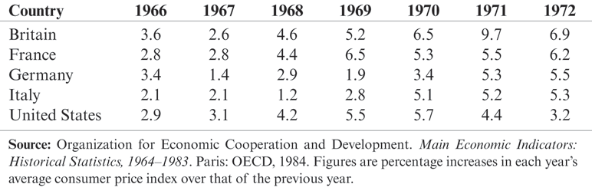
Table 19-1: Inflation Rates in Industrial Countries, 1966–1972 (percent per year)

Slide 35
Collapse of the Bretton Woods System (cont.)
The Bretton Woods system collapsed in 1973 because central banks were unwilling to continue to buy overvalued dollar-denominated assets and to sell undervalued foreign currency–denominated assets.
In 1973, central banks thought they would temporarily stop trading in the foreign exchange market and would let exchange rates adjust to supply and demand, and then would reimpose fixed exchange rates soon.
But no new global system of fixed rates was started again.

Slide 36
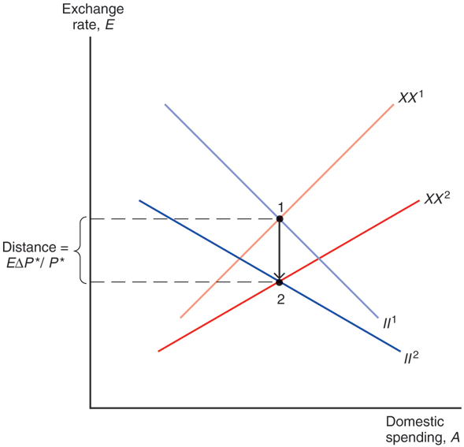
Fig. 19-4: Effect on Internal and External Balance of a Rise in the Foreign Price Level, P*

Slide 37
Case for Floating Exchange Rates
Monetary policy autonomy
  Without a need to trade currency in foreign exchange markets, central banks are more free to influence the domestic money supply, interest rates, and inflation.
  Central banks can more freely react to changes in aggregate demand, output, and prices in order to achieve internal balance.

Slide 38
Case for Floating Exchange Rates (cont.)
Automatic stabilization
  Flexible exchange rates change the prices of a country’s products and help reduce “fundamental disequilibria.”
  One fundamental disequilibrium is caused by an excessive increase in money supply and government purchases, leading to inflation, as we saw in the US during 1965–1972.
  Inflation causes the currency’s purchasing power to fall, both domestically and internationally, and flexible exchange rates can automatically adjust to account for this fall in value, as purchasing power parity predicts.

Slide 39
Case for Floating Exchange Rates (cont.)
  Another fundamental disequilibrium could be caused by a change in aggregate demand for a country’s products.
  Flexible exchange rates would automatically adjust to stabilize high or low aggregate demand and output, thereby keeping output closer to its normal level and also stabilizing price changes in the long run.

Slide 40
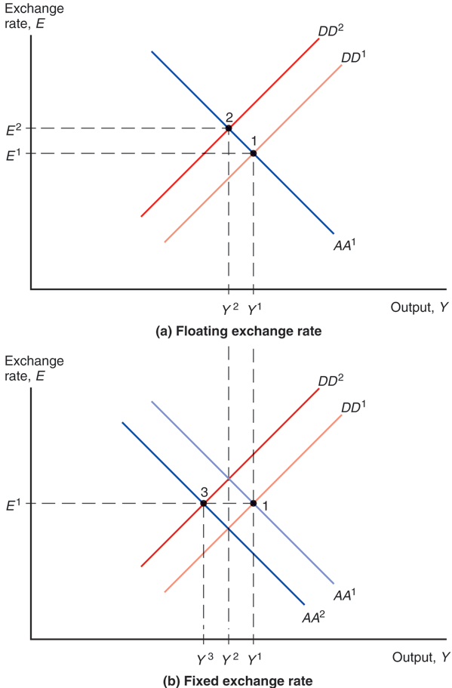
Fig. 19-5: Effects of a Fall in Export Demand

Slide 41
Case for Floating Exchange Rates (cont.)
  In the long run, a real depreciation of domestic products occurs as prices fall (due to low aggregate demand, output, and employment) under fixed exchange rates.
  In the short run and long run, a real depreciation of domestic products occurs through a nominal depreciation under flexible exchange rates.
Fixed exchange rates cannot survive for long in a world with divergent macroeconomic policies and other changes that affect national aggregate demand and national income differently.

Slide 42
Case for Floating Exchange Rates (cont.)
Flexible exchange rates may also prevent speculation in some cases.
  Fixed exchange rates are unsustainable if markets believe that the central bank does not have enough official international reserves.

Slide 43
Case for Floating Exchange Rates (cont.)
Symmetry (not possible under Bretton Woods)
  The U.S. is now allowed to adjust its exchange rate, like other countries.
  Other countries are allowed to adjust their money supplies for macroeconomic goals, like the U.S. could.

Slide 44
Since 1973
In 1975, IMF members met in Rambouillet, France to allow flexible exchange rates, but to prevent “erratic fluctuations.”
In 1976 in Kingston, Jamaica, they amended the articles of agreement for IMF membership to formally endorse flexible rates,
  but prevented members from “manipulating exchange rates … to gain an unfair competitive advantage”: no expenditure-switching policies were allowed.
  The articles allowed “surveillance” of members by other members to be sure they were acting fairly.

Slide 45
Since 1973 (cont.)
Due to contractionary monetary policy and expansive fiscal policy in the U.S., the dollar appreciated by about 50% relative to 15 currencies from 1980 to 1985.
  This contributed to a growing current account deficit by making imports cheaper and U.S. goods more expensive.

Slide 46
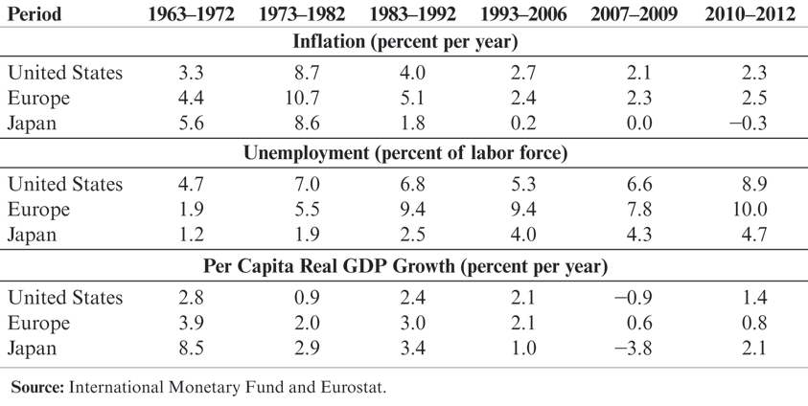
Table 19-2: Macroeconomic Data for Key Industrial Regions, 1963–2012

Slide 47
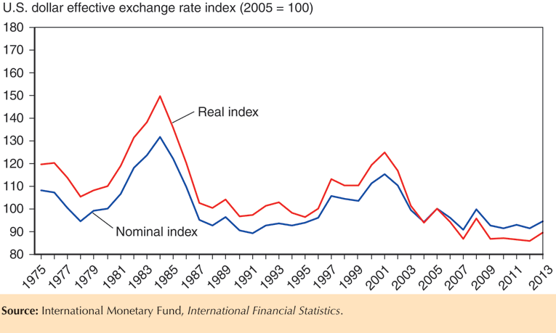
Fig. 19-6: Nominal and Real Effective Dollar Exchange Rate Indexes, 1975–2013

Slide 48
Since 1973 (cont.)
To reduce the value of the U.S. $, the U.S., Germany, Japan, Britain, and France announced in 1985 that their central banks would jointly intervene in the foreign exchange markets in order to reduce the value of the dollar.
  The dollar dropped sharply the next day and continued to drop as the U.S. continued a more expansionary monetary policy, pushing down interest rates.
  The agreement was called the Plaza Accords, because it was announced at the Plaza Hotel in New York.

Slide 49
Since 1973 (cont.)
After the value of the dollar fell, countries were interested in stabilizing exchange rates.
  U.S., Germany, Japan, Britain, France, and Canada announced renewed cooperation in 1987, pledging to stabilize exchange rates.
  They calculated zones of about +/– 5% around which current exchange rates were allowed to fluctuate.
  The agreement was called the Louvre Accords, because it was announced at the Louvre in Paris.

Slide 50
Since 1973 (cont.)
It is not at all apparent that the Louvre Accords succeeded in stabilizing exchange rates.
  The stock market crash in October 1987 made production, employment, and price stability the primary goals for the U.S. central bank, and exchange rate stability became less important.
  New targets were (secretly) made after October 1987, but central banks had abandoned these targets by the early 1990s.

Slide 51
Since 1973 (cont.)
Many fixed exchange rate systems have nonetheless developed since 1973.
  European monetary system and euro zone (studied in Econ Chapter 21/Finance Chapter 10).
  The Chinese central bank currently fixes the value of its currency.
  ASEAN countries have considered a fixed exchange rates and policy coordination.
No system is right for all countries at all times.

Slide 52
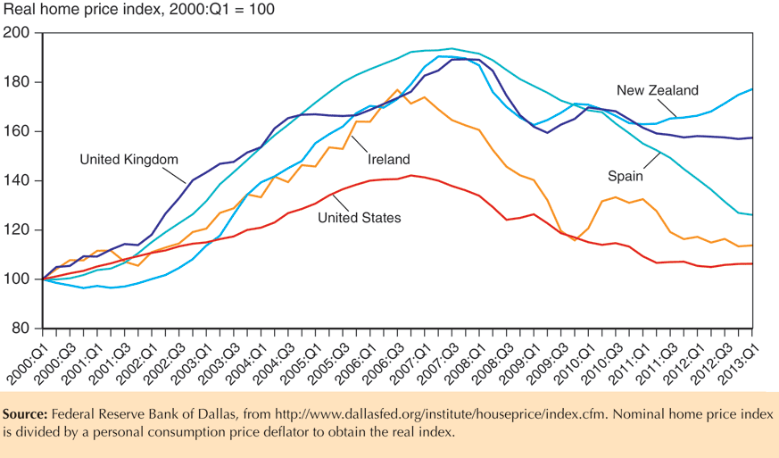
Fig. 19-7: Real Home Prices in Selected Countries, 2000–2013

Slide 53
Macroeconomic Interdependence under Floating Exchange Rates
Previously, we assumed that countries are “small” in that their policies do not affect world markets.
  For example, a depreciation of the domestic currency was assumed to have no significant influence on aggregate demand, output, and prices in foreign countries.
  For countries like Costa Rica, this may be an accurate description.
However, large economies like the U.S., EU, Japan, and China are interdependent because policies in one country affect other economies.

Slide 54
Macroeconomic Interdependence under Floating Exchange Rates (cont.)
If the U.S. permanently increases the money supply, the DD-AA model predicts for the short run:
  an increase in U.S. output and income
  a depreciation of the U.S. dollar
What would be the effects for Japan?
  an increase in U.S. output and income would raise demand for Japanese products, thereby increasing aggregate demand and output in Japan.
  a depreciation of the U.S. dollar means an appreciation of the yen, lowering demand for Japanese products, thereby decreasing aggregate demand and output in Japan.
  The total effect of (1) and (2) is ambiguous.

Slide 55
Macroeconomic Interdependence under Floating Exchange Rates (cont.)
If the U.S. permanently increases government purchases, the DD-AA model predicts:
  an appreciation of the U.S. dollar.
What would be the effects for Japan?
  an appreciation of the U.S. dollar means an depreciation of the yen, raising demand for Japanese products, thereby increasing aggregate demand and output in Japan.
What would be the subsequent effects for the U.S.?
  Higher Japanese output and income means that more income is spent on U.S. products, increasing aggregate demand and output in the U.S. in the short run.

Slide 56
Macroeconomic Interdependence under Floating Exchange Rates (cont.)
In fact, the U.S. has depended on saved funds from many countries, while it has borrowed heavily.
  The U.S. has run a current account deficit for many years due to its low saving and high investment expenditure.

Slide 57
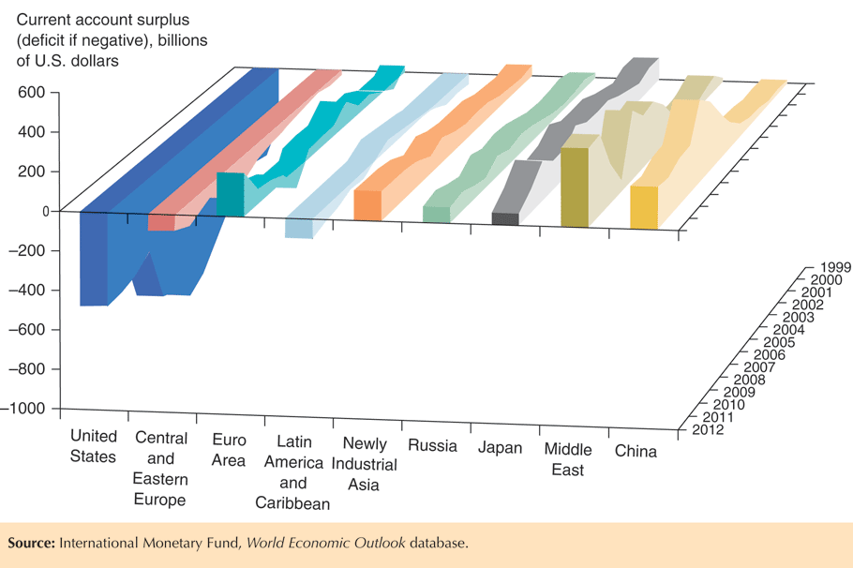
Fig. 19-8: Global External Imbalances, 1999–2012

Slide 58
Macroeconomic Interdependence under Floating Exchange Rates (cont.)
But as foreign countries spend more and lend less to the U.S.,
  interest rates are rising slightly
  the U.S. dollar is depreciating
  the U.S. current account is increasing (becoming less negative).

Slide 59
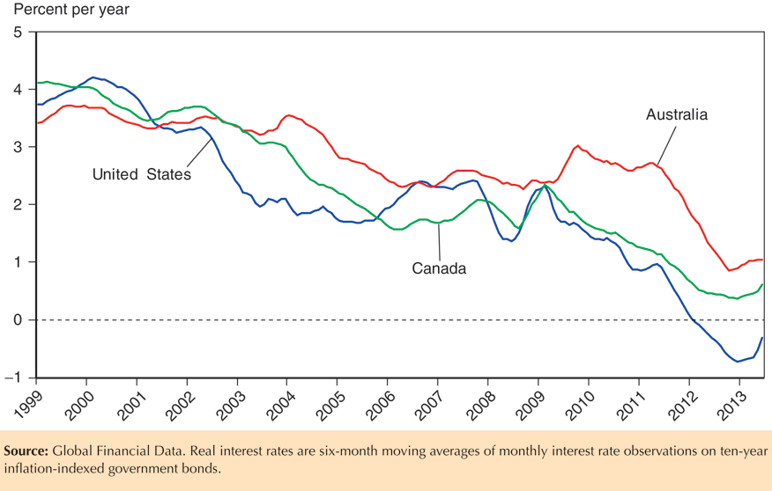
Fig. 19-9: Long-Term Real Interest Rates for the United States, Australia, and Canada, 1999–2013

Slide 60
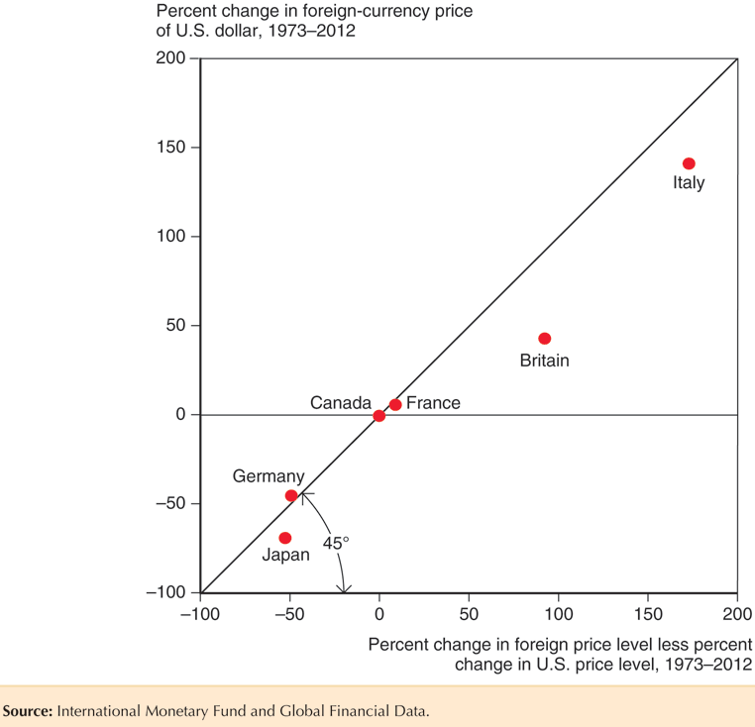
Fig. 19-10: Exchange Rate Trends and Inflation Differentials, 1973–2012

Slide 61
Summary
Internal balance means that an economy enjoys normal output and employment and price stability.
External balance roughly means a stable level of official international reserves or a current account that is not too positive or too negative.
The gold standard had two mechanisms that helped to prevent external imbalances:
  Price-specie-flow mechanism: the automatic adjustment of prices as gold flows into or out of a country.
  Rules of the game: buying or selling of domestic assets by central banks to influence flows of financial assets.

Slide 62
Summary (cont.)
The Bretton Woods agreement in 1944 established fixed exchange rates, using the U.S. dollar as the reserve currency.
The IMF was also established to provide countries with financing for balance of payments deficits and to judge if changes in fixed rates were necessary.
Under the Bretton Woods system, fiscal policies were used to achieve internal and external balance, but they could not do both simultaneously, so external imbalances often resulted.

Slide 63
Summary (cont.)
Internal and external imbalances of the U.S.—caused by rapid growth in government purchases and the money supply—and speculation about the value of the U.S. dollar in terms of gold and other currencies ultimately broke the Bretton Woods system.
High inflation from U.S. macroeconomic policies was transferred to other countries late in the Bretton Woods system.

Slide 64
Summary (cont.)
Arguments for flexible exchange rates are that they allow monetary policy autonomy, can stabilize the economy as aggregate demand and output change, and can limit some forms of speculation.
Arguments against flexible exchange rates are that they allow expenditure switching policies, can make aggregate demand and output more volatile because of uncoordinated policies across countries, and make exchange rates more volatile.

Slide 65
Summary (cont.)
Since 1973, countries have engaged in 2 major global efforts to influence exchange rates:
  The Plaza Accords reduced the value of the dollar relative to other major currencies.
  The Louvre Accords agreement was intended to stabilize exchange rates, but it was quickly abandoned.
Models of large countries account for the influence that domestic macroeconomic policies have in foreign countries.

Slide 66
Chapter 19 (8)
Appendix: International Policy Coordination Failures

Slide 67
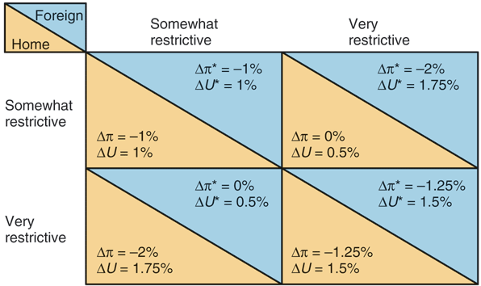
Fig. 19A-1: Hypothetical Effects of Different Monetary Policy Combinations on Inflation and Unemployment

Slide 68
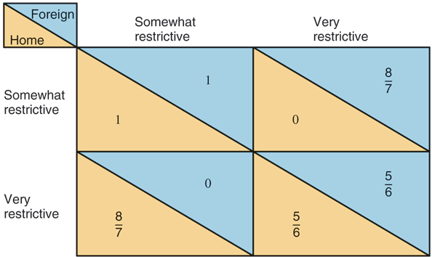
Fig. 19A-2: Payoff Matrix for Different
Monetary Policy Moves

