Slide 1
Chapter 20 (9)
Financial Globalization: Opportunity
and Crisis

Slide 2
Preview
Gains from trade
Portfolio diversification
Players in the international capital markets
Attainable policies with international capital markets
Offshore banking and offshore currency trading
Regulation of international banking
Tests of how well international capital markets allow portfolio diversification, allow intertemporal trade, and transmit information

Slide 3
International Capital Markets
International asset (capital) markets are a group of markets (in London, Tokyo, New York, Singapore, and other financial cities) that trade different types of financial and physical assets (capital), including
  stocks
  bonds (government and private sector)
  deposits denominated in different currencies
  commodities (like petroleum, wheat, bauxite, gold)
  forward contracts, futures contracts, swaps, options contracts
  real estate and land
  factories and equipment

Slide 4
Gains from Trade
How have international capital markets increased the gains from trade?
When a buyer and a seller engage in a voluntary transaction, both receive something that they want and both can be made better off.
A buyer and seller can trade
  goods or services for other goods or services
  goods or services for assets
  assets for assets

Slide 5
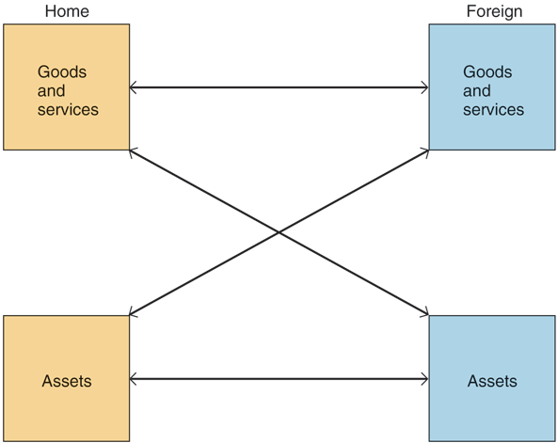
Fig. 20-1: The Three Types of
International Transaction

Slide 6
Gains from Trade (cont.)
The theory of comparative advantage describes the gains from trade of goods and services for other goods and services:
  With a finite amount of resources and time, use those resources and time to produce what you are most productive at (compared to alternatives), then trade those products for goods and services that you want.
  Be a specialist in production, while enjoying many goods and services as a consumer through trade.

Slide 7
Gains from Trade (cont.)
The theory of intertemporal trade describes the gains from trade of goods and services for assets, of goods and services today for claims to goods and services in the future (today’s assets).
  Savers want to buy assets (claims to future goods and services) and borrowers want to use assets to consume or invest in more goods and services than they can buy with current income.
  Savers earn a rate of return on their assets, while borrowers are able to use goods and services when they want to use them: they both can be made better off.

Slide 8
Gains from Trade (cont.)
The theory of portfolio diversification describes the gains from trade of assets for assets, of assets with one type of risk for assets with another type of risk.
  Investing in a diverse set, or portfolio, of assets is a way for investors to avoid or reduce risk.
  Most people most of the time want to avoid risk: they would rather have a sure gain of wealth than invest in risky assets when other factors are constant.
    People usually display risk aversion: they are usually averse to risk.

Slide 9
Portfolio Diversification
Suppose that 2 countries have an asset of farmland that yields a crop, depending on the weather.
The yield (return) of the asset is uncertain, but with bad weather the land can produce 20 tons of potatoes, while with good weather the land can produce 100 tons of potatoes.
On average, the land will produce 1/2 x 20 + 1/2 x 100 = 60 tons if bad weather and good weather are equally likely (both with a probability of 1/2).
  The expected value of the yield is 60 tons.

Slide 10
Portfolio Diversification (cont.)
Suppose that historical records show that when the domestic country has good weather (high yields), the foreign country has bad weather (low yields).
  and that we can assume that the future will be like the past.
What could the two countries do to avoid suffering from a bad potato crop?
Sell 50% of one’s assets to the other party and buy 50% of the other party’s assets:
  diversify the portfolios of assets so that both countries always achieve the portfolios’ expected (average) values.

Slide 11
Portfolio Diversification (cont.)
With portfolio diversification, both countries could always enjoy a moderate potato yield and not experience the vicissitudes of feast and famine.
  If the domestic country’s yield is 20 and the foreign country’s yield is 100, then both countries receive
  50% x 20 + 50% x 100 = 60.
  If the domestic country’s yield is 100 and the foreign country’s yield is 20, then both countries receive
  50% x 100 + 50% x 20 = 60.
  If both countries are risk averse, then both countries could be made better off through portfolio diversification.

Slide 12
Classification of Assets
Assets can be classified as either
Debt instruments
  Examples include bonds and deposits.
  They specify that the issuer must repay a fixed amount regardless of economic conditions.
  or
Equity instruments
  Examples include stocks or a title to real estate.
  They specify ownership (equity = ownership) of variable profits or returns, which vary according to economic conditions.

Slide 13
International Capital Markets
The participants:
Commercial banks and other depository institutions:
  Accept deposits.
  Lend to commercial businesses, other banks, governments, and/or individuals.
  Buy and sell bonds and other assets.
  Some commercial banks underwrite new stocks and bonds by agreeing to find buyers for those assets at a specified price.

Slide 14
International Capital Markets (cont.)
Nonbank financial institutions such as securities firms, pension funds, insurance companies, mutual funds:
  Securities firms specialize in underwriting stocks and bonds (securities) and in making various investments.
  Pension funds accept funds from workers and invest them until the workers retire.
  Insurance companies accept premiums from policy holders and invest them until an accident or another unexpected event occurs.
  Mutual funds accept funds from investors and invest them in a diversified portfolio of stocks.

Slide 15
International Capital Markets (cont.)
Private firms:
  Corporations may issue stock, may issue bonds, or may borrow to acquire funds for investment purposes.
  Other private firms may issue bonds or may borrow from commercial banks.
Central banks and government agencies:
  Central banks sometimes intervene in foreign exchange markets.
  Government agencies issue bonds to acquire funds, and may borrow from commercial banks or securities firms.

Slide 16
Offshore Banking
Offshore banking refers to banking outside of the boundaries of a country.
There are at least 3 types of offshore banking institutions, which are regulated differently:
  An agency office in a foreign country makes loans and transfers, but does not accept deposits, and is therefore not subject to depository regulations in either the domestic or foreign country.

Slide 17
Offshore Banking (cont.)
A subsidiary bank in a foreign country follows the regulations of the foreign country, not the domestic regulations of the domestic parent.
A foreign branch of a domestic bank is often subject to both domestic and foreign regulations, but sometimes may choose the more lenient regulations of the two.

Slide 18
Offshore Currency Trading
An offshore currency deposit is a bank deposit denominated in a currency other than the currency that circulates where the bank resides.
  An offshore currency deposit may be deposited in a subsidiary bank, a foreign branch, a foreign bank, or another depository institution located in a foreign country.
  Offshore currency deposits are sometimes (confusingly) referred to as eurocurrency deposits, because these deposits were historically made in European banks.

Slide 19
Offshore Currency Trading (cont.)
Offshore currency trading has grown for three
reasons:
  growth in international trade and international business
  avoidance of domestic regulations and taxes
  political factors (ex., to avoid confiscation by a government because of political events)

Slide 20
Offshore Currency Trading (cont.)
Reserve requirements are the primary example of a domestic regulation that banks have tried to avoid through offshore currency trading.
  Depository institutions in the U.S. and other countries are required to hold a fraction of domestic currency deposits on reserve at the central bank.
  These reserves cannot be lent to customers and do not earn interest in many countries, therefore the reserve requirement reduces income for banks.
  But offshore currency deposits in many countries are not subject to this requirement, and thus can earn interest on the full amount of the deposit.

Slide 21
Regulation of International Banking
Banks fail because they do not have enough or the right kind of assets to pay for their liabilities.
  The principal liability for commercial banks and other depository institutions is the value of deposits, and banks fail when they cannot pay their depositors.
  If the value of assets decline, say because many loans go into default, then liabilities could become greater than the value of assets and bankruptcy could result.
In many countries there are several types of regulations to avoid bank failure or its effects.

Slide 22
Banking and Financial Fragility
Banks fail because they do not have enough or the right kind of assets to pay for their liabilities.
  The principal liability for commercial banks and other depository institutions is the value of deposits, and banks fail when they cannot pay their depositors.
  If the value of assets decline, say because many loans go into default, then liabilities could become greater than the value of assets and bankruptcy could result.
In many countries there are several types of regulations to avoid bank failure or its effects.

Slide 23
Government Safeguards against Financial Instability
Deposit insurance
  Insures depositors against losses up to $100,000 in the U.S. when banks fail.
  Prevents bank panics due to a lack of information: because depositors cannot determine the financial health of a bank, they may quickly withdraw their funds if they are not sure that a bank is financially healthy enough to pay for them.

Slide 24
Government Safeguards against Financial Instability (cont.)
  Creates a moral hazard for banks to take excessive risk because they are no longer fully responsible for failure.
    Moral hazard: a hazard that a party in a transaction will engage in activities that would be considered inappropriate (ex., too risky) according to another party who is not fully informed about those activities
Reserve requirements
  Banks required to maintain some deposits on reserve at the central bank in case they need cash.

Slide 25
Government Safeguards against Financial Instability (cont.)
Capital requirements and asset restrictions
  Higher bank capital (net worth) means banks have more funds available to cover the cost of failed assets.
  Asset restrictions reduce risky investments by preventing a bank from holding too many risky assets and encourage diversification by preventing a bank from holding too much of one asset.
Bank examination
  Regular examination prevents banks from engaging in risky activities.

Slide 26
Government Safeguards against Financial Instability (cont.)
Lender of last resort
  In the U.S., the Federal Reserve System may lend to banks with inadequate reserves (cash).
  Prevents bank panics.
  Acts as insurance for depositors and banks, in addition to deposit insurance.
  Creates a moral hazard for banks to take excessive risk because they are not fully responsible for the risk.

Slide 27
Government Safeguards against Financial Instability (cont.)
Government-organized bailouts
  Failing all else, the central bank or fiscal authorities may organize the purchase of a failing bank by healthier institutions, sometimes throwing their own money into the deal as a sweetener.
  In this case, bankruptcy is avoided thanks to the government’s intervention as a crisis manager, but perhaps at public expense.
Safeguards were not nearly sufficient to prevent the financial crisis of 2007–2009.

Slide 28
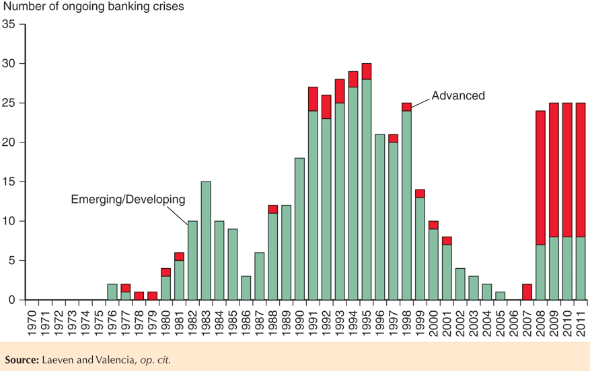
Fig. 20-2 Frequency of Systemic Banking Crises, 1970-2011

Slide 29
Difficulties in Regulating International Banking
Deposit insurance in the U.S. covers losses up to $100,000, but since the size of deposits in international banking is often much larger, the amount of insurance is often minimal.
Reserve requirements also act as a form of insurance for depositors, but countries cannot impose reserve requirements on foreign currency deposits in agency offices, foreign branches, or subsidiary banks of domestic banks.

Slide 30
Difficulties in Regulating International Banking (cont.)
Bank examination, capital requirements, and asset restrictions are more difficult internationally.
  Distance and language barriers make monitoring difficult.
  Different assets with different characteristics (ex., risk) exist in different countries, making judgment difficult.
  Jurisdiction is not clear in the case of subsidiary banks: for ex., if a subsidiary of an Italian bank is located in London but primarily has offshore U.S. dollar deposits, which regulators have jurisdiction?

Slide 31
Difficulties in Regulating International Banking (cont.)
No international lender of last resort for banks exists.
  The IMF sometimes acts a “lender of last resort” for governments with balance of payments problems.
The activities of nonbank financial institutions are growing in international banking, but they lack the regulation and supervision that banks have.
Derivatives and securitized assets make it harder to assess financial stability and risk because these assets are not accounted for on the traditional balance sheet.
  A securitized asset is a combination of different illiquid assets like loans that is sold as a security.

Slide 32
The Financial Trilemma
Regulations of the type used in the United States and other countries become even less effective in an international environment where banks can shift their business among different regulatory jurisdictions.
To see why an international banking system is harder to regulate than a national system, look at how the effectiveness of the U.S. safeguards described earlier is reduced as a result of offshore banking activities.

Slide 33
The Financial Trilemma (cont.)
Deposit insurance is essentially absent in international banking.
While Eurobanks derived a competitive advantage from escaping the required reserve tax, there was a social cost by reducing the stability of the banking system.
Bank examination to enforce capital requirements and asset restrictions is difficult in an international setting.
Several governments may have to share operational and financial responsibility for a rescue or reorganization.

Slide 34
The Financial Trilemma (cont.)
A financial trilemma constrains what policymakers in an open economy can achieve. At most two goals from the following list of three are simultaneously feasible:
Financial stability.
National control over financial safeguard policy.
Freedom of international capital movements

Slide 35
International Regulatory Cooperation
Basel accords (in 1988 and 2006) provide standard regulations and accounting for international financial institutions.
  1988 accords tried to make bank capital measurements standard across countries.
  They developed risk-based capital requirements, where more risky assets require a higher amount of bank capital.
Core principles of effective banking supervision was developed by the Basel Committee in 1997 for countries without adequate banking regulations and accounting standards.

Slide 36
International Regulatory Cooperation (cont.)
The financial crisis made obvious the inadequacies of the Basel II regulatory framework, so in 2010 the Basel Committee proposed a tougher set of capital standards and regulatory safeguards for international banks, Basel III.
In April 2009, at the height of the global crisis, the Financial Stability Forum became the Financial Stability Board (FSB), with a broader membership (including a number of emerging market economies) and a larger permanent staff.
Many countries have embarked on far-reaching national reforms of their financial systems.

Slide 37
The Macroprudential Perspective
Ensuring that each individual financial institution is sound will not ensure that the financial system as a whole is sound.
National financial regulators often face fierce lobbying from their home financial institutions, which argue that stricter rules would put them at a disadvantage relative to foreign rivals.
The Basel multilateral process plays an essential role in allowing governments to overcome domestic political pressures against adequate oversight and control of the financial sector.

Slide 38
Extent of International Portfolio Diversification
In 2008, U.S.-owned assets in foreign countries represented about 46.6% of U.S. capital, while foreign assets in the U.S. represented about 54.7% of U.S. capital.
  These percentages are about 5 times as large as percentages from 1970, indicating that international capital markets have allowed investors to diversify.
  In a fully diversified world economy, about 80% of U.S. capital would be owned by foreigners, while U.S. residents’ claims on foreigners would equal around 80% of U.S. capital.
Likewise, foreign assets and liabilities as a percent of GDP has grown for the U.S. and other countries.

Slide 39
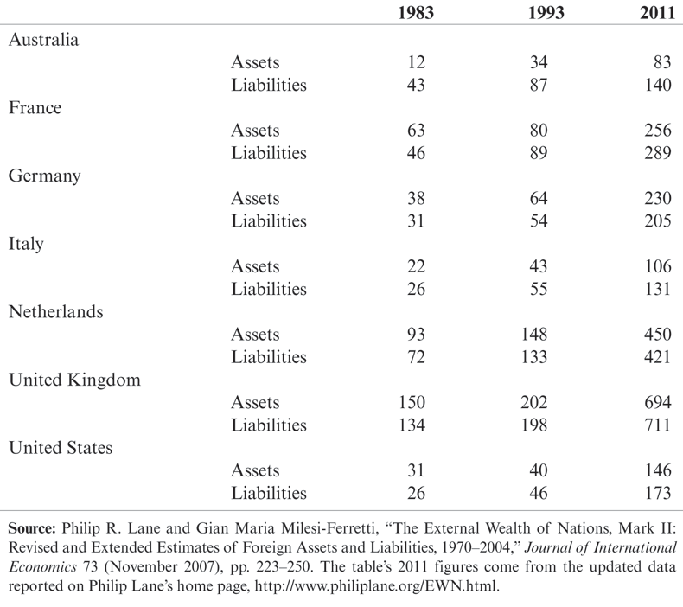
Table 20-1: Gross Foreign Assets and Liabilities of Selected Industrial Countries, 1983–2011 (percent of GDP)

Slide 40
Extent of International Portfolio Diversification (cont.)
Still, some economists argue that it would be optimal if investors diversified more by investing more in foreign assets, avoiding the “home bias” of investment.

Slide 41
Extent of International Intertemporal Trade
If some countries borrow for investment projects (for future production and consumption) while others lend to these countries, then national saving and investment levels should not be highly correlated.
  Recall that national saving – investment = current account.
  Some countries should have large current account surpluses as they save a lot and lend to foreign countries.
  Some countries should have large current account deficits as they borrow a lot from foreign countries.
In reality, national saving and investment levels are highly correlated.

Slide 42
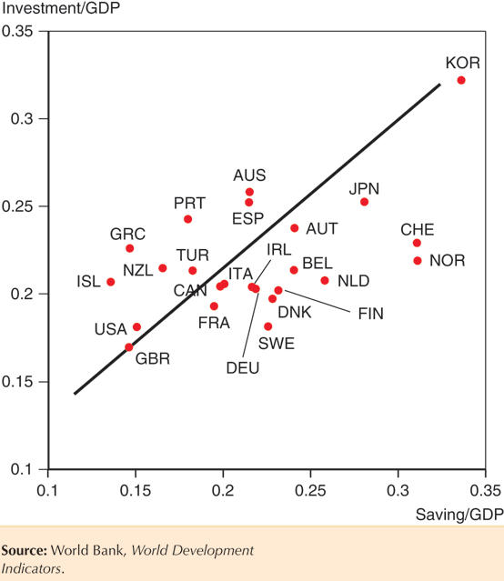
Fig. 20-3: Saving and Investment Rates for 24 Countries, 1990–2011 Averages

Slide 43
Extent of International Intertemporal Trade (cont.)
Are international capital markets unable to allow countries to engage in much intertemporal trade?
Not necessarily: factors that generate a high saving rate, such as rapid growth in production and income, may also generate a high investment rate.
Governments may also enact policies to avoid large current account deficits or surpluses.

Slide 44
Extent of Information Transmission and Financial Capital Mobility
We should expect that interest rates on offshore currency deposits and those on domestic currency deposits within a country should be the same if
  the two types of deposits are treated as perfect substitutes,
  assets can flow freely across borders, and
  international capital markets are able to quickly and easily transmit information about any differences in rates.

Slide 45
Extent of Information Transmission and Financial Capital Mobility (cont.)
In fact, differences in interest rates have approached zero as financial capital mobility has grown and information processing has become faster and cheaper through computers and telecommunications.

Slide 46
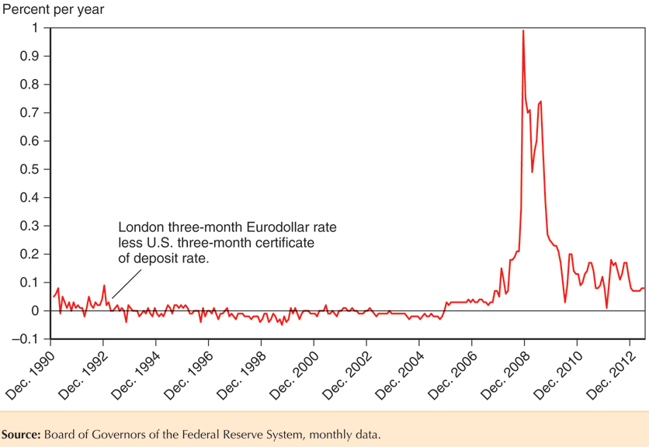
Fig. 20-4: Comparing Onshore and Offshore Interest Rates for the Dollar

Slide 47
Extent of Information Transmission and Financial Capital Mobility (cont.)
If assets are treated as perfect substitutes, then we expect interest parity to hold on average:
R_{t} – R*_{t} = (E^{e}_{t+1} – E_{t})/E_{t}
Under this condition, the interest rate difference is the market’s forecast of expected changes in the exchange rate.
  If we replace expected exchange rates with actual future exchange rates, we can test how well the market predicts exchange rate changes.
  But interest rate differentials fail to predict large swings in actual exchange rates and even fail to predict in which direction actual exchange rates change.

Slide 48
Extent of Information Transmission and Financial Capital Mobility (cont.)
Given that there are few restrictions on financial capital in most major countries, does this mean that international capital markets are unable to process and transmit information about interest rates?
Not necessarily: if assets are imperfect substitutes, then
      R_{t} – R*_{t} = (E^{e}_{t+1} – E_{t})/E_{t} + ρ_{t}
  Interest rate differentials are associated with exchange rate changes and with risk premiums that change over time.
  Changes in risk premiums may drive changes in exchange rates rather than interest rate differentials.

Slide 49
Extent of Information Transmission and Financial Capital Mobility (cont.)
R_{t} – R*_{t} = (E^{e}_{t+1} – E_{t})/E_{t} + ρ_{t}
Since both expected changes in exchange rates and risk premiums are functions of expectations and since expectations are unobservable,
  it is difficult to test if international capital markets are able to process and transmit information about interest rates.

Slide 50
Exchange Rate Predictability
In fact, it is hard to predict exchange rate changes over short horizons based on money supply growth, government spending growth, GDP growth, and other “fundamental” economic variables.
  The best prediction for tomorrow’s exchange rate appears to be today’s exchange rate, regardless of economic variables.
  But over long time horizons (more than 1 year), economic variables do better at predicting actual exchange rates.

Slide 51
Summary
Gains from trade of goods and services for other goods and services are described by the theory of comparative advantage.
Gains from trade of goods and services for assets are described by the theory of intertemporal trade.
Gains from trade of assets for assets are described by the theory of portfolio diversification.
Policy makers can choose only 2 of the following: a fixed exchange rate, a monetary policy for domestic goals, free international flows of assets.

Slide 52
Summary (cont.)
Several types of offshore banks deal in offshore currency trading, which developed as international trade grew and as banks tried to avoid domestic regulations.
Domestic banks are regulated by deposit insurance, reserve requirements, capital requirements, restrictions on assets, and bank examinations. The central bank also acts as a lender of last resort.
International banking is generally not regulated in the same manner as domestic banking, and there is no international lender of last resort.

Slide 53
Summary (cont.)
As international capital markets have developed, diversification of assets across countries has grown and differences between interests rates on offshore currency deposits and domestic currency deposits within a country have shrunk.
If foreign and domestic assets are perfect substitutes, then interest rates in international capital markets do not predict exchange rate changes well.
Even economic variables do not predict exchange rate changes well in the short run.

