Slide 1
Chapter 21 (10)
Optimum
Currency Areas
and the Euro

Slide 2
Preview
The European Union
The European Monetary System
Policies of the EU and the EMS
Theory of optimal currency areas
Is the EU an optimal currency area?
Other considerations of an economic and monetary union

Slide 3
What Is the EU?
The European Union is a system of international institutions, the first of which originated in 1957, which now represents 27 European countries through the following bodies:
  European Parliament: elected by citizens of member countries
  Council of the European Union: appointed by governments
  of the member countries
  European Commission: executive body
  Court of Justice: interprets EU law
  European Central Bank, which conducts monetary policy through a system of member country banks called the European System of Central Banks

Slide 4
What Is the EMS?
The European Monetary System was originally a system of fixed exchange rates implemented in 1979 through an exchange rate mechanism (ERM).
The EMS has since developed into an economic and monetary union (EMU), a more extensive system of coordinated economic and monetary policies.
  The EMS has replaced the exchange rate mechanism for most members with a common currency under the economic and monetary union.

Slide 5
Membership of the
Economic and Monetary Union
To be part of the economic and monetary union, EMS members must
  adhere to the ERM: exchange rates were fixed in specified bands around a target exchange rate.
  follow restrained fiscal and monetary policies as determined by Council of the European Union and the European Central Bank.
  replace the national currency with the euro, whose circulation is determined by the European System of Central Banks.

Slide 6
Membership of the EU
To be a member of the EU, a country must, among other things,
  have low barriers that limit trade and flows of financial assets
  adopt common rules for emigration and immigration to ease the movement of people
  establish common workplace safety and consumer protection rules
  establish certain political and legal institutions that are consistent with the EU’s definition of liberal democracy.

Slide 7
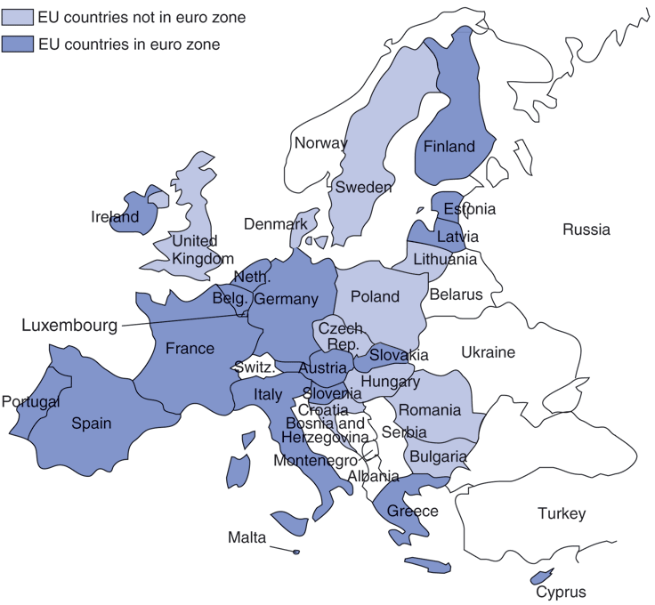
Fig. 21-1: Members of the Euro Zone as of January 1, 2014

Slide 8
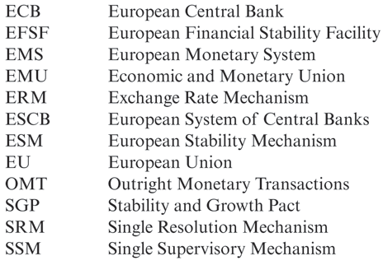
Table 21-1: A Brief Glossary of Euronyms

Slide 9
Why the EU?
Countries that established the EU and EMS had several goals
  To enhance Europe’s power in international affairs: as a union of countries, the EU could represent more economic and political power in the world.
  To make Europe a unified market: a large market with free trade, free flows of financial assets, and free migration of people—in addition to fixed exchange rates or a common currency—was believed to foster economic growth and economic well-being.
  To make Europe politically stable and peaceful.

Slide 10
Why the Euro (EMU)?
EU members adopted the euro for 4 main reasons:
  Unified market: the belief that greater market integration and economic growth would occur.
  Political stability: the belief that a common currency would make political interests more uniform.
  The belief that German influence under the EMS would be moderated under a European System of Central Banks.
  Elimination of the possibility of devaluations/ revaluations: with free flows of financial assets, capital flight and speculation could occur in an EMS with separate currencies, but it would be more difficult for them to occur in an EMS with a single currency.

Slide 11
The EMS: 1979–1998
From 1979 to 1993, the EMS defined the exchange
rate mechanism to allow most currencies to fluctuate +/– 2.25% around target exchange rates.
The exchange rate mechanism allowed larger fluctuations (+/– 6%) for currencies of Portugal, Spain, Britain (until 1992) and Italy (until 1990).
  These countries wanted greater flexibility with monetary policy.
  The wider bands were also intended to prevent speculation caused by differing monetary and fiscal policies.

Slide 12
The EMS: 1979–1998 (cont.)
To prevent speculation,
early in the EMS some exchange controls were also enforced to limit trading of currencies.
  But from 1987 to 1990 these controls were lifted in order to make the EU a common market for financial assets.
A credit system was also developed among EMS members to lend to countries that needed assets and currencies that were in high demand in the foreign exchange markets.

Slide 13
The EMS: 1979–1998 (cont.)
But because of differences in monetary and fiscal policies across the EMS, market participants began buying German assets (because of high German interest rates) and selling other EMS assets.
As a result, Britain left the EMS in 1992 and allowed the pound to float against other European currencies.
As a result, the exchange rate mechanism was redefined in 1993 to allow for bands of +/–15% of the target value in order devalue many currencies relative to the deutschemark.

Slide 14
The EMS: 1979–1998 (cont.)
But eventually, each EMS member adopted similarly restrained fiscal and monetary policies, and the inflation rates in the EMS eventually converged (and speculation slowed or stopped).
  In effect, EMS members were following the restrained monetary policies of Germany, which has traditionally had low inflation.
  Under the EMS exchange rate mechanism of fixed bands, Germany was “exporting” its monetary policy.

Slide 15
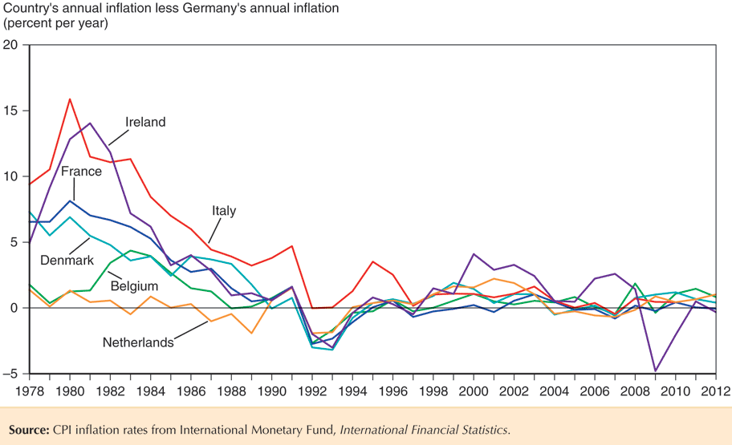
Fig. 21-2: Inflation Convergence for Six Original EMS Members, 1978–2012

Slide 16
Policies of the EU and EMS
The Single European Act of 1986 recommended that many barriers to trade, financial asset flows, and immigration be removed by December 1992.
  It also allowed EU policy to be approved with less than unanimous consent among members.
The Maastricht Treaty, proposed in 1991, required the 3 provisions to transform the EMS into an economic and monetary union.
  It also required standardizing regulations and centralizing foreign and defense policies among EU countries.
  Some EU/EMS members have not ratified all of the clauses.

Slide 17
Policies of the EU and EMS (cont.)
The Maastricht Treaty requires that members that want to enter the economic and monetary union
attain exchange rate stability defined by the ERM before adopting the euro.
attain price stability: a maximum inflation rate of
1.5% above the average of the three lowest national inflation rates among EU members.
maintain a restrictive fiscal policy:
  a maximum ratio of government deficit to GDP of 3%.
  a maximum ratio of government debt to GDP of 60%.

Slide 18
Policies of the EU and EMS (cont.)
The Maastricht Treaty requires that members that want to remain in the economic and monetary union
maintain a restrictive fiscal policy:
  a maximum ratio of government deficit to GDP of 3%.
  a maximum ratio of government debt to GDP of 60%.
  Financial penalties are imposed on countries with “excessive” deficits or debt.
The Stability and Growth Pact, negotiated in 1997, also allows for financial penalties on countries with “excessive” deficits or debt.

Slide 19
Policies of the EU and EMS (cont.)
The euro was adopted in 1999, and the previous exchange rate mechanism became obsolete.
But a new exchange rate mechanism—ERM 2—was established between the economic and monetary union and outside countries.
  It allowed countries (either within or outside of the EU) that wanted to enter the economic and monetary union in the future to maintain stable exchange rates before doing so.
  It allowed EU members outside of the economic and monetary union to maintain fixed exchange rates if desired.

Slide 20
Theory of Optimum Currency Areas
The theory of optimum currency areas argues that the optimal area for a system of fixed exchange rates, or a common currency, is one that is highly economically integrated.
  economic integration means free flows of
    goods and services (trade)
    financial capital (assets) and physical capital
    workers/labor (immigration and emigration)
The theory was developed by Robert Mundell in 1961.

Slide 21
Theory of Optimum Currency Areas (cont.)
Fixed exchange rates have costs and benefits for countries deciding whether to adhere to them.
Benefits of fixed exchange rates are that
they avoid the uncertainty and international transaction costs that floating exchange
rates involve.
The gain that would occur if a country joined a fixed exchange rate system is called the monetary efficiency gain.

Slide 22
Theory of Optimum Currency Areas (cont.)
The monetary efficiency gain of joining a fixed exchange rate system depends on the amount of economic integration.
Joining fixed exchange rate system would be beneficial for a country if
  trade is extensive between it and member countries, because transaction costs would be greatly reduced.
  financial assets flow freely between it and member countries, because the uncertainty about rates of return would be greatly reduced.
  people migrate freely between it and member countries, because the uncertainty about the purchasing power of wages would be greatly reduced.

Slide 23
Theory of Optimum Currency Areas (cont.)
In general, as the degree of economic integration increases, the monetary efficiency gain increases.
Draw a graph of the monetary efficiency gain as a function of the degree of economic integration.

Slide 24
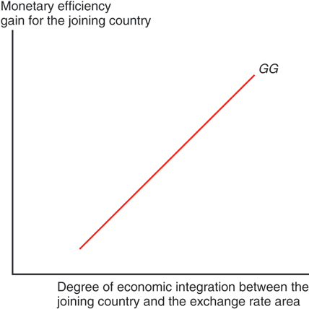
Fig. 21-3: The GG Schedule

Slide 25
Theory of Optimum Currency Areas (cont.)
When considering the monetary efficiency gain,
we have assumed that the members of the fixed exchange rate system would maintain stable prices.
  But when variable inflation exists among member countries, then joining the system would not reduce uncertainty
  (as much).
we have assumed that a new member would be fully committed to a fixed exchange rate system.
  But if a new member is likely to leave the fixed exchange rate system, then joining the system would not reduce uncertainty (as much).

Slide 26
Theory of Optimum Currency Areas (cont.)
Economic integration also allows prices to converge between members of a fixed exchange rate system and a potential member.
  The law of one price is expected to hold better when markets are integrated.

Slide 27
Theory of Optimum Currency Areas (cont.)
Costs of fixed exchange rates are that they require the loss of monetary policy for stabilizing output and employment, and the loss of automatic adjustment of exchange rates to changes in aggregate demand.
Define this loss that would occur if a country joined a fixed exchange rate system as the economic stability loss.

Slide 28
Theory of Optimum Currency Areas (cont.)
The economic stability loss of joining a fixed exchange rate system also depends on the amount of economic integration.
After joining a fixed exchange rate system, if the new member faces a fall in aggregate demand:
  Relative prices will tend to fall, which will lead other members to increase aggregate demand greatly if economic integration is extensive, so that the economic loss is not as great.
  Financial assets or labor will migrate to areas with higher returns or wages if economic integration is extensive, so that the economic loss is not as great.

Slide 29
Theory of Optimum Currency Areas (cont.)
  The loss of the automatic adjustment of flexible exchange rates is not as great if goods and services markets are integrated. Why?
  Consider what would have happened if the country did not join the fixed exchange rate system:
    the automatic adjustment would have caused a depreciation of the domestic currency and an appreciation of foreign currencies, which would have caused an increase in many prices for domestic consumers when goods and services markets are integrated.

Slide 30
Theory of Optimum Currency Areas (cont.)
In general, as the degree of economic integration increases, the economic stability loss decreases.
Draw a graph of the economic stability loss as a function of the degree of economic integration.

Slide 31
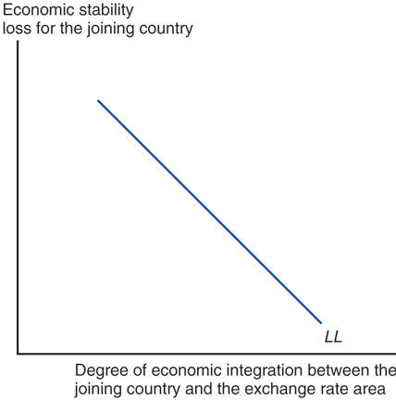
Fig. 21-4: The LL Schedule

Slide 32
Theory of Optimum Currency Areas (cont.)
At some critical point measuring the degree of integration, the monetary efficiency gain will exceed the economic stability loss for a member considering whether to join a fixed exchange rate system.

Slide 33
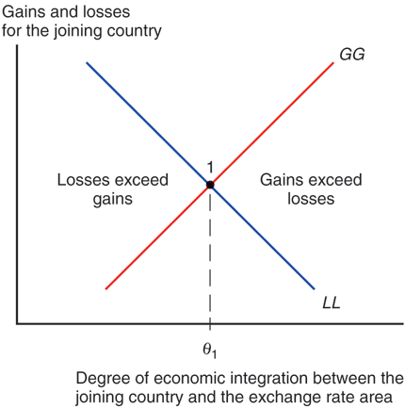
Fig. 21-5: Deciding When to Peg the Exchange Rate

Slide 34
Theory of Optimum Currency Areas (cont.)
There could be an event that causes the frequency or magnitude of changes in aggregate demand to increase for a country.
If so, the economic stability loss would be greater for every measure of economic integration between a new member and members of a fixed exchange rate system.
How would this affect the critical point where the monetary efficiency gain equals economic stability loss?

Slide 35
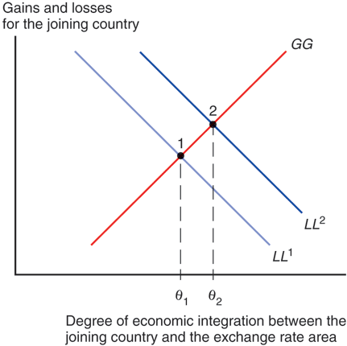
Fig. 21-6: An Increase in Output Market Variability

Slide 36
Is the EU an Optimum Currency Area?
If the EU/EMS/economic and monetary union can be expected to benefit members, we expect that its members have a high degree of economic integration:
  large trade volumes as a fraction of GDP
  a large amount of foreign financial investment
  and foreign direct investment relative to total investment
  a large amount of migration across borders as a fraction of total labor force

Slide 37
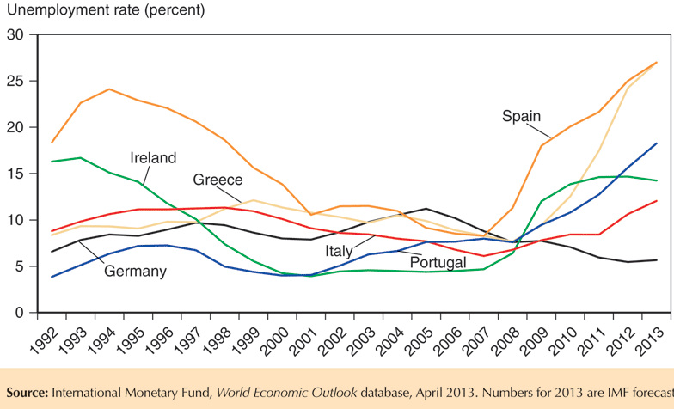
Fig. 21-7: Unemployment Rates in Selected EU Countries

Slide 38
Is the EU an Optimum Currency Area? (cont.)
Deviations from the law of one price also occur in many EU markets.
  If EU markets were greatly integrated, then the (currency-adjusted) prices of goods and services should be nearly the same across markets.
  The price of the same BMW car varies 29.5% between British and Dutch markets.

Slide 39
Is the EU an Optimum Currency Area? (cont.)
Regional migration is not extensive in the EU.
Europe has many languages and cultures, which hinder migration and labor mobility.
Unions and regulations also impede labor movements between industries and countries.
Differences of U.S. unemployment rates across regions are smaller and less persistent than differences of national unemployment rates in the EU, indicating a lack of EU labor mobility.

Slide 40
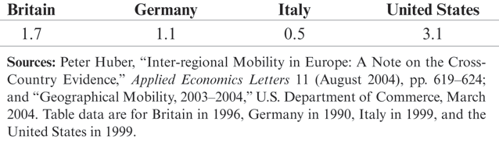
Table 21-2: People Changing Region of Residence in the 1990s (percent of total population)

Slide 41
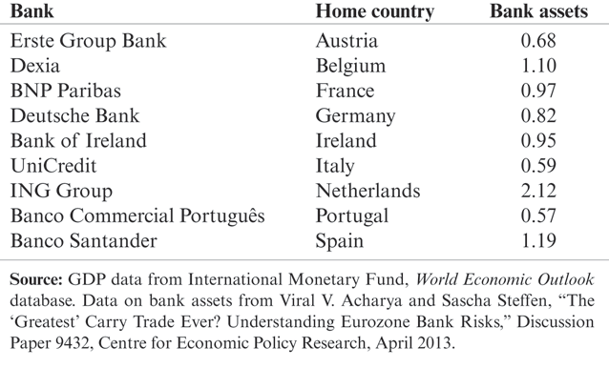
Table 21-3: Assets of Some Individual Banks as a Ratio to National Output, End-2011

Slide 42
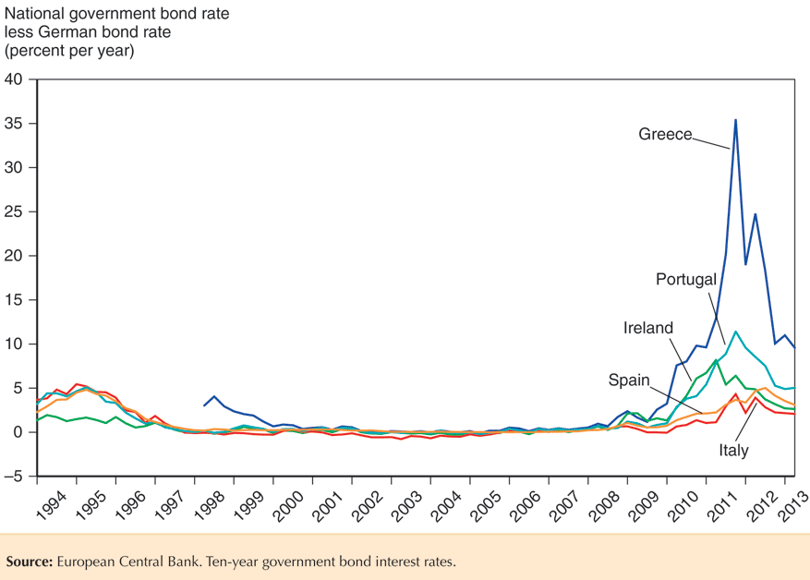
Fig. 21-8: Nominal Government Borrowing Spreads over Germany

Slide 43
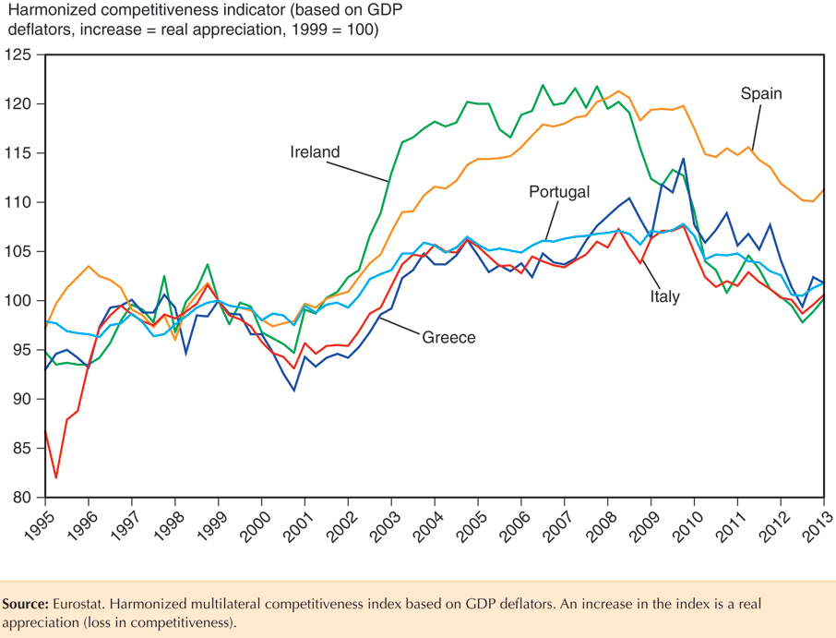
Fig. 21-9: Real Appreciation in Peripheral Euro Zone Countries

Slide 44
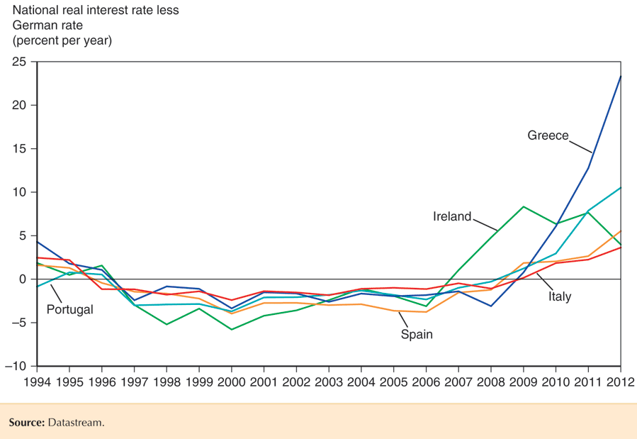
Fig. 21-10: Divergent Real Interest Rates in the Euro Zone

Slide 45
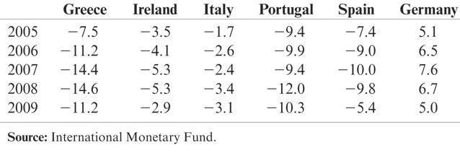
Table 21-4: Current Account Balances of Euro Zone Countries, 2005–2009 (percent of GDP)

Slide 46
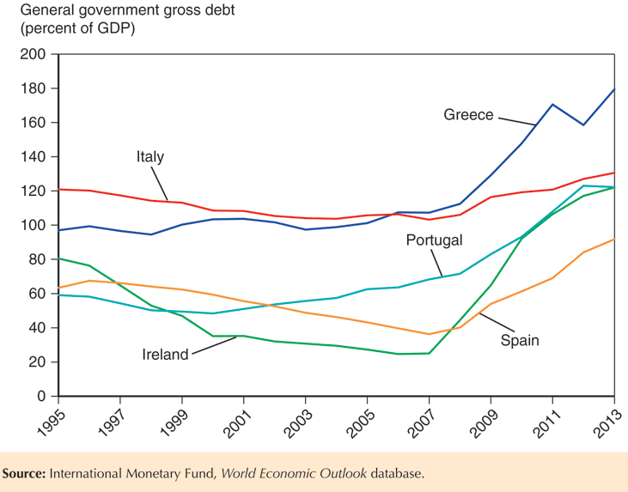
Fig. 21-11: Gross Public Debt to GDP Ratios in the Euro Area

Slide 47
Is the EU an Optimum Currency Area? (cont.)
There is evidence that financial assets were able to move more freely within the EU after 1992 and 1999.
But capital mobility without labor mobility can make the economic stability loss greater.
  After a reduction of aggregate demand in a particular EU country, financial assets could be easily transferred elsewhere while labor is stuck.
  The loss of financial assets could further reduce production and employment.

Slide 48
Other Considerations for an EMU
The structure of the economies in the EU’s economic and monetary union is important for determining how members respond to aggregate demand shocks.
  The economies of EU members are similar in the sense that there is a high volume of intra-industry trade relative to the total volume.
  They are different in the sense that Northern European countries have high levels of physical capital per worker and more skilled labor, compared with Southern European countries.

Slide 49
Other Considerations for an EMU (cont.)
  How an EU member responds to aggregate demand shocks may depend on how the structure of its economy compares to that of fellow EU members.
  For example, the effects on an EU member of a reduction in aggregate demand caused by a reduction in demand in the software industry will depend on whether the EU member has a large number of workers skilled in programming relative to fellow EU members.

Slide 50
Other Considerations for an EMU (cont.)
The amount of transfers among the EU members may also affect how EU economies respond to aggregate demand shocks.
  Fiscal payments between countries in the EU’s federal system, or fiscal federalism, may help offset the economic stability loss from joining an economic and monetary union.
  But relative to interregional transfers in the U.S., little fiscal federalism occurs among EU members.

Slide 51
The Future of EMU
EMU must overcome some difficult challenges, however, if it is to survive its current crisis and prosper.
  Europe is not an optimum currency area. Therefore, asymmetric economic developments within different countries of the euro zone - developments that might well call for different national interest rates under a regime of individual national currencies - will remain hard to handle through monetary policy.

Slide 52
The Future of EMU (cont.)
  In most EU countries, labor markets remain highly unionized and subject to employment taxes and regulations that impede labor mobility between industries and regions. The result has been persistently high levels of unemployment. Unless labor markets become much more flexible, individual euro zone countries will have a hard time adjusting toward full employment and competitive real exchange rates. Other structural problems also abound.
Thus, the euro faces significant challenges in the years ahead

Slide 53
Summary
The EMS was first a system of fixed exchange rates but later developed into a more extensive coordination of economic and monetary policies: an economic and monetary union.
The Single European Act of 1986 recommended that EU members remove barriers to trade, capital flows, and immigration by the end of 1992.

Slide 54
Summary (cont.)
The Maastricht Treaty outlined 3 requirements for the EMS to become an economic and monetary union.
  It also standardized many regulations and gave the EU institutions more control over defense policies.
  It also set up penalties for spendthrift EMU members.
A new exchange rate mechanism was defined in 1999 vis-à-vis the euro, when the euro came into existence.

Slide 55
Summary (cont.)
An optimum currency area is a union of countries with a high degree of economic integration among goods and services, financial assets, and labor markets.
  It is an area where the monetary efficiency gain of joining a fixed exchange rate system is at least as large as the economic stability loss.
The EU does not have a large degree of labor mobility due to differences in culture and due to unionization and regulation.
The EU is not an optimum currency area.

