Slide 1
Chapter 22 (11)
Developing Countries:
Growth, Crisis,
and Reform

Slide 2
Preview
Snapshots of rich and poor countries
Characteristics of poor countries
Borrowing and debt in poor and middle-income economies
The problem of “original sin”
Types of financial assets
Latin American, East Asian, and Russian crises
Currency boards and dollarization
Lessons from crises and potential reforms
Geography’s and human capital’s role in poverty

Slide 3
The Gap between Rich and Poor
Low income: most sub-Saharan Africa, India, Pakistan
Lower-middle income: China, Caribbean countries
Upper-middle income: Brazil, Mexico, Saudi Arabia, Malaysia, South Africa, Czech Republic
High income: U.S., Singapore, France, Japan, Kuwait

Slide 4
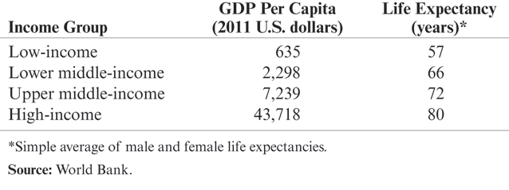
Table 22-1: Indicators of Economic Welfare in Four Groups of Countries, 2011

Slide 5
Has the World Income Gap Narrowed over Time?
While some previously middle- and low-income economies have grown faster than high-income countries, and thus have “caught up” with high- income countries, others have languished.
  The income levels of high-income countries and some previously middle-income and low-income countries have converged.
  But the some of the poorest countries have had the lowest growth rates.

Slide 6
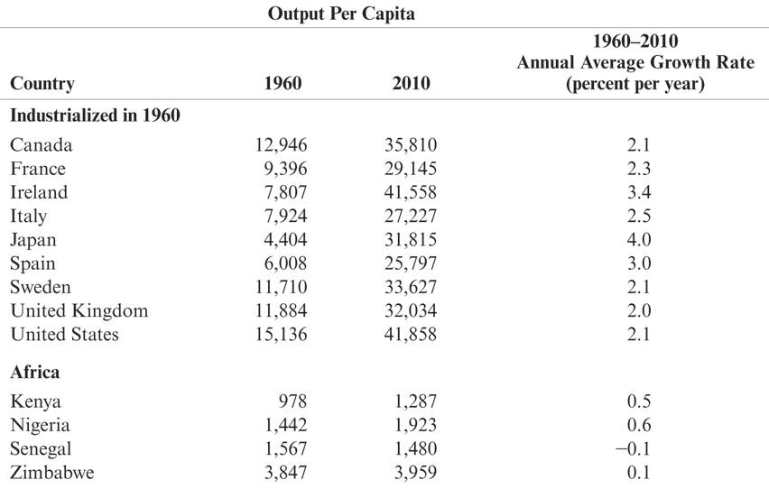
Table 22-2: Output per Capita in Selected Countries, 1960–2010 (in 2005 U.S. dollars)

Slide 7
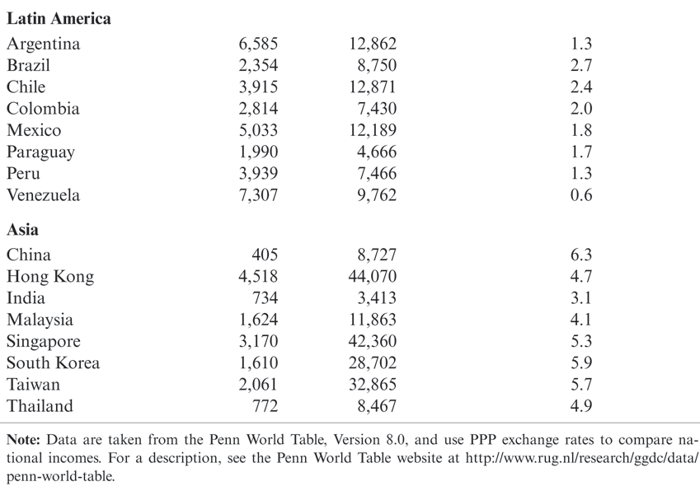
Table 22-2: Output per Capita in Selected Countries, 1960–2010 (in 2005 U.S. dollars) (cont.)

Slide 8
Structural Features of Developing Countries
What causes poverty is a difficult question, but low-income countries have at least some of following characteristics, which could contribute to poverty:
Government control of the economy
  Restrictions on trade
  Direct control of production in industries and a high level
  of government purchases relative to GNP
  Direct control of financial transactions
  Reduced competition reduces innovation; lack of market prices prevents efficient allocation of resources

Slide 9
Structural Features of Developing Countries (cont.)
Unsustainable macroeconomic policies that cause high inflation and unstable output and employment
  If governments cannot pay for debts through taxes, they can print money to finance debts.
  Seigniorage is paying for real goods and services by printing money.
  Seigniorage generally leads to high inflation.
  High inflation reduces the real cost of debt that the government has to repay and reduces the real value of repayments for lenders.
  High and variable inflation is costly to society; unstable output and employment is also costly.

Slide 10
Structural Features of Developing Countries (cont.)
Lack of financial markets that allow transfer of funds from savers to borrowers
  Banks frequently lend funds to poor or risky projects.
  Loans may be made on the basis of personal connections rather than prospective returns, and government safeguards against financial fragility, such as bank supervision, tend to be ineffective due to incompetence, inexperience, and outright fraud.
  Usually harder in developing countries for shareholders to find out how a firm’s money is being spent or to control firm managers.
  The legal framework for resolving asset ownership in cases of bankruptcy typically is also weak.

Slide 11
Structural Features of Developing Countries (cont.)
Where exchange rates are not pegged outright (as in China), they tend to be managed more heavily by developing-country governments. Government measures to limit exchange rate flexibility reflect both a desire to keep inflation under control and the fear that floating exchange rates would be subject to huge volatility in the relatively thin markets for developing-country currencies. There is a history of allocating foreign exchange through government decree rather than through the market, a practice (called exchange control) that some developing countries still maintain. Most developing countries have, in particular, tried to control capital movements by limiting foreign exchange transactions connected with trade in assets. More recently, however, many emerging markets have opened their capital accounts.

Slide 12
Structural Features of Developing Countries (cont.)
Natural resources or agricultural commodities make up an important share of exports for many developing countries.
  For example, Russian petroleum, Malaysian timber, South African gold, and Colombian coffee.
Attempts to circumvent government controls, taxes, and regulations have helped to make corrupt practices such as bribery and extortion a way of life in many developing countries.
  Due to government control of the economy and weak enforcement of economic laws and regulations, underground economies and corruption flourish.

Slide 13
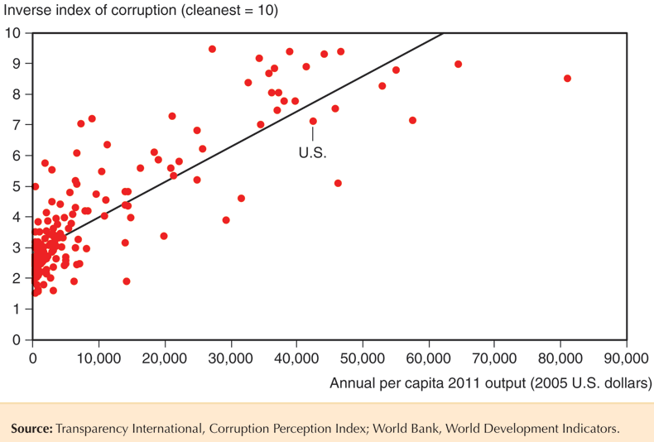
Fig. 22-1: Corruption and Per Capita Income

Slide 14
Developing-Country Borrowing and Debt
Another common characteristic for many low- and middle-income countries is that they have traditionally borrowed from foreign countries.
  Financial asset flows from foreign countries are able to finance investment projects, eventually leading to higher production and consumption.
  But some investment projects fail and other borrowed funds are used primarily for consumption purposes.
  Some countries have defaulted on their foreign debts when the domestic economy stagnated or during financial crises.
  But this trend has recently reversed as these countries have begun to save.

Slide 15
The Economics of Financial Inflows to Developing Countries
national saving – investment = the current account
  where the current account is approximately equal to the value of exports minus the value of imports.
Countries with national saving less than domestic investment will have financial asset inflows and a negative current account (a trade deficit).

Slide 16
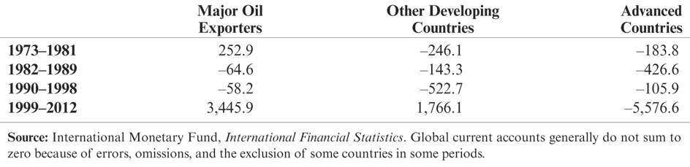
Table 22-3: Cumulative Current Account Balances of Major Oil Exporters, Other Developing Countries, and Advanced Countries, 1973–2012 (billions of dollars)

Slide 17
The Problem of Default
A financial crisis may involve
a debt crisis: an inability to repay sovereign (government) or private sector debt.
a balance of payments crisis under a fixed exchange rate system.
a banking crisis: bankruptcy and other problems for private sector banks.

Slide 18
The Problem of Default (cont.)
A debt crisis in which governments default on their debt can be a self-fulfilling mechanism.
  Fear of default reduces financial asset inflows and increases financial asset outflows (capital flight), decreasing investment and increasing interest rates, leading to low aggregate demand, output, and income.
  Financial asset outflows must be matched with an increase in net exports or a decrease in official international reserves in order to pay individuals and institutions who desire foreign funds.

Slide 19
The Problem of Default (cont.)
  Otherwise, the country cannot afford to pay those who want to remove their funds from the domestic economy.
  The domestic government may have no choice but to default on its sovereign debt (paid for with foreign funds) when it comes due and when investors are unwilling to reinvest.

Slide 20
The Problem of Default (cont.)
In general, a debt crisis can quickly magnify itself: it causes low income and high interest rates, which make government and private sector debts even harder to repay.
  High interest rates cause high interest payments for both the government and the private sector.
  Low income causes low tax revenue for the government.
  Low income makes loans made by private banks harder to repay: the default rate increases, which may cause bankruptcy.

Slide 21
The Problem of Default (cont.)
If the central bank tries to fix the exchange rate, a balance of payment crisis may result along with a debt crisis.
  Official international reserves may quickly be depleted because governments and private institutions need to pay for their debts with foreign funds, forcing the central bank to abandon the fixed exchange rate.
A banking crisis may result from a debt crisis.
  High default rates on loans made by banks reduce their income to pay for liabilities and may increase bankruptcy.
  If depositors fear bankruptcy due to possible devaluation of the currency or default on government debt (assets for banks), then they will quickly withdraw funds from banks (and possibly purchase foreign assets), leading to actual bankruptcy.

Slide 22
The Problem of Default (cont.)
A debt crisis, a balance of payments crisis, and a banking crisis can occur together, and each can make the other worse.
  Each can cause aggregate demand, output, and employment to fall (further).
If people expect a default on sovereign debt,
a currency devaluation, or bankruptcy of private banks, each can occur, and each can lead to another.

Slide 23
Alternative Forms of Financial Inflow
Bond finance: government or private sector bonds are sold to foreign individuals and institutions.
Bank finance: commercial banks or securities firms lend to foreign governments or foreign businesses.
Official lending: the World Bank, Inter-American Development Bank, or other official agencies lend to governments.
  Sometimes these loans are made on a “concessional” or favorable basis, in which the interest rate is low.

Slide 24
Alternative Forms of Financial Inflow (cont.)
Foreign direct investment: a firm directly acquires or expands operations in a subsidiary firm in a foreign country.
  A purchase by Ford of a subsidiary firm in Mexico is classified as foreign direct investment.
Portfolio equity investment: a foreign investor purchases equity (stock) for his portfolio.
  Privatization of government-owned firms in many countries has created more equity investment opportunities for foreign investors.

Slide 25
Alternative Forms of Financial Inflow (cont.)
Debt finance includes bond finance, bank finance, and official lending.
Equity finance includes direct investment and portfolio equity investment.
While debt finance requires fixed payments regardless of the state of the economy, the value of equity finance fluctuates depending on aggregate demand and output.

Slide 26
The Problem of “Original Sin”
Sovereign and private sector debts in the U.S., Japan, and European countries are mostly denominated in their respective currencies.
But when poor and middle-income countries borrow in international financial capital markets, their debts are almost always denominated in U.S. $, yen, or euros: a condition called “original sin.”

Slide 27
The Problem of “Original Sin” (cont.)
When a depreciation of domestic currencies occurs in the U.S., Japan, or European countries, liabilities (debt) that are denominated in domestic currencies do not increase, but the value of foreign assets increases.
  A devaluation of the domestic currency causes an increase in net foreign wealth.
When a depreciation/devaluation of domestic currencies occurs in most poor and middle-income economies, the value of their liabilities (debt) rises because their liabilities are denominated in foreign currencies.
  A devaluation of the domestic currency causes a decrease in net foreign wealth.

Slide 28
The Problem of “Original Sin” (cont.)
  In particular, a fall in aggregate demand of domestic products causes a depreciation/devaluation of the domestic currency and causes a decrease in net foreign wealth if assets are denominated in domestic currencies and liabilities (debt) are denominated in foreign currencies.
  This is a situation of “negative insurance” against a fall in aggregate demand.

Slide 29
The Debt Crisis of the 1980s
In the 1980s, high interest rates and an appreciation of the U.S. dollar caused the burden of dollar-denominated debts in Argentina, Mexico, Brazil, and Chile to increase drastically.
A worldwide recession and a fall in many commodity prices also hurt export sectors in these countries.
In August 1982, Mexico announced that it could not repay its debts, mostly to private banks.

Slide 30
The Debt Crisis of the 1980s (cont.)
The U.S. government insisted that the private banks reschedule the debts, and in 1989 Mexico was able to achieve
  a reduction in the interest rate
  an extension of the repayment period
  a reduction in the principal by 12%
Brazil, Argentina, and other countries were also allowed to reschedule their debts with private banks after they defaulted.

Slide 31
Reforms, Capital Inflows, and the Return of Crisis
The Mexican government implemented several reforms due to the crisis. Starting in 1987, it
  reduced government deficits.
  reduced production in the public sector (including banking) by privatizing industries.
  reduced barriers to trade.
  maintained an adjustable fixed exchange rate (“crawling peg”) until 1994 to help curb inflation.

Slide 32
Reforms, Capital Inflows, and the Return of Crisis (cont.)
It extended credit to newly privatized banks with loan losses.
  Losses were a problem due to weak enforcement or lack of asset restrictions and capital requirements.
Political instability and loan defaults at private banks contributed to another crisis in 1994, after which the Mexican government allowed the value of the peso to fluctuate.

Slide 33
Reforms, Capital Inflows, and the Return of Crisis (cont.)
Starting in 1991, Argentina carried out similar reforms:
  It reduced government deficits.
  It reduced production in the public sector by privatizing industries.
  It reduced barriers to trade.
  It enacted tax reforms to increase tax revenues.
  It enacted the Convertibility Law, which required that each peso be backed with 1 U.S. dollar, and it fixed the exchange rate to 1 peso per U.S. dollar.

Slide 34
Reforms, Capital Inflows, and the Return of Crisis (cont.)
Because the central bank was not allowed to print more pesos without having more dollar reserves, inflation slowed dramatically.
Yet inflation was about 5% per annum, faster than U.S. inflation, so that the price/value of Argentinean goods appreciated relative to U.S. and other foreign goods.
Due to the relatively rapid peso price increases, markets began to speculate about a peso devaluation.
A global recession in 2001 further reduced the demand of Argentinean goods and currency.

Slide 35
Reforms, Capital Inflows, and the Return of Crisis (cont.)
Maintaining the fixed exchange rate was costly because high interest rates were needed to attract investors, further reducing investment and consumption expenditure, output, and employment.
As incomes fell, tax revenues fell and government spending rose, contributing to further peso inflation.

Slide 36
Reforms, Capital Inflows, and the Return of Crisis (cont.)
Argentina tried to uphold the fixed exchange rate, but the government devalued the peso in 2001 and shortly thereafter allowed its value to fluctuate.
It also defaulted on its debt in December 2001 because of the unwillingness of investors to reinvest when the debt was due.

Slide 37
Reforms, Capital Inflows, and the Return of Crisis (cont.)
Brazil carried out similar reforms in the 1980s and 1990s:
  It reduced production in the public sector by privatizing industries.
  It reduced barriers to trade.
  It enacted tax reforms to increase tax revenues.
  It fixed the exchange rate to 1 real per
  U.S. dollar.
  But government deficits remained high.

Slide 38
Reforms, Capital Inflows, and the Return of Crisis (cont.)
High government deficits led to inflation and speculation about a devaluation of the real.
The government did devalue the real in 1999, but a widespread banking crisis was avoided because Brazilian banks and firms did not borrow extensively in dollar-denominated assets.

Slide 39
Reforms, Capital Inflows, and the Return of Crisis (cont.)
Chile suffered a recession and financial crisis in the 1980s, but thereafter
  enacted stringent financial regulations for banks.
  removed the guarantee from the central bank that private banks would be bailed out if their loans failed.
  imposed controls on flows of short-term assets, so that funds could not be quickly withdrawn during a financial panic.
  granted the central bank independence from fiscal authorities, allowing slower money supply growth.
Chile avoided a financial crisis in the 1990s.

Slide 40
East Asia: Success and Crisis
Before the 1990s, Indonesia, Korea, Malaysia, Philippines, and Thailand relied mostly on domestic saving to finance investment.
But afterwards, foreign funds financed much of investment, and current account balances turned negative.

Slide 41
East Asia: Success and Crisis (cont.)
Despite the rapid economic growth in East Asia between 1960 and 1997, growth was predicted to slow as economies “caught up” with Western countries.
  Most of the East Asian growth during this period is attributed to an increase in physical capital and education.
  The marginal productivities of physical capital and education are diminishing: as more physical capital was built and as more people acquired more education, further increases added less productive capability to the economy.

Slide 42
The Asian Financial Crises
More directly related to the East Asian crises are issues related to economic laws and regulations:
Weak enforcement of financial regulations and a lack of monitoring caused commercial firms, banks, and borrowers to engage in risky or even fraudulent activities: moral hazard.
  Ties between commercial firms and banks on the one hand and government regulators on the other hand allowed risky investments to occur.

Slide 43
The Asian Financial Crises (cont.)
Nonexistent or weakly enforced bankruptcy laws and loan contracts worsened problems after the crisis started.
  Financially troubled firms stopped paying their debts, and they could not operate without cash, but no one would lend more until previous debts were paid.
  But creditors lacked the legal means to confiscate and sell assets to other investors or to restructure the firms to make them productive again.

Slide 44
The Asian Financial Crises (cont.)
The East Asian crisis started in Thailand in 1997,
but quickly spread to other countries.
  A fall in real estate prices, and then stock prices, weakened aggregate demand and output in Thailand.
  A fall in aggregate demand in Japan, a major investor and export market, also contributed to the economic slowdown.
  Speculation about a devaluation of the baht occurred, and in July 1997 the government devalued the baht slightly, but this only invited further speculation.
Malaysia, Indonesia, Korea, and the Philippines soon faced speculations about the value of their currencies.

Slide 45
The Asian Financial Crises (cont.)
Most debts of banks and firms were denominated in U.S. dollars, so that devaluations of domestic currencies would make the burden of the debts in domestic currency increase.
  Bankruptcy and a banking crisis would have resulted.
To maintain fixed exchange rates would have required high interest rates and a reduction in government deficits, leading to a reduction in aggregate demand, output, and employment.
  This would have also led to widespread default on debts and a banking crisis.

Slide 46
The Asian Financial Crises (cont.)
All of the affected economies except Malaysia turned to the IMF for loans to address the balance of payments crises and to maintain the value of the domestic currencies.
  The loans were conditional on increased interest rates (reduced money supply growth), reduced budget deficits, and reforms in banking regulation and bankruptcy laws.
Malaysia instead imposed controls on flows of financial assets so that it could increase its money supply (and lower interest rates), increase government purchases, and still try to maintain the value of the ringgit.

Slide 47
The Asian Financial Crises (cont.)
Because consumption and investment expenditure decreased with output, income, and employment, imports fell and the current account increased after 1997.

Slide 48
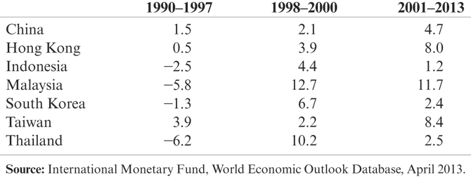
Table 22-4: East Asian Current Accounts (annual averages, percent of GDP)

Slide 49
Lessons of Crises
Fixing the exchange rate has risks: governments desire to fix exchange rates to provide stability in the export and import sectors, but the price to pay may be high interest rates or high unemployment.
  High inflation (caused by government deficits or increases in the money supply) or a drop in demand of domestic exports leads to an overvalued currency and pressure for devaluation.
  Given pressure for devaluation, commitment to a fixed exchange rate usually means high interest rates (a reduction in the money supply) and a reduction in domestic prices.

Slide 50
Lessons of Crises (cont.)
  Prices can be reduced through a reduction in government deficits, leading to a reduction in aggregate demand, output, and employment.
  A fixed currency may encourage banks and firms to borrow in foreign currencies, but a devaluation will cause an increase in the burden of this debt and may lead to a banking crisis and bankruptcy.
  Commitment a fixed exchange rate can cause a financial crisis to worsen: high interest rates make loans for individuals and institutions harder to repay, and the central bank cannot freely print money to give to troubled banks (cannot act as a lender of last resort).

Slide 51
Lessons of Crises (cont.)
Weak enforcement of financial regulations can lead to risky investments and a banking crisis when a currency crisis erupts or when a fall in output, income, and employment occurs.
Liberalizing financial asset flows without implementing sound financial regulations can lead to capital flight when investments lose value during a recession.

Slide 52
Lessons of Crises (cont.)
The importance of expectations: even healthy economies are vulnerable to crises when expectations change.
  Expectations about an economy often change when other economies suffer from adverse events.
  International crises may result from contagion: an adverse event in one country leads to a similar event in other countries.

Slide 53
Reforming the World’s Financial “Architecture”
Countries face tradeoffs when trying to achieve the following goals:
  exchange rate stability
  financial capital mobility
  autonomous monetary policy devoted to domestic goals
Generally, countries can attain only 2 of the 3 goals, and as financial assets have become more mobile, maintaining a fixed exchange with an autonomous monetary policy has been difficult.

Slide 54
Reforming the World’s Financial “Architecture” (cont.)
Preventative (“prophylactic”) measures:
Better monitoring and more transparency: more information allows investors to make sound financial decisions in good and bad times.
Stronger enforcement of financial regulations: reduces moral hazard.
Deposit insurance and reserve requirements.
Increased equity finance relative to debt finance.
Increased credit for troubled banks through central banks or the IMF?

Slide 55
Reforming the World’s Financial “Architecture” (cont.)
Coping with crisis - reforms for after a crisis occurs:
Bankruptcy procedures for default on sovereign debt and improved bankruptcy law for private sector debt.
A bigger or smaller role for the IMF as a lender of last resort for governments, central banks, and even the private sector? (See 5 above.)
  Moral hazard versus the benefit of insurance before and after a crisis occurs.

Slide 56
China’s Currency
China has tried to maintain a fixed exchange rate to promote its exports.
  The value of its renminbi has been kept low relative to the U.S. dollar so that its goods are not expensive in U.S. markets.
  Exports have surged and imports have been low because of an undervalued renminbi and because Chinese citizens save a lot.
Because of China’s large current account surplus and because of large amounts of financial asset inflows, foreign assets held by the central bank have grown substantially.
  Some foreign investors who have bought Chinese assets did so from speculation that the renminbi will be revalued.

Slide 57
China’s Currency (cont.)
As the central bank purchased foreign assets, the domestic money supply has grown substantially, resulting in inflation.
To moderate inflation and political pressure about trade surpluses, the Chinese central bank has gradually allowed the value of the renminbi to increase relative to the U.S. dollar.
  A more valuable renminbi allows Chinese buyers to afford to spend more on imports, so that the large current account surpluses and the “excessive” amount of saving can be reduced.

Slide 58
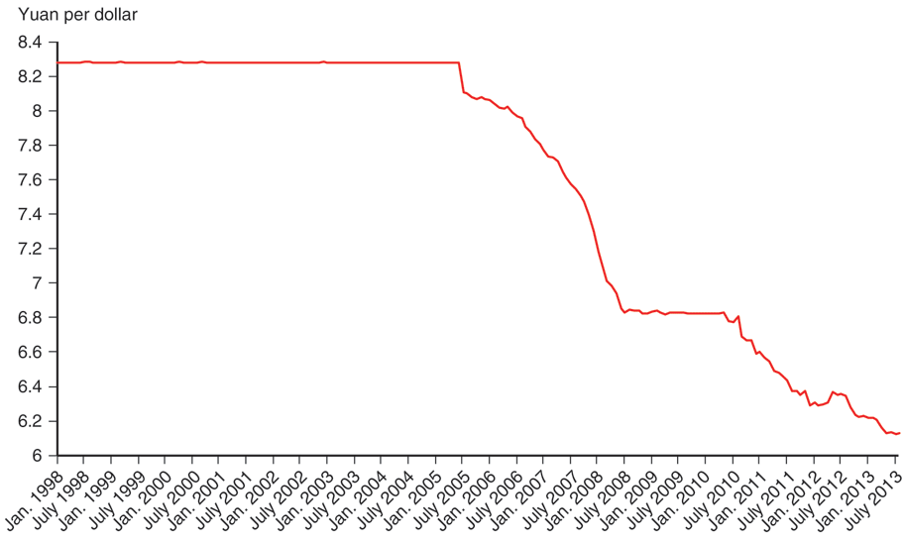
Fig. 22-2: Yuan/Dollar Exchange Rate, 1998–2013

Slide 59
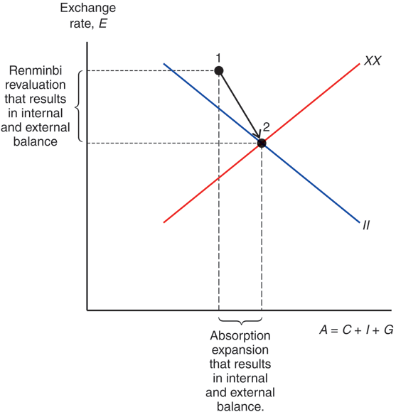
Fig. 22-3: Rebalancing China’s Economy

Slide 60
Geography, Human Capital, and Institutions
What causes poverty?
A difficult question: economists argue about whether geography or human capital is more important in influencing economic and political institutions, and ultimately poverty.

Slide 61
Geography, Human Capital, and Institutions (cont.)
Geography matters:
International trade is important for growth, and ocean harbors and a lack of geographical barriers foster trade with foreign markets.
  Landlocked and mountainous regions are predicted to
  be poor.
Also, geography is said to have determined institutions, which may play a role in development.
  Geography determined whether Westerners established property rights and long-term investment in colonies, which in turn influenced economic growth.

Slide 62
Geography, Human Capital, and Institutions (cont.)
  Geography determined whether Westerners died from malaria and other diseases. With high mortality rates, they established practices and institutions based on quick plunder of colonies’ resources, rather than institutions favoring long-term economic growth.
  Plunder led to property confiscation and corruption, even after political independence from Westerners.
  Geography also determined whether local economies were better for plantation agriculture, which resulted in income inequalities and political inequalities. Under this system, equal property rights were not established, hindering long-term economic growth.

Slide 63
Geography, Human Capital, and Institutions (cont.)
Human capital matters:
As a population becomes more literate, numerate, and educated, economic and political institutions evolve to foster long-term economic growth.
  Rather than geography, Western colonization, and plantation agriculture, the amount of education and other forms of human capital determine the existence or lack of property rights, financial markets, international trade, and other institutions that encourage economic growth.

Slide 64
Summary
Some countries have grown rapidly since 1960, but others have stagnated and remained poor.
Many poor countries have extensive government control of the economy, unsustainable fiscal and monetary policies, lack of financial markets, weak enforcement of economic laws, a large amount of corruption, and low levels of education.
Many developing economies have traditionally borrowed from international capital markets, and some have suffered from periodic sovereign debt crises, balance of payments crises, and banking crises.

Slide 65
Summary (cont.)
Sovereign debt, balance of payments, and banking crises can be self-fulfilling, and each crisis can lead to another within a country or in another country.
“Original sin” refers to the fact that poor and middle- income countries often cannot borrow in their domestic currencies.
Fixing exchange rates may lead to financial crises if the country is unwilling to restrict monetary and fiscal policies.

Slide 66
Summary (cont.)
Fixing exchange rates may lead to financial crises if the country is unwilling to restrict monetary and fiscal policies.
Weak enforcement of financial regulations causes a moral hazard and may lead to a banking crisis, especially with free movement of financial assets.
Geography and human capital may influence economic and political institutions, which in turn may affect long-term economic growth.

