Slide 1
Pandas and Seaborn
Python for neuroscience
08/05/2024

Slide 2
Pandas
“panel data” (…s?)

Slide 3

What are pandas?
Pandas are the most ridiculous animals to have narrowly escaped the hand of natural selection, second perhaps only to koalas
Some important facts about pandas:
Pandas almost exclusively eat bamboo, which contain very little nutritional value and thus requires them to spend up to 16 hours of a day eating. Due to the fact that they’ve evolved from carnivores, they also can’t properly digest bamboo.
About 1,850 giant pandas (Ailuropoda melanoleuca) are alive in the wild, and about 300 live in captivity.
They’re also not super helpful for computational neuroscience :(

Slide 4

What is pandas?
Pandas is centered around a data type called a “DataFrame” – as an array is to numpy, DataFrames are to pandas
DataFrames work really well with tabular data – think Excel spreadsheets (or JSON, Parquet, CSV, SQL, etc.)
In [1]: import pandas as pd
In [2]: df2 = pd.DataFrame(
...: {
...: "A": 1.0,
...: "B": pd.Timestamp("20130102"),
...: "C": pd.Series(1, index=list(range(4)), dtype="float32"),
...: "D": np.array([3] * 4, dtype="int32"),
...: "E": pd.Categorical(["test", "train", "test", "train"]),
...: "F": "foo",
...: }
...: )
...:
In [3]: df2
Out[3]:
A B C D E F
0 1.0 2013-01-02 1.0 3 test foo
1 1.0 2013-01-02 1.0 3 train foo
2 1.0 2013-01-02 1.0 3 test foo
3 1.0 2013-01-02 1.0 3 train foo

Slide 5
Key features to DataFrames
Can handle multiple types of data – however, must be the same across columns
Data is mutable
Indices can be labelled
Data can be “queried” based on index (similar to numpy), but also based on labels (so-called label-based indexing)
You will also likely encounter Series: these are like a singular column of a DataFrame, as we will see in the notebook
In [1]: import pandas as pd
In [2]: df2 = pd.DataFrame(
...: {
...: "A": 1.0,
...: "B": pd.Timestamp("20130102"),
...: "C": pd.Series(1, index=list(range(4)), dtype="float32"),
...: "D": np.array([3] * 4, dtype="int32"),
...: "E": pd.Categorical(["test", "train", "test", "train"]),
...: "F": "foo",
...: }
...: )
...:
In [3]: df2
Out[3]:
A B C D E F
0 1.0 2013-01-02 1.0 3 test foo
1 1.0 2013-01-02 1.0 3 train foo
2 1.0 2013-01-02 1.0 3 test foo
3 1.0 2013-01-02 1.0 3 train foo

Slide 6
When should I use pandas vs. numpy?
*In reality, pandas and numpy can often be used interchangeably, as they both offer a ton of functionality. However, there are often cases where one is more convenient, or simply better, than the other!
numpy
pandas
When speed is the priority
Arrays can be insanely faster, but it really depends on the application
As such, many fields that rely heavily on matrix math (i.e. machine learning) depend mostly on numpy
Data must be homogeneous
Much better for working with data best represented with >2 dimensions
When structure/flexibility really matters
Accessing the data in different ways
Often handled like a “dataset” where each row represents a new entry
Allows for different data types per column
Great at handling missing/incomplete data
(This is not an exhaustive list, some references will be included at the end of this presentation for more information)

Slide 7
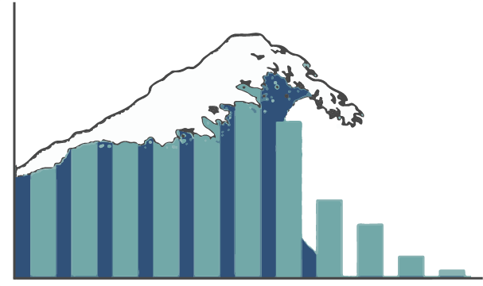
Seaborn
You’ve heard of data streams,
now it’s time to catch
something more gnarly

Slide 8

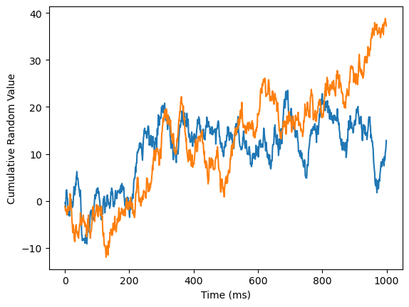
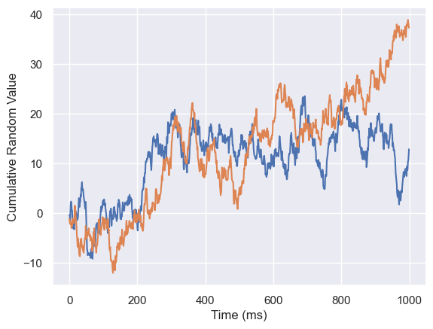
A Brief Introduction to Seaborn
Seaborn is a “wrapper” library to matplotlib which enables you to generate (subjectively) prettier plots, often with very little effort in comparison
The main improvements of seaborn is the addition of some new plotting types/functions and default styles
Seaborn works even more nicely with pandas than matplotlib (which also likes pandas data)
In practice, you will almost always use seaborn in conjunction with matplotlib
The difference:
import seaborn as sns
sns.set_theme()
# All of the plotting code

Slide 9
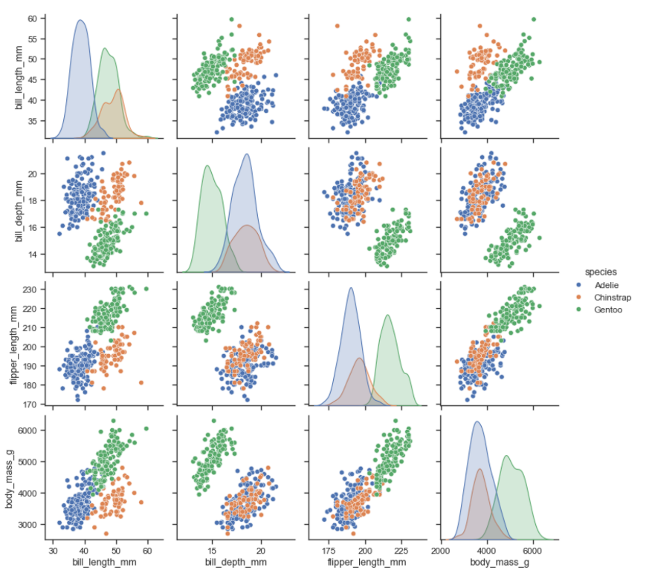
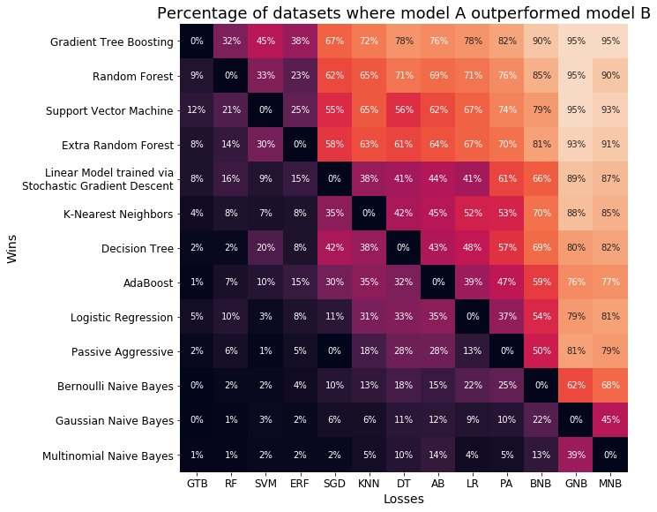
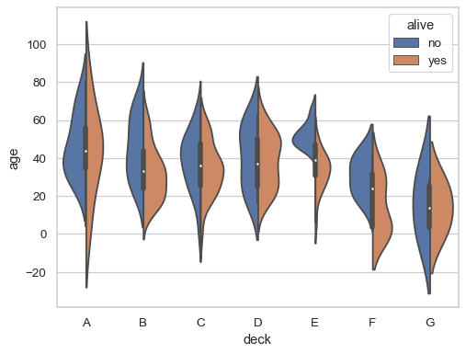
A Brief Introduction to Seaborn

Slide 10
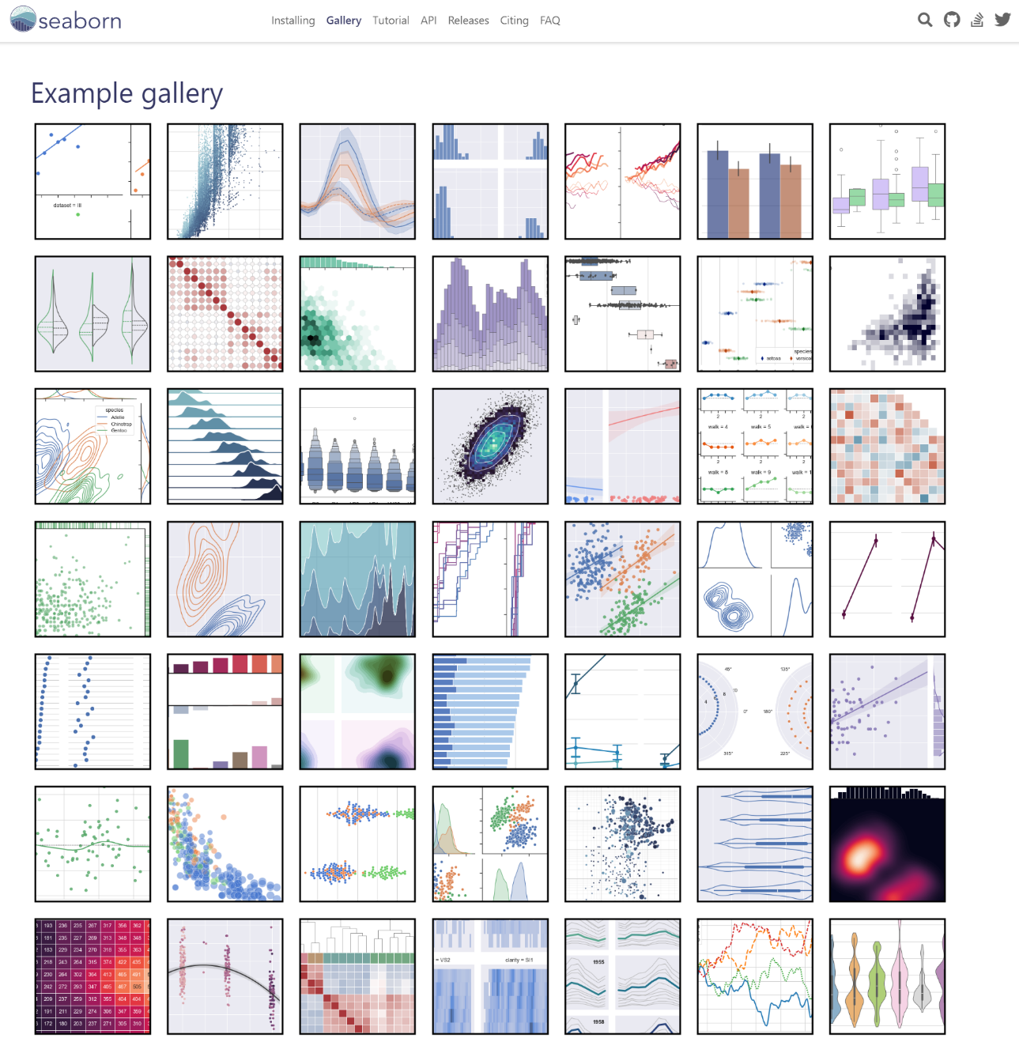
A Brief Introduction to Seaborn

Slide 11
Some key takeaways
Pandas is a very nice framework for building and accessing data in a dataset-style manner
Although often interchangeable, numpy and pandas have different strengths, and there is often (but not always) a clear winner for which one to use. However, the choice is yours
Regardless, never use pandas (the animal) for your data management and analysis
Seaborn is a nice add-on to matplotlib to add more functionality and make generating pretty plots easier
Other plotting libraries in Python you may encounter: bokeh, altair, dash, plotly, ggplot

Slide 12
References
Potentially useful to you:
Pandas documentation – https://pandas.pydata.org/docs/
Seaborn documentation – https://seaborn.pydata.org/
Comparison of pandas and numpy - https://www.interviewbit.com/blog/pandas-vs-numpy/
Another comparison - https://www.nobledesktop.com/classes-near-me/blog/pandas-vs-numpy-for-data-analytics#:~:text=Pandas%20is%20most%20commonly%20used,makes%20N%2Ddimensional%20homogeneous%20objects
Attributions for creating these slides:
https://www.reddit.com/r/changemyview/comments/1l28m9/pandas_suck_and_we_should_stop_trying_to_conserve/
https://seaborn.pydata.org
https://twitter.com/randal_olson/status/914944699865141248

