Slide 1
Python (1980ies)
an interpreted, high-level, general-purpose computer programming language, designed by Guido van Rossum in the late 1980s, with a dynamic type system and an emphasis on readability and rapid prototyping.
“interpreted doesn’t mean slow or only interactive.” “Python serves as the input language to a scientific application, and the actual computations are performed both in Python itself and in compiled extensions.” (Dubois, 2007)
Scipy (1990ies)
SciPy’s arrival at this point is surprising and somewhat anomalous. When started, the library had little funding, and was written mainly by graduate students—many of them without a computer science education, and often without the blessing of their advisors. To even imagine that a small group of “rogue” student programmers could upend the already well-established ecosystem of research software — backed by millions in funding and many hundreds of highly qualified engineers — was preposterous.
NumPy (1990ies)
In 2005, Travis Oliphant combined the best elements of Numeric and NumArray, thereby solving the dilemma and paving the way for Python to become a very significant player in the Data Science movement. NumPy 1.0 was released in October 2006.
Matplotlib (2000s)
John Hunter, a postdoc at the University of Chicago, liked the plotting functionality available in MATLAB, but had problems accessing their laboratory’s license, which was governed by a hardware dongle. In response, he wrote a plotting library from scratch, and Matplotlib 0.1 was released April 2003.
https://arxiv.org/pdf/1907.10121

Slide 2
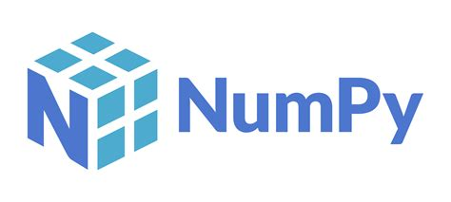
(Numerical Python Library)
The fundamental package for scientific computing
(basis of e.g. scipy, scikit-learn, pandas, …)

Slide 3
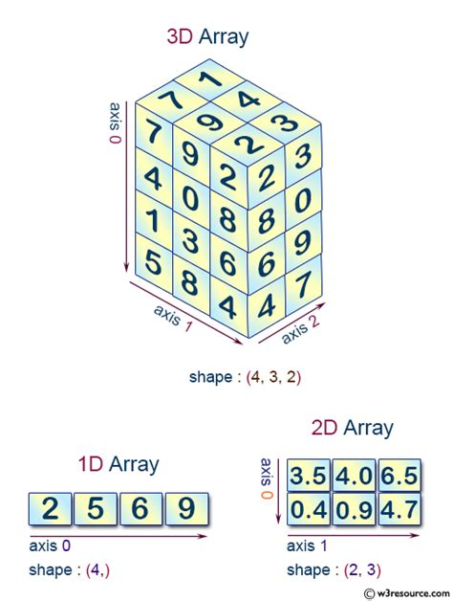
Library to rapidly compute with n-dimensional arrays (ndarrays)
1D array: e.g.
- voltage trace
2D array: e.g.
- greyscale image,
- EEG-traces
3D array: e.g.
- color image (immunohistochemistry)
- greyscale video
- MRI scan
4D array: e.g.
- color image over time
- fMRI over time
5D array: e.g.
- fMRI over time across two conditions
…..
www.w3resource.com/numpy/ndarray/index.php

Slide 4
Why numpy?
It‘s fast and powerful.
Fast:
(much faster than python lists or loops)
- uses C-code
processes each data-type (int8, int16, int32, float,…) with whichever
algorithm maximizes speed for that type
Powerful:
e.g. - item-wise arithmetic or filtering
- inbuilt matrix operations,
- random number generators
- …

Slide 5
Two rules about indexing:
- Start at 0!
- Work from outside in
a = [2,5,6,9]
b = [[3, 5, 6],
[0, 1, 4]]
c = [[[7, 9, 2], [1, 4, 3]],
[[4, 0, 8], [ ., ., 0]],
[[1, 3, 6], [ ., ., 9]],
[[5 ,8 ,4], [ ., ., 7]]]
a[0] = 2
a[1] = 5
b[1,2] = 4
c[0,1,2] = 3

Slide 6
Some frequently used code:
import numpy as np
# Import numpy package
a = np.array([1,2,3])
# convert arbitrary array into numpy.array
b = np.zeros((2,3))
# create ‚empty‘ numpy array of given shape
c = np.random.rand(4,2)
# create numpy array of given shape with random numbers

Slide 7
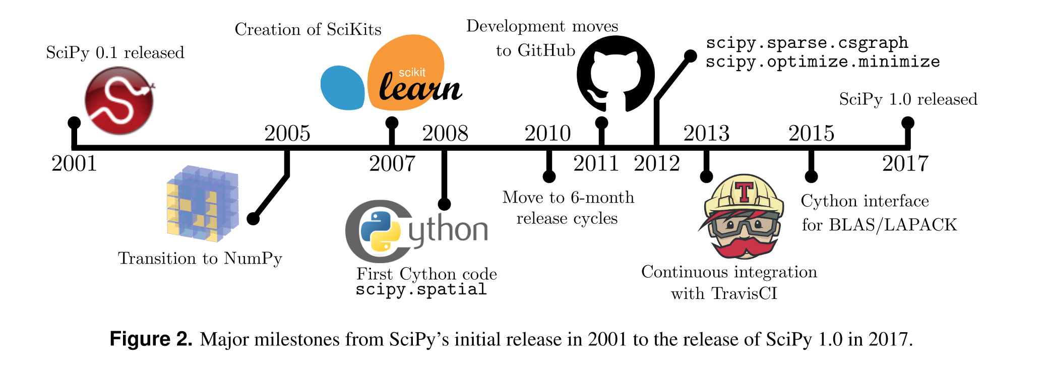
https://arxiv.org/pdf/1907.10121

Slide 8
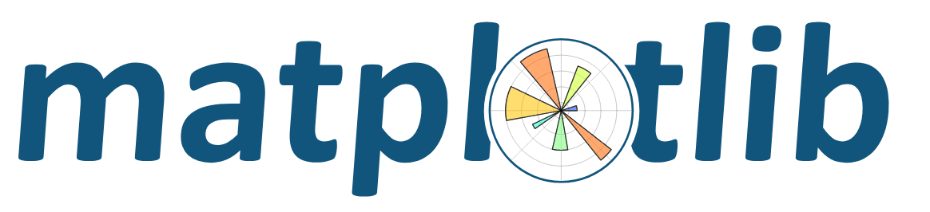
John Hunter, a postdoc at the University of Chicago, liked the plotting functionality available in MATLAB, but had problems accessing their laboratory’s license, which was governed by a hardware dongle. In response, he wrote a plotting library from scratch, and Matplotlib 0.1 was released April 2003.

Slide 9
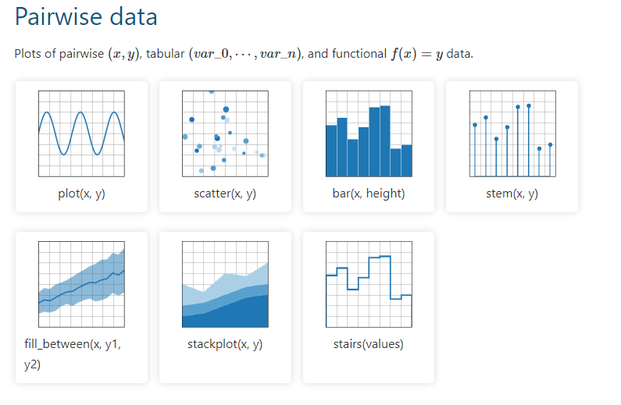

Slide 10
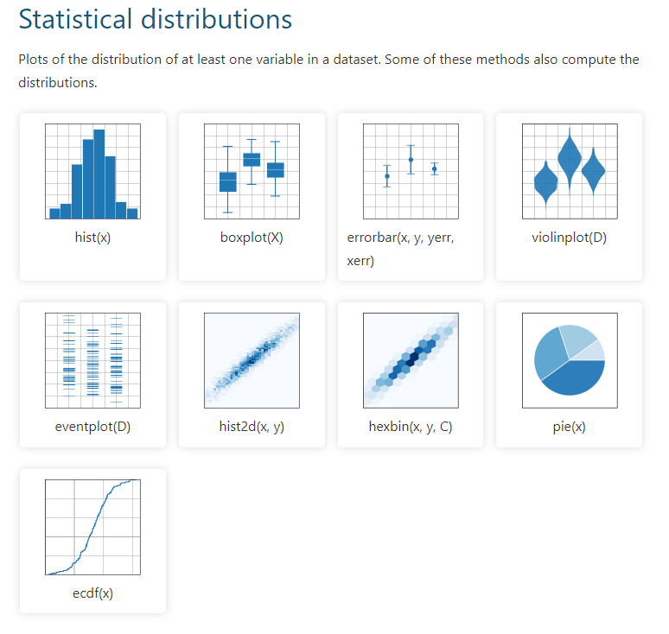

Slide 11
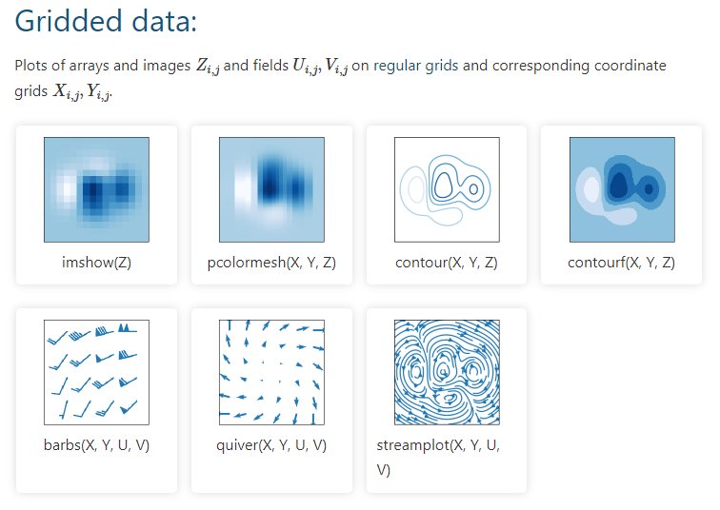

Slide 12
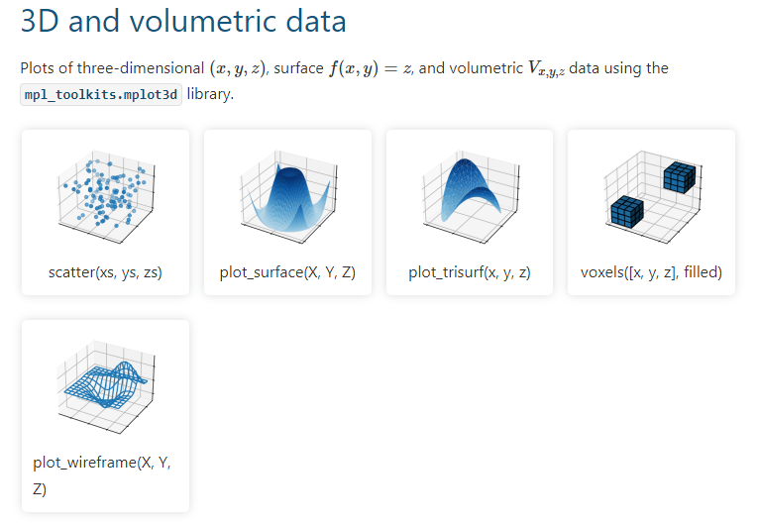

Slide 13
Some basic code:
import matplotlib.pyplot as plt
# Import package
plt.plot(x,y)
# line plot
plt.scatter(x,y)
# scatter plot
plt.title(‚some_string‘)
# add title to plot
plt.xlabel(‚some_string‘)
# add an x-axis-label

