Slide 1
Battle of the neighborhoods
Best location for a Mexican restaurant in Manhattan, new York

Slide 2
Best Neighborhood in Manhattan for a Mexican Restaurant?
According to an article in Fast Food Industry Analysis 2018 - Cost & Trends, Fast Food revenue in the United States was $200 billion in 2015.
The industry is expected to have an annual growth of 2.5% for the next several years
The United States fast food market continues to be dominated by hamburger fast food restaurants, accounting for over 30% of industry sales. However that market share is sliding, and Mexican food in particular has been gaining
Data Points:
Age, Population, Race, Household income and Top Venue Categories

Slide 3
Data Research, Acquisition and Cleaning
Data was broken into segmented data sets for specified use
Nan or unrelated features were deleted
Duplicated or similar features were removed
Manhattan stats;
age, race, employment status & income extracted from New York open data:
https://data.cityofnewyork.us/browse?category=City+Government&limitTo=datasets
Wikipedia data was scraped for Neighborhood population stats:
https://www.worldatlas.com/articles/manhattan-neighborhoods-by-population.html
Fast Food Industry research:
https://www.franchisehelp.com/industry-reports/fast-food-industry-analysis-2018-cost-trends/

Slide 4
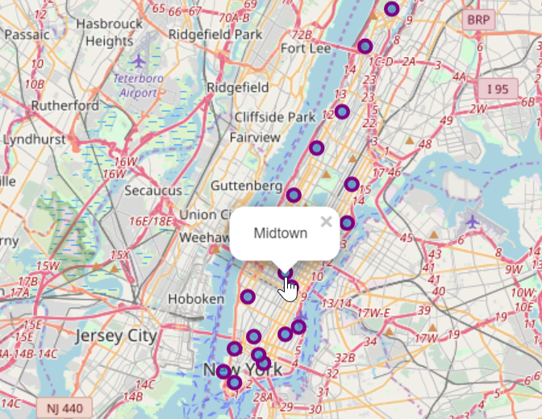
Manhattan neighborhood coordinates
Midtown is Manhattan highest populated neighborhood.
391,397- total population
Little Italy is the lowest populated neighborhood
1,211 – total population

Slide 5
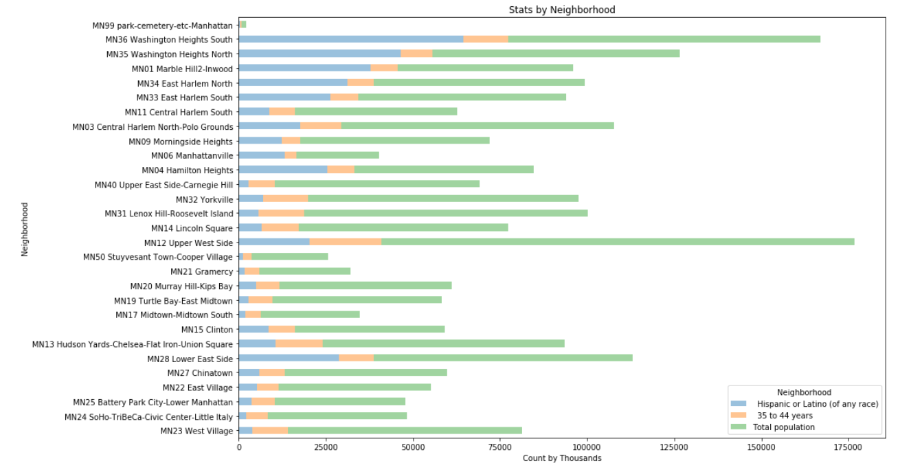
Comparison of Stats by Manhattan Neighborhoods by Target Data Points
Washington Heights South is the highest populated Hispanic neighborhood
Upper West Side is the highest populated neighborhood

Slide 6
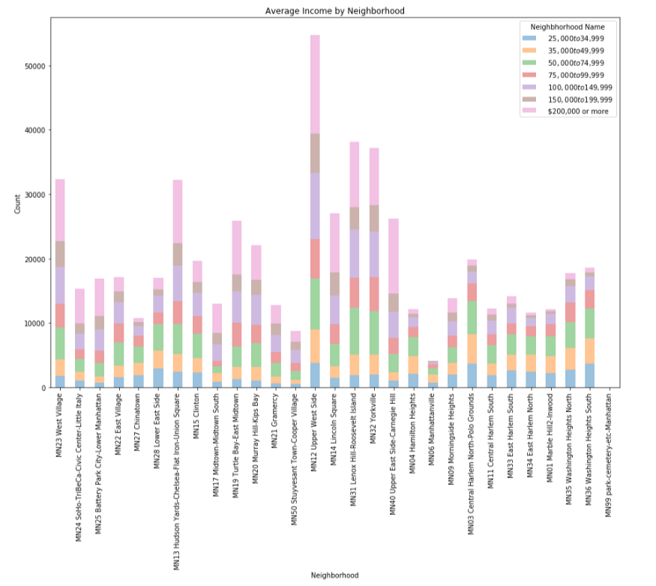
Comparison of Income Stats by Manhattan Neighborhoods
Upper West Side is the highest income neighborhood
Cooper Village is the lowest income neighborhood

Slide 7
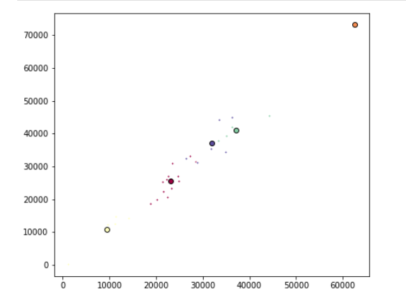
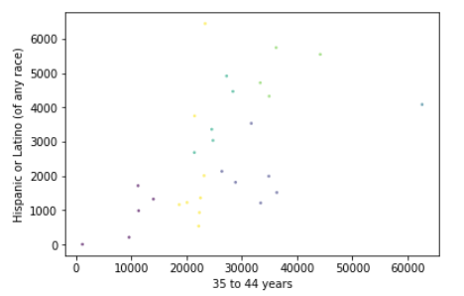
Neighborhoods Segmentation
K-Means Clusters
Clusters created from full Data Set
Clusters created from Top 5 Hispanic neighborhoods. ( Race & Age)

Slide 8
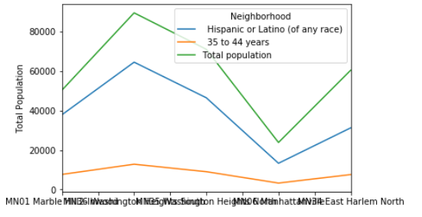
Top 5 stats results
Target average age of 35 to 44 years is constant within our 5 neighborhoods.
Washington Heights is the highest populated Hispanic race with the highest target age group of 35 to 44 years
Manhattanville has the lowest populated Hispanic race with the lowest target age group of 35 to 44 years

Slide 9
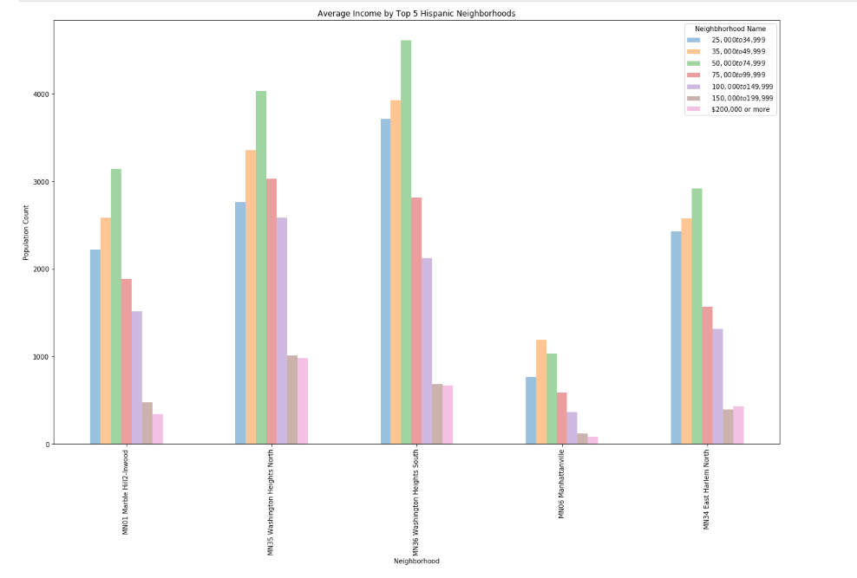
Top 5 income stats results
Washington Heights South has the highest average income of $25,000 to $74,999
Washington Heights North has the highest average income > $200,000
Manhattanville has the lowest income combined

Slide 10
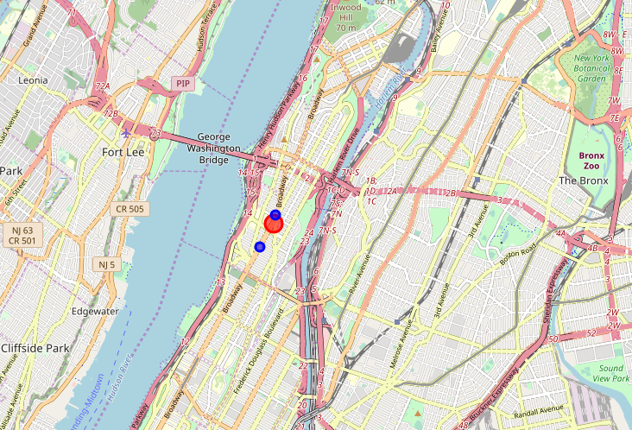
Winner is Washington heights!
Best Location !!
Highest populated Hispanic Neighborhood
Highest populated target age group within 35 to 44 years
Highest Hispanic average household income of $50,000 to $74,999
30 venues around Washington Heights
2 “Mexican” type restaurants located within 500 miles of Washington Heights Coordinates
There are currently no trending venues
2 Mexican Restaurants

