Slide 1
Best London Borough
to buy a house
Capstone Project by Veselina Dimitrova
Capstone project by Peter van Liesdonk

Slide 2
London - one of the world’s most important global cities
With population of nearly 9 million people, the city is been top ranked for innovation, influence, power, sustainability, investment and popularity for work. It ranks 26th of 300 major cities for economic performance. London is one of the largest financial centres.
Investment in Real Estate property in London will be always considered to be one of the best options.
The city is also considered one of the most expensive, thus finding the best borough to invest in a house for a mid-class household requires more thorough analysis and observations.

Slide 3
Data
The main source of data used to determine the best borough to invest is London Datastore – Greater London Authority.
Additional source for obtaining the information regarding venues per borough is Foursquare - The Trusted Location Data & Intelligence Company

Slide 4
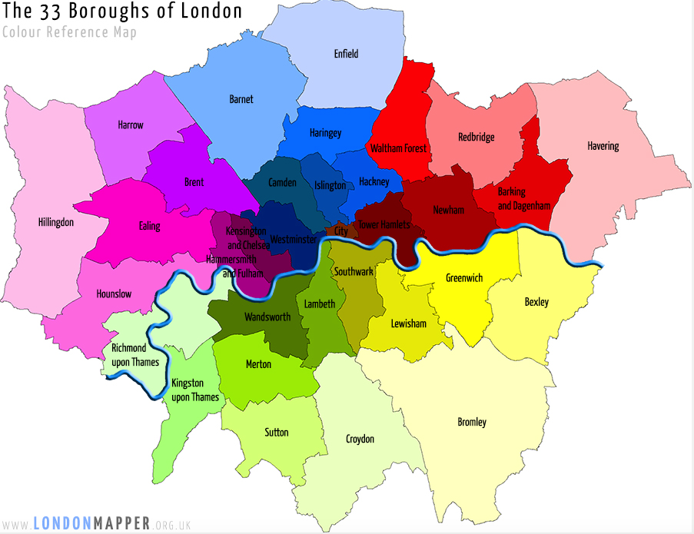
Map of boroughs in London

Slide 5
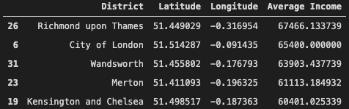
Top 5 boroughs in London based on Highest Average Income

Slide 6
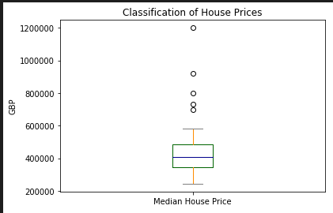
Housing price classification

Slide 7
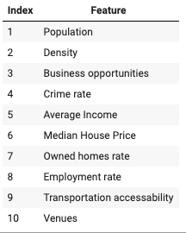
Selected Features

Slide 8
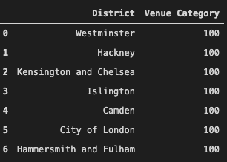
Top 5 boroughs with 100 venues on 500 m

Slide 9
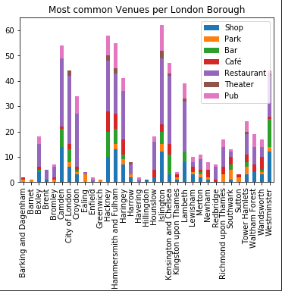
Top common venues distribution per borough

Slide 10
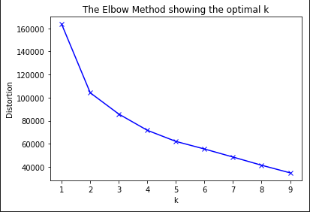
Determine the number of clusters

Slide 11
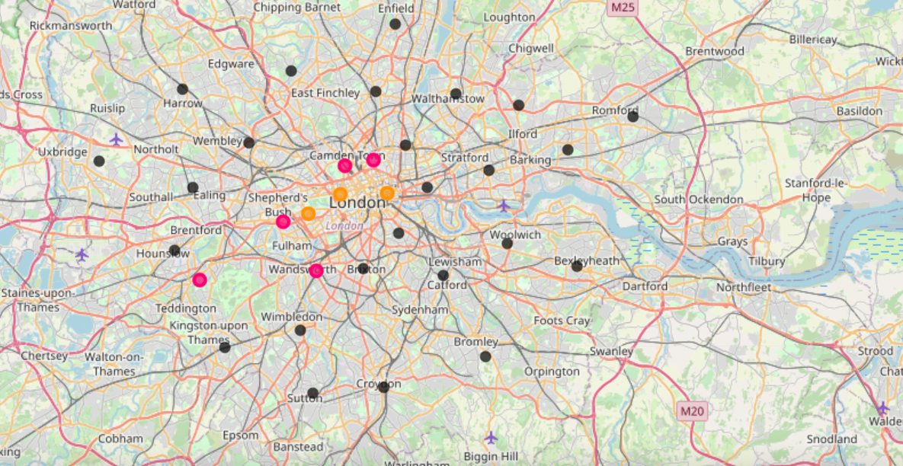
London map with clusters

Slide 12
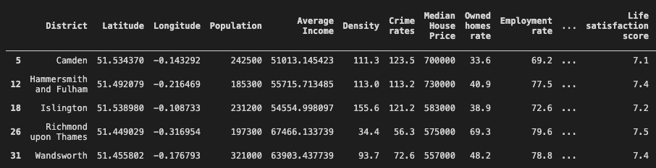
Boroughs from selected cluster

Slide 13
Final Recommendation - Richmond upon Thames
Median House Price: 575 000 GBP
Population: 197 300
Density: 34.4%
Crime Rate: 56%
Average Income: 67 500 GBP
Employment rate:79.6%
Number of business: 14 185
Satisfaction score: 7.5
Transportation accessability: 3.1
Venues: 38 on 500 m

Slide 14
THANK YOU FOR YOUR ATTENTION!

