Slide 1
AutoEncoders

Slide 2
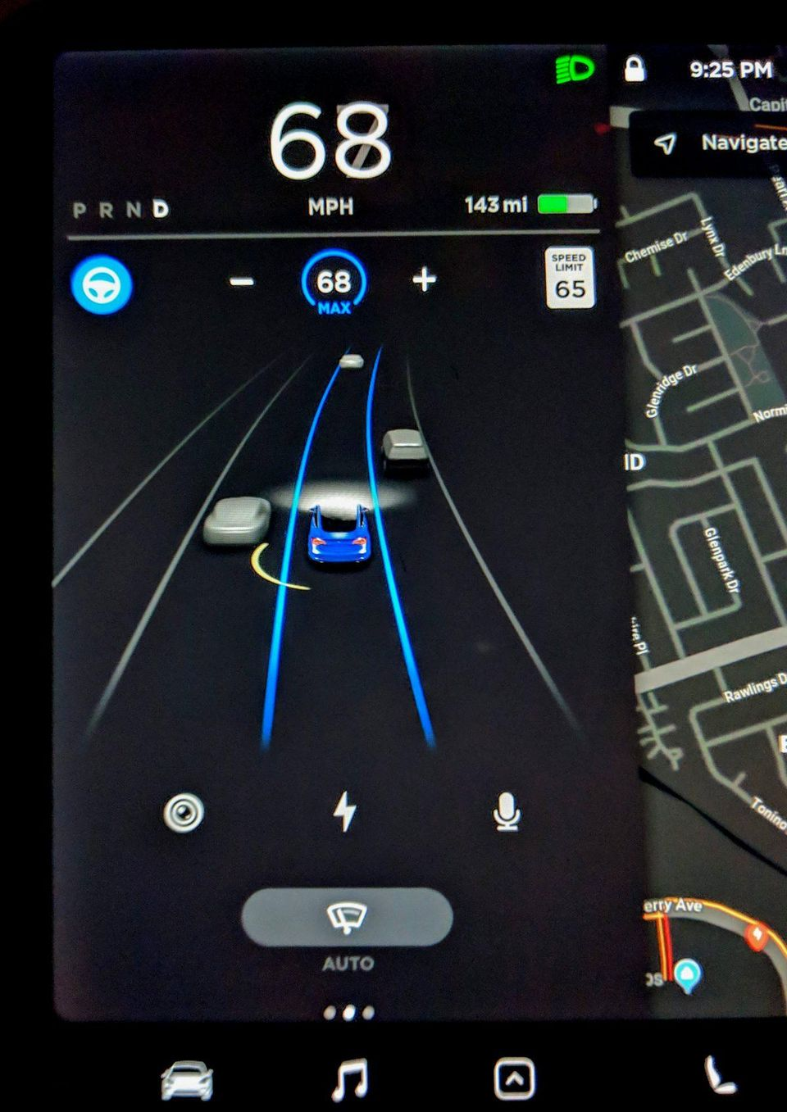
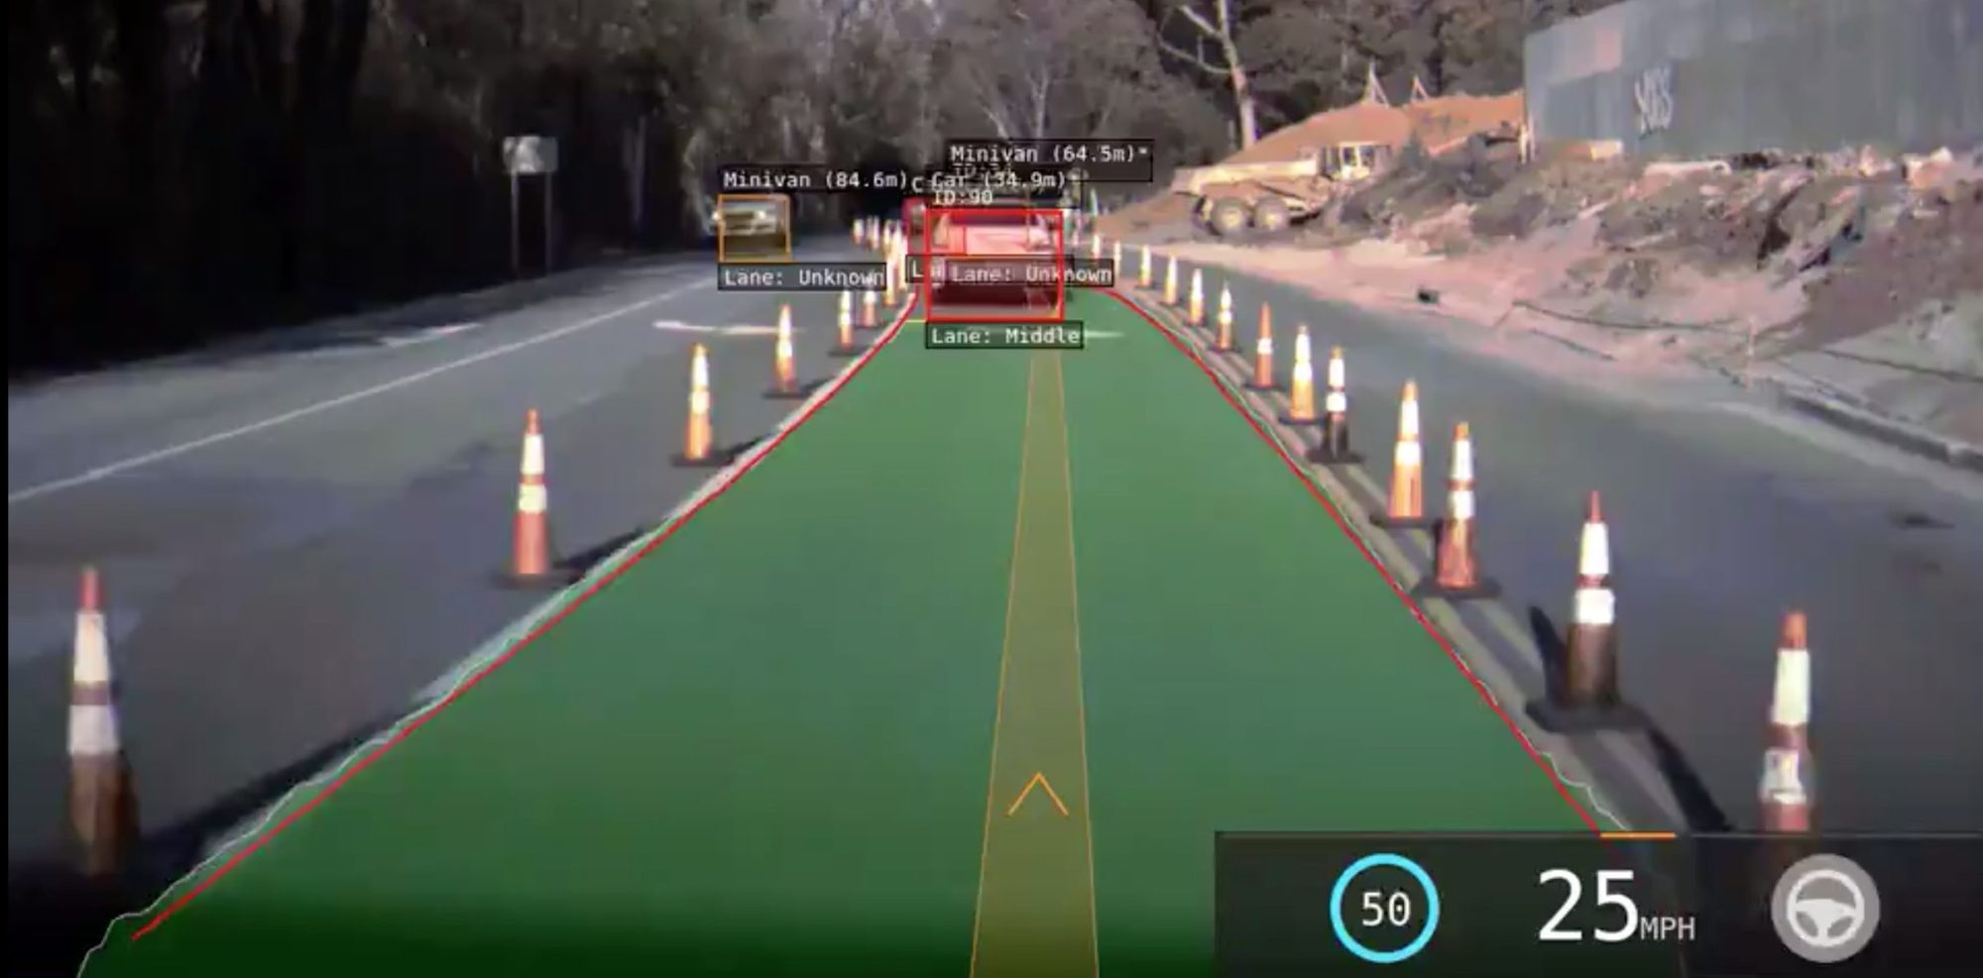
Why AutoEncoders?
“The hardest thing [about self-driving cars] is having accurate representations of physical objects in vector space,” Elon Musk

Slide 3
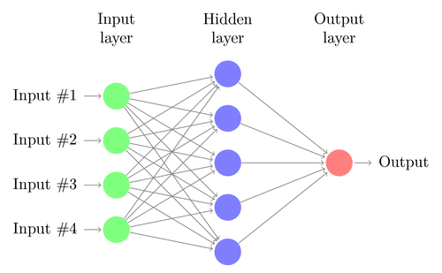
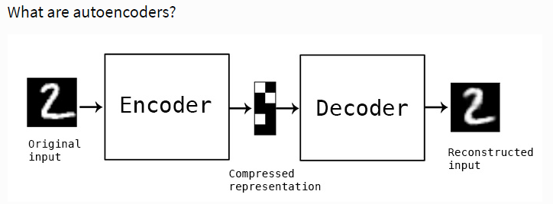
What it is?
Neural network for data compression
Reduce image to N numbers
Build new image based on those N numbers
Self-supervised
Colab code is based on this tutorial

Slide 4
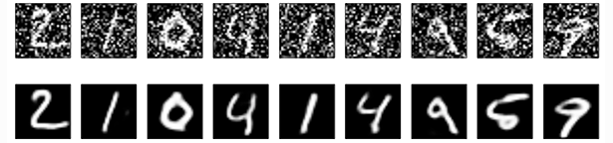
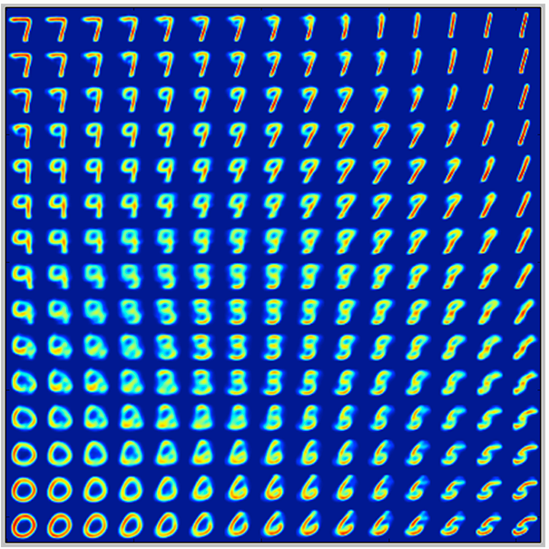
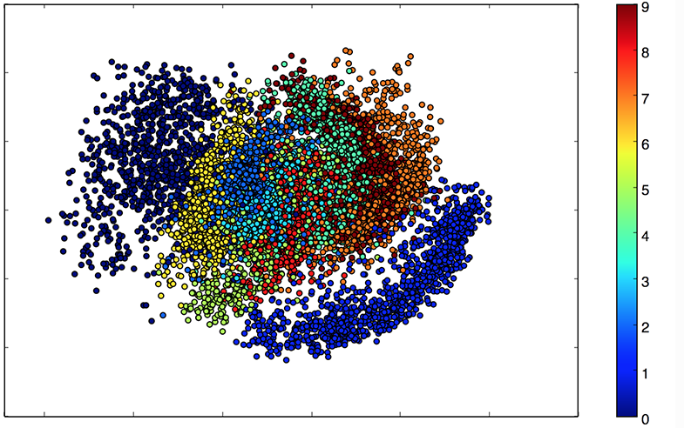
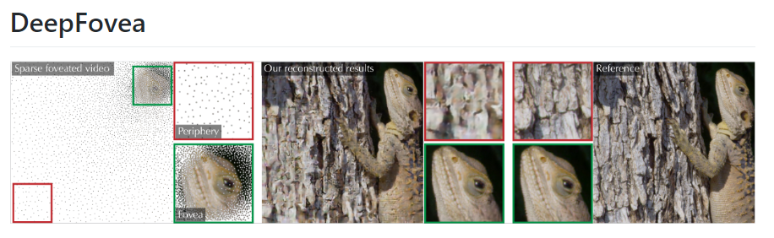
Use Cases – Image Denoising & Generation
Bridging image data gaps with semantics
Variational AutoEncoders
Facebook’s DeepFovea for video
Notes:
Convolutional autoencoder

Slide 5
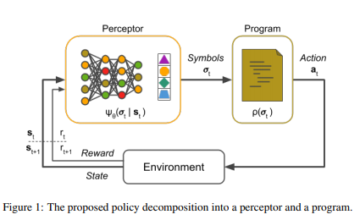
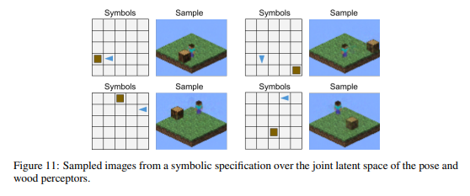
Do the latent vectors understand?
Perception vs Understanding
Usefulness of abstractions
Perceptor Gradients paper, by Svetlin Penkov, Subramanian Ramamoorthy
Notes:
‘We consider both feedforward and autoencoding perceptors and view the program as a regulariser on the latent space which not only provides a strong inductive bias structuring the latent space, but also attaches a semantic meaning to the learnt representations.’
‘We demonstrate that the proposed algorithm is not only able to efficiently learn transferable symbolic representations, but also enables the generation of new observations according to a semantically meaningful specification.’

Slide 6
Thank you!

