Slide 1
Word2Vec
Language Modelling

Slide 2
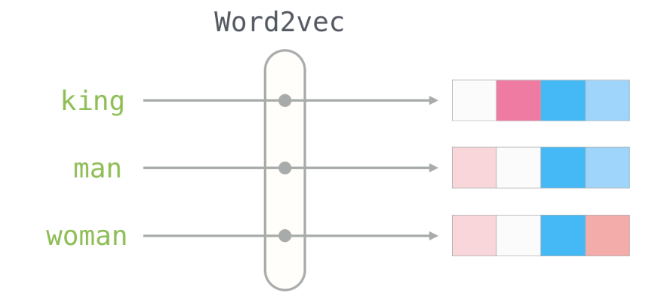
Word2Vec Language Models
Images courtesy of Jay Alammar at his brilliant blog!

Slide 3
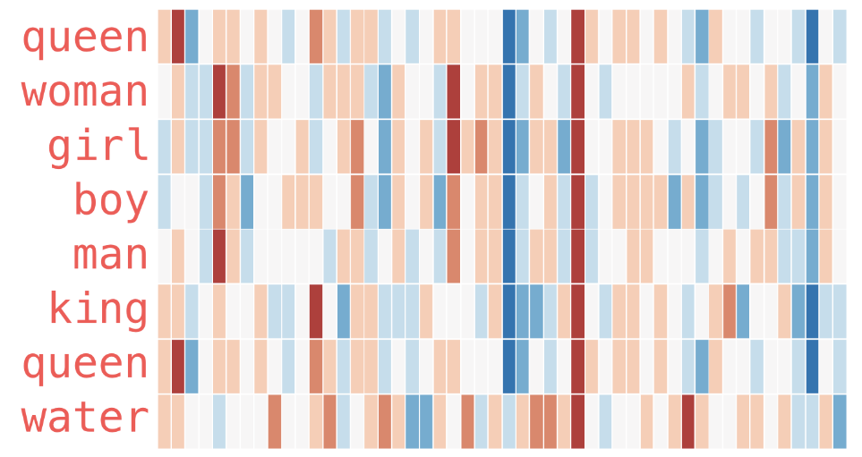
Word2Vec Language Models

Slide 4
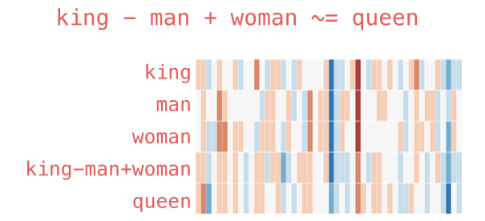
Word2Vec Language Models

Slide 5
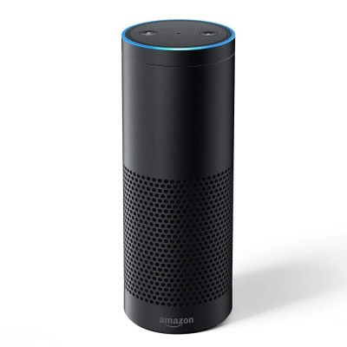
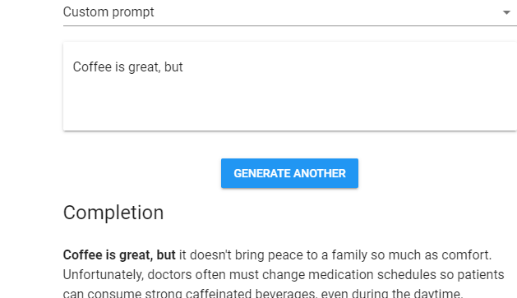
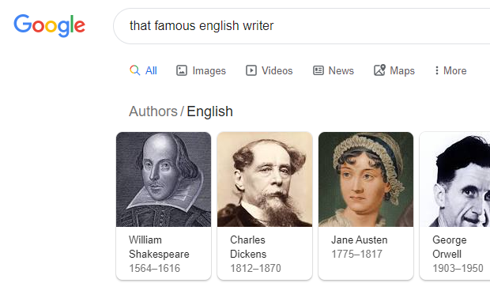
Word2Vec Language Models
Text classification & ChatBots
Sentiment analysis
Semantic search
Question answering
Summary & text generation

Slide 6
Thank you!

