Slide 1

DietWell
AI-Powered Personalised Nutrition & Healthy Diet Planning System
B.Tech Final Year Project · Computer Science Engineering
Abhishek Kumar|2230723

Slide 2

The Problem
Unhealthy Eating Habits
No Personalised Guidance
Most people lack awareness of what they consume daily, leading to poor long-term health outcomes.
Generic diet plans ignore individual health goals, allergies, and metabolic conditions.
Information Overload
The internet is flooded with conflicting dietary advice, making it impossible to find trustworthy, tailored plans.

Slide 3

INTRODUCING DIETWELL
One Smart Platform. Tailored Nutrition.
DietWell harnesses the power of Large Language Models to generate dynamic, personalised diet plans based on each user's profile — and adapts them over time.
Personalised AI Diet Plans
Smart Calorie & Nutrition Tracking
Adaptive Recommendations

Slide 4
Key Features
Personalised Meal Planning
Calorie Tracking
Nutrition Monitoring
AI-generated plans tailored to age, weight, goals, and dietary restrictions.
Daily intake monitoring with macro breakdowns per meal and per day.
Tracks proteins, carbs, fats, vitamins, and minerals in real time.
Progress Dashboard
Adaptive AI
Visual insights into health trends, goal completion, and weekly summaries.
Plans evolve with user feedback and logged progress for continuous improvement.

Slide 5
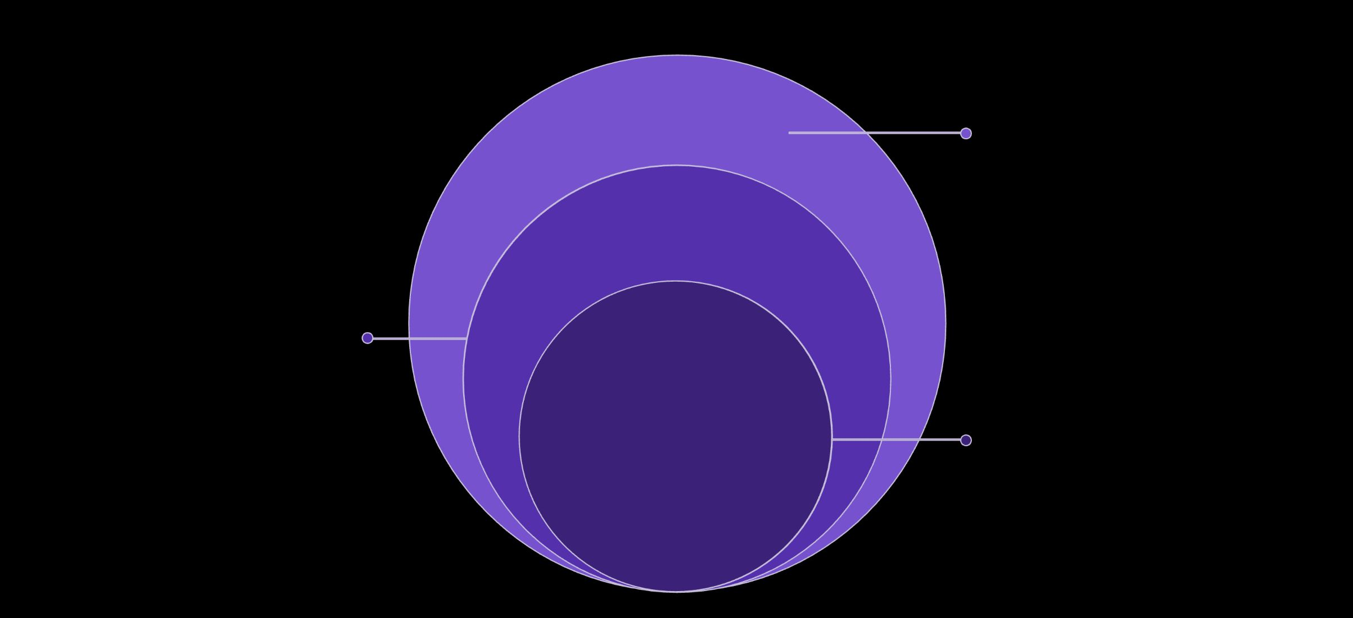
System Architecture
AI & Data
Groq API / LLaMA3 inference over PostgreSQL
Backend API
Spring Boot REST services and business logic
Frontend
React 18 with Vite for fast SPA delivery
A clean Client-Server architecture separates concerns across four layers — ensuring scalability, maintainability, and secure AI integration through a dedicated Groq API service layer.

Slide 6
Tech Stack
Backend
Security
Frontend
Spring Boot · Java 21
JWT · BCrypt
React 18 · Vite
Database
AI Model
PostgreSQL
Groq API · LLaMA3

Slide 7

System Design & Data Flow
Frontend Component Flow
01
User fills profile & health form
02
React sends API request via Axios
Database
Repository
03
Backend validates JWT token
Service
Controller
04
AI plan returned & rendered in dashboard

Slide 8
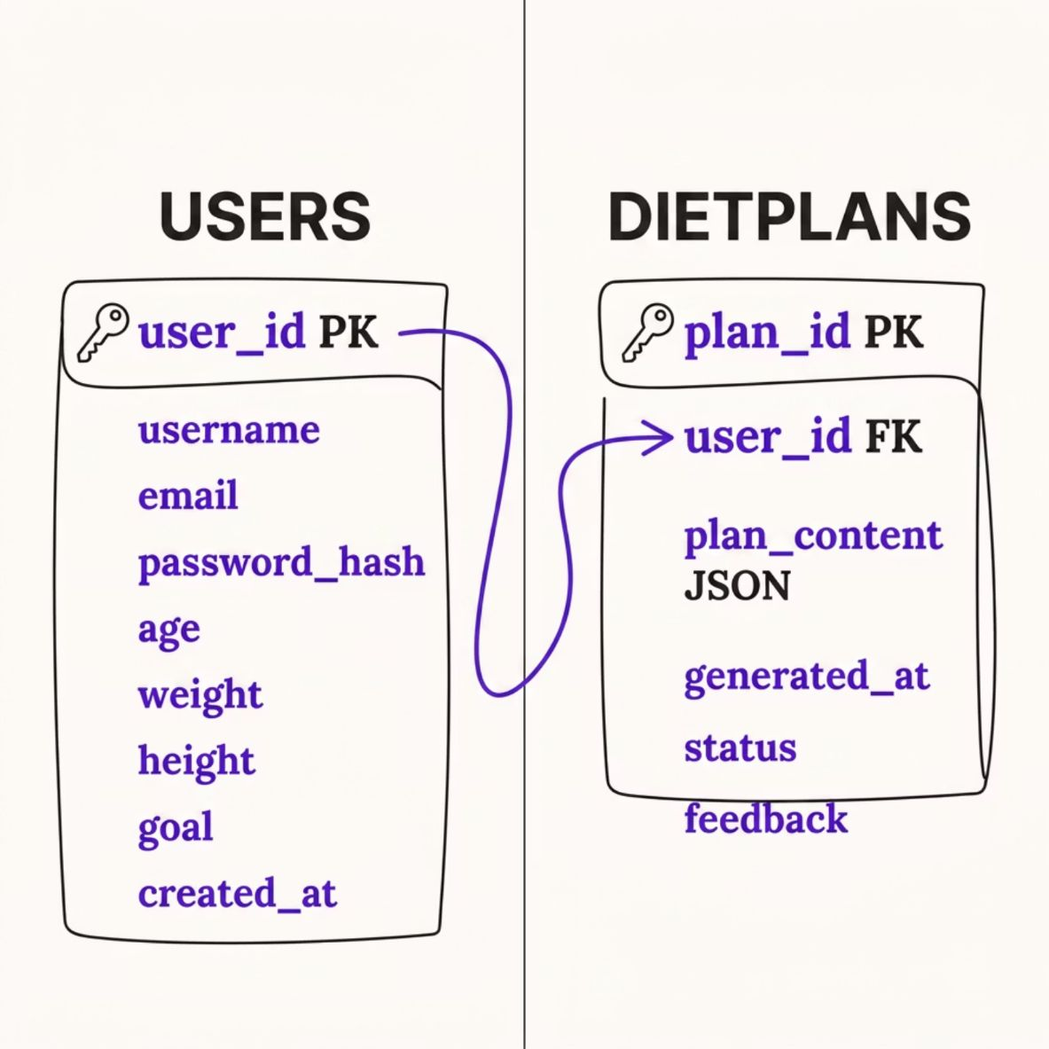


Database Schema
Schema Highlights
Users — stores credentials, health profile, and dietary goals
DietPlans — persists AI-generated plans as structured JSON
Foreign key constraint enforces user-plan integrity
Timestamps support progress tracking and plan versioning
Plans are stored as JSON blobs, enabling flexible AI output structures without schema migrations.

Slide 9
API Endpoints
Endpoint
Method
Description
Auth Required
/api/auth/register
POST
New user registration
No
/api/auth/login
POST
Authenticate & issue JWT
No
/api/diet/generate
POST
Generate AI diet plan via Groq
Yes
/api/diet/plans
GET
Fetch all saved plans for user
Yes
/api/diet/progress
POST
Log & analyse progress data
Yes
/api/diet/adjust
PUT
Adjust plan based on feedback
Yes

Slide 10

Challenges & Solutions
🔴 AI Inconsistent Output → ✅ Markdown Stripping
LLaMA3 returned raw markdown in JSON fields. A custom sanitisation layer strips symbols before parsing, ensuring clean structured data.
🔴 API Rate Limits → ✅ Resource Validation Layer
Groq API throttling was handled via request queuing and user-side rate guards to prevent failures silently.
🔴 React State Bugs → ✅ Deep Copy Updates
Shallow state mutations caused stale renders. Replacing with deep copy patterns using spread operators resolved UI inconsistencies.
🔴 Spring Circular Dependency → ✅ @Lazy Annotation
Bean injection cycles between services were resolved using Spring's @Lazy annotation to defer initialisation.

