Slide 1

DIET WELL
Jatin Sood | B.Tech CSE | 2230783

Slide 2
Problem Statement
Modern students face unprecedented challenges in placement preparation
Information Overload
No Structure
No Adaptivity
Thousands of resources with no clear direction
Unorganised preparation leads to wasted effort
Static resources can't adjust to individual progress

Slide 3

Solution Overview
Digital Mentor
PlacementPath AI transforms placement preparation into a guided journey. Using advanced LLM technology, it generates a personalised 6-week roadmap tailored to each student's profile and goals.
AI-generated curriculum based on your profile
Real-time progress tracking and insights
Adaptive recalibration as you learn

Slide 4
Key Features
AI Curriculum Generation
Progress Dashboard
LLM-powered roadmap creation tailored to your skills, weaknesses, and placement goals
Real-time tracking of mastery levels across all topics with visual analytics
Weak Area Detection
Adaptive Recalibration
Automatically flags topics below 50% mastery for focused improvement
Dynamically adjusts roadmap based on weekly progress and mastery levels

Slide 5
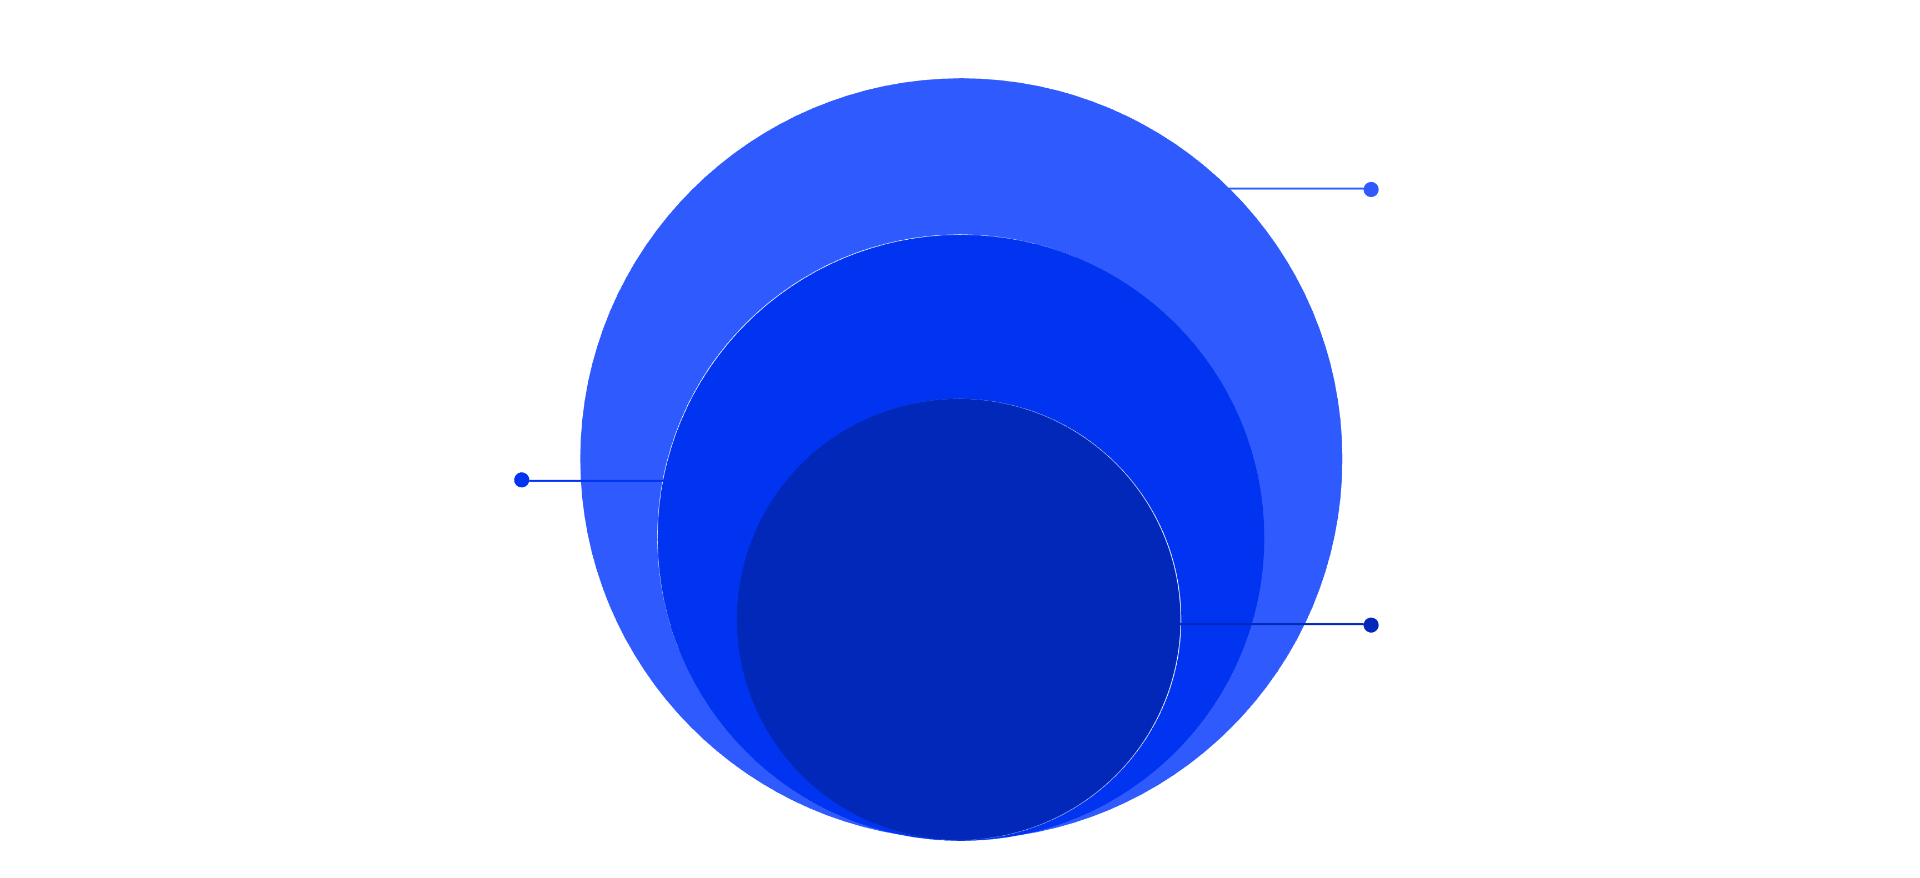
System Architecture
Client & Data
React frontend and PostgreSQL persistence
API Layer
Spring Boot backend with JWT auth
AI Layer
Groq API with LLaMA3 for inference

Slide 6
Technology Stack
Backend
AI Engine
Java 21
Spring Boot 3.x
Spring Security
PostgreSQL
Groq API
LLaMA3
WebClient
Security
Frontend
JWT tokens
BCrypt hashing
Rate limiting
React 18
Vite
TypeScript

Slide 7



Core Innovation
Adaptive Feedback Loop
User Progress
ProgressAnalyzer
AdjustmentService
Weekly assessments and completion tracking
Detects weak areas and mastery gaps
Regenerates roadmap with new focus areas
This dynamic learning path ensures the roadmap evolves with the student's progress, creating a truly personalised experience

Slide 8
Implementation Highlights
JWT Authentication
AI Response Sanitization
Stateless token-based security with refresh tokens and session management
Custom parser handles LLM JSON inconsistencies and malformed responses
ResourceBank Integration
Defensive React Rendering
Pre-defined resource library prevents hallucinations and ensures quality
Null checks and error boundaries prevent UI crashes from API failures

Slide 9
Challenges & Solutions
Challenge
Solution
LLM JSON output inconsistency
Custom sanitization with retry logic
API rate limiting
Exponential backoff strategy
Circular dependencies
@Lazy annotation
UI instability
Comprehensive null checks

Slide 10




Future Scope & Impact
AI Quiz System
Notes Module
Advanced Analytics
Company Roadmaps
Automated assessments with adaptive difficulty
Integrated study notes and resource library
Predictive insights and performance trends
Custom paths for specific company requirements
Saves Time
Structured Path
No more searching for resources
Clear 6-week timeline
Personalised
Improves Readiness
Adapts to your pace
Higher placement success
AI + Education = Future. PlacementPath as your intelligent mentor.

