Slide 1
Need-to-know front-end concepts

Slide 2

Roy Honders
Working at Quintor as a Front-end developer.
Currently in the role of DevOps Engineer at Essent.
Worked for 5+ years at multiple companies.

Slide 3
What is the first thing that comes to mind when thinking about Front-end?

Slide 4
Front-end frameworks
Angular
React
Vue.js
Svelte
Do you know any other frameworks?

Slide 5
Browser functionality
3D inspection
Sources & debugging
Connect to file system to make changes directly from browser.
Network tab

Slide 6
Caniuse
This website is useful to see if users are already migrated to a newer browser version in order to use new language features.
For example: https://caniuse.com/webp

Slide 7
Lazy loading
Only load information on the webpage, when it is requested.
Can be useful to improve loading speeds of a website.
Example: https://enviragallery.com/demo/lazy-loading-demo/

Slide 8
Managing state
Example frameworks
Redux
NGRX (Angular)
There are more.

Slide 9
Code abstraction
Creating functions for functionality that you use more than once.
When you need to make a change then you can do it everywhere at once.
In front-end you can create components to create an abstraction for repeated HTML code.
Notes:
Shopping cart with multiple product items, what if you need to add a link.

Slide 10
Clean code
Based on a book with the same name.
Try to practice clean code with your team during code reviews.
Example:
Not using many boolean parameters in functions;
saveToDatabase(user: User, isEmployee: boolean);

Slide 11
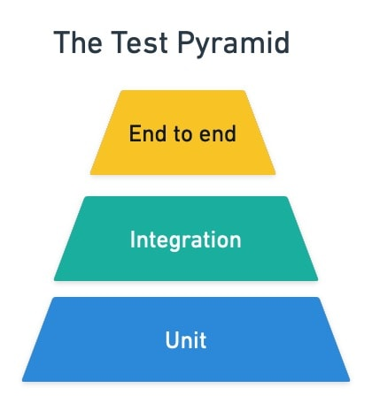
Testing

Slide 12
Coding principles
KISS 💋
Keep it simple, straightforward.
SOLID
Single Responsibility Principle (SRP)
Open-Closed Principle (OCP)
Liskov Substitution Principle (LSP)
Interface Segregation Principle (ISP)
Dependency Inversion Principle (DIP)
https://www.freecodecamp.org/news/solid-principles-for-better-software-design/
Notes:
Liskov substitution principle zit heel erg verweven in Typscript waarbij je een subtype kan hebben.

Slide 13
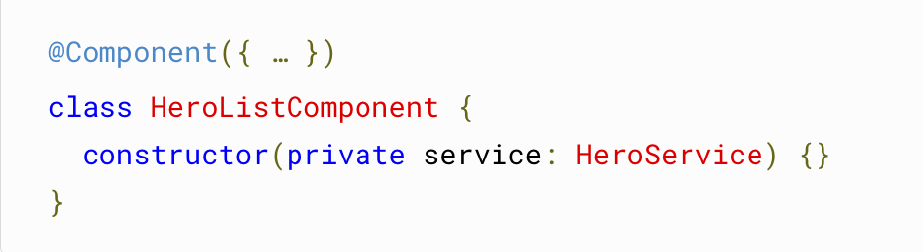
Dependency injection
Providing services to components
Programming against an interface versus an implementation
Example in Angular:

Slide 14
Security
Example; using ‘safe’ links by adding rel="noopener noreferrer" to your links.
For other security best practices you can check the OWASP top 10.
Notes:
What you see a lot in practice is that companies add a service within their front-end application to safely or efficiëntly handle the way links are being clicked.
This is now handled by major browsers, but there is still a big user base that is
https://stackoverflow.com/a/50709760

Slide 15



Mono repository
Not for every front-end project.
Helps to organize code into one repository.
Example frameworks:
Notes:
NX
Bazel made by Google
Lerna
Another benefit of having a mono repository is that the tooling can provide a way to publish packages

Slide 16
Continuous integration
Depends on which framework you use.
Used for:
Running tests
Building the project (artifacts) for deployment.
In practice:
Either you manage your own pipelines or another team does it for you.

Slide 17
Web components
It is a component that is served over HTTP.
In practice commonly used to solve unique problems.
Can be used with front-end frameworks.

Slide 18
Web component example
Call me back function on a website.
Depending on the location of a website this component can change it’s functionality.
When logged in, the user doesn’t have to provide a phone number.
When not logged in, the user provides their phone number manually.

Slide 19

Webcomponents – Hands-on
https://github.com/veslav3/webcomponent-workshop

Slide 20
Thanks for participating

